Slide 1
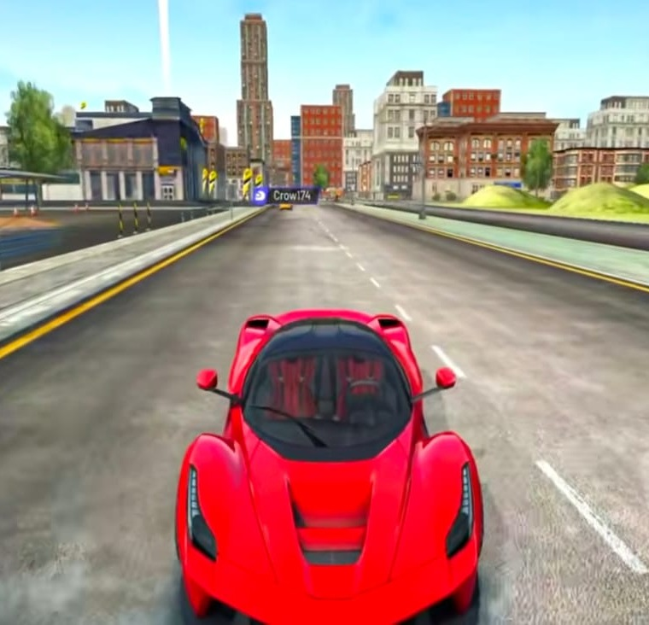
Multiplayer Racing Game
thegameio
Game requirements & build proposal: cars, routes, pools, laps, leaderboard sync, branding and wallet top-ups
5+
4
10
cars to select
race routes
racers per pool
Reference visual only
Notes:
Opening: thegameio's browser-based multiplayer racing game. Key numbers: at least 5 selectable cars, 4 routes (approved as they look good), pools of up to 10 racers. Details and costing come from thegameio_Racing_Game_Quotation_01.xlsx.

Slide 2





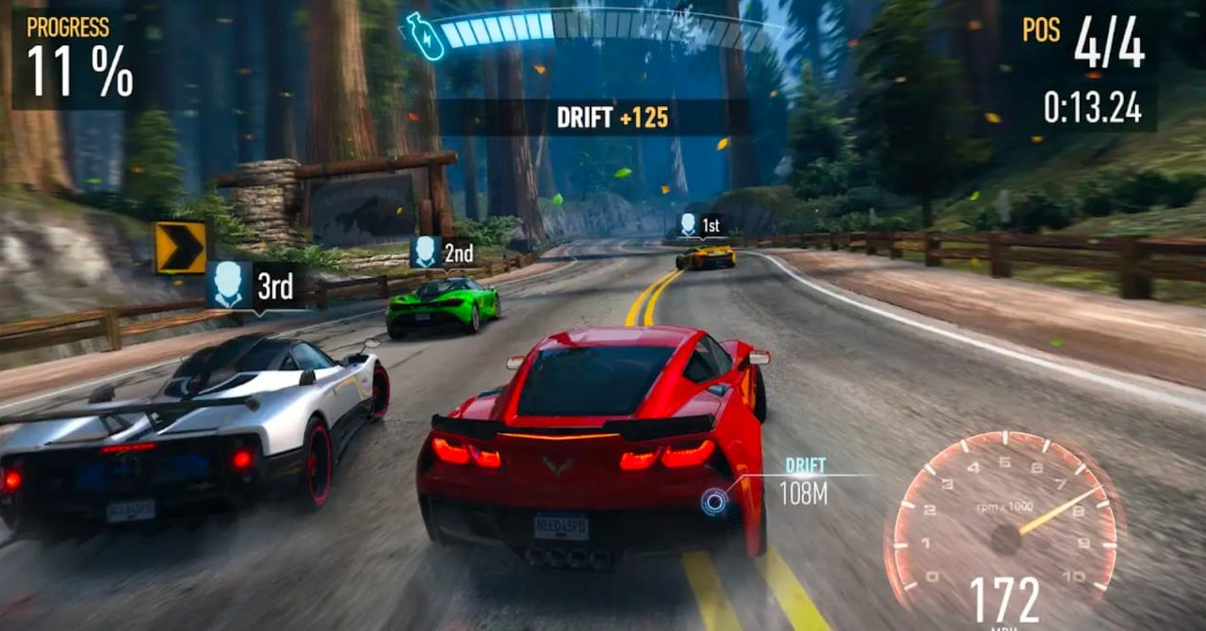

Pick a car, pick a route
Garage screen with at least 5 original cars, each with its own speed, acceleration and handling
Regular
Fast & Furious style
Speedo
Classic Muscle
Street Rally
Balanced everyday car, easy to drive
Tuner / drift racer with nitro feel
Hypercar with the top speed
Raw power, heavy and loud
Grip and control on any corner
Speed
Speed
Speed
Speed
Speed
Accel
Accel
Accel
Accel
Accel
Handling
Handling
Handling
Handling
Handling
4 routes confirmed, as per the current look
Route 1
Route 2
Route 3
Route 4
Each route has its own layout, corners, scenery, checkpoints, start grid and minimap, not a repeat of one track.
Reference look for routes
Notes:
Car options requested: Regular, Fast & Furious style, Speedo and more. The quotation includes 5: Regular, Tuner/Drift (Fast & Furious style), Speedo hypercar, Classic Muscle, Street Rally. Car designs and names are original; 'Fast & Furious' is a style description only, no film branding. Stat bars are indicative. The 4 routes are approved as they look good.

Slide 3
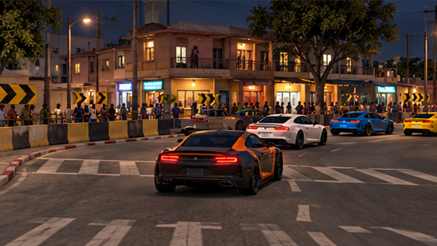
AFRICAN CITY / ENVIRONMENT DESIGN
A grounded, achievable game look
Restrained nighttime lighting
Streetlights, selected lit windows and shop signs keep the road readable.
Mixed city scale
Small shops and houses sit beside apartments and taller office buildings.
Practical visual detail
Dry roads, simple materials and reusable building assets. Final quality follows an approved sample.
CONCEPT PRESENTATION • Visuals are illustrative, not final gameplay captures
02

Slide 4
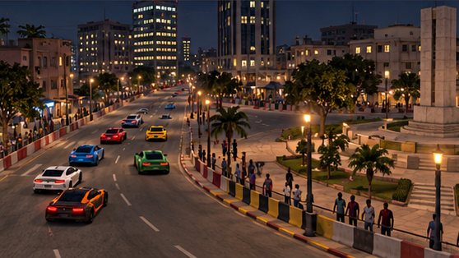
AFRICAN CITY / ENVIRONMENT DESIGN
Race staging for 10 cars
10-car field
A proposed two-column, five-row starting grid with clear spacing and a visible start line.
Room for racing
Wider opening straight, overtaking zones and readable corner approaches.
Spectators & safety
African spectators stand on sidewalks behind barriers, outside the racing surface.
Environment planning and visual placement only. Car behaviour is outside this scope.
CONCEPT PRESENTATION • Visuals are illustrative, not final gameplay captures
03

Slide 5
AFRICAN CITY / ENVIRONMENT DESIGN
Concept loop map
CONCEPT LAYOUT — NOT FINAL
START / FINISH →
One connected urban loop
Five visual sectors: downtown, market, residential, commercial junction and civic square.
Downtown avenue
Market
corner
Layout review
Clockwise circuit
Confirm corner radii, road widths, grid spacing and barrier positions during greybox review.
Civic square
Design status
Route shape is schematic. Distance, lap count and final dimensions remain to be agreed.
Residential street
CONCEPT PRESENTATION • Visuals are illustrative, not final gameplay captures
04

Slide 6
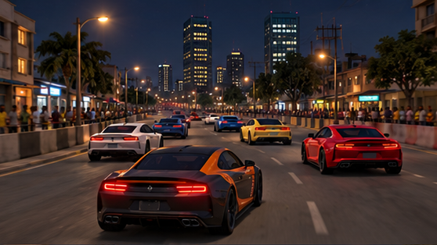
AFRICAN CITY / ENVIRONMENT DESIGN
Downtown avenue & commercial junction
Road character
Broad straights flow into junction turns, with clear road markings and direction boards.
Building frontage
Office blocks, apartments and smaller retail units create a varied street edge.
Night treatment
Consistent streetlight spacing, modest sign illumination and a readable skyline.
Level sectors 01–02: proposed fast section and controlled corner sequence
CONCEPT PRESENTATION • Visuals are illustrative, not final gameplay captures
05

Slide 7
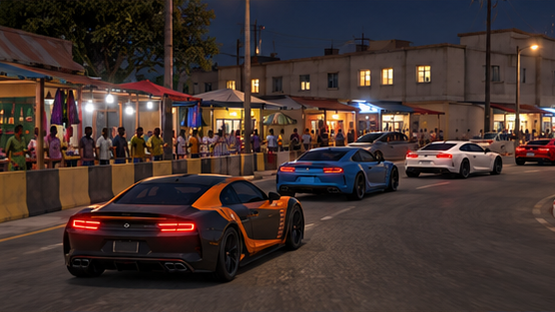
AFRICAN CITY / ENVIRONMENT DESIGN
Market streets & local city life
Market identity
Small shops, awnings, shutters and local storefront colour give the sector its character.
Corner visibility
Keep stalls and props away from racing lines. Use barriers to define turns.
African city population
African spectators in contemporary everyday clothing populate safe sidewalk zones.
Level sector 03: tighter street rhythm with clear sightlines at each turn
CONCEPT PRESENTATION • Visuals are illustrative, not final gameplay captures
06

Slide 8
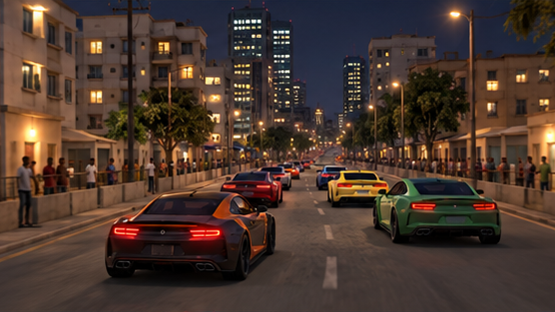
AFRICAN CITY / ENVIRONMENT DESIGN
Residential streets & civic square
Small and large buildings
Low-rise houses, mid-rise apartments and occasional tall buildings line the route.
Street detail
Sidewalks, gates, balconies, boundary walls, street trees and parked props outside the track.
Open square section
A wider urban section creates visual relief and a clear return towards the main straight.
Level sectors 04–05: neighbourhood detail and an open city landmark
CONCEPT PRESENTATION • Visuals are illustrative, not final gameplay captures
07

Slide 9
AFRICAN CITY / ENVIRONMENT DESIGN
Detailed environment & level scope
01 Route & greybox
04 Race dressing
Circuit planning, 10-car grid spacing, road widths, turns, junctions and sightline review.
Start / finish art, direction boards, barriers, spectator zones, street furniture and vegetation.
02 Road & surface work
05 Materials & lighting
Road mesh, kerbs, sidewalks, lane markings, medians, drains and pavement transitions.
Road and building materials, restrained night lighting, selected lit windows and visual consistency.
03 Buildings & city assets
06 Final level package
Modular small and large buildings, shopfronts, roof forms, windows, doors and skyline masses.
Scene organisation, reusable assets, visual cleanup, agreed refinements and handover notes.
CONCEPT PRESENTATION • Visuals are illustrative, not final gameplay captures
08

Slide 10
AFRICAN CITY / ENVIRONMENT DESIGN
4-month production schedule
MONTH 01 / Planning & sample
MONTH 03 / Detail & night lighting
Approve the visual target. Prepare the loop map, road greybox, 10-car grid and a sample street.
Review: route and quality direction.
Dress all urban sectors with materials, shops, barriers, African spectators and street lighting.
Review: full environment presentation.
MONTH 02 / City construction
MONTH 04 / Refinement & handover
Build road sections, mixed-height building modules, junctions and district boundaries.
Review: complete route and main structures.
Resolve agreed visual feedback, clean up assets, organise scenes and prepare the level package.
Review: final environment delivery.
CONCEPT PRESENTATION • Visuals are illustrative, not final gameplay captures
09

Slide 11


Admin creates pools of up to 10 racers
Pool 1, Pool 2, Pool 3 and so on are created and priced from the web admin panel
Admin: Create pool
Pool 1
Open
Pool 2
Full
Pool 3
Racing
Pool name
Pool 4
P1
P2
P1
P2
P1
P2
P3
P4
P3
P4
P3
P4
Entry fee
Set by admin
P5
P6
P5
P6
P5
P6
Laps
e.g. 3
P7
Open
P7
P8
P7
P8
Route
Route 1 to 4
Open
Open
P9
P10
P9
P10
Start time
Date and time
7 / 10 joined
10 / 10 joined
10 / 10 joined
Max players
10
Entry fee set by admin
Entry fee set by admin
Entry fee set by admin
Admin creates pool
User pays entry fee
Joins (max 10)
Race starts
Results & prizes
Notes:
Admin creates Pool1, Pool2, Pool3 etc. from the web admin panel and sets the entry fee, laps, route and start time. Each pool takes a maximum of 10 players. Pool status: open, full, racing, finished. The user pays the admin-defined price to join.

Slide 12






Fastest time over all laps wins
Lap and winner logic is validated on the server, then results flow to a leaderboard synced with thegameio
Laps set by admin
Every racer completes the same number of laps
Leaderboard · Pool 3
Synced with thegameio
Rank
Player
Best lap
Total time
Checkpoint validation
No shortcuts or wrong-way driving; missed checkpoint = lap not counted
RaceKing_21
0:41.08
2:05.62
NitroNeha
0:41.55
2:06.10
Minimum total time wins
Lap timer per lap; winner has the lowest total race time
DriftAce
0:41.90
2:07.34
4
SpeedoSam
0:42.31
2:08.77
Tie-break
5
TurboTara
0:42.88
2:10.02
Best single lap first, then earliest finish; unfinished = DNF
6
LapHunter
0:43.40
2:11.45
Anti-cheat
…
All pool players listed
Race times re-checked server-side before results are final
Gold, Silver and Bronze trophies on top · Views: pool-wise, daily, weekly, all-time
Notes:
Winner logic: admin sets laps; checkpoints validate each lap; total race time decides the winner (minimum time). Tie-break: best lap, then earliest finish. DNF for incomplete races. Times re-validated server-side. Leaderboard shows all users, with top 3 ordered by winner trophy. Leaderboard and user tables sync with thegameio via secure API or shared database, with single login (SSO). Player names shown are sample data.

Slide 13
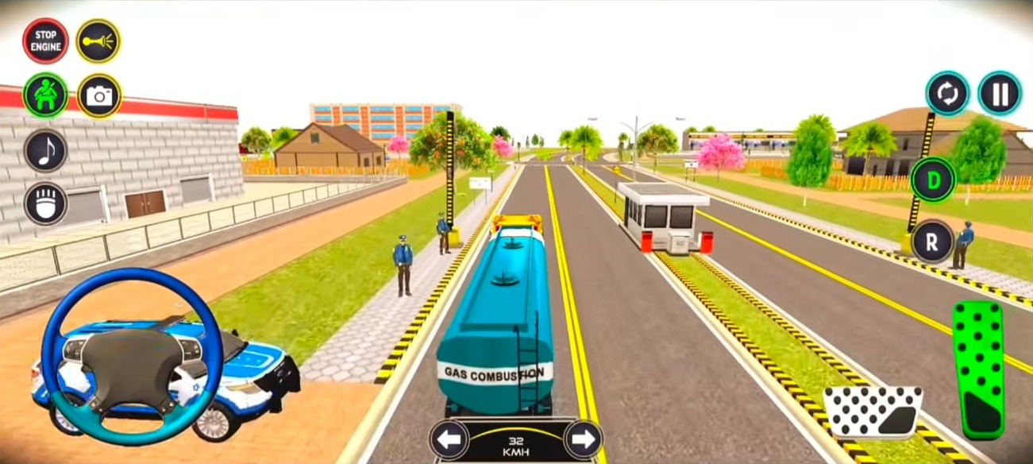



thegameio branding everywhere, easy top-ups
Branded from first load to victory screen, with wallet recharge by payment gateway or airtime
Recharge & add funds
Payment gateway
Cards, UPI, net banking, wallets
Airtime
Reference HUD: rebuilt in thegameio style
Pay from mobile balance (carrier billing)
Splash & loader
Menu & garage skin
In-race HUD logo
Add funds
Wallet
Entry fee on join
Prize credit
Track billboards
Car number plates
Victory screen
Note: the current quotation excludes the payment, wallet and airtime system. The game sends a "payment confirmed" hook; gateway and airtime integration need a separate quote.
Notes:
Branding touchpoints from the scope sheet: splash screen, loader, menu skin, HUD logo, in-world billboards, number plates, victory screen. Client supplies logo, colours and fonts. Recharge: requirement is to add funds via payment gateway or airtime. Per the quotation, payment/add funds/wallet is NOT included; it's handled by the client's payment provider and our backend receives a 'payment confirmed' call when a player joins a pool. Decide whether to add this to scope.

Slide 14
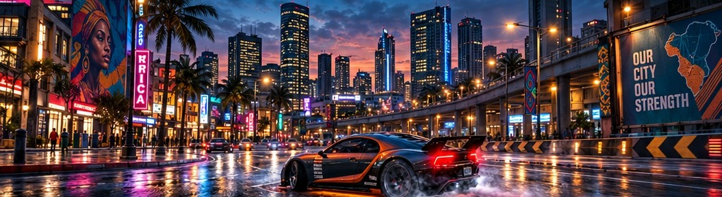
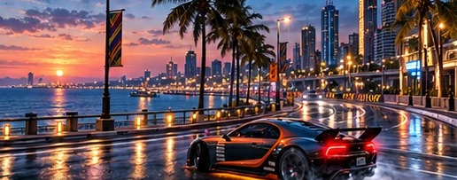
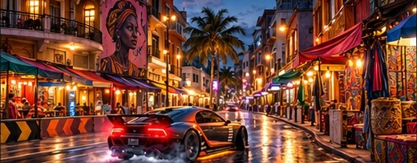
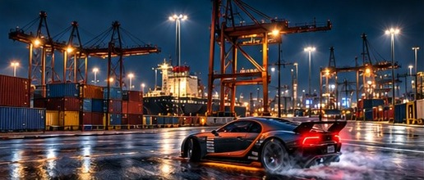
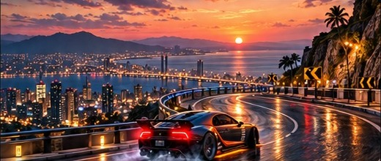





African City: five connected race districts
A fictional African coastal metropolis at night, with each district built as its own route
02 Waterfront Run
Coastal boulevard, sweeping bends
03 Market District
Shopfronts and narrow turns
01 Downtown Circuit
Neon streets, wide junctions, technical corners
04 Industrial Port
Container yards, broad drift zones
05 Hillside Express
Elevated roads, hairpins
Track planning
City environment
Race presentation
5 route layouts, corner flow, overtaking sections
District buildings, storefronts, skyline, bridges
Start/finish, grid, checkpoint markers
Road construction
Trackside dressing
Visual finishing
Asphalt, junctions, kerbs, markings, medians
Barriers, direction boards, streetlights, props
Lighting, reflections, cleanup and handover
Notes:
African City concept: five connected districts in a fictional African coastal metropolis. 01 Downtown Circuit, 02 Waterfront Run, 03 Market District, 04 Industrial Port, 05 Hillside Express. Scope covers track planning, city environment, race presentation, road construction, trackside dressing and visual finishing. Concept visuals illustrate the proposed art direction.

