Slide 1




NEXT GEN EMPLOYABILITY PROGRAM
Creating a future-ready workforce
Team Members
College Name
Student Name : Piyo Licira J
Student ID : au311121104044
Loyola-ICAM College Of Engineering And Technology.

Slide 2

CAPSTONE PROJECT SHOWCASE
Project Title
Music Web Application using Django Framework
Abstract | Problem Statement | Project Overview | Proposed Solution | Technology Used | Modelling & Results | Conclusion

Slide 3
Abstract
Developed a music application using various technologies such as Django, JavaScript, HTML, and CSS. Django was used for the database, while Node.js was used for the backend.
HTML, CSS,Bootstrap and JavaScript were used for the front-end development. Our application offers various functionalities such as accessing music libraries, creating your playlists, logging in to your profile, and much more.
Source :

Slide 4
Problem Statement
To develop a music application using languages:
HTML, CSS, and JavaScript for the front-end development of the application.
Django for the backend development and database management,
Source :

Slide 5
Project Overview
Transfer Request
Front-End
Html,Css,Js
Back-End
Django
Request
Fetch Information from the database
User/
Client-
Browser
Application Server Helps in managing request and response.
DataBase-
Django
Response
Response
Source :

Slide 6
Proposed Solution
Developed a robust and feature-rich music application using some of the most advanced technologies in the market.
The application was created using a combination of Django, JavaScript, HTML, and CSS, which allowed us to build a highly efficient and scalable music platform.
Source :

Slide 7
Our application is designed to meet the diverse needs of music lovers, and it offers a wide range of functionalities that make it stand out from the rest.
We utilized Django for both the database management and backend development of our application. This choice enabled us to efficiently store and retrieve data while also building a scalable and robust server-side architecture.
Source :

Slide 8
For the front-end development, we used HTML, CSS, and JavaScript, which helped us create an intuitive and user-friendly interface.
Our application comprises various music libraries, and users can easily access them to discover new music.
Additionally, users can create their own playlists, log in to their profiles, and much more.
Source :

Slide 9


Technology Used
Front-end
Back-end
Source :

Slide 10
Modelling & Results
Loads Server
Play Music
Update the music
Start
Stop
Login
Validate user
Create Playlist
Add to playlist
LogOut
Source :

Slide 11
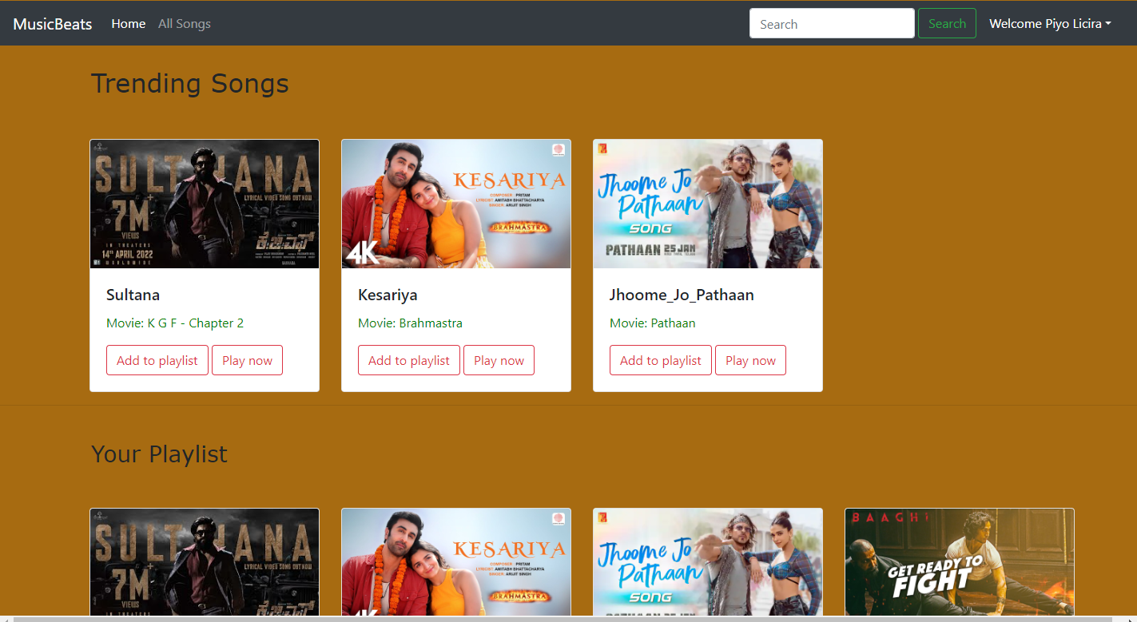
Homepage

Slide 12
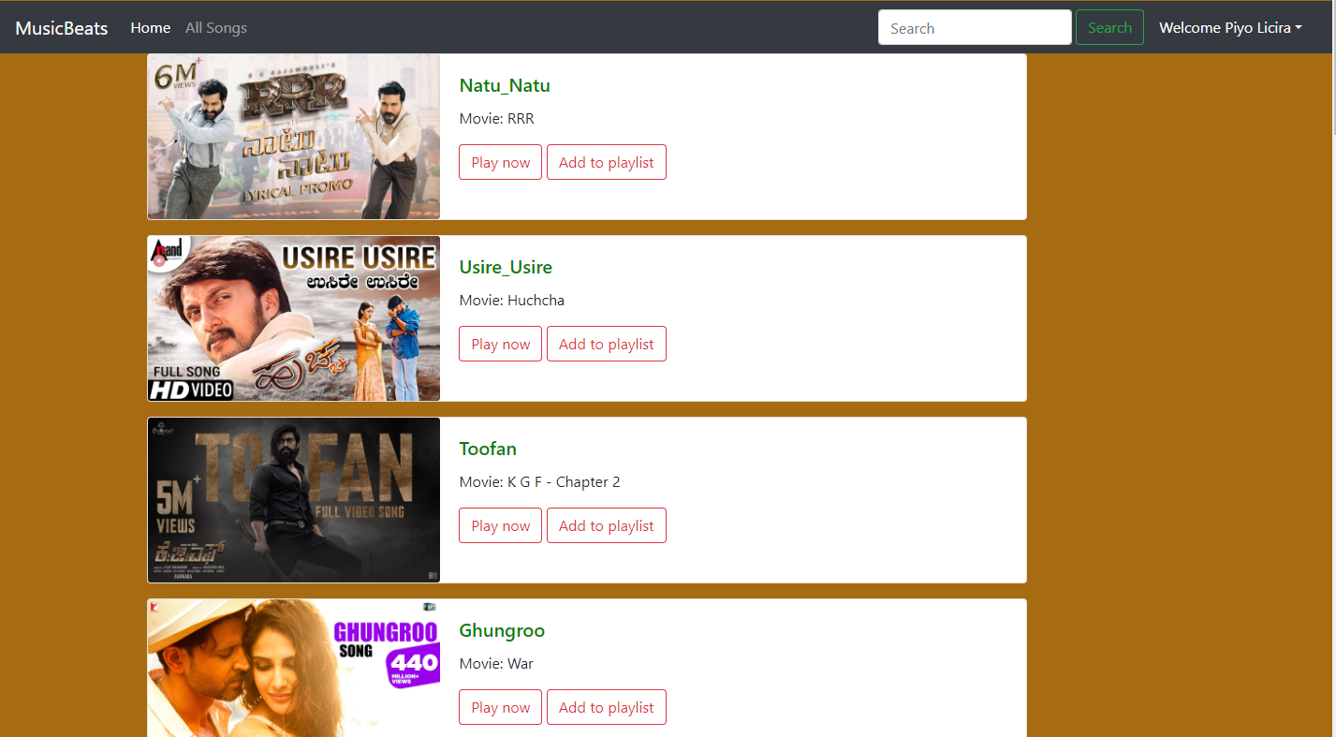
All Songs Page

Slide 13
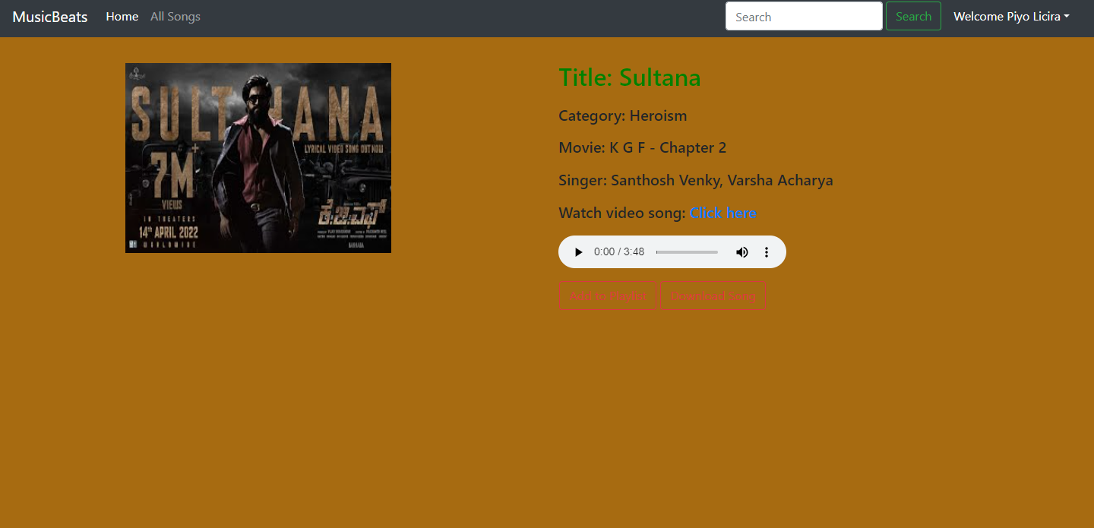
Song Page

Slide 14
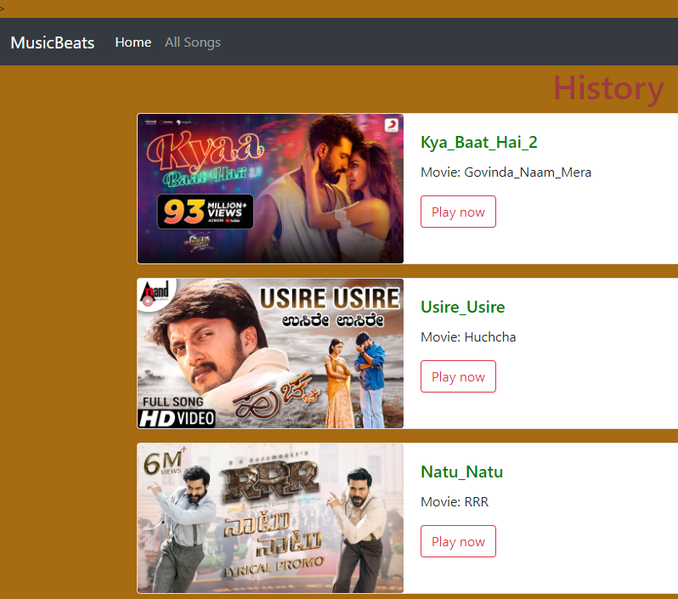
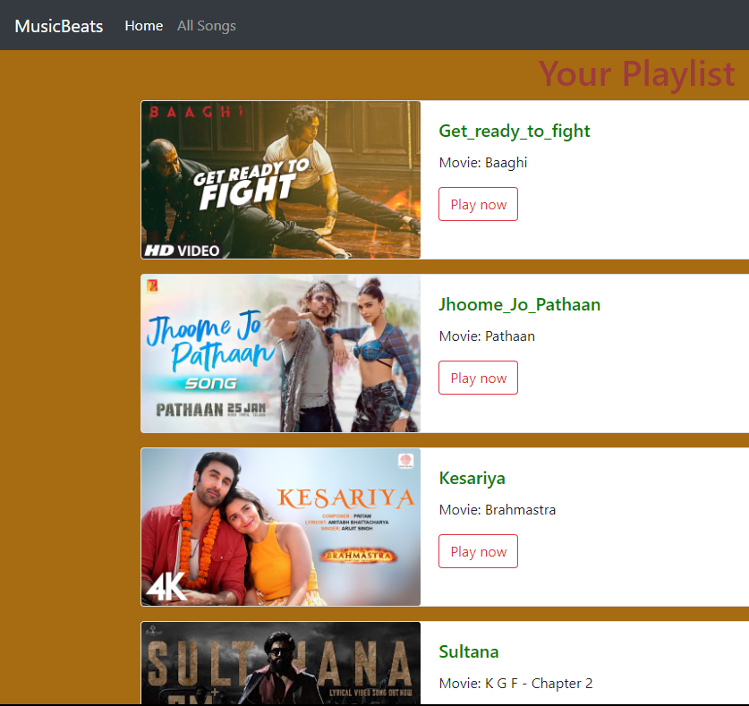
History
Playlist

Slide 15
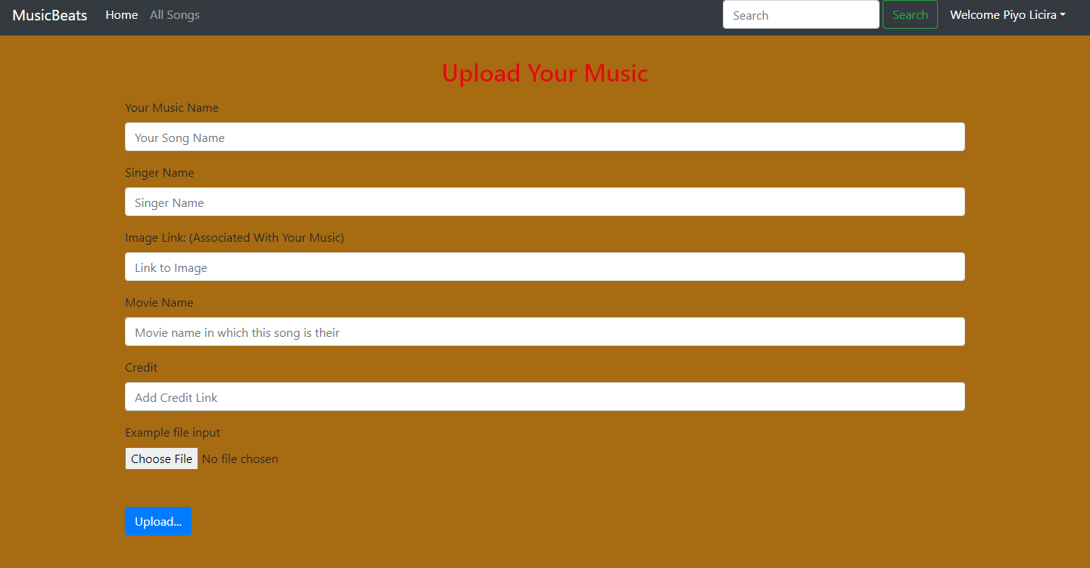
Upload Page

Slide 16
Future Enhancements:
Another potential enhancement could be the integration of machine learning algorithms to provide personalized music recommendations based on the user's listening history and preferences.
Additionally, the application could be made more user-friendly by improving the user interface and adding more intuitive navigation features.
Finally, the application could be expanded to include a wider variety of music genres and artists to cater to a broader audience.

Slide 17
Conclusion
We're proud of what we've accomplished with this music application despite limited resources. We're confident that it will offer a seamless and enjoyable experience for music lovers. We look forward to further enhancing its features based on user feedback.
Source :

Slide 18
Thank You!
Notes:
Thank You !!

