Slide 1
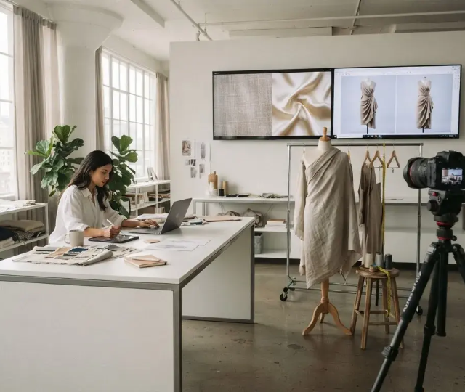
IBM Internship 2026
AI Fashion Design
Generator
AI-powered fashion creation,
visualization, recommendation and
virtual try-on
Developed by Piyush Ramteke

Slide 2
Evolution of Fashion Design Workflows
Visualization Gap
Realistic Garment
Visualization
Manual Overhead
From Prompt to Design
Discovery Friction
Intelligent Product Discovery
Try-On Barriers
Platform Capabilities
Tool Fragmentation
Integrated AI Fashion
Platform

Slide 3
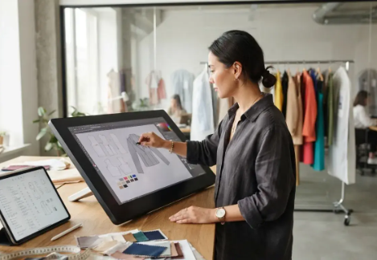
An Integrated AI
Fashion Platform
Combining generative AI with practical design and shopping
tools
01
02
03
04
05
AI Specification
AI Generation
Product Discovery
Virtual Try-On
Design Assets
Structured data from natural
High-fidelity design concept
Intelligent recommendations
Realistic visualization on
Tech-pack generation and
language.
images.
via RapidAPI.
person images.
collections.

Slide 4
Core Goals and Deliverables
Defining the success criteria for the AI
Fashion Design Generator
Convert fashion ideas
1
Convert natural-language fashion ideas into structured specifications.
Generate design concepts
2
Generate fashion design concepts using AI.
Recommend fashion products
3
Recommend relevant fashion products.
Provide virtual try-on
4
Provide realistic virtual try-on.
Integrate design workflow
5
Provide an integrated fashion design workflow.

Slide 5
Technical Stack and Data Flow
AI Services
User Interface
Backend Services

Slide 6
AI Fashion Design Workflow
Fashion
Specification
AI Image
User Prompt
Generation
The system gener-
The user provides
ates a detailed
The system
an initial input
fashion
performs AI image
prompt.
specification.
generation.
Gemini Processing
Optimized Image
Generated Fashion
Prompt
Design
The prompt is
The specification is
The final fashion
processed by
converted into an
design is produced.
Gemini.
optimized image
prompt.

Slide 7
Realistic Garment
IDM-VTON is a third-party AI service.
Visualization
Unrealistic Try-On
Input Images
AI Engine
Realistic Try-On
Low-fidelity virtual try-
Person and garment
IDM-VTON processes
High-fidelity virtual try-
on
images
images
on

Slide 8
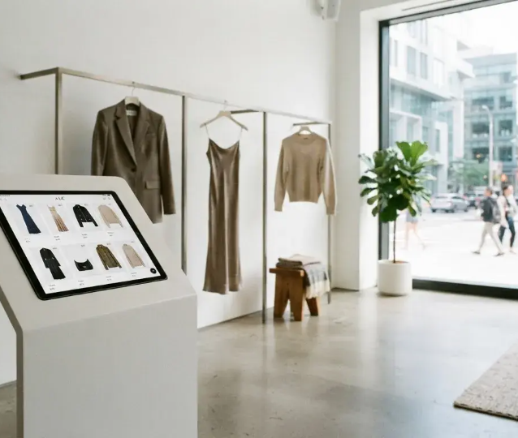
Intelligent Product
Discovery
Process
Fashion Specification → Product Search →
RapidAPI → Product Filtering → Recommendation
Ranking → Top Matching Products
Metadata Surfaced
Product image, name, price, brand,
recommendation score, and direct link.
Mapping AI-generated specifications to real-world inventory

Slide 9
The Technology Stack
Frontend: React, Vite, Tailwind
CSS
Development
Backend: Python, FastAPI
Tools for building and deploying
the platform
Integration
Connecting different services and
APIs
AI: Google Gemini, Cloudflare
AI
Workers AI, IDM-VTON
Intelligent design generation and
processing
Backend
Server-side logic and data
Integration: REST APIs, Hugging
management
Frontend
Face, RapidAPI
User interface and experience
Development: GitHub, Vercel

Slide 10
API Security Ensures Application
Compliance
API Security
Secure and compliant
application
Access Control
Rate limiting, CORS, licenses
Input Validation
Strict file type and size
Backend Proxying
Protected API calls handled
Credential Management
API keys in environment variables

Slide 11
Platform Capabilities
Key Features: Intelligent Product
Recommendations
AI Fashion Studio
AI Fashion Image Generation
Provides a comprehensive suite for
Primary
Focuses on the creative rendering of
specification and tech pack
Functionality
apparel
generation
Produces high-fidelity visual
Streamlines technical documentation
representations from text prompts
and production readiness
Facilitates collections and wardrobe
Workflow
Enables virtual try-on integration
management
Integration
Bridges the gap between conceptual
Organizes complex design assets into
design and realistic visualization
cohesive seasonal lines

Slide 12
Overcoming Technical Hurdles
Navigating the complexities of AI
integration and API management
Environment-Based
Input Validation
API Rate Limiting
Secrets
Challenge: AI model integration
Ensure data integrity
Manage external API
Securely manage API
for AI
usage effectively
keys
and try-on quality — Solution:
FastAPI service layer and input
validation
Technical
Seamless AI
Challenge: External API
Integration
Integration
Challenges
High-quality try-on
limitations and quotas — Solution:
Complex AI and API
and secure access
management
API rate limiting and error
handling
Challenge: Secure integration —
Solution: Environment-based
secrets and backend
orchestration

Slide 13
The Roadmap Ahead
Future Improvements
Near-Term
Mid-Term
Mid-Term
Mid-Term
Long-Term
Virtual Try-On &
Marketplace
Personalization &
Mobile App
Trend Analytics
Segmentation
Integration
Cloud Storage
Development
Implement advanced
Implement advanced
Integrate with global
Develop personalized
Launch a mobile
fashion trend analytics for
virtual try-on and garment
fashion marketplaces for
recommendations and
application for enhanced
data-driven insights
segmentation
wider reach
user cloud storage
user experience

Slide 14
Achieved Outcomes
Project Results
Professional
Interface
Virtual Try-On
Scalable
Architecture
High-Fidelity
Concepts
Integrated
Workflow

Slide 15
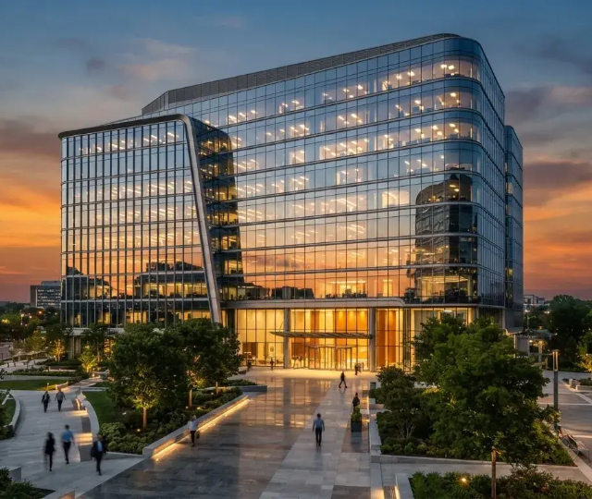
Conclusion
Thank You
AI Fashion Design Generator:
Redefining fashion ideation and
visualization
Piyush Ramteke

