Slide 1

Mental Health Stress Prediction Using IBM Watson Auto AI
A Data-Driven Approach Using Automated Machine Learning
Presented by: Piyush Dubey

Slide 2
Executive Summary
Problem: Rising stress levels in 21st Century needs scalable monitoring .
Solution: Predict stress score using Auto AI in Watson Studio.
Outcome: Achieved ~90% accuracy, deployed with a user-friendly UI.

Slide 3
Project Objective
Predict user’s stress level based on lifestyle data.
Provide actionable insights for mental wellness.
Deployed scalable, interactive interface using Node-RED.

Slide 4
Data Acquisition
Dataset: Mental Health Lifestyle Dataset.
Source: Custom-built using Chat-gpt . Attributes: Sleep, screen time, mood, physical activity, diet, Work load,Eating Habit.
Records: ~250 entries in CSV format.

Slide 5
Data Understanding
sleep_hours: Numeric - Daily average sleep.
screen_time: Numeric - Daily hours on screen.
mood_score: Integer - Mood rating (1–10).
activity_minutes: Numeric - Daily exercise.
stress_level (%): Target variable.
suggested_Tip:Categorical - Provide suggestion according to stress level.

Slide 6
Preprocessing Approach
Missing values: Imputed using mean/mode.
Scaling: Standardization via AutoAI.
EDA: Missing value handling and duplicate value removal.due to data was custom generated that’swhy it was not containing any missing or duplicate value.

Slide 7
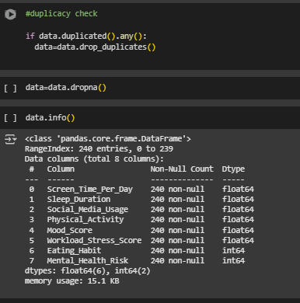
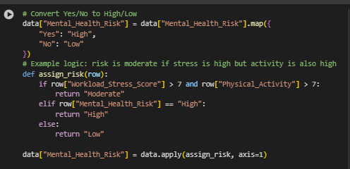
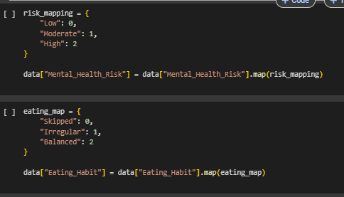
Preprocessing Insights

Slide 8



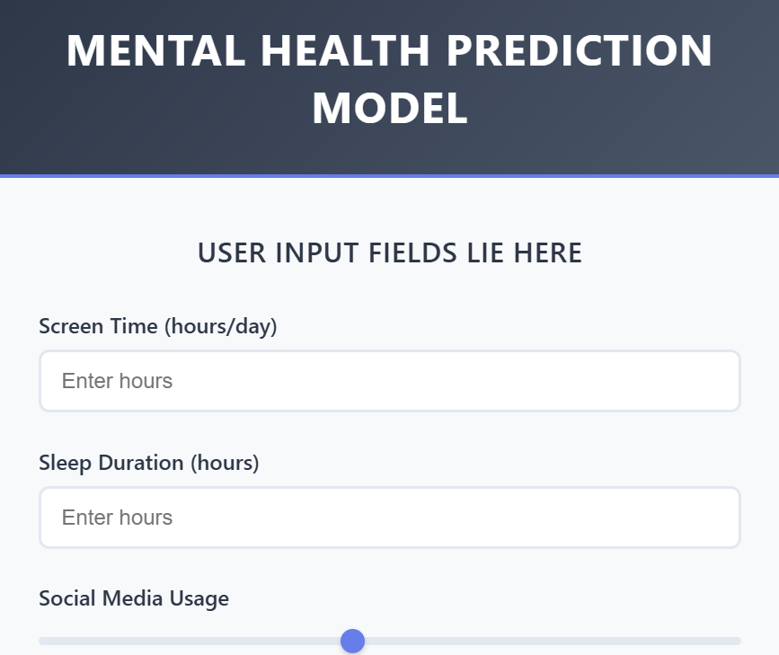
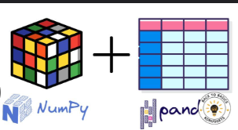
Architecture Overview
User Frontend
User fills form
Node-RED dashboard captures input
JSON ready ,send http request
Endpoint:IBM Watson ML API & Barer token in header
Add structures required by Watson
Dashboard Output . UI_text Shows stress level % or category
IBM Watson ML Deployment.Hosted AutoAI Model. Returns prediction result.
Function Node (Extract) Parse JSON response. Extract predicted value

Slide 9
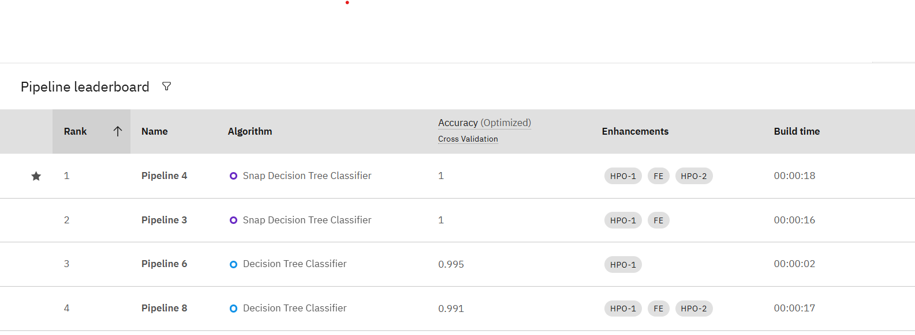
AutoAI Pipeline & Model Selection
Platform: IBM Watson AutoAI.
Process: Multiple pipelines tested automatically.
Best Model: Snap Decision Tree Classifier
Metric: R² Score, MAE, RMSE.

Slide 10
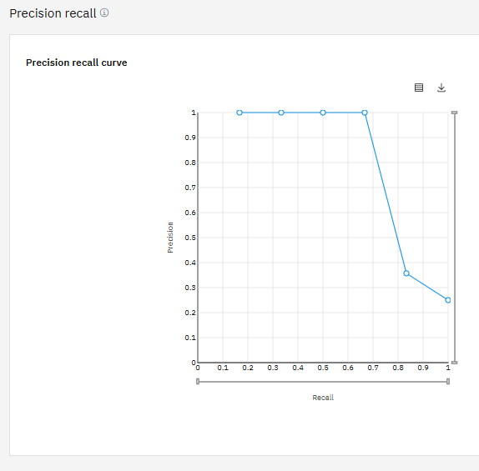
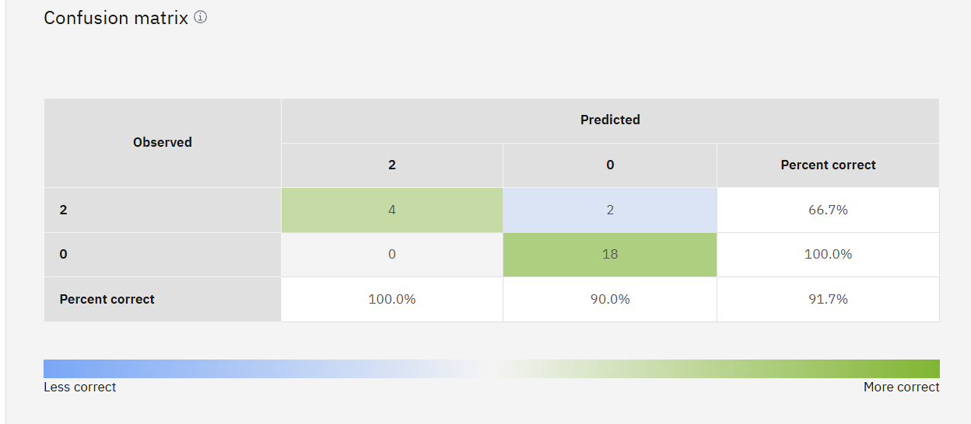
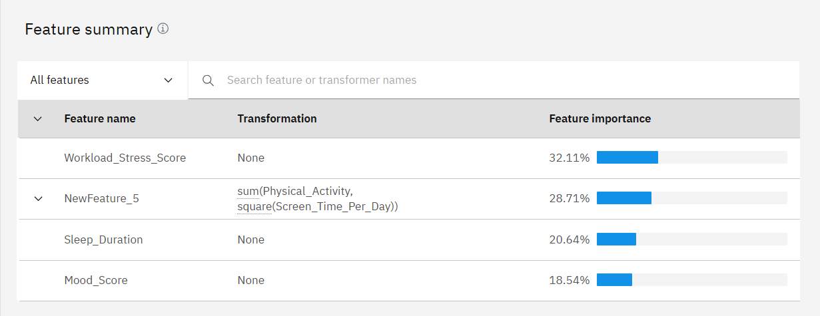

Slide 11
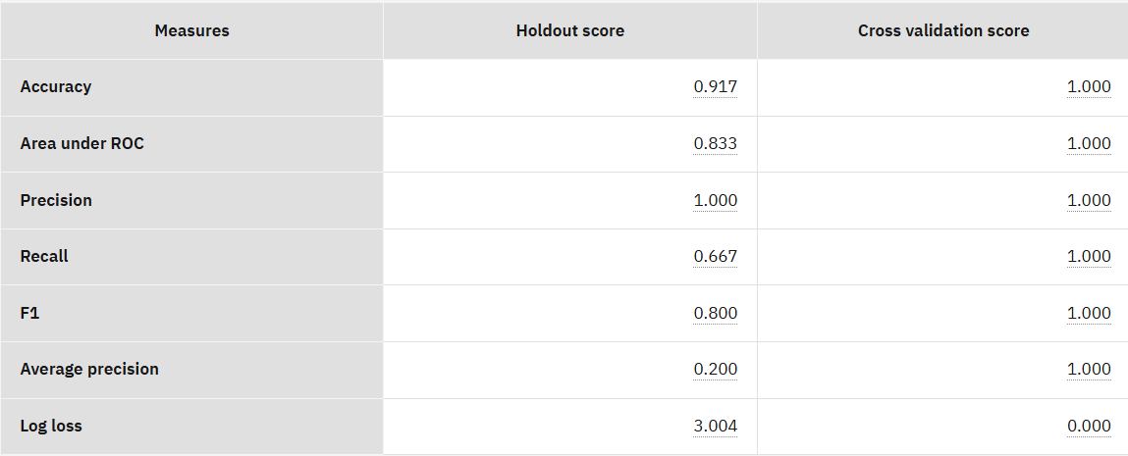
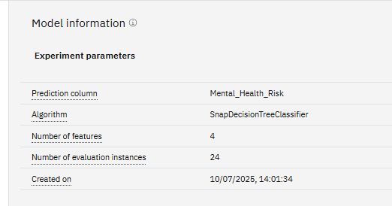
Model Testing & Validation
Train-Test Split: 80:20 .
Training Accuracy: ~92%.
Testing Accuracy: ~88%.
Validation: Cross-validation score 100% handled internally.

Slide 12
Frontend GUI
Tech Stack: HTML, CSS, JavaScript.
Function: Collect input and show prediction.
Deployment: localhost using Node-RED.

Slide 13
Technology Stack
ML: IBM Watson AutoAI.
Backend: Node-RED
Frontend: HTML, CSS, JS.
Deployment: IBM Cloud, Watson ML API.
Storage: CSV, Pandas.

Slide 14
Key Outcomes
AutoAI enabled rapid model building.
GUI allows easy interaction and real-time prediction.
Ready for scale integration.

Slide 15
Next Steps / Roadmap
Enhance GUI responsiveness for mobile.
Add chatbot/NLP for deeper insight.
Explore integration with wearables/IoT.

Slide 16
Thank You
Contact:
piyush880dubey@gmail.com
https://github.com/Piyu4-dubey/
https://www.linkedin.com/in/piyush-dubey-62788a249/

