Slide 1

Resume Builder
Presentation
Submitted to
(Mini Project Coordinator)
Mr. Ashish Kumar (Sir)
Submitted By
Prateekshit Jaiswal
2101430100130
Piyush Singh
2101430100125
Muskan Gupta
2101430100112
Maneesh Kumar
2101430100105

Slide 2

Introduction
Creating a Resume is a bit tedious task for any working professional from any industry.One has to keep it short , simple,with the latest work experience and constantly update it over a while .it is an application that simplifies th task of creating a Resume for individual.The system is flexible to be used and reduces the need of thinking and designing and appropriate resume accordingly to qualification.The system is developed to provide and easy means for creating a professional looking resume individual just have to fill up a form that specifies questions from all required fields such as personal questions, educational qualities skills and so on .The answer provide by the users are stored an the system automatically generates a well -structured resume users. Have option to create resume in any format and file .

Slide 3
BRIEF DESCRIPTION ABOUT THE MINI PROJECT
AIM OF THE PROJECT:
-This project is completely based on the web development ,Getting the knowledge about the resume building .
-This project will helpful in recognising to build a strong ,perfect resume .
-Main aim of this project to get deep knowledge,Useful learning about the languages that we are using and to developing a Resume builder on website .

Slide 4
Innovation
Some builders are purely 100% online and don’t have the functionality to allow the user to save their resume to other word processing software such as Microsoft Word, and often you can only print out what users have completed online.
Some of the resume builders only provide a PDF copy of resume which again restricts users for further adaption or updating.
Hence, our website will be covering these major problems by allowing users to save there progress and transfer there progress to different platforms.

Slide 5


METHODOLOGY
Here In this Project we are using the two very well known and used at majority level languages.
Html and CSS .We can discuss in it shortly that why we are using or taking benifits from these two languages.
  1.HTML(Hypertext Markup Language) and CSS (Cascading Style Sheets) are two of the core techniques for building Web pages. HTML provides the structure of the page, CSS the (visual and aural) layout, for a variety of devices. Along with graphics and scripting, HTML and CSS are the basis of building Web pages and Web Applications.
  2.Cost effective Multi-Platform Development.
  3.Consistency across multiple browsers.
  4.Extension of video to a wide range of platforms.

Slide 6


TECHNOLOGY
The technological tool that here we are using is Laptop.Laptops are embraced because of the technological tools they offer combined with their portability.
An HTTP server i.e; a computer (software) program (or even a software component included in an other program) that plays the role of a server in a client–server model by implementing the server part of the HTTP and/or HTTPS network protocol(s).

Slide 7
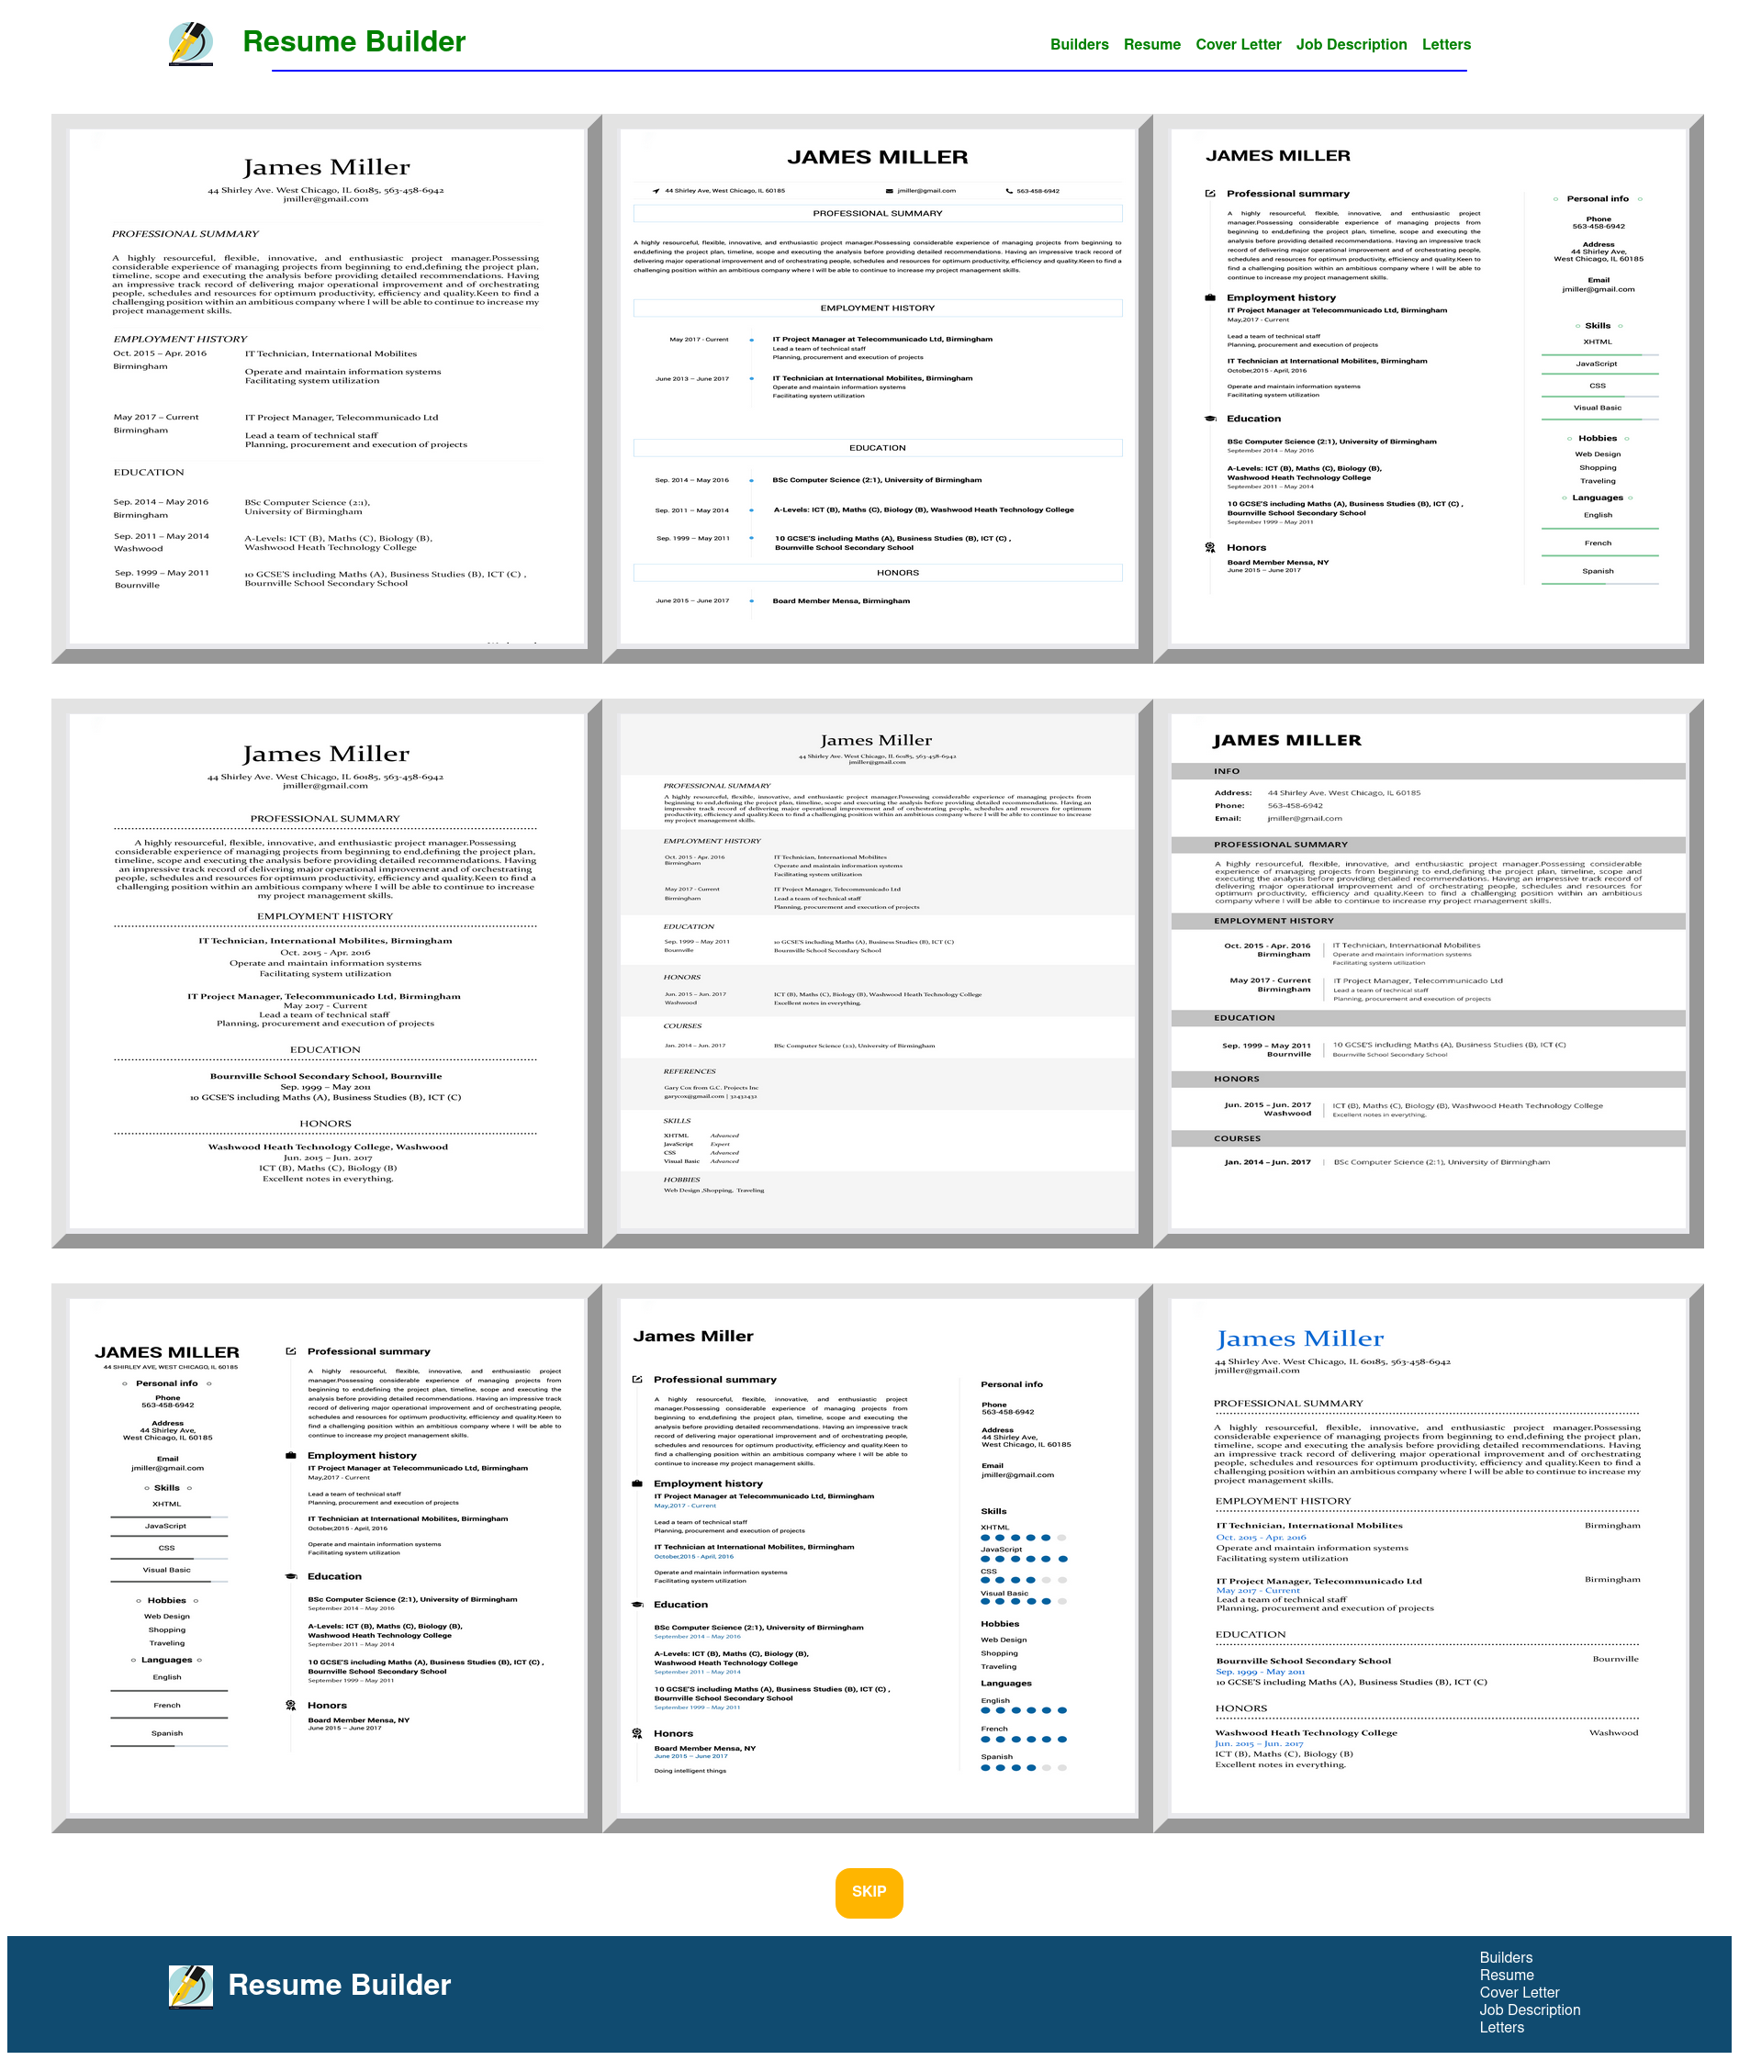
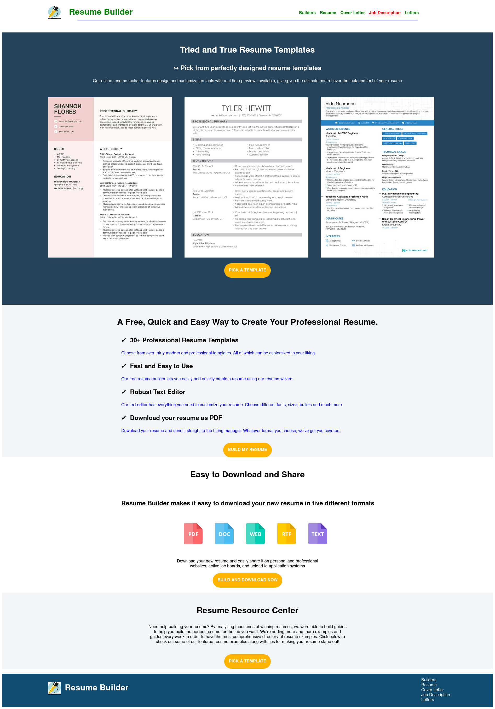
Progress...

Slide 8
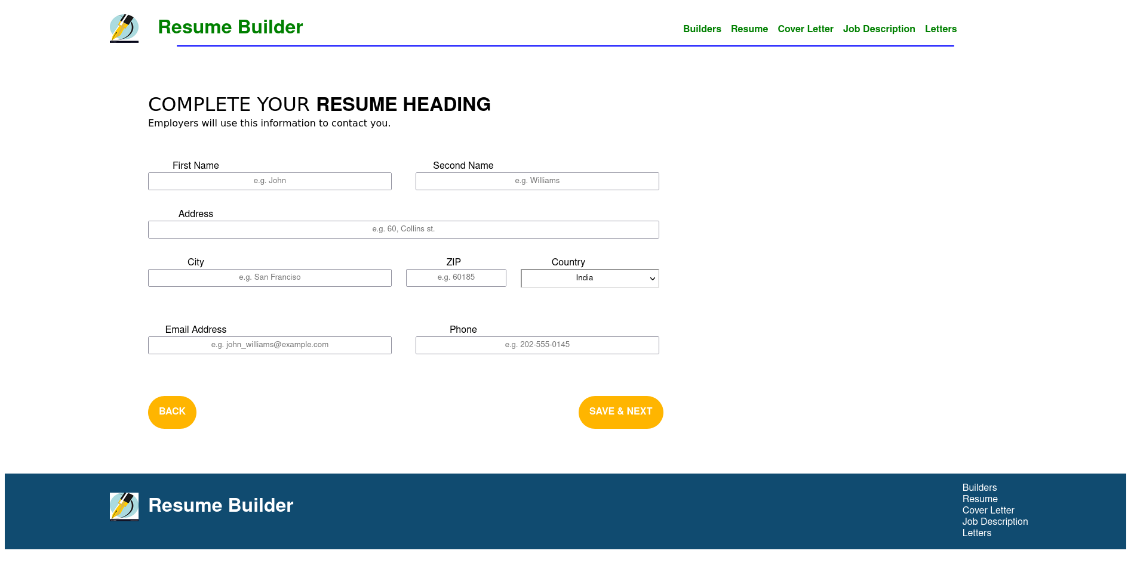

Slide 9
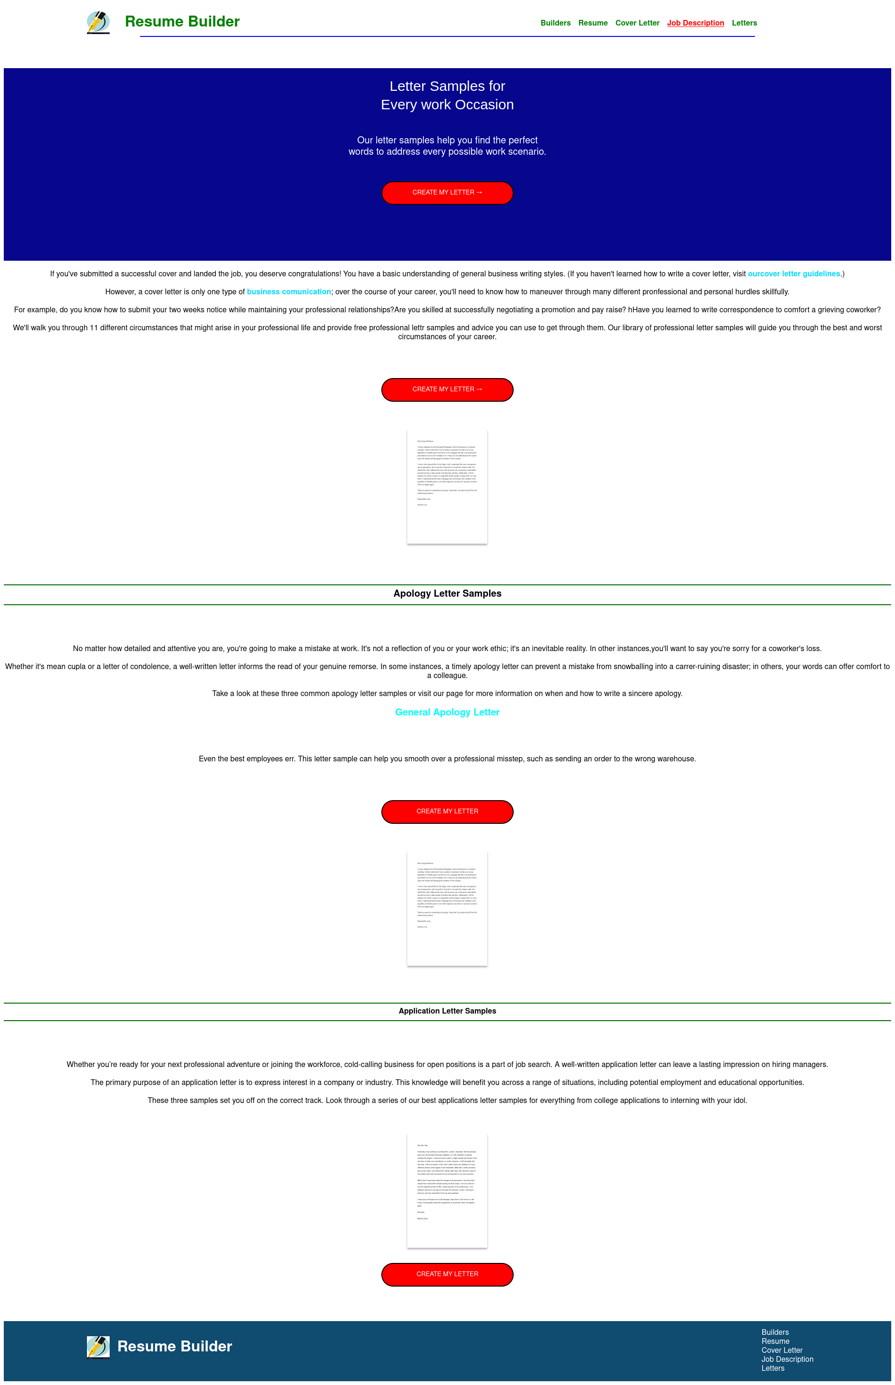
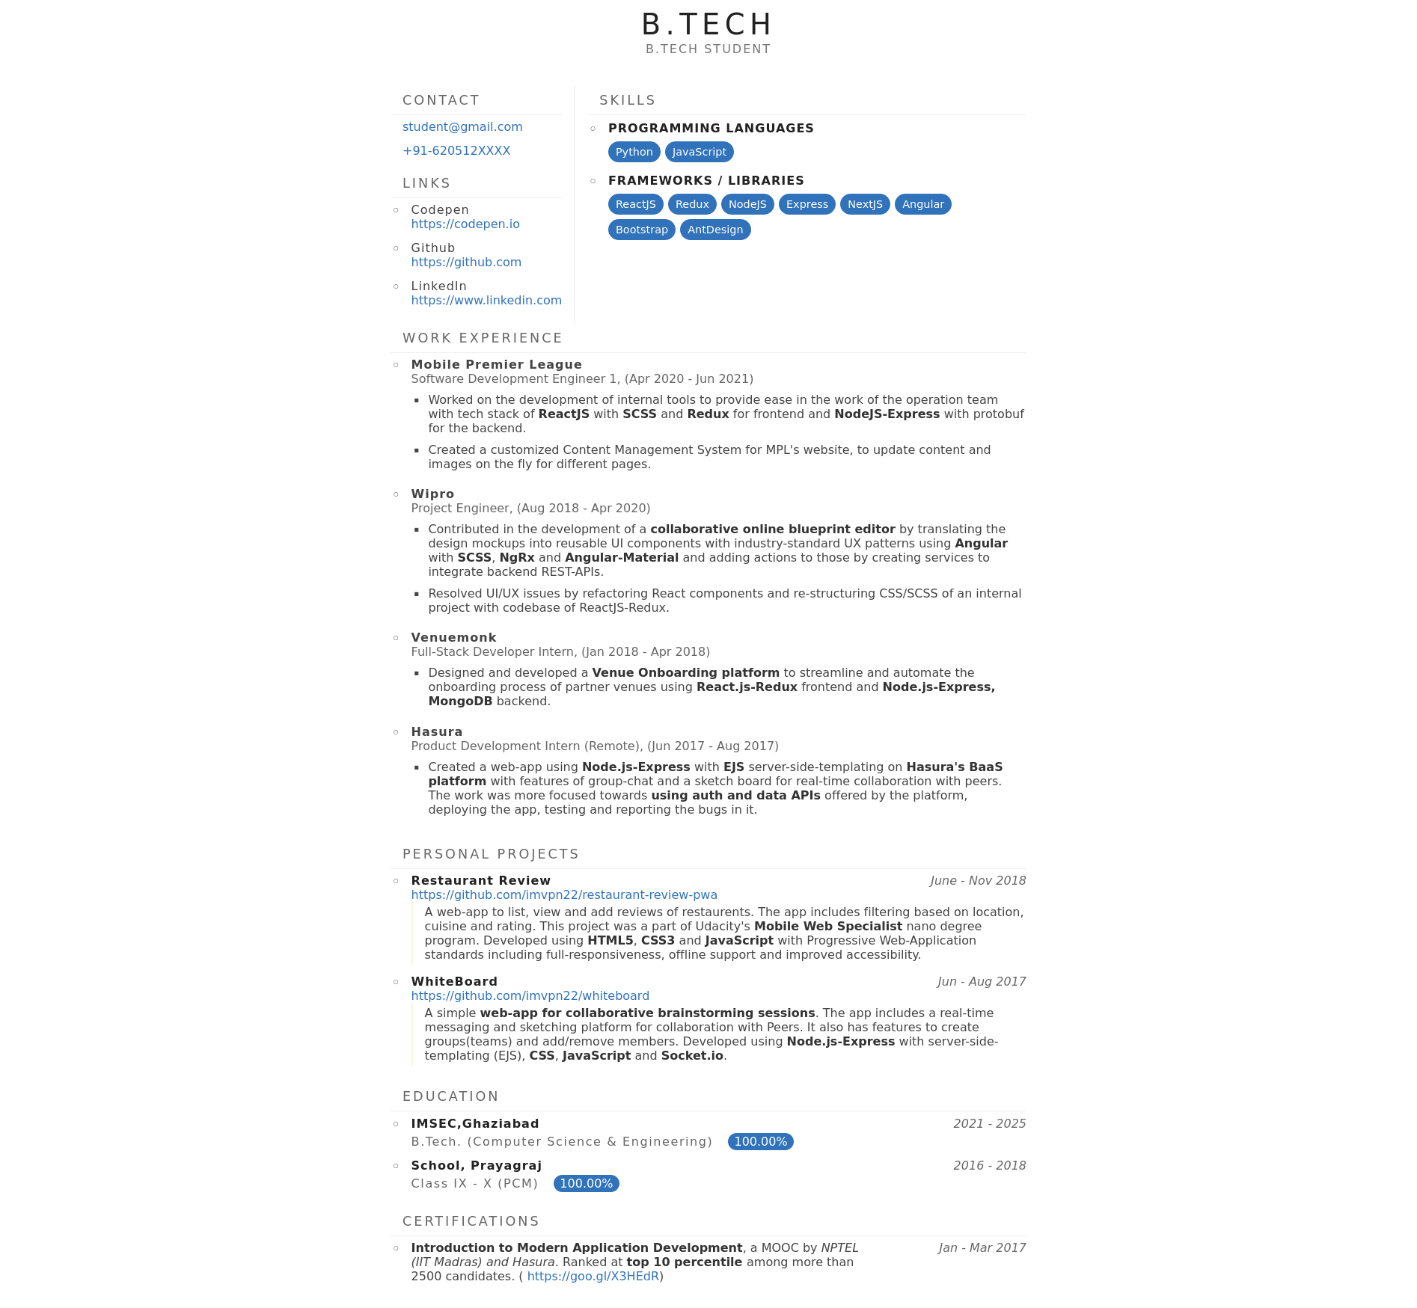

Slide 10
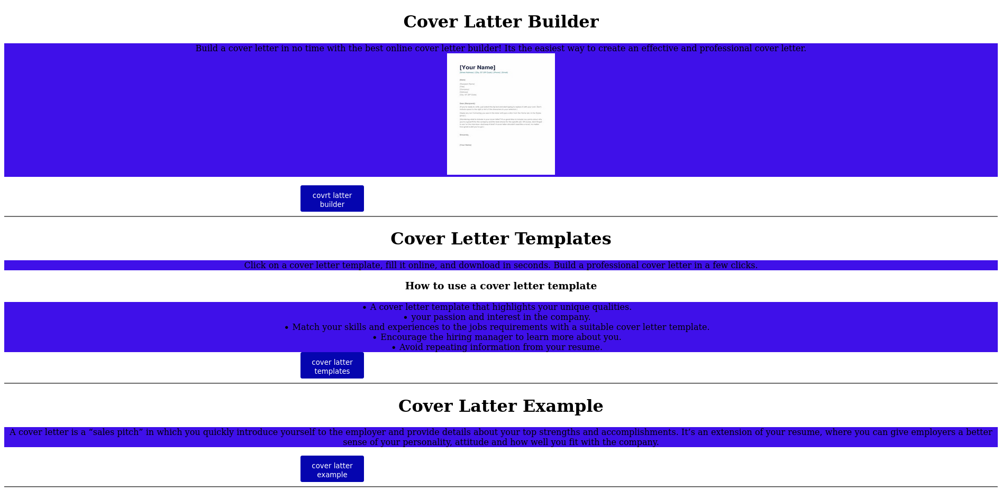

Slide 11
CONCLUSION AND RESULT
The online resume builder is one of the most fantastic system for the people who are either recently graduated students in their domain or if they don't have enough idea about the resume or don't have enough time to create the resume of good design and patterns then this platform is very productive place for them .ARB(analytical re resume builder)will analyse and give the required output of top trending technology with proper proof of data ,graphs and statistics.the student can analyse the material and course which they can option for which will be more useful for them in their placements and future it will be a clear path and guide which will make it decision and much more easy and effective there will be a less chance of regretting and wasting the time of different courses which are not worth.

Slide 12
SUPERVISOR
Supervisor of our team in this mini project is Mr. Ashish Kumar sir.

Slide 13
THANK YOU

