Slide 1
Card-Fraud Triage: GMM Density Scoring vs Autoencoder Anomaly Detector
Project 26 · Phase 1: Machine Learning
Team T068 · Section B
Newton School of Technology, Rishihood University

Slide 2
Team T068 (Section B)
Name | Enrollment No. | Role in this phase
Sharma Piyush | 2401010437 | Data quality, EDA, chronological split
Saransh Singh Tomar | 2401010418 | Feature engineering, scaling ablation
Satwik Mani Tripathi | 2401020056 | GMM theory, EM, AIC/BIC, stability
Gourav Tanwar | 2401010173 | Baselines and error analysis
Alok Kumar | 2401010058 | Evaluation, thresholds, cost analysis
Notes:
Introduce the team and the project: ranking card transactions for human review using a density model of legitimate behaviour.

Slide 3
Fraud is rare, changing and labelled late
0.17%
99.83%
Weeks
of transactions are fraud (1 in 600)
accuracy of a model that never flags fraud — so we never report accuracy
until chargebacks reveal which transactions were fraud
Triage, not classification: analysts can review only a few alerts — rank transactions so the most suspicious come first
Learn what legitimate behaviour looks like (abundant, available now), not what fraud looked like last month
Score = how unlikely a transaction is under the legitimate model; metrics = PR-AUC, recall at a false-positive budget, precision at review capacity
Notes:
Why anomaly detection: few positives, drifting patterns, delayed labels. Why not accuracy.

Slide 4
Pipeline: model legitimate behaviour, rank by surprise
1 Clean & split
2 Engineer
3 Fit density
4 Score & rank
Drop 1,081 duplicates; time-ordered 60 / 20 / 20 split
log(1+Amount), cyclic hour, quantile transform — fitted on legit train rows only
Gaussian Mixture by EM on legitimate rows; labels never seen
s(x) = −log p(x); thresholds fixed on validation, frozen for test
Labels are used only to (a) remove fraud from training, (b) choose thresholds on validation, (c) report test results once
Every comparison is averaged over several EM seeds; test differences checked by paired bootstrap

Slide 5
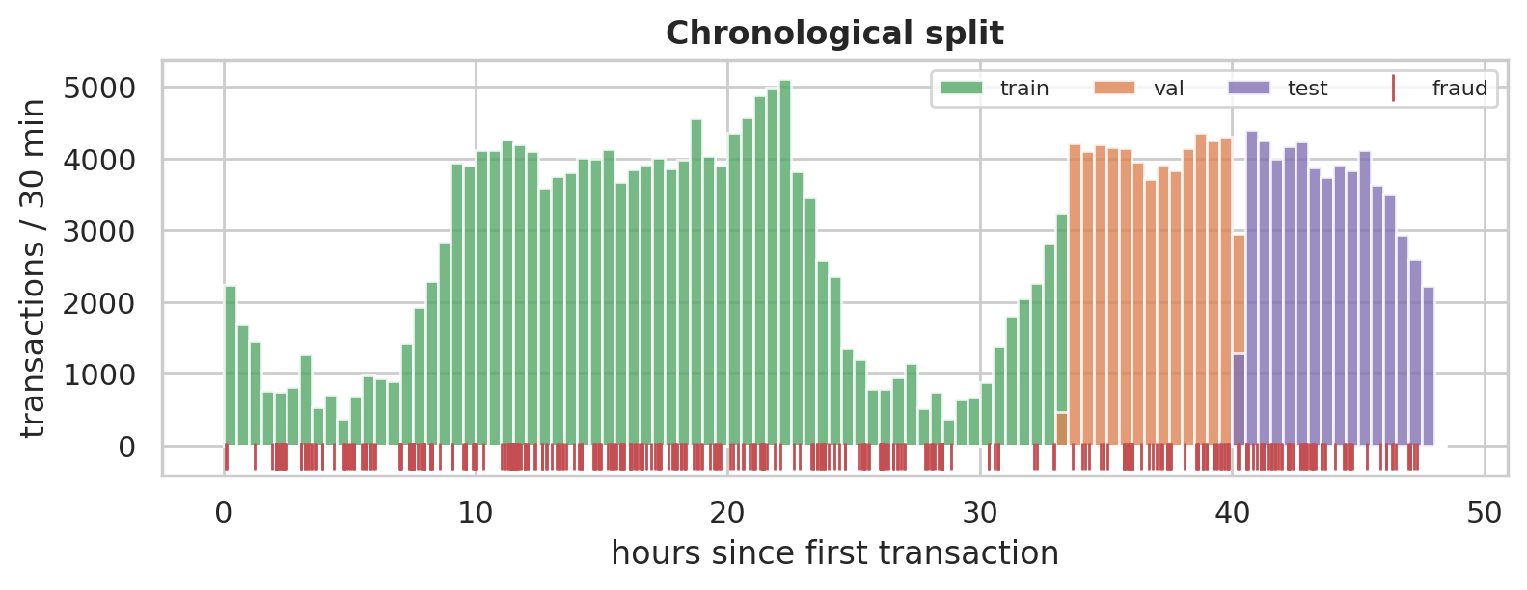
ULB credit-card data, split by time
Block | Rows | Frauds | Rate
train | 170,236 | 342 | 0.201%
val | 56,745 | 57 | 0.100%
test | 56,745 | 74 | 0.130%
284,807 transactions over 2 days; V1–V28 are PCA components of confidential features
Train on the past, test on the future — base rates drift between blocks (0.20% → 0.10% → 0.13%)
Validation and test fall in daytime hours — night-time fraud appears only in training (limitation)

Slide 6
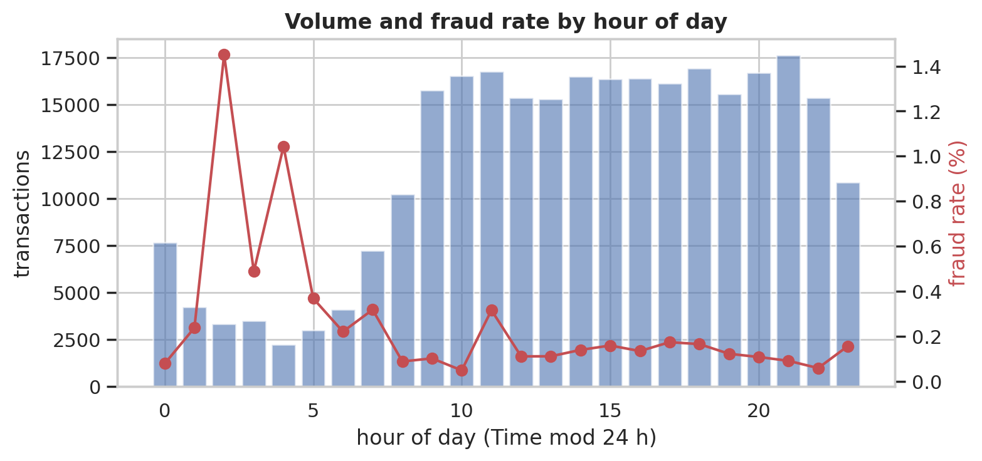
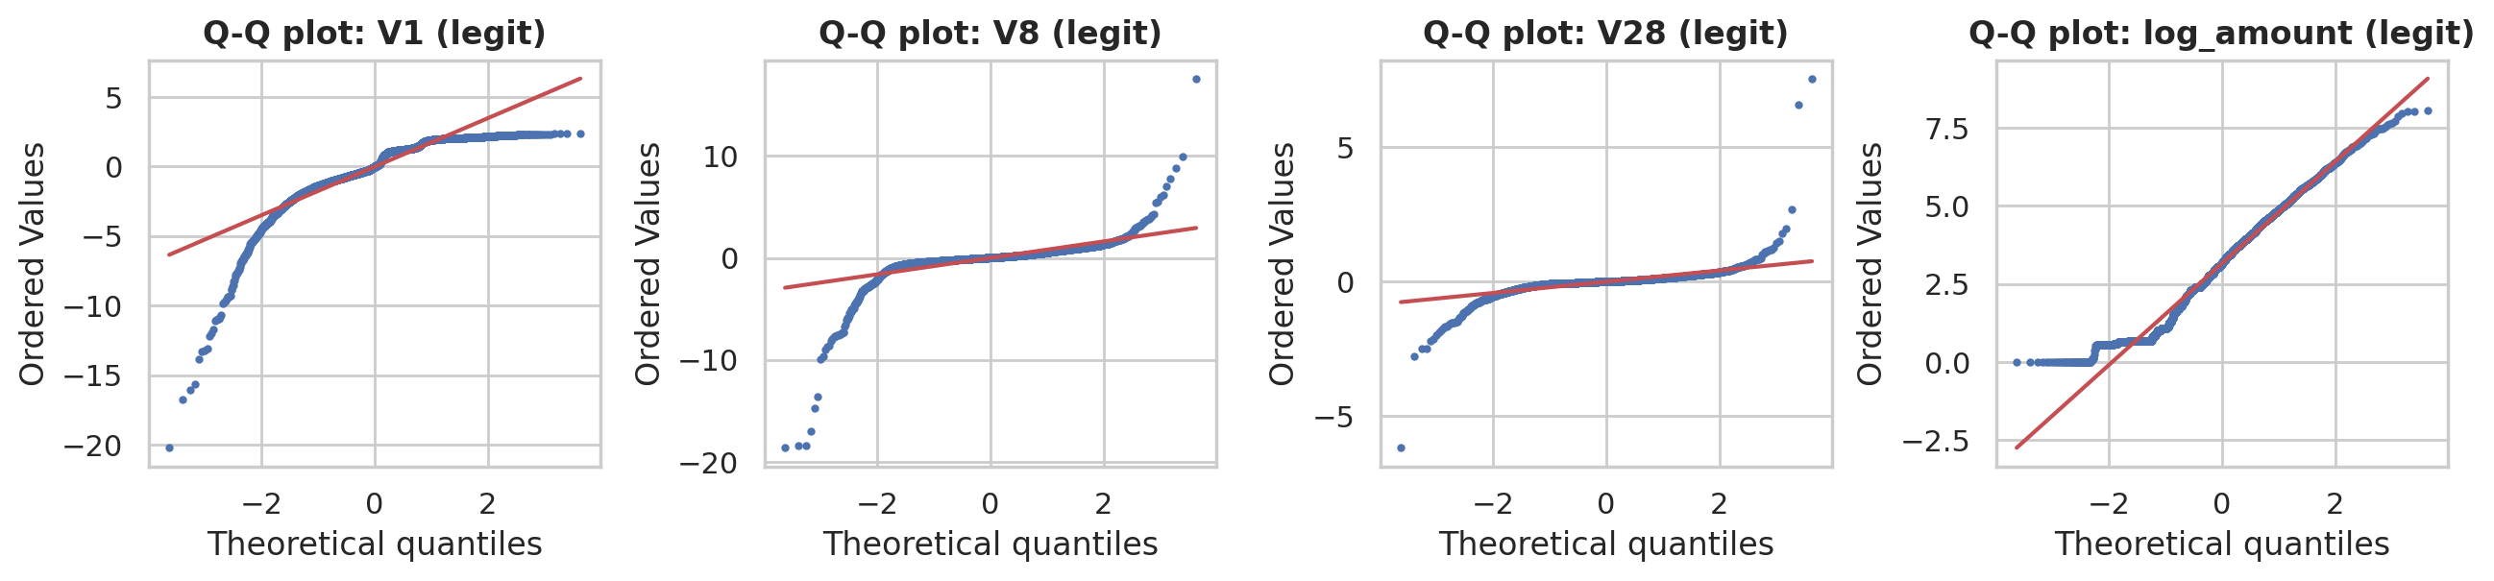
Legitimate behaviour is heavy-tailed, fraud loves the night
Fraud rate peaks at night (up to ≈ 9× the average) → hour of day is encoded as sin / cos
18 of 31 features have excess kurtosis > 3 (V28 ≈ 966) — far from Gaussian
Frauds sit in the tails of V14, V10, V12, V4 — and move several components together

Slide 7
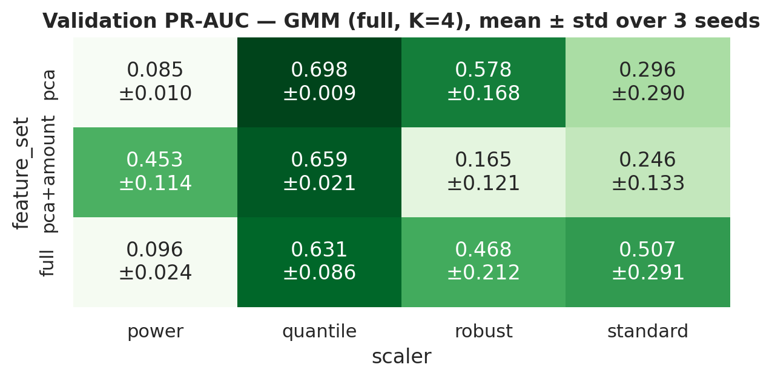
The quantile transform is what makes a GMM work
0.163
0.691
single Gaussian, standard scaling
same model, quantile inputs
Quantile transform: each feature → its empirical CDF → inverse normal CDF; fitted on legitimate rows only
Removes the heavy tails that let a few legitimate outliers dominate EM — and makes results stable across seeds
Selected inputs: pca + quantile

Slide 8
Gaussian mixture, fitted by Expectation–Maximisation
Model and score
EM algorithm
p(x) = Σₖ πₖ · N(x | μₖ, Σₖ)
Anomaly score s(x) = −log p(x)
Full covariance: (K−1) + K·d + K·d(d+1)/2 parameters
E-step: responsibilities γᵢₖ ∝ πₖ N(xᵢ | μₖ, Σₖ)
M-step: πₖ = Nₖ/N, μₖ, Σₖ = weighted averages (+ λI)
Never decreases likelihood — but only a local optimum
Choosing K: AIC and BIC
AIC = 2p − 2 log L̂ BIC = p log n − 2 log L̂
Both reward fit and penalise parameters; BIC penalises more. We sweep K and covariance type (full / diagonal) and compare the criteria with validation PR-AUC.

Slide 9
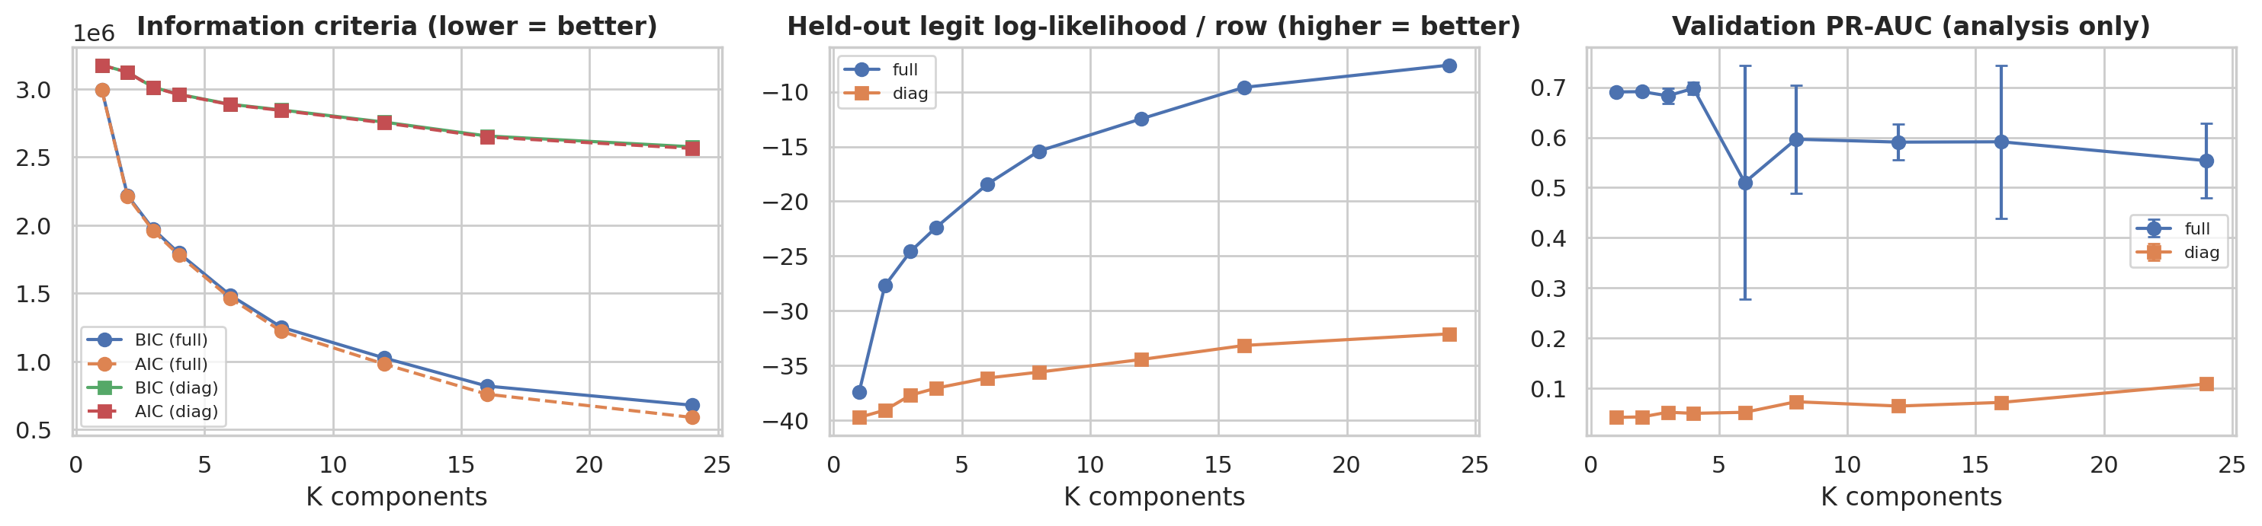
BIC wants more components; detection does not improve
AIC and BIC choose K = 24 (largest tried); held-out likelihood keeps rising — at large n the penalty p log n is small
Validation PR-AUC is flat or lower for large K, and less stable across seeds → K = 4 selected on validation
Diagonal covariance fails at every K: fraud is visible in combinations of components

Slide 10
The label-free GMM is a strong triage tool
0.686
Model | PR-AUC | Recall@0.1% | P@50
GMM (K=4, full) | 0.686 | 0.757 | 0.90
GMM, BIC choice (K=24, full) | 0.626 | 0.662 | 0.86
Single Gaussian (K=1) | 0.691 | 0.757 | 0.92
Single Gaussian, standard scaling | 0.163 | 0.081 | 0.18
Isolation Forest | 0.050 | 0.014 | 0.02
Supervised LogReg † | 0.739 | 0.770 | 0.88
test PR-AUC (95% CI 0.57–0.81)
76%
of frauds caught at a 0.1% false-positive budget
90%
of the top-50 alerts are fraud
† uses fraud labels — upper reference, not a fair competitor. Thresholds chosen on validation, applied once to test.

Slide 11
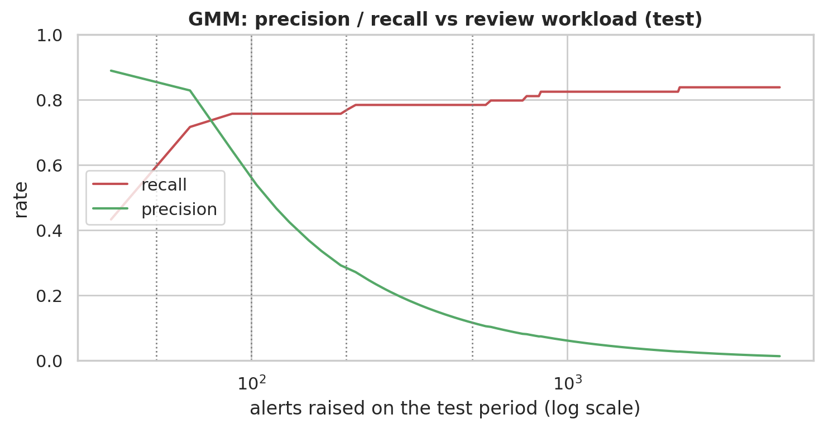
Choosing the threshold is a workload decision
FP budget | Alerts | /hour | Caught | Precision
0.1% | 94 | 12.3 | 56/74 | 0.60
0.5% | 221 | 28.9 | 58/74 | 0.26
1.0% | 399 | 52.1 | 58/74 | 0.14
Tighter budget → much smaller queue, few extra frauds missed: most frauds are either very anomalous or look completely normal
Cost view (review = 5 per alert, missed fraud = its amount): best to review the top 61 alerts — total 2,763 vs 7,728 with no model

Slide 12
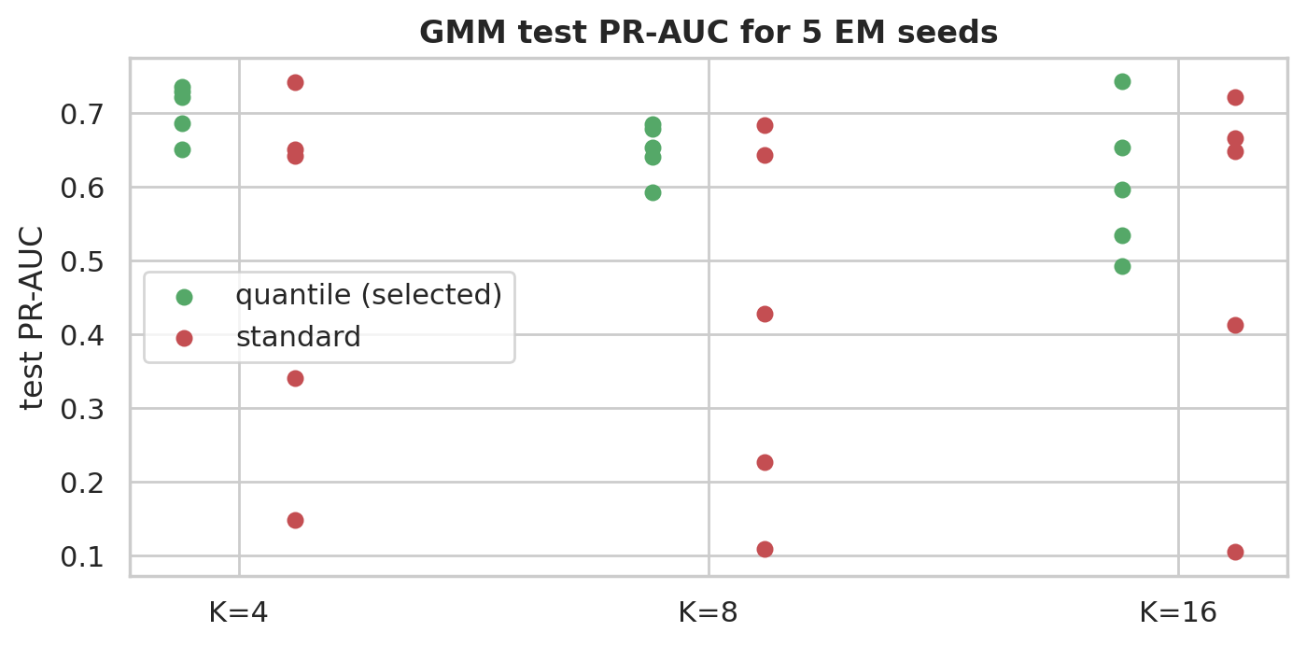
The gap: EM is unstable in high dimensions
0.15–0.74
0.65–0.74
test PR-AUC range, 5 seeds, standard inputs
same, quantile inputs
Same model, different random start → very different detector (standard inputs)
Spread grows with K; covariance condition numbers up to ≈ 2,467 — nearly flat directions
Gaussian shape is forced: the quantile transform clips extremes; adding ellipsoids does not help

Slide 13
Feature engineering, not mixture size, made the GMM work
Label-free GMM: PR-AUC 0.686, 76% of frauds at a 0.1% false-positive budget
Gap → Phase 2: a learned non-linear model (autoencoder) and an ML + DL hybrid

Slide 14
Questions
Code, notebooks (run on Google Colab), report and viva notes: see the GitHub repository

