Slide 1
Card-Fraud Triage: GMM Density Scoring vs Autoencoder Anomaly Detector
Project 26 · Phase 2: Deep Learning
Team T068 · Section B
Newton School of Technology, Rishihood University

Slide 2
Team T068 (Section B)
Name | Enrollment No. | Role in this phase
Sharma Piyush | 2401010437 | DL data handling, contamination study
Saransh Singh Tomar | 2401010418 | Autoencoder input preprocessing
Satwik Mani Tripathi | 2401020056 | Hybrid second stage, evidence analysis
Gourav Tanwar | 2401010173 | Autoencoder architecture and ablations
Alok Kumar | 2401010058 | Significance tests, label efficiency

Slide 3
Phase 1 recap: a strong GMM with a clear gap
0.686
76%
90%
label-free GMM test PR-AUC (K = 4, quantile inputs)
of frauds caught at a 0.1% false-positive budget
of the top-50 alerts are fraud
Gap 1 — shape: works only after every feature is forced to look Gaussian; components are fixed ellipsoids
Gap 2 — instability: 434 parameters per component in 28-D; EM depends on its random start
Gap 3 — selection: AIC / BIC keep asking for more components without better detection
Phase 2 question: can a learned non-linear model of legitimate behaviour — or a hybrid — close the gap?

Slide 4
Autoencoder: compress and rebuild legitimate transactions
Score = reconstruction error
e(x) = ‖x − x̂‖² / d, on the clean input.
Trained on legitimate rows only; it rebuilds normal behaviour well and unusual behaviour badly.
Denoising AE
28
24
16
16
16
24
28
Train on corrupted input (Gaussian noise σ = 0.2), rebuild the clean input → learns to pull points back onto the data manifold (Vincent et al., 2008).
input x → encoder → code z → decoder → x̂
ELU activations, linear code and output; Adam, early stopping on a label-free holdout

Slide 5
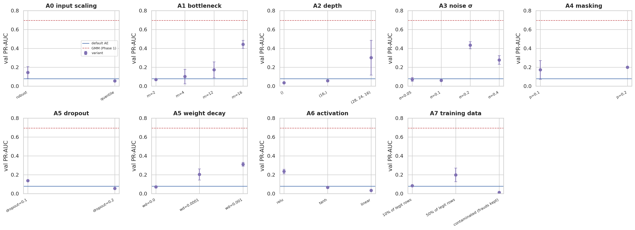
27 ablation variants × 2 seeds, all decided on validation
Chosen AE: inputs standard, bottleneck m = 16, hidden 24–16, elu; DAE adds Gaussian noise σ = 0.2
Factors interact: stacking every helpful change scored ≈ 0.02 → the final model is chosen among validated candidates

Slide 6
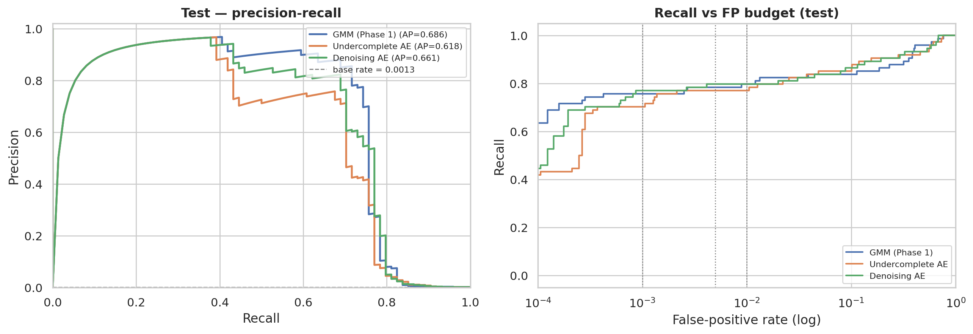
The denoising AE matches the GMM; the plain AE trails
Model | PR-AUC | Rec@0.1% | P@50
GMM (Phase 1) | 0.686 | 0.757 | 0.90
Undercomplete AE | 0.618 | 0.703 | 0.72
Denoising AE | 0.661 | 0.703 | 0.84
DAE − GMM = -0.025 (95% CI -0.055 to 0.001) — not significant; AE − GMM = -0.068 (95% CI -0.107 to -0.032) — significant (paired bootstrap)
Seeds: DAE 0.61 / 0.64 / 0.63 (stable) vs AE 0.58 / 0.48 / 0.64
Denoising (Gaussian noise σ = 0.2) is the regulariser that matters; dropout hurts; a linear (PCA-like) AE fails

Slide 7
Diagnosis: same frauds, different false alarms
1 · Direction weighting (hypothesis)
2 · Over-generalisation
Theory: a Gaussian score weights near-flat directions by 1/λ; MSE weights all equally.
Test: a Mahalanobis score on the AE residuals is worse — residuals are heavy-tailed, so the simple fix fails.
The network rebuilds part of each fraud too.
Share of deviation reconstructed — legit 74%, fraud 32%.
0.583
0.171
0.941 / 0.43
AE test PR-AUC, MSE score
same AE, Mahalanobis score on its residuals
rank correlation of AE and GMM: fraud / legit rows

Slide 8
Five ML + DL hybrid designs
H1 Latent GMM
H2 DAGMM-style
H3 Augmented GMM
GMM on the AE code z — density in a low-dimensional learned space (DAGMM idea)
GMM on [z, log error, cosine(x, x̂)] — where on the manifold + how far from it
GMM on [x, log error] — keep all inputs, add the learned error as a dimension
H4 Late fusion
H5 Semi-supervised
Leakage control: half A of legit training rows trains the AE, half B fits every stage-2 GMM; 3 seeds
average of rank-normalised GMM and AE scores — the naive baseline
gradient boosting on [x, GMM score, AE error] with the few frauds analysts labelled

Slide 9
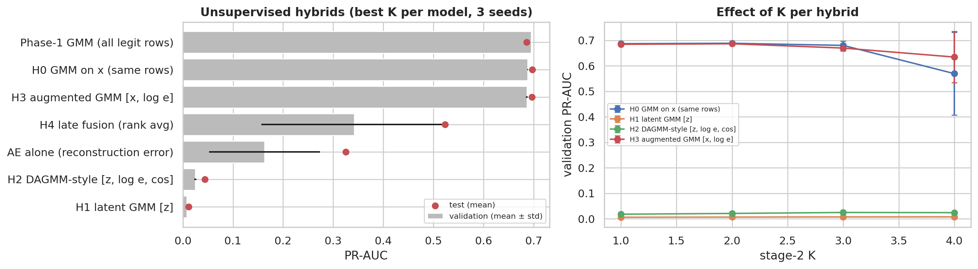
Hybrid ablation: which combination adds information?
Latent hybrids fail: at 1% FPR the latent GMM flags 4% of frauds vs 77% for the GMM on raw inputs — the encoder maps fraud to normal-looking codes
Best unsupervised hybrid (H3 augmented GMM [x, log e]) only ties the GMM: the AE adds no new frauds

Slide 10
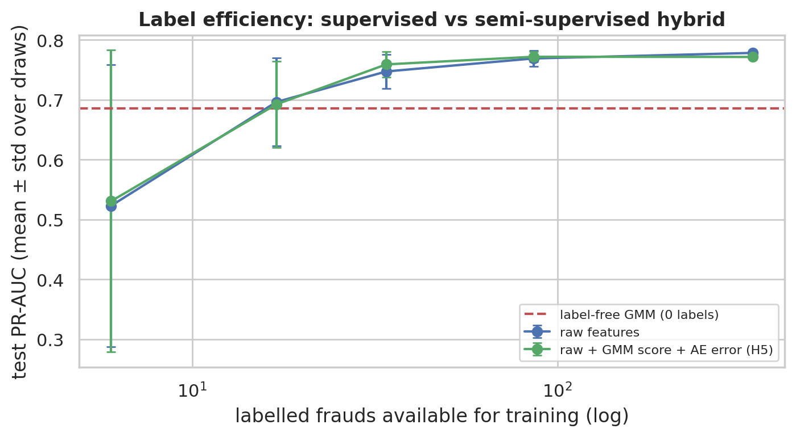
What are a few analyst labels worth?
With all 342 training frauds labelled, supervised models beat the label-free GMM
Adding GMM + AE scores as features (H5) changes little at any label budget
The label-free GMM ≈ a supervised model trained on about 17 labelled frauds

Slide 11
Final comparison on the untouched test set
Model | PR-AUC | Rec@0.1% | Rec@1% | P@50 | P@100
GMM (Phase 1) | 0.686 | 0.757 | 0.784 | 0.90 | 0.56
Stage-1 DAE alone (half the rows) | 0.301 | 0.189 | 0.770 | 0.48 | 0.40
Hybrid H3 augmented GMM [x, log e] | 0.695 | 0.757 | 0.770 | 0.92 | 0.56
Supervised GBM, raw features † | 0.778 | 0.784 | 0.865 | 0.96 | 0.58
Semi-supervised hybrid H5 † | 0.771 | 0.757 | 0.865 | 0.94 | 0.56
H3 augmented GMM [x, log e] − GMM: 0.009 (95% CI -0.009 to 0.023)
Stage-1 DAE alone − GMM: -0.384 (95% CI -0.474 to -0.299)
H5 − supervised GBM: -0.007 (95% CI -0.045 to 0.033)
supervised GBM − GMM: 0.092 (95% CI 0.026 to 0.145)
† uses fraud labels. Thresholds from validation, applied once to test. Paired bootstrap, 1,000 resamples.

Slide 12
Triage recommendation
Policy | Alerts | /hour | Caught | Precision
FP budget 0.1% | 94 | 12.3 | 56/74 | 0.60
FP budget 0.5% | 221 | 28.9 | 58/74 | 0.26
FP budget 1.0% | 399 | 52.1 | 58/74 | 0.14
review capacity top-50 | 50 | 6.5 | 45/74 | 0.90
review capacity top-100 | 100 | 13.1 | 56/74 | 0.56
review capacity top-200 | 200 | 26.1 | 57/74 | 0.28
review capacity top-500 | 500 | 65.3 | 58/74 | 0.12
Deploy
Label-free model: GMM (Phase 1). Start with a strict 0.1% budget or a fixed top-k queue.
Then
As analyst labels accumulate, switch to (or add) a supervised model — labels are worth more than any unsupervised refinement.

Slide 13
A well-engineered Gaussian density is hard to beat without labels
A carefully validated denoising autoencoder matches the GMM; design choices interact
Hybrids that keep the raw inputs match the GMM; latent-space hybrids lose fraud information
Future work: joint DAGMM training, normalising flows, longer time spans with drift

Slide 14
Questions
Code, Colab notebooks, reports and viva notes: see the GitHub repository

