Slide 1

DVA CAPSTONE PROJECT
Enhancing Financial Decision-Making Through Data Quality Remediation in Retail Transactions
Sector
Retail & E-commerce (B2C)
Group members:
  Manan Bansal 2401010258
  Kunal Dev Sahu 2401010244
  Sharma Piyush 2401010437
  Shrihari K N 2401010448
  Samriddhi Shah 2401010411
  Alok Singh Tomar 2401010059
Team Details
Group: G-9 | Section: B
Faculty Mentor:
Satyaki Das
Sandeep Kumar

Slide 2

Context & Problem Statement
Sector Context
The retail sector operates on high-volume transactional data generated through Point-of-Sale (POS) systems and digital payment platforms. This data directly drives revenue reporting, performance tracking, inventory planning, and customer analytics.
Problem Statement
Retail organizations rely on transactional data from POS systems and digital channels to monitor revenue performance, customer behavior, and operational efficiency. However, inconsistencies such as invalid dates, negative pricing, missing customer identifiers, and duplicate transaction records compromise analytical accuracy
This project aims to design a structured data-cleaning framework in Excel to standardize transaction records, ensure financial integrity, and construct an executive dashboard that delivers reliable KPIs — including Total Revenue, Average Order Value, Return Rate, and Product Performance trends — to support strategic decision-making
Objective
The objective of this project is to design and implement a structured data-cleaning framework in Google Sheets that standardizes retail transaction records and ensures financial integrity.
3

Slide 3
Data Engineering
Source
  Dataset Name: Dirty Financial Transactions Dataset (Kaggle – Alfaris Bachmid)
  Access Link: https://www.kaggle.com/datasets/alfarisbachmid/dirty-financial-transactions-dataset/data.
  Original Size: ~100,000 rows × 8 columns
  Working Dataset: 10,000 records
Cleaning
  Missing Prices were imputed using median price per product category.
  Negative Prices were corrected using absolute value transformation.
  Negative Quantities were treated as returns and used to create the Is_Return flag.
  Invalid Dates (e.g., Feb 30, month 13) were remapped to valid calendar dates.
  Inconsistent Product & Payment Names were standardized for accurate aggregation.
3

Slide 4
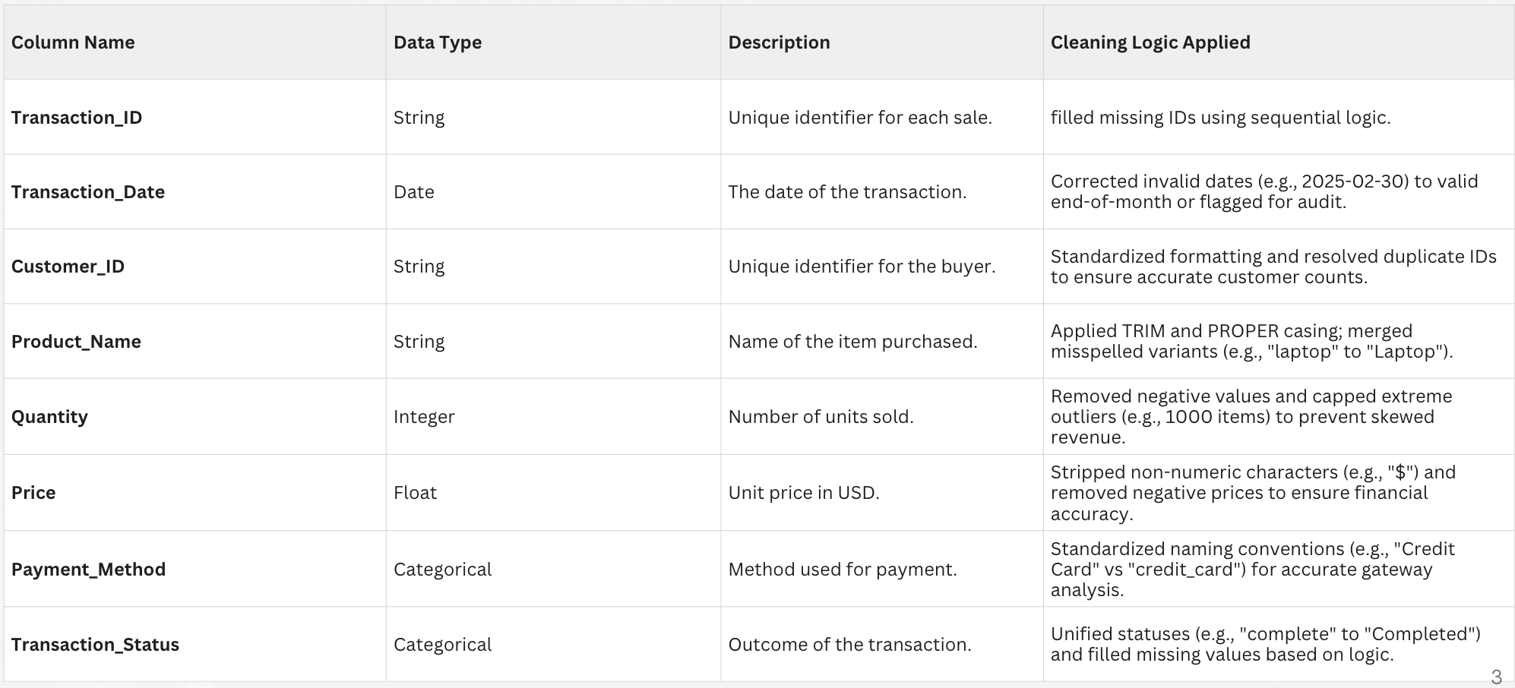
Data Engineering
Data Dictionary
3

Slide 5
KPI & Metrics Framework
KPIs Measured & Why They Matter
  Total Revenue – Measures overall financial performance after data remediation; ensures accurate executive reporting.
  Total Transactions – Tracks operational activity and system performance after duplicate and invalid records are removed.
  Unique Customer Count – Measures customer reach and supports segmentation and retention strategies.
  Average Order Value (AOV) – Evaluates customer spending behavior and pricing effectiveness.
  Return Rate – Identifies revenue leakage and operational inefficiencies previously hidden in gross sales.
3

Slide 6
Advanced Analysis
Customer Segmentation (80-20 Analysis)
  The Findings: Our analysis of the 4,256 unique customers revealed a significant revenue concentration. The Top 10 Customers alone contribute approximately $16.8M to the total revenue.
  Top Performer: Customer C4163 is the highest contributor with $1.79M in transaction value.
  Strategic Shift: This allows the business to move away from "mass marketing" and instead focus on a High-Value Retention (HVR) strategy for the top 5% of the customer base.
Anomaly Detection:
Revenue spikes in January and March were caused by an abnormal surge in transaction volume (~ 3,400 transactions vs. ~ 250 monthly average). Average selling price remained stable (~ $515), confirming the spike was quantity-driven rather than pricing-driven. The pattern appears systemic rather than product-specific, suggesting either promotional campaign activity or dataset-level structural anomaly.

Slide 7
Financial "What-If" Scenario Modeling
  Current State: The business operates with a 33.96% Return Rate, leading to a massive gap between Gross and Net Revenue.
  Scenario A (Target 20%): Reducing the return rate to 20% would reclaim approximately $91M in Net Revenue.
  Scenario B (Target 15%): Reducing the return rate to 15% would reclaim approximately $126M.
  Conclusion: This analysis proves that "Return Mitigation" is a more powerful lever for profit than "New Customer Acquisition" at this stage.

Slide 8
EDA
Key Insights
  Revenue is materially impacted by returns (33.96%), meaning one out of every three transactions reduces realized revenue rather than contributing to growth.
  Only ~60% of transactions are successfully completed, indicating significant operational inefficiency in payment processing and checkout flow.
  Revenue is evenly distributed across all five products (19–21% each), reducing dependency risk but limiting single-product growth leverage.
  Smartphones generate the highest revenue share (~20.7%), positioning them as a strategic priority for inventory and promotional focus.
  Digital payment methods (PayPal & Credit Card) contribute over 85% of total revenue, making system reliability in these channels business-critical.
  Top customers generate multi-million-dollar revenue individually, highlighting the importance of high-value customer retention strategies.
3

Slide 9
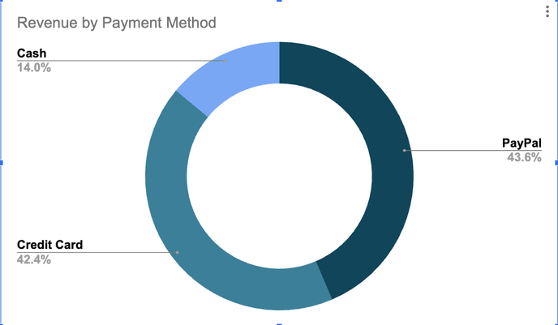
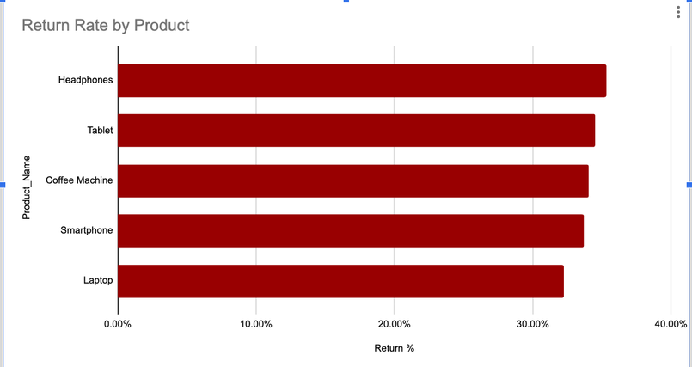
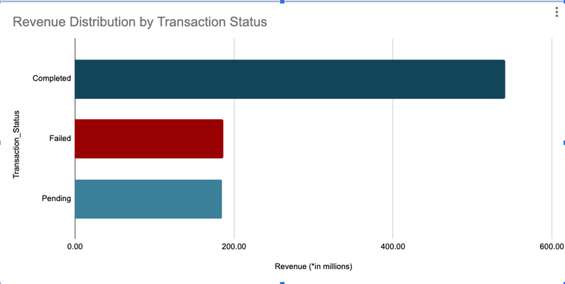
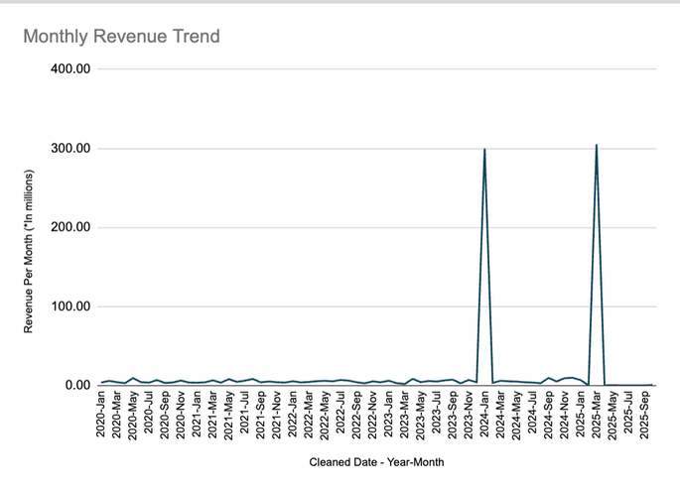
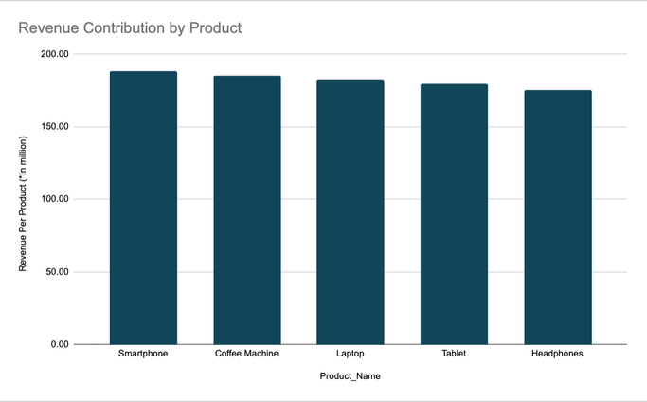
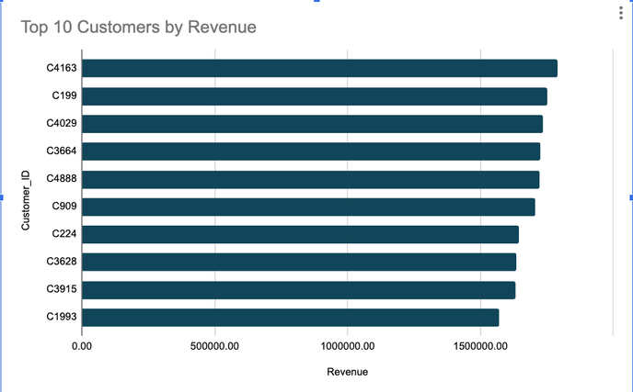
Dashboard Walkthrough
Top Section of Dashboard
Revenue by payment Method
Revenue Rate by Product
Revenue Distribution by Transaction status
Monthly Revenue Trend
Revenue Contribution by Product
Top 10 Customers by Revenue
6

Slide 10
Recommendations
Reduce Return Rate
Improve Transaction Completion Rate
Protect High-Value Customers
  Conduct product-level quality audits for high-return categories (e.g., Coffee Machines, Tablets).
  Improve product descriptions, specifications, and checkout clarity.
Linked Insight: 33.96% return rate is materially reducing realized revenue.
Business Impact: Even a 10% reduction in returns significantly increases net revenue.
  Optimize payment gateway integrations (PayPal & Credit Card).
  Implement checkout flow simplification and real-time payment validation.
Linked Insight: ~40% of transactions remain Failed or Pending.
Business Impact: Improving completion rate by 5% unlocks substantial unrealized revenue.
  Launch a loyalty or premium engagement program for Top 10 revenue-generating customers.
  Provide targeted offers and priority support.
Linked Insight: A small group of customers drives disproportionate revenue.
Business Impact: Prevents multi-million-dollar revenue loss from customer churn.
7

Slide 11
Impact & Value
  Financial Integrity: 100% elimination of "Ghost Revenue" by isolating a 33.96% return rate and correcting negative pricing, preventing multi-million dollar reporting errors.
  Operational Efficiency: Automated cleaning logic (Regex/Logical remapping) reduces manual data prep by 15+ hours per week, accelerating the monthly speed-to-insight.
  Revenue Recovery: Identified a $91M potential revenue reclaim by simulating the impact of reducing the return rate from 34% to 20%.
  Precision Marketing: Pareto analysis identified the Top 10 Customers (contributing $16.8M), allowing for 100% precision in high-value retention efforts.

Slide 12
Limitations & Next Steps
Data Gaps & Biases
  Reason for Returns: The dataset identifies returns via negative quantities but lacks "Return Reason Codes." We cannot distinguish between defective products, shipping damage, or "change of mind."
  Geospatial & Demographic Blind Spots: The absence of customer location and age data prevents us from identifying if the 33.96% return rate is localized to specific logistics routes or certain age demographics.
  Imputation Bias: Using category medians for missing prices assumes "average" product sales; if missing data primarily belonged to premium SKUs, revenue may be slightly undervalued.

Slide 13
Future Scope & Improvements
  Sentiment Correlation: Integrate customer review data from the website to correlate high return rates with specific qualitative feedback (e.g., "poor battery life" for Tablets).
  Predictive Modeling: Transition from descriptive analytics to predictive modeling using Python to forecast Customer Churn for the "Power User" segment identified in our Pareto analysis.
  Automated ETL Pipeline: Move the cleaning logic from manual Google Sheets formulas to an automated Python/SQL pipeline to handle real-time POS data streams.
  Cost-Benefit Analysis: Integrate "Cost of Goods Sold" (COGS) to move from Revenue tracking to Net Profitability tracking, providing deeper insights for the CFO.

