Slide 1
DigiSecure Pitch Deck
Shielding You from Scams, Fraud, and More!

Slide 2
Problem
Market
01
04
Solution
Revenue Model
02
05
Tech in Use
1 Year Roadmap
03
06
Problem Statement
Market Analysis &
Target Market
The proposed solution
Model of Business
Technology used in solution
How we plan to proceed

Slide 3
01
Problem
Problem Statement

Slide 4
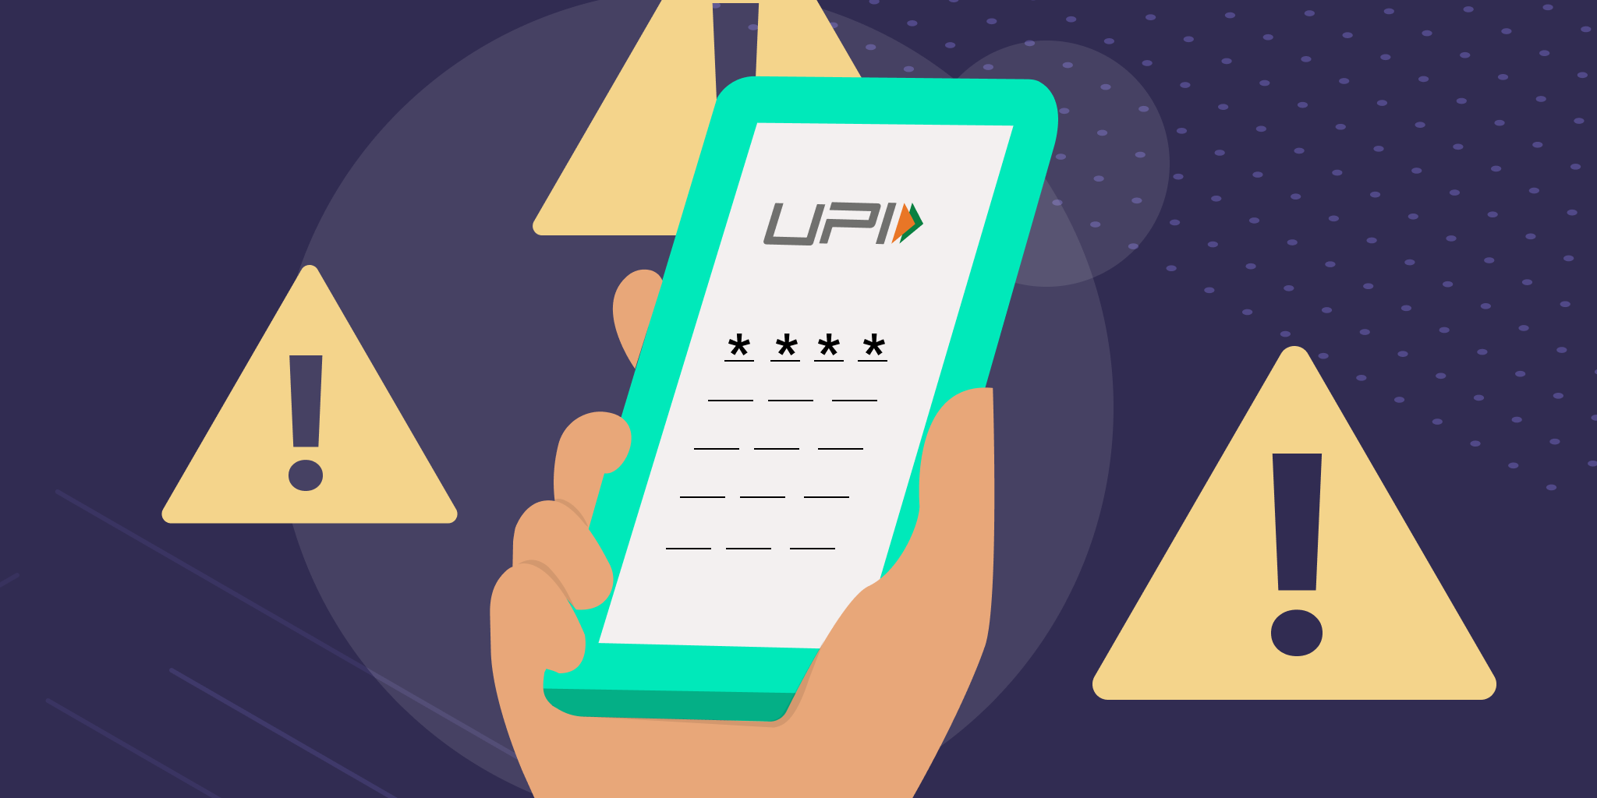




PROBLEM STATEMENT
Individuals face heightened risk of financial frauds through digital payment systems
Scammers use messages and calls to exploit these vulnerable groups
Urgent solution needed to protect vulnerable user and safeguard their finances

Slide 5
02
Solution
An App to protect from Digital frauds

Slide 6



SOLUTION
AI Call Manager
Sandbox Browser
Report & Insurance
Securing from ​fraudulent Call or Message in real time
Protecting against deceptive ecommerce websites or harmful URL
Assistance with post fraud procedure, filing complaint & insurance

Slide 7
03
Tech in Use
Technology used in solution

Slide 8
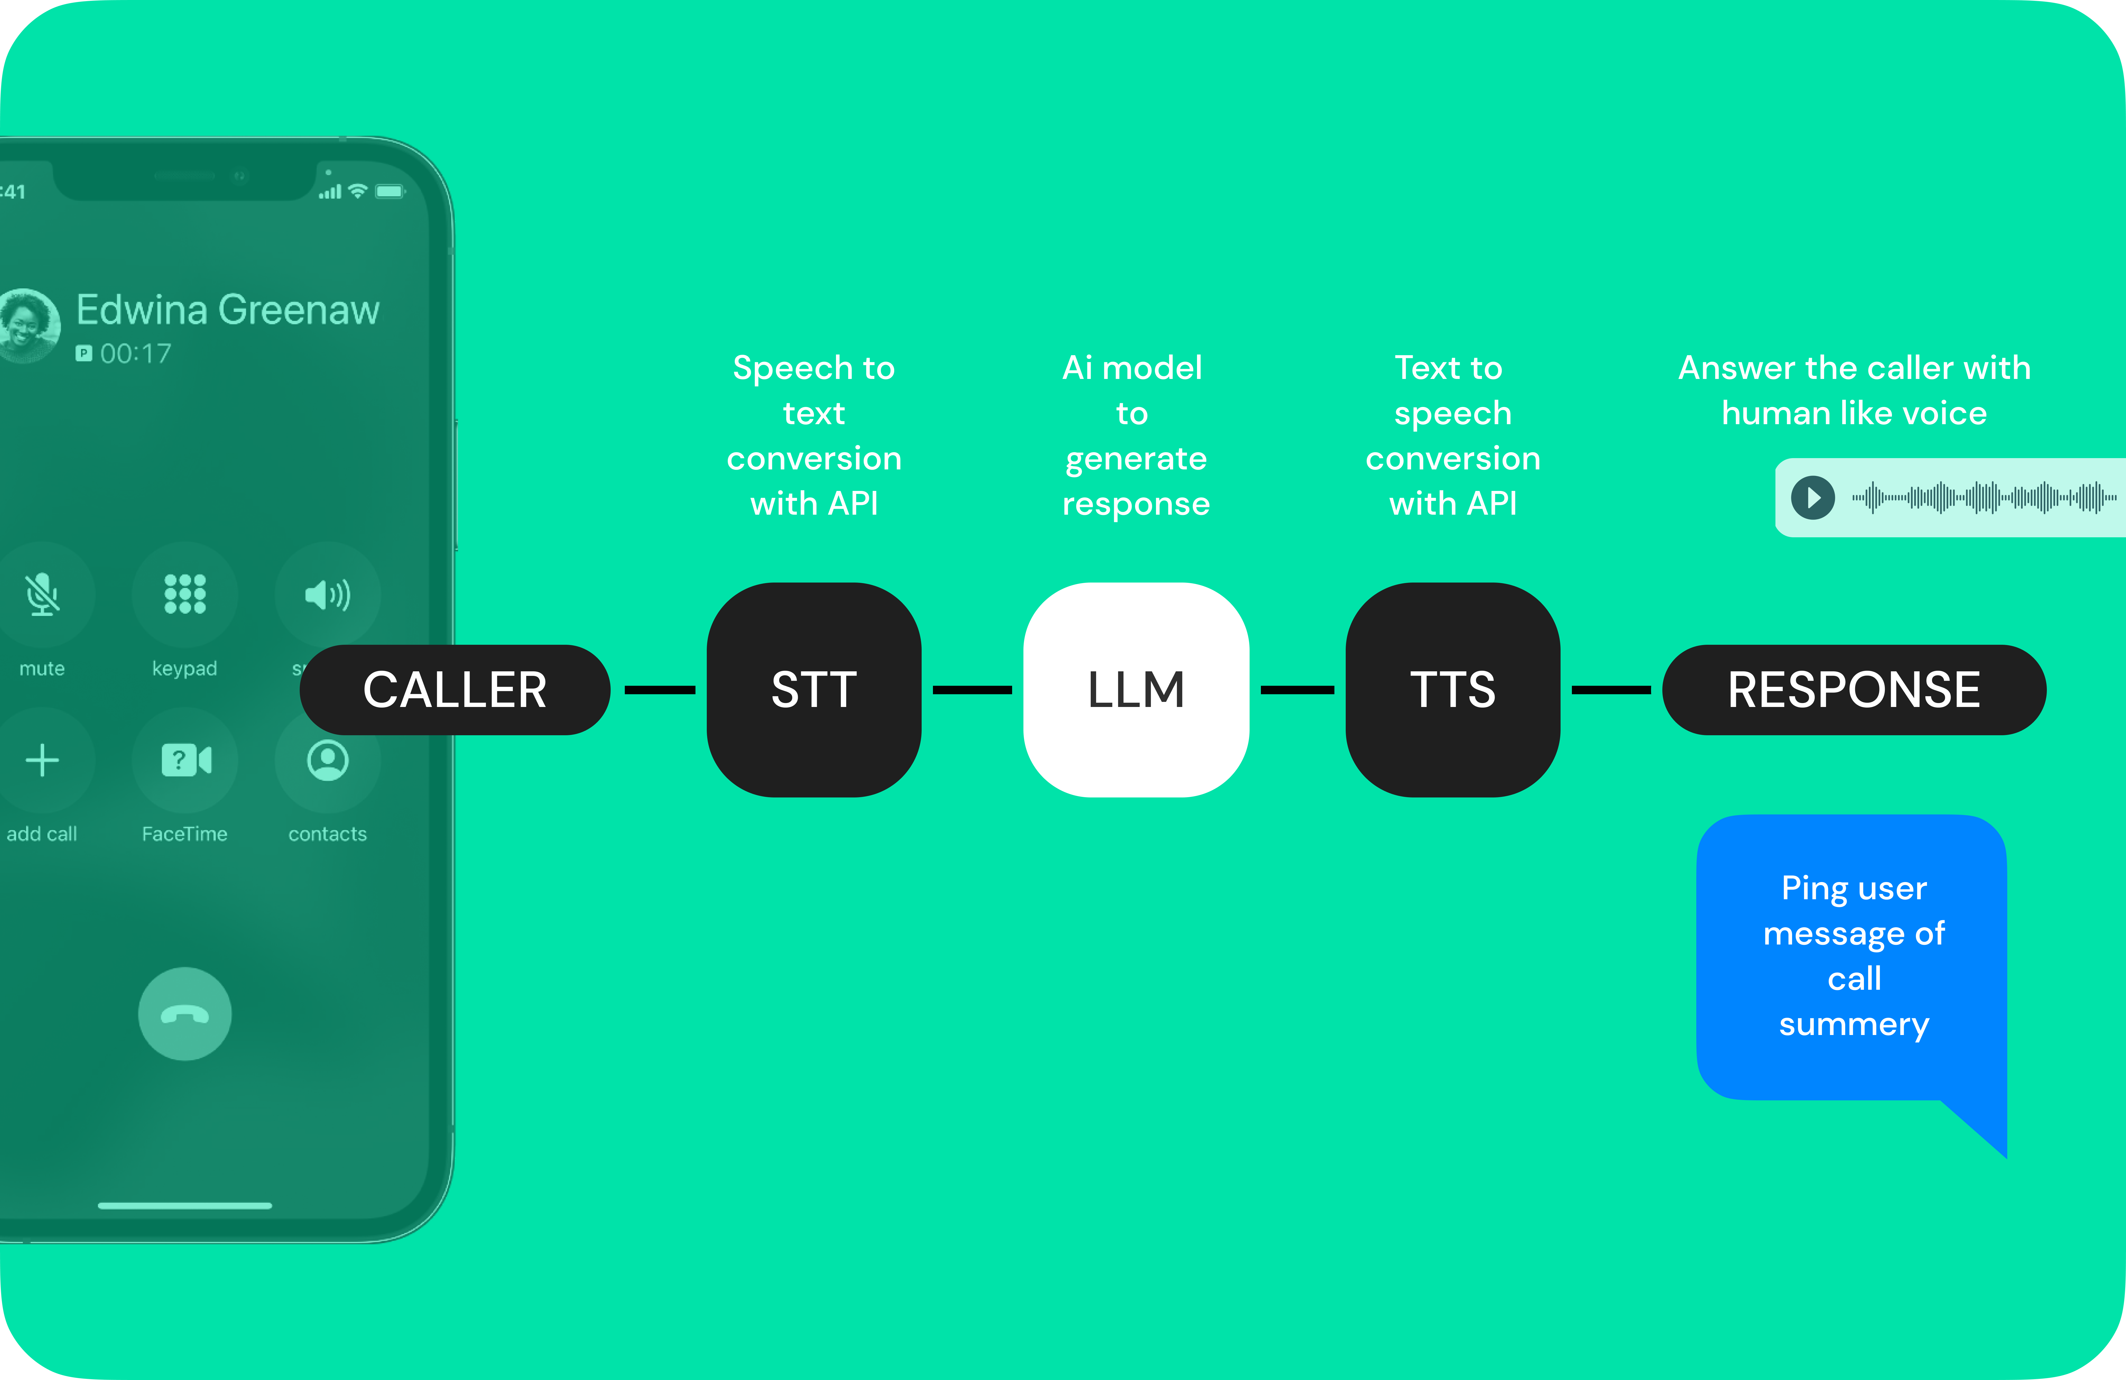
HOW AI MODEL WORKS?
Privacy
Processes calls you've approved (+unknown)
Alerts
Rates the call and Flag alerts with fraud call
Also
Provide security from scam messages

Slide 9



TECHNOLOY USED IN SOLUTION
STT/TTS
LLM
SANDBOX
Open source AI models like DeepSpeech & Merlin can be trained to answer calls across multiple languages
Utilizing open-source technologies such as Mistral AI to construct an LLM that identifies fraud calls & messages
Sandbox in browser isolates website you visit, preventing any your data compromise or running harmful code

Slide 10
04
MARKET
Market Analysis &
Target Market

Slide 11
DIGITAL PAYMENT FRAUD IN MAY MONTH 2022
15%
Other
Card & Banking
55%
30%
UPI
DATA CLICK HERE
Voice phishing, e-wallet, etc.
Card related and Internet banking related frauds
34k UPI related cases with 50% less than 10k ₹

Slide 12
FINANCIAL FRAUDS IN INDIA 2023
Unsolved
Amount Involved
1.13 Million
Recovered Money
DATA CLICK HERE
Between 5,300 to 6,200Cr ₹
Financial fraud cases registered
7,400Cr ₹ form 1.13M cases
1,200Cr ₹ saved from 470K complaints

Slide 13
90.7 BILLION $
Global Financial Fraud Detection Software Market Size by 2030
DATA CLICK HERE

Slide 14
GLOBAL MARKET IN 2030
Asia Pacific Making 25%
US, Europe and Middle East Making 65%

Slide 15

TARGET MARKET
B2B
B2C
Users
Business Listing & AI Caller
18+ Y/O
80- Y/O
Individuals, Business Professionals, Elderly
Startups, Financial institutions, Telecom Companies, SMEs, Corporates, BPOs

Slide 16
05
Revenue Model
Model of Business

Slide 17




REVENUE MODEL
Business Listing
Subscription
Insurance
B2B
Verified Business caller ID or IDs
AI model for customer call support
Offering Subscription model for users
Provides Digital Fraud insurance to users

Slide 18
06
1 Year Roadmap
How we plan to proceed

Slide 19
OUR PROCESS
Quarter 2
Quarter 4
Quarter 1
Quarter 3
Foundation & Validation
Expansion & Validation
Research & Product Dev
Growth & Traction

Slide 20
1 YEAR ROADMAP
 | 1st Quarter | 2nd Quarter | 3rd Quarter | 4th Quarter
Product | Create Minimum Viable Product (MVP) | Refine MVP, Testing & Iteration | New Features, Product-Market Fit | Product Roadmap, Long-Term Vision
Sales | Customer Research, Target Audience | Sales Strategy, Metrics & Tracking | Customer Acquisition, Metrics & Analysis | Recurring Revenue
Marketing | Business Model & Revenue Strategy | Launch Strategy, Marketing Channels | Optimize Strategies | Brand Building, Market Share
Operation | Team Building, Funding | Exploring Partnerships | Team Expansion | Financial Sustainability

Slide 21
THANKS!
We're happy to provide further explanations or address any additional query.
piyush.shende@iitg.ac.in
r.somesh@iitg.ac.in

