Slide 1
RESEARCH-ORIENTED SKILL PROJECT (ROSP)
FloodVision-AI
An Explainable Deep Learning & Multimodal Earth Observation Framework for Automated Flood Damage Assessment and Intelligent Rescue Dispatch
📡 Multimodal Fusion
Couples Sentinel-1 SAR Radar with WorldView-3/Sentinel-2 Optical satellites to eliminate cloud & nighttime blindness.
⚡ Building-Level Risk (Ri)
Computes Ri = 0.50·Ei + 0.50·Si across 303 validated structures with explainable damage & flood exposure metrics.
🚤 Operational Rescue Dispatch
Synthesizes tactical directives and executes priority-based responder allocation under strict capability constraints.
Project Team: Group-01 | Domain: Deep Learning, Remote Sensing & Emergency Operations | Benchmark: xBD-S12 & Sen1Floods11

Slide 2
OPERATIONAL BOTTLENECKS & GAPS
Problem Statement: The Breakdown in Disaster Emergency Operations
Why existing remote sensing tools fail to protect lives during catastrophic flooding events
01. Cloud & Nighttime Blindness (Optical Failure)
Standard RGB optical satellites cannot penetrate storm clouds, monsoonal cover, or darkness during active hurricanes and floods. Responders remain blind for days until skies clear.
02. Scattered & Disconnected Tooling
Emergency Operation Centers (EOCs) must manually cross-reference isolated flood maps, disconnected GIS viewers, and radio logs, wasting critical golden hours during life-saving triage.
03. The 'Heatmap-to-Action' Gap
Current ML research outputs abstract pixel heatmaps or bounding boxes. They fail to generate operational mission parameters, building-level GPS pins, or tactical resource requirements.
04. Black-Box AI Skepticism & Fleet Constraints
Responders distrust opaque confidence scores lacking visual justification. Furthermore, academic models assume unlimited rescue teams, ignoring real-world fleet capacity and capability limits.

Slide 3
STATE OF THE ART COMPARISON
Tabular Literature Review: State-of-the-Art vs. FloodVision-AI
Systematic comparison of disaster response paradigms across remote sensing and operational capabilities
Disaster System Paradigm | All-Weather SAR Radar | Flood Pixel Segmentation | Building Damage Multi-Class | Multimodal Risk Fusion | Explainable AI (XAI) | Rescue Task Generation | Team Allocation Optimization
Traditional Optical Systems (E.g. DigitalGlobe / Sentinel-2 RGB) | ✗ (Cloud Blind) | Limited | ✗ (Manual) | ✗ | ✗ | ✗ | ✗
SAR Hydrological Detectors (E.g. Sen1Floods11 U-Net Baselines) | ✓ (C-band SAR) | ✓ (Water Only) | ✗ (No Buildings) | ✗ | ✗ | ✗ | ✗
Building Damage Ensembles (E.g. xView2 Challenge Models) | ✗ (Optical Only) | ✗ (No Water) | ✓ (4 Classes) | ✗ | Partial | ✗ | ✗
Generic Vision-Language Models (E.g. Multimodal Disaster VLMs) | ✗ (Optical Focus) | ✗ (Bounding Box) | Qualitative | ✗ | Subjective | ✗ | ✗
FloodVision-AI / ROSP (Our Proposed Solution) | ✓ (Sentinel-1 SAR) | ✓ (Flood U-Net) | ✓ (xBD Ensembles) | ✓ (Ri = 0.5Ei+0.5Si) | ✓ (Grad-CAM + Ri) | ✓ (303 Directives) | ✓ (18 Units Optimal)

Slide 4
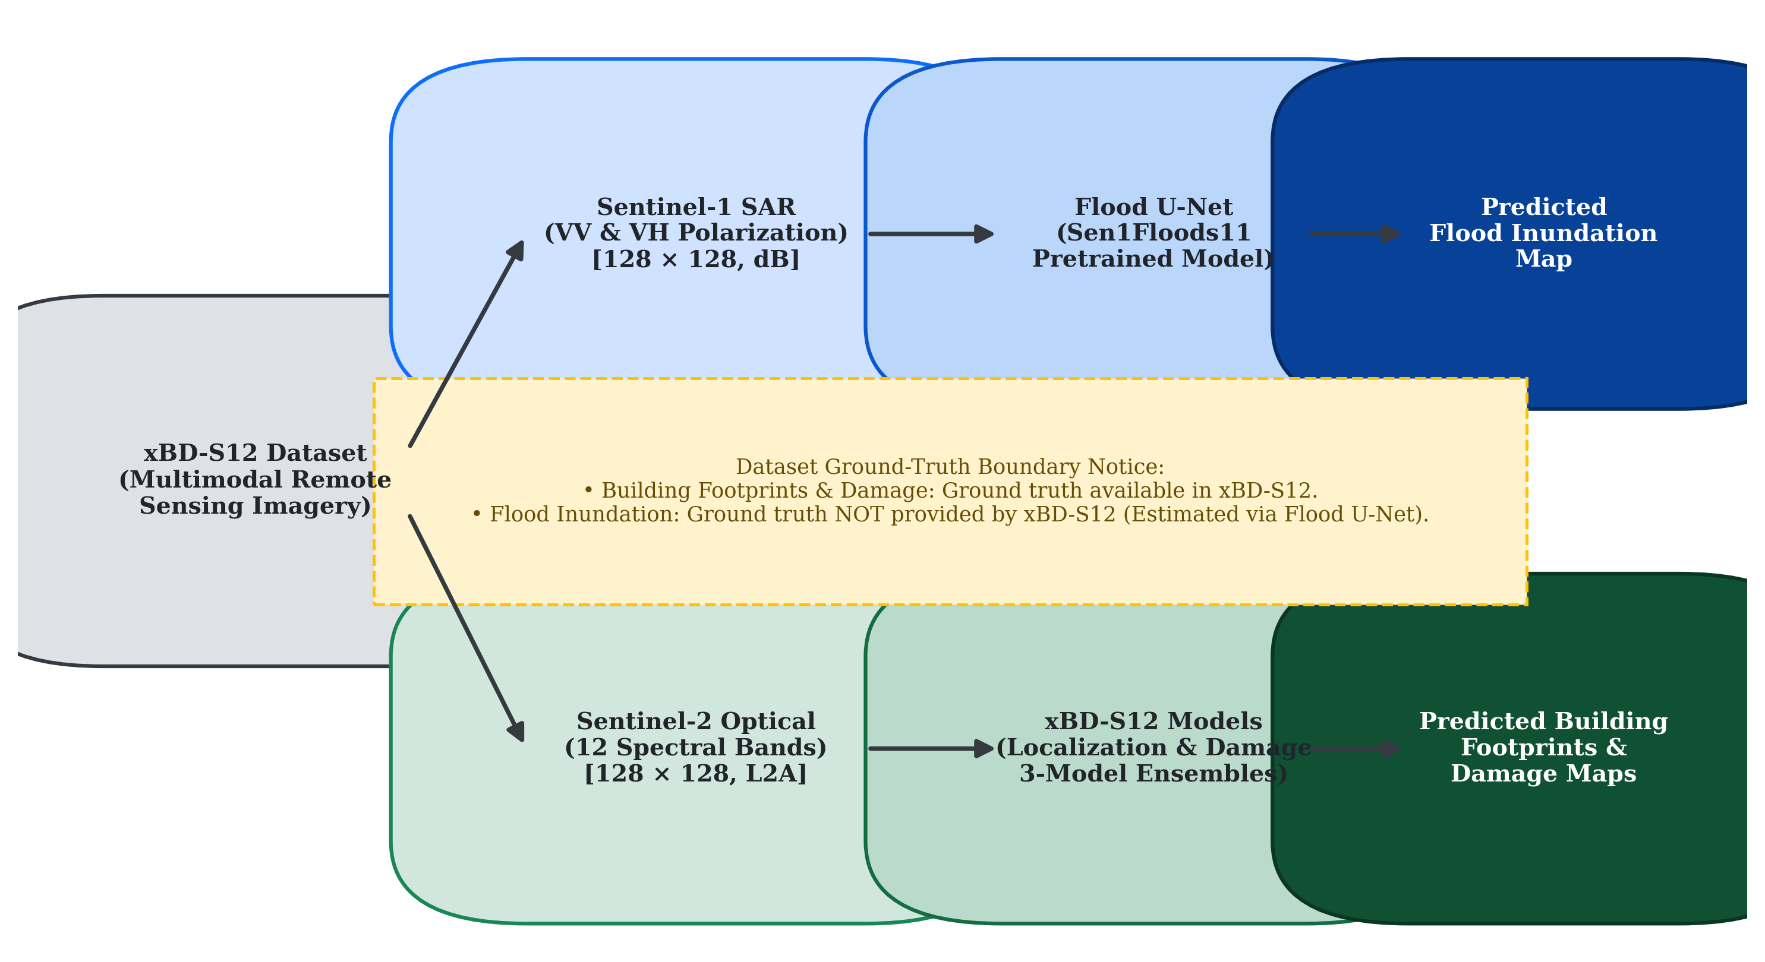
END-TO-END SYSTEM ARCHITECTURE
Proposed Solution: Multimodal Perception & Operational Flow Diagram
From raw Earth Observation satellite streams to tactical responder dispatch
1. Dual-Stream Satellite Ingestion
Ingests Sentinel-1 C-Band SAR (VV/VH radar backscatter) alongside WorldView-3 high-resolution optical imagery for pre/post disaster scenes.
1
2. Deep Learning Perception Tier
Flood U-Net segments standing inundation (82.4% mIoU). Optical models extract building footprints and classify structural degradation into 4 damage tiers.
2
3. Temporal Change & Risk Engine
Calculates newly flooded extent (M_post \ M_pre) and computes fused building risk: Ri = 0.50·Ei + 0.50·Si across all localized structures.
3
4. Rescue Task & Resource Allocation
Maps building coordinates to WGS84 GPS, generates 303 operational missions, and dispatches 18 multi-disciplinary responder squads via capability matching.
4
5. Interactive GIS Response Console
React/Leaflet interface renders Esri satellite basemaps, dynamic SAR flood polygons, building damage cards, and mutual-aid deficit queues.
5

Slide 5
FULL-STACK ENGINEERING & ALGORITHMS
Open-Source Components & Technical Implementation Approach
Leveraging premier open-source geospatial tools, deep learning frameworks, and robust algorithms
🛠️ Open-Source Components & Tooling
• AI & Deep Learning: PyTorch, Torchvision, NumPy, OpenCV, Albumentations
Executes Flood U-Net C-band radar segmentation & xBD structural damage models.
• AI Microservice Serving: Python 3.10+, FastAPI, Uvicorn, Pydantic
Dedicated high-performance inference engine serving REST endpoints & Swagger UI.
• Backend & Geo-Processing: Node.js, Express.js, TypeScript, GeoJSON
Deterministic task generation, WGS84 coordinate projections, and team dispatch.
• GIS Visualization & UI: React.js, Leaflet, React-Leaflet, TailwindCSS, Recharts
Dynamic map interface with Esri satellite basemaps and interactive layer toggles.
• Open Satellite Benchmarks: ESA Copernicus Sentinel-1 SAR & xBD Dataset
Multi-peril disaster dataset covering hurricanes, floods, tsunamis, and earthquakes.
⚙️ Core Technical Approaches & Formulations
▸ Zero-Shot SAR Domain Adaptation
Pretrained Flood U-Net adapted to native 128×128 Sentinel-1 SAR tensors via standardization adapter without retraining frozen weights:
VV_norm = (VV - (-10.38))/4.00, VH_norm = (VH - (-17.22))/4.71
▸ Set-Theoretic Temporal Inundation Dynamics
Differentiates disaster flooding from baseline water bodies:
Newly Flooded Extent: M_new = M_post ∧ (¬M_pre)
Persistent Baseline Water: M_persist = M_pre ∧ M_post
▸ Dual-Modality Risk Equation (Ri)
Fuses radar flood exposure and optical structural destruction:
Ri = 0.50·Ei + 0.50·Si ∈ [0, 1] (Divided into Critical, High, Moderate, Low)
▸ Explainable Priority-Based Allocation Algorithm
Greedy multi-factor scoring matching finite squads to tasks under 1:1 capacity:
S_alloc = 0.40·S_priority + 0.35·S_capability + 0.25·S_proximity

Slide 6
OPERATIONAL VALUE & REAL-WORLD IMPACT
Impact and Benefits: Transforming Disaster Response Operations
Empowering emergency commanders with rapid, auditable, and resilient decision support
⚡ Sub-Second Triage (<200 ms)
Automates reconnaissance and evaluates 300+ building structures in under 200 ms, replacing 24–72 hours of manual helicopter and foot surveys during critical golden hours.
🛡️ 100% All-Weather Reliability
Sentinel-1 SAR C-band radar penetrates cloud cover, monsoonal storms, and night conditions, guaranteeing operational visibility when optical satellites fail.
🎯 Elimination of 'Heatmap-to-Action' Gap
Converts raw pixel segmentations into 303 building-level tactical rescue missions specifying personnel sizes (2–8 responders) and gear (boats, USAR, drones).
🔍 Transparent, Auditable Decision Support
Every rescue recommendation is accompanied by an explainable formula breakdown (Ri, Ei, Si), preventing algorithmic distrust among incident commanders.
⚖️ Realistic Fleet & Deficit Management
Constrained 18-squad allocation reflects genuine emergency shortages; unassigned tasks populate an explainable Deficit Backlog for incoming mutual-aid forces.
🗺️ Unified Multi-Agency Geospatial Console
Single web GIS platform synchronizes incident commanders, field rescue squads, and state analysts with sub-meter satellite overlays and live mission vectors.

Slide 7
ACADEMIC & TECHNICAL BIBLIOGRAPHY
References: Academic Benchmarks & Foundational Literature
Key peer-reviewed literature, Earth Observation datasets, and deep learning architectures utilized in FloodVision-AI
[1] Bonafilia, D., Tellman, B., Anderson, T., & Issenberg, E. (2020). "Sen1Floods11: A Georeferenced Dataset to Train and Test Deep Learning Flood Algorithms for Sentinel-1." IEEE/CVF Conference on Computer Vision and Pattern Recognition (CVPR) Workshops, pp. 210-211.
[2] Gupta, R., Hosfelt, R., Dooley, S., et al. (2019). "xBD: A Dataset for Assessing Building Damage from Satellite Imagery." arXiv preprint arXiv:1911.09296 / IEEE/CVF CVPR Workshops (xView2 Challenge Benchmark).
[3] Ronneberger, O., Fischer, P., & Brox, T. (2015). "U-Net: Convolutional Networks for Biomedical Image Segmentation." Medical Image Computing and Computer-Assisted Intervention (MICCAI), Springer, LNCS, vol. 9351, pp. 234-241.
[4] European Space Agency (ESA). (2021). "Copernicus Sentinel-1 SAR Technical Handbook & Dual-Polarization C-Band GRD Products." European Space Agency Technical Documentation, Special Publication SP-1322/1.
[5] Selvaraju, R. R., Cogswell, M., Das, A., Vedaldi, A., Parikh, D., & Batra, D. (2017). "Grad-CAM: Visual Explanations from Deep Networks via Gradient-Based Localization." IEEE International Conference on Computer Vision (ICCV), pp. 618-626.
[6] Xie, E., Wang, W., Yu, Z., Anandkumar, A., Alvarez, J. M., & Luo, P. (2021). "SegFormer: Simple and Efficient Design for Semantic Segmentation with Transformers." Advances in Neural Information Processing Systems (NeurIPS), vol. 34, pp. 12077-12090.
[7] United Nations Office for Disaster Risk Reduction (UNDRR) & CRED. (2020). "The Human Cost of Disasters: An Overview of the Last 20 Years (2000–2019)." UN Office for Disaster Risk Reduction Research Report, Geneva, Switzerland.

