Slide 1
TIME MANAGEMENT
WRITE BY PIYUSH KUMAR

Slide 2
HOW CAN WE MANAGE OUR TIME
Eliminate distractions: Block out distractions and remove non-essential tasks.
Eliminate distractions: Block out distractions and remove non-essential tasks.
Set goals: Set clear, achievable, and measurable goals. You can use the SMART method, which stands for Specific, Measurable, Achievable, Relevant, and Time-bound.
Prioritize: Prioritize tasks based on importance and urgency.
Create a schedule: Create a daily planner or to-do list to organize your tasks
Set time limits: Set a time limit for each task.
Take breaks: Take a break between tasks.

Slide 3
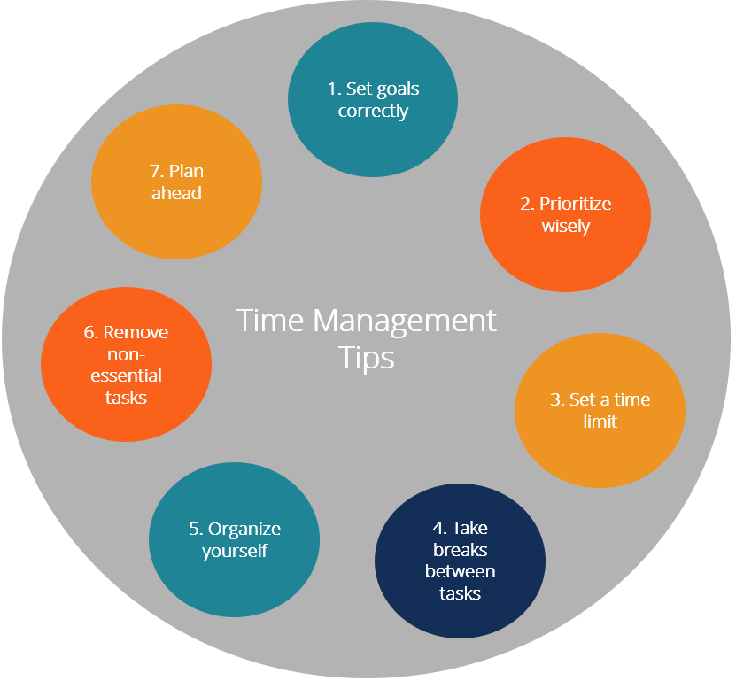
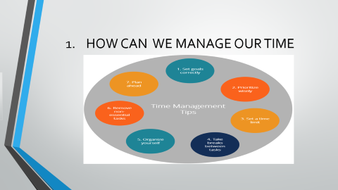
HOW CAN WE MANAGE OUR TIME

Slide 4
TIME IMPORTENTS

