Slide 1
Pos Tagging Using HMM-Viterbi
Bigram & Trigram Assumption

Slide 2
Assignment-Discussion HMM-Viterbi
Piyush Singh Pasi, 213050069
Paramveer Choudhary, 213050061
Ajay, 213059004
21/08/2021

Slide 3
Problem Statement
Given a sequence of words, produce the POS tag sequence : Brown Corpus
Technique used: HMM-Viterbi
Used Universal Tag Set (12 in number)
5-fold cross validation
‘.’, 'ADJ', 'ADP', 'ADV', 'CONJ', 'DET', 'NOUN', 'NUM', 'PRON', 'PRT', 'VERB', 'X'

Slide 4
Overall performance
Precision : 0.9307
Recall : 0.8853
F-score (3 values)
F1-score : 0.9074
F0.5-score : 0.9212
F2-score : 0.8940

Slide 5
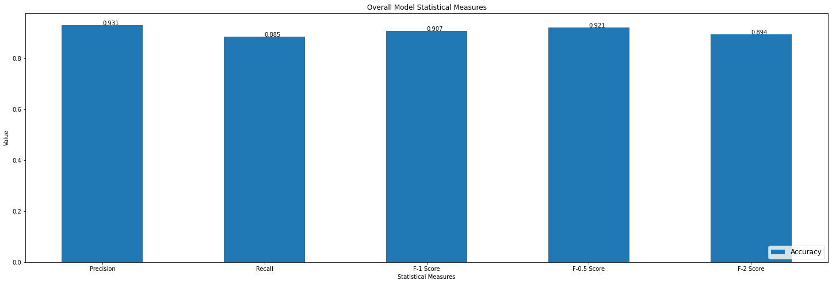

Slide 6
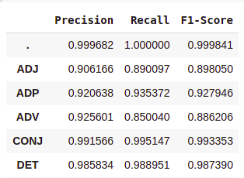
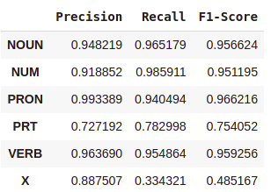
Per POS performance

Slide 7
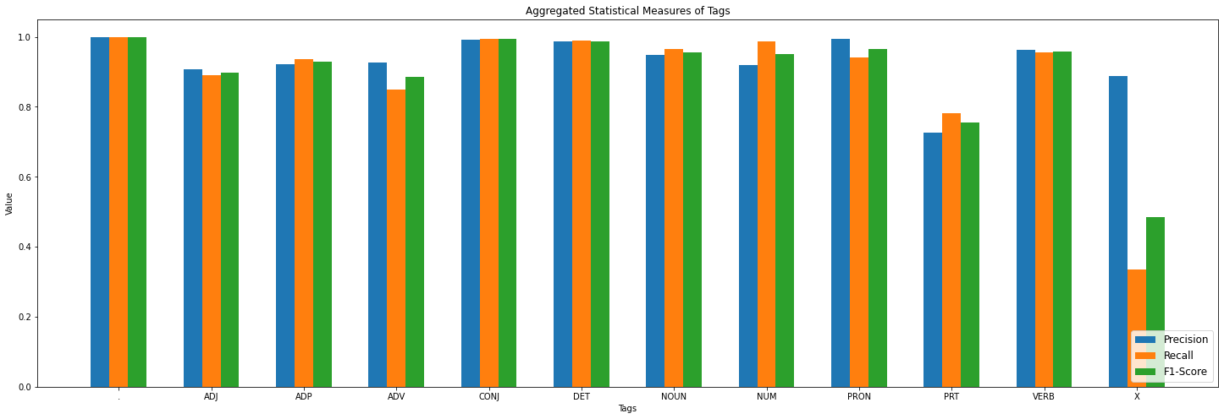

Slide 8
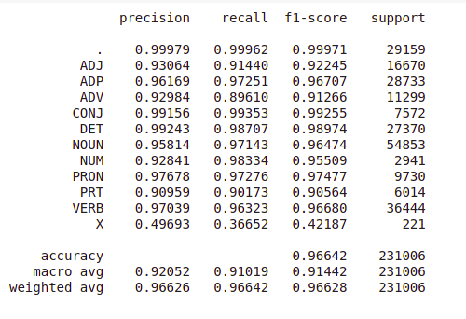
Statistical Validations for Trigram Assumption

Slide 9
Confusion Matrices

Slide 10
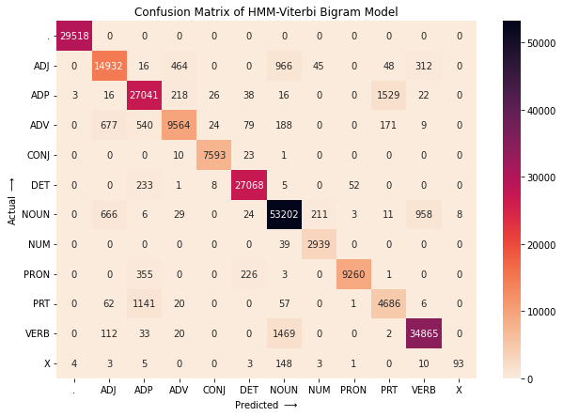

Slide 11
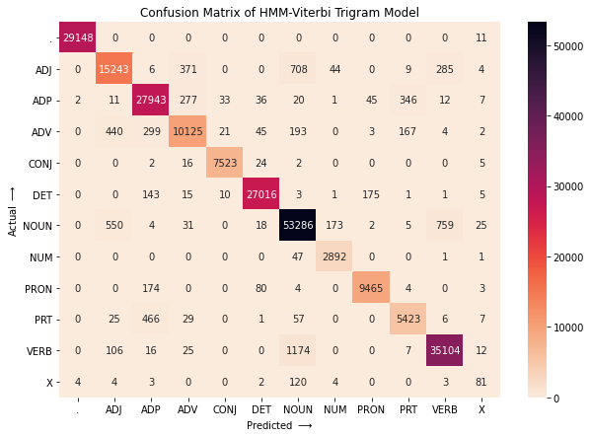

Slide 12
Interpretation of confusion (error analysis)
ADP (Adposition) confused with PRT (particle)
NOUN and VERB
ADJ as NOUN
Confusion might occur :
Due to ambiguous nature of language like the following
Test_input: [('Let', 'VERB'), ('the', 'DET'), ('media', 'NOUN'), ('clean', 'VERB'), ('house', 'NOUN')]
Output_tag : ['VERB', 'DET', 'NOUN', 'ADJ', 'NOUN']

Slide 13
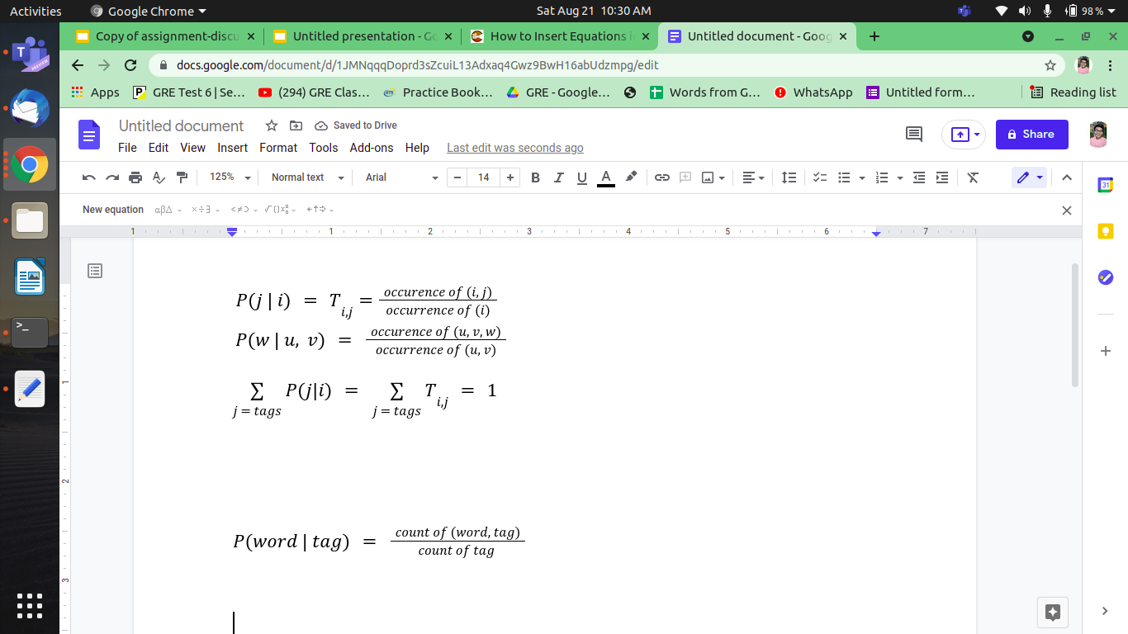
Data Processing Info (Pre-processing)
Transition Probability :

Slide 14
Data Processing Info (Pre-processing)
Emission Probability :
Pre-processing :
Lowercasing is done when exact match is absent
For unseen words rule based tagger is used
Deleted Interpolation is used for unseen tag sequence in trigram

Slide 15
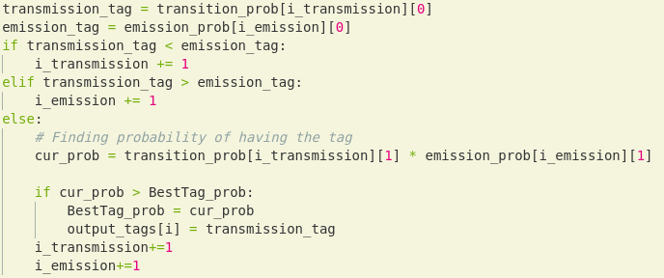
Inferencing/Decoding Info
Probability of taking a path is the product of emission and transmission probabilities
The maximum among all the paths are computed to find the path with the highest probability

Slide 16
Thoughts on generative vs. discriminative POS tagging
Generative models learn joint probability and predicts conditional probability using Bayes Theorem
Discriminative models learns the conditional probability by explicitly modelling decision boundary between classes.
Discriminative models perform better for sequence labelling tasks.

