Slide 1
CS626: Project Discussion
Hate speech detection
Ajay Ravindran, 213059004
Piyush Singh Pasi, 213050069
Paramveer Choudhary, 213050061
27/11/21

Slide 2
Motivation
Hate speech and toxic comments on online platforms has been a serious concern ever since social media came into existence.
The first step to removing such comments is by detecting them.
The motivation is to identify people who discriminate other people on the basis of race, ethnicity, gender, sexuality on social media platforms.
By classifying comments warnings can be issued to such people and even blocking of their account can be initiated.
Our project tries out various techniques to identify hate speech and toxic comments.

Slide 3
Problem Statement
Detecting sentences with toxic content.
Toxic Comment Prediction -
Input : Text Comment
Output : Toxic or Non-Toxic
Challenges:
Imbalanced classes
Biases in annotated data
Text to feature conversion
Computational Limitation

Slide 4
Supporting Papers (Literature survey)
Exploring Data Augmentation for Toxic Comment Classification, Chetanya et al. (Journal ArXiv July 2020)
Toxic Comment Classification on Social Media Using SVM and Chi Square Feature Selection, Nadhia et al.(International Journal on Information and Communication Technology, July 2021)

Slide 5
Data
Jigsaw dataset used for Kaggle Toxic Comment Classification Challenge was used
It contains 1,59,571 labelled sentences
The dataset can be downloaded from https://www.kaggle.com/c/jigsaw-toxic-comment-classification-challenge/data

Slide 6
Main Technique
Support Vector Machine is the primary approach used.
Online SVM with Neural Network
SVM with different embeddings at word and sentence level.

Slide 7
Features Used
Number of capital characters and all capital words. Angry commenter often capitalise for emphasis on slurs.
Number of exclamation marks, question marks, and other punctuations. Often abusive words have some characters replaced by symbols. Also multiple exclamation marks are often used to emphasis strongly worded statements.
Length of text, number of words, number of unique words, number of stop words, number of words inside quotes and several more.
The features were used to augment the custom embeddings and normalised within a range of 0-1.
The features failed to improve prediction accuracy and in-fact reduced the accuracy of just custom embeddings of 768 dimensions. This could be due to features being utilised from sentiment analysis domain.

Slide 8
Results
Model | Accuracy | Precision | Recall | F1-Score
SVM_rbf_custom_embedding_tf_idf_without_features | 0.93 | 0.81 | 0.76 | 0.78
SVM_rbf_custom_embedding_tf_idf_with_features | 0.92 | 0.80 | 0.63 | 0.68
SVM_rbf_custom_embedding_tf_idf_with_features_normalised | 0.93 | 0.80 | 0.73 | 0.76
linear_svm_avg_custom_word2vec_embedding | 0.93 | 0.79 | 0.77 | 0.78
linear_svm_avg_tfidf_custom_word2vec_embedding | 0.91 | 0.93 | 0.55 | 0.56
svm_rbf_avg_custom_word2vec_embedding | 0.93 | 0.81 | 0.82 | 0.82
sgd_classifier_avg_custom_word2vec_embedding | 0.92 | 0.76 | 0.84 | 0.80
sgd_classifier_avg_tfidf_custom_word2vec_embedding | 0.92 | 0.77 | 0.84 | 0.80
svm_rbf_doc2vec_custom_embedding | 0.91 | 0.76 | 0.71 | 0.73
sgd_doc2vec_custom_embedding | 0.92 | 0.76 | 0.84 | 0.80

Slide 9
Results
Model | Accuracy | Precision | Recall | F1-Score
linear_svm_countVectorizer_tfidf | 0.92 | 0.78 | 0.87 | 0.82
linear_svm_countVectorizer_tfidf_nystroem_approximation | 0.93 | 0.82 | 0.78 | 0.8
linear_svm_countVectorizer_tfidf_fourier_approximation | 0.92 | 0.84 | 0.66 | 0.71
svm_rbf_countVectorizer_tfidf | 0.92 | 0.78 | 0.85 | 0.81
sgd_svm_countVectorizer_tfidf | 0.92 | 0.77 | 0.87 | 0.81
sgd_svm_countVectorizer_tfidf_nystroem_approximation | 0.93 | 0.83 | 0.76 | 0.79
sgd_svm_countVectorizer_tfidf_fourier_approximation | 0.92 | 0.86 | 0.65 | 0.70
model1_flatten_svm | 0.88 | 0.54 | 0.52 | 0.52
model1_oversampled_flatten_svm | 0.90 | 0.69 | 0.54 | 0.55
model1_oversampled_flatten_svm_with_kernel_nystroem | 0.90 | 0.45 | 0.50 | 0.47

Slide 10
Results
Model | Accuracy | Precision | Recall | F1-Score
model3_flatten_svm | 0.89 | 0.71 | 0.78 | 0.74
model3_conv1d_svm | 0.90 | 0.71 | 0.76 | 0.73
model3_flatten_svm_with_kernel_nystroem | 0.90 | 0.45 | 0.50 | 0.47
sgd_classifier_with_NN_preprocessing | 0.89 | 0.55 | 0.51 | 0.5
sgd_classifier_oversample_with_NN_preprocessing | 0.70 | 0.53 | 0.56 | 0.51
SVM_rbf_sentence_embedding | 0.93 | 0.80 | 0.82 | 0.81
SVM_sigmoid_sentence_embedding | 0.86 | 0.64 | 0.68 | 0.65
SVM_polynomial_sentence_embedding | 0.92 | 0.77 | 0.80 | 0.79
SVM_fourier_approximation_sentence_embedding | 0.90 | 0.45 | 0.50 | 0.47
SVM_nystroem_approximation_sentence_embedding | 0.90 | 0.45 | 0.50 | 0.47

Slide 11
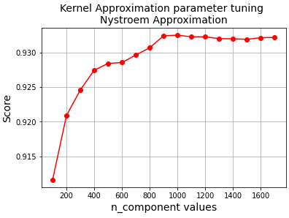
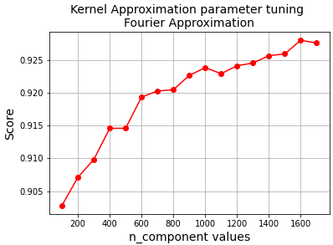
Results

Slide 12
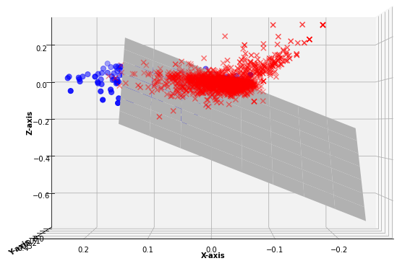
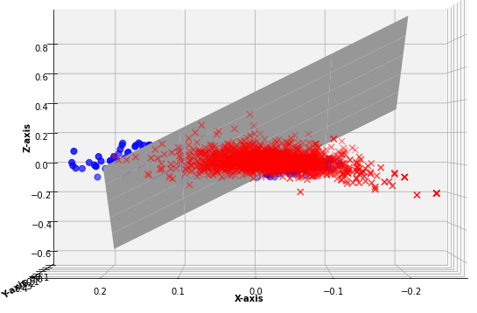
Kernel Approximation Visualization
Nystroem Kernel Approximation
Fourier Kernel Approximation
Blue dots -> Non Toxic Points Red Cross -> Toxic Points

Slide 13
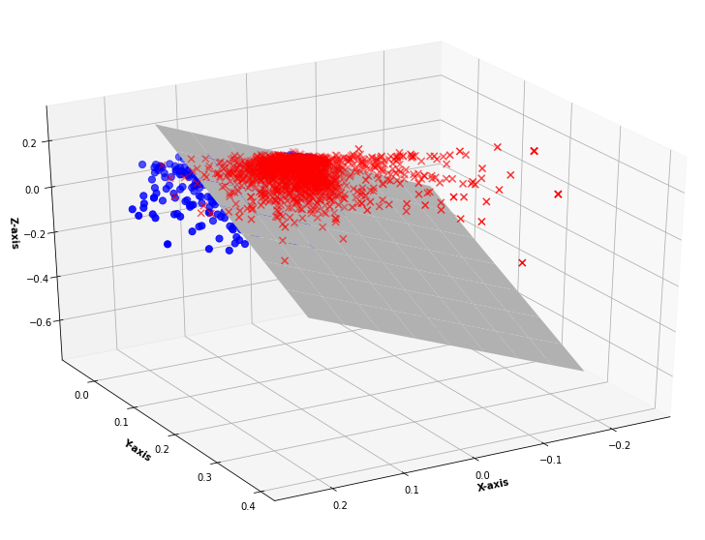
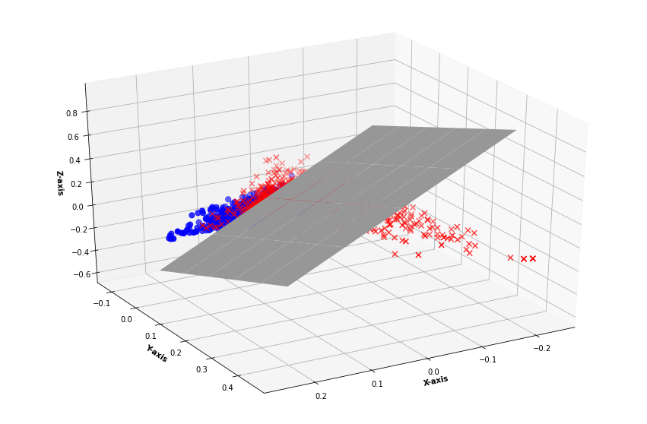
Kernel Approximation Visualization
Nystroem Kernel Approximation
Fourier Kernel Approximation
Blue dots -> Non Toxic Points Red Cross -> Toxic Points

Slide 14
Analysis
NN integrated SVM handles typos well.
Presence of abusive words highly affects the toxic label irrespective of the context surrounding the word. Eg: F*** off is such a derogatory term and should not be used. 19 models gave Toxic predictions.
For shorter sentences ‘Doc2Vec’ sometimes doesn’t perform well.

Slide 15
Analysis
Some words that appears with slangs but are not individually obscene or toxic are classified as Toxic. Eg. Your MOTHER is good. About 5 models predicted it. as toxic.
Language Bias Present in the models. Eg. Your SISTER is good.
Only 1 predicted as Toxic

Slide 16
Analysis
Some models captures racial bias Eg.You are of black race. 5 models predicted it as Toxic, You are of white race. 0 models predicted it as Toxic
The prediction often fails even with sufficient near contextual information. Eg. You are a smart ass. gave 9 toxic predictions

Slide 17
Analysis
Only four models were able to account for negation in some instances.
Eg. "Donald Trump is a not an a****le." 6 toxic predictions
"Donald Trump is an a****le." 9 toxic predictions

Slide 18
Conclusion
NN extractor with online SVM gives better results than without NN extractor
Kernel Approximations works better with Linear SVM and with sparse representation of features.
Tradeoff of RunTime vs Accuracy with Online SVM and actual SVM.
We have achieved comparable accuracies when compared to the reference papers, and even beating them in some cases (Reference paper 1 reported a highest F1-Score of 0.8155 and reference paper 2 reported a maximum of 0.7657 F1-Score)

Slide 19
Demo
Jupyter NoteBooks

