Slide 1
Dropout

Slide 2
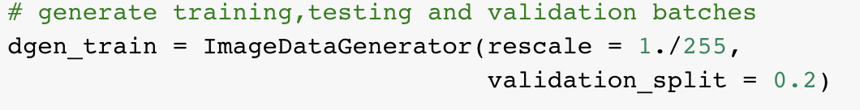
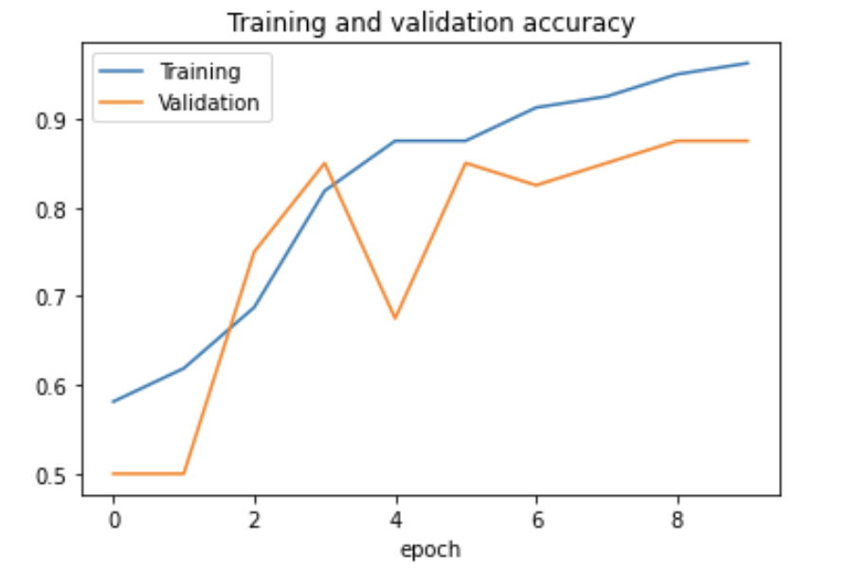
Use Validation dataset to check overfitting

Slide 3
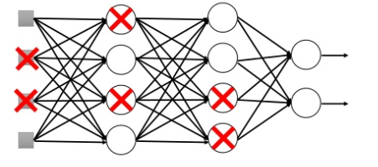

Drop Out
When training: Each time before updating the parameters:
Each neuron has p% to dropout

Slide 4
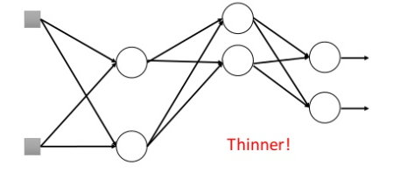
Drop Out
When training: Each time before updating the parameters:
Each neuron has p% to dropout
For each minibatch, we resample the dropout neurons

