Slide 1
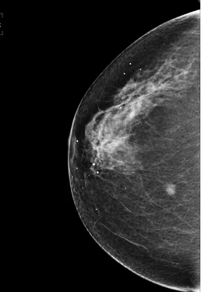
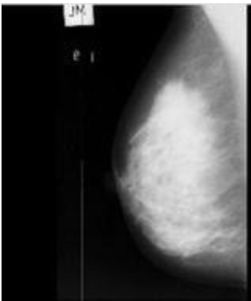
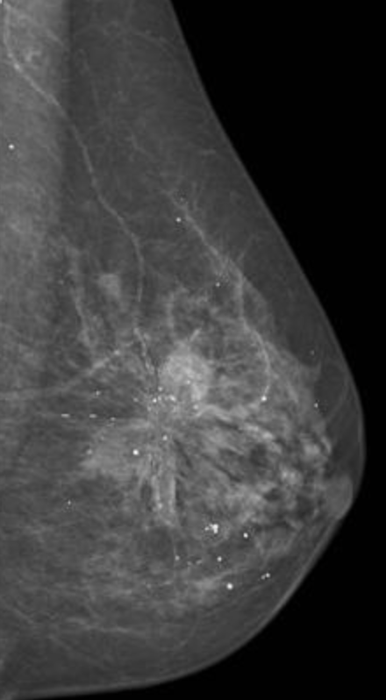
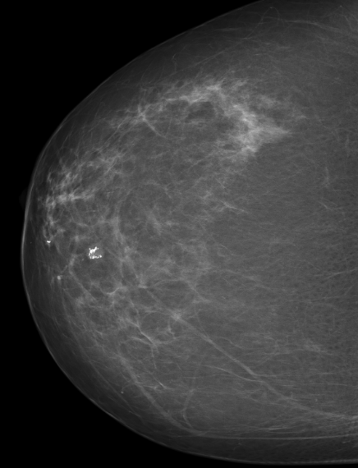
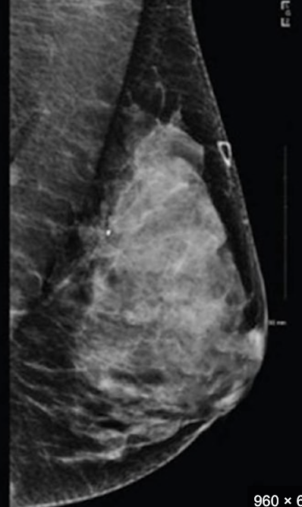

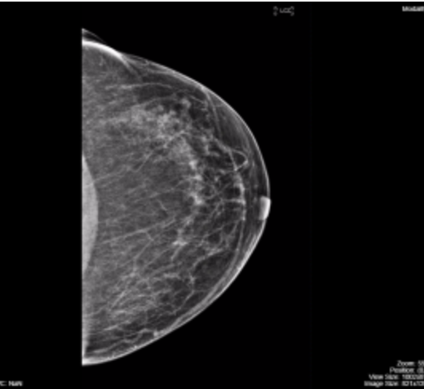
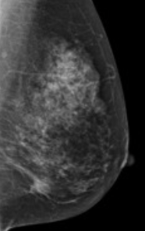
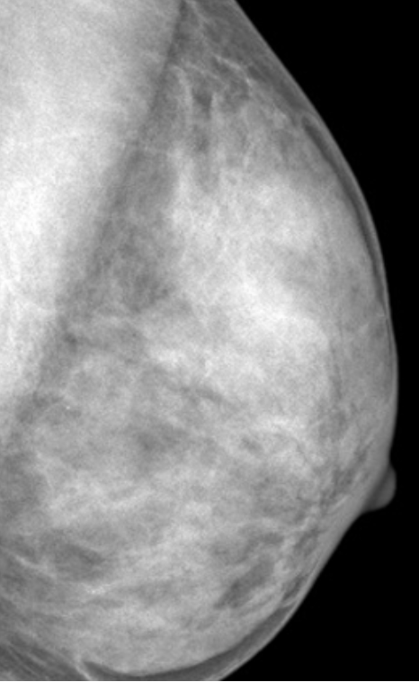
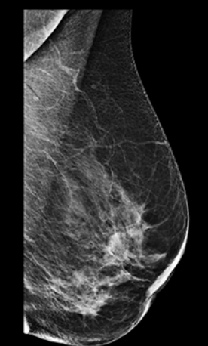
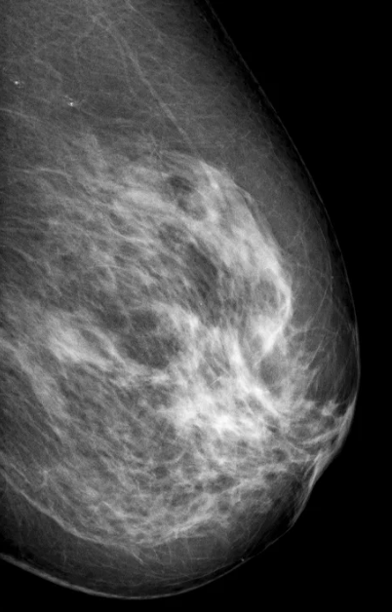
Process 10 images
Prediction score
0.95
0.86
0.75
0.68
0.49
0.48
0.37
0.28
0.15
0.05
Label as “Cancer”
Label as “Non-Cancer”
Ground Truth = “Cancer”
Fed these images into our Machine Learning model
Arrange the results in descending order based on the model's prediction scores
Ground Truth = “Non-Cancer”

Slide 2
Process 1 image
Prediction score
0.95
0.86
0.75
0.68
0.49
0.48
0.37
0.28
0.15
0.05
Label as “Cancer”
Label as “Non-Cancer”
Fed these images into our Machine Learning model
Arrange the results in descending order based on the model's prediction scores

Slide 3
Process 1 image
Prediction score
0.95
0.86
0.75
0.68
0.49
0.48
0.37
0.28
0.15
0.05
Label as “Cancer”
Label as “Non-Cancer”
Fed these images into our Machine Learning model
Arrange the results in descending order based on the model's prediction scores

Slide 4
Process 1 image
Prediction score
0.95
0.86
0.75
0.68
0.49
0.48
0.37
0.28
0.15
0.05
Label as “Cancer”
Label as “Non-Cancer”
Fed these images into our Machine Learning model
Arrange the results in descending order based on the model's prediction scores

Slide 5
Process 1 image
Prediction score
0.95
0.86
0.75
0.68
0.49
0.48
0.37
0.28
0.15
0.05
Label as “Cancer”
Label as “Non-Cancer”
Fed these images into our Machine Learning model
Arrange the results in descending order based on the model's prediction scores

Slide 6
Process 1 image
Prediction score
0.95
0.86
0.75
0.68
0.49
0.48
0.37
0.28
0.15
0.05
Label as “Cancer”
Label as “Non-Cancer”
Fed these images into our Machine Learning model
Arrange the results in descending order based on the model's prediction scores

Slide 7
Process 1 image
Prediction score
0.95
0.86
0.75
0.68
0.49
0.48
0.37
0.28
0.15
0.05
Label as “Cancer”
Label as “Non-Cancer”
Fed these images into our Machine Learning model
Arrange the results in descending order based on the model's prediction scores

Slide 8
Process 1 image
Prediction score
0.95
0.86
0.75
0.68
0.49
0.48
0.37
0.28
0.15
0.05
Label as “Cancer”
Label as “Non-Cancer”
Fed these images into our Machine Learning model
Arrange the results in descending order based on the model's prediction scores

Slide 9
Process 1 image
Prediction score
0.95
0.86
0.75
0.68
0.49
0.48
0.37
0.28
0.15
0.05
Label as “Cancer”
Label as “Non-Cancer”
Fed these images into our Machine Learning model
Arrange the results in descending order based on the model's prediction scores

Slide 10
Process 1 image
Prediction score
0.95
0.86
0.75
0.68
0.49
0.48
0.37
0.28
0.15
0.05
Label as “Cancer”
Label as “Non-Cancer”
Fed these images into our Machine Learning model
Arrange the results in descending order based on the model's prediction scores

Slide 11
Process 1 image
Prediction score
0.95
0.86
0.75
0.68
0.49
0.48
0.37
0.28
0.15
0.05
Label as “Cancer”
Label as “Non-Cancer”
Fed these images into our Machine Learning model
Arrange the results in descending order based on the model's prediction scores

Slide 12
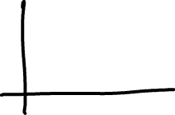



Draw the ROC curve based on the model prediction results below,
then calculate the rough AUROC
Predicted Probabilities
Ground Truth = 0
Non-Cancer
Non-Cancer
Non-Cancer
Non-Cancer
Non-Cancer
Non-Cancer
Ground Truth = 1
Cancer
Cancer
Cancer
Cancer
0.1
0.2
0.3
0.4
0.5
0.6
0.7
0.8
0.9
0.0
1.0
Predicted Risk of Cancer (in probability)
Notes:
XX: 4 red, 6 black

Slide 13



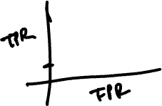



Draw the ROC curve based on the model prediction results below,
then calculate the rough AUROC
Predicted Probabilities
Ground Truth = 0
Non-Cancer
Non-Cancer
Non-Cancer
Non-Cancer
Non-Cancer
Non-Cancer
Ground Truth = 1
Cancer
Cancer
Cancer
Cancer
0.1
0.2
0.3
0.4
0.5
0.6
0.7
0.8
0.9
0.0
1.0
Predicted Risk of Cancer (in probability)
Notes:
XX: 4 red, 6 black

Slide 14
Draw the ROC curve based on the model prediction results below,
then calculate the rough AUROC
Predicted Probabilities
Ground Truth = 0
Non-Cancer
Non-Cancer
Non-Cancer
Non-Cancer
Non-Cancer
Non-Cancer
Ground Truth = 1
Cancer
Cancer
Cancer
Cancer
0.1
0.2
0.3
0.4
0.5
0.6
0.7
0.8
0.9
0.0
1.0
Predicted Risk of Cancer (in probability)
Notes:
XX: 4 red, 6 black

Slide 15
Draw the ROC curve based on the model prediction results below,
then calculate the rough AUROC
Predicted Probabilities
Ground Truth = 0
Non-Cancer
Non-Cancer
Non-Cancer
Non-Cancer
Non-Cancer
Non-Cancer
Ground Truth = 1
Cancer
Cancer
Cancer
Cancer
0.1
0.2
0.3
0.4
0.5
0.6
0.7
0.8
0.9
0.0
1.0
Predicted Risk of Cancer (in probability)
Notes:
XX: 4 red, 6 black

