Slide 1
LendingClub
02/04/2025

Slide 2

Introduction to LendingClub
About LendingClub:
Founded in San Francisco, CA.
First peer-to-peer lending platform to register with the Securities and Exchange Commission (SEC).
Introduced loan trading on a secondary market.
Currently the world’s largest peer-to-peer lending platform.
Business Focus:
Offers diverse loan options, primarily catering to urban clients.

Slide 3
The Business Problem
Risk Factors in Loan Decisions:
Missed Opportunities: Denying loans to reliable borrowers.
Financial Losses: Approving loans for applicants who default.
Why This Matters:
Striking the right balance is crucial for maximizing profits and minimizing losses.
lending loans to ‘risky’ applicants is the largest source of financial loss (called credit loss). In this case, the customers labelled as 'charged-off' are the 'defaulters’.
If one is able to identify these risky loan applicants, then such loans can be reduced thereby cutting down the amount of credit loss.
Notes:
Why This Matters:
Striking the right balance is crucial for maximizing profits and minimizing losses.
lending loans to ‘risky’ applicants is the largest source of financial loss (called credit loss). The credit loss is the amount of money lost by the lender when the borrower refuses to pay or runs away with the money owed. In this case, the customers labelled as 'charged-off' are the 'defaulters’.
If one is able to identify these risky loan applicants, then such loans can be reduced thereby cutting down the amount of credit loss. Identification of such applicants using EDA and machine learning is the aim of this case study.

Slide 4


Name: Jack Thompson
Loan Amount: $21,000
Loan Term: 5 years
Interest Rate: 12.29%
Monthly Payment: $470.22
Annual Income: $125,000
Debt-to-Income Ratio (DTI): 24.99%
Credit History Start: 1992
Open Credit Lines: 21
Revolving Credit Balance: $30,697
Revolving Credit Utilization: 67.6%
Total Credit Accounts: 45
Mortgage Accounts: 1
Loan Purpose: Credit Card
Consolidation Verification Status: Source Verified
Loan Defaulted!
Name: Mark Davis
Loan Amount: $16075.00
Loan Term: 5 years
Interest Rate: 21.48%
Monthly Payment: $439.24
Annual Income: $36,111
Debt-to-Income Ratio: 38.25%
Credit History Start: Since 1992
Open Credit Lines: 15
Revolving Credit Balance: $27,117
Revolving Credit Utilization: 82.40%
Total Credit Accounts: 26
Mortgage Accounts: 1
Loan Purpose: Debt consolidation
Verification: source verified
Loan Paid Off
in Full!
Notes:
1st one:
Loan Amount: $21,000
Loan Term: 5 years
Interest Rate: 12.29% (Moderate, not too high)
Monthly Payment: $470.22
Annual Income: $125,000 (High income, suggesting repayment ability)
Debt-to-Income Ratio (DTI): 24.99% (Moderate, but approaching riskier levels)
Credit History Start: 1992 (Long credit history, which is a good sign)
Open Credit Lines: 21 (High, but could mean well-managed credit)
Revolving Credit Balance: $30,697 (Moderate credit usage)
Revolving Credit Utilization: 67.6% (Fairly high, could be a risk factor)
Total Credit Accounts: 45 (Experienced borrower)
Mortgage Accounts: 1 (Likely a homeowner, which usually correlates with lower default risk)
Loan Purpose: Credit Card Consolidation (Might indicate existing high debt, but also suggests financial responsibility)
Verification Status: Source Verified (More reliable income verification)
2nd one: Loan Amount: $24,000
Loan Term: 3 years
Interest Rate: 13.05% (Moderate-to-high, increases repayment burden)
Monthly Payment: $809.24
Annual Income: $55,000 (Moderate, but loan payments are a significant portion)
Debt-to-Income Ratio (DTI): 21.77% (Moderate, but close to riskier levels)
Credit History Start: 1996 (Long credit history, a good sign)
Open Credit Lines: 21 (Many accounts, could indicate good credit management or high reliance on credit)
Revolving Credit Balance: $31,865 (Moderately high, suggests dependence on credit)
Revolving Credit Utilization: 58.7% (Above average, but not extreme)
Total Credit Accounts: 40 (Experienced borrower)
Mortgage Accounts: 0 (No homeownership, potentially higher risk)
Loan Purpose: Debt Consolidation (May indicate pre-existing financial struggles, but also a desire to manage debt)
Verification Status: Source Verified (Income is confirmed, reducing lender risk)

Slide 5
Aim of the Case Study
Identify Risky Loan Applicants: Use Exploratory Data Analysis (EDA) and AI to predict potential defaulters.
Reduce Credit Loss: Minimize financial losses by avoiding high-risk loans.
Optimize Lending Decisions: Strike the right balance between risk and opportunity to maximize profitability.

Slide 6
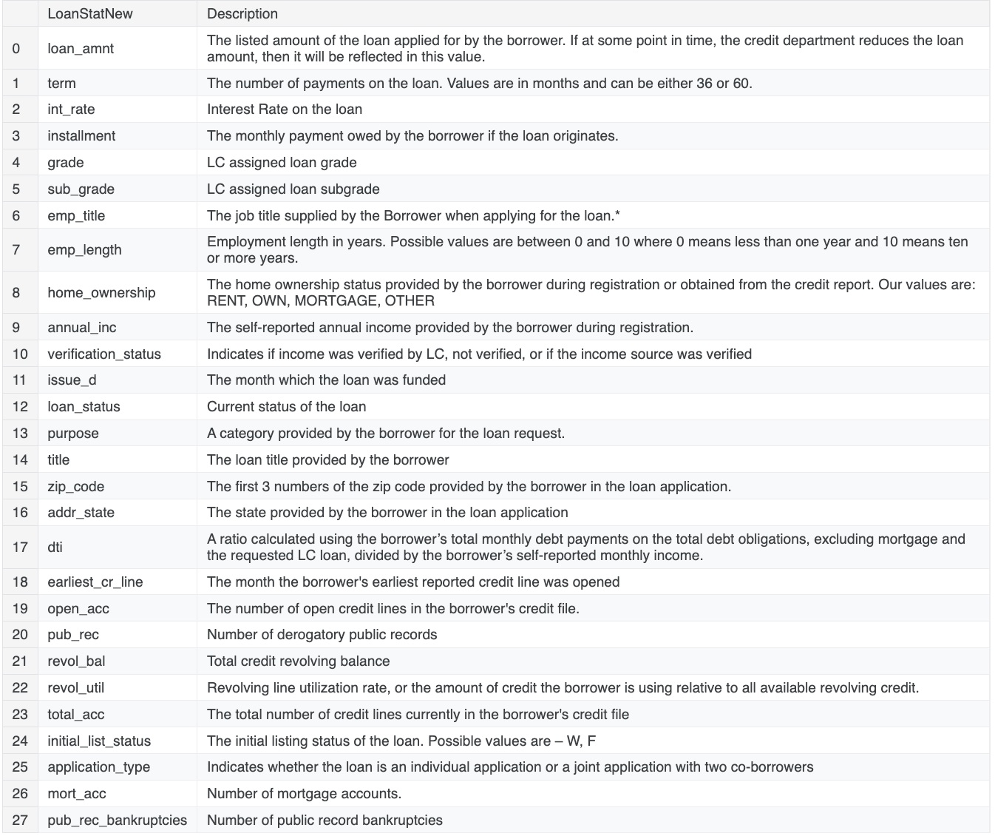
The Dataset Overview
Data Description:
Historical data on loan applicants.
Includes information on applicants who defaulted and those who didn’t.
Key Variables:
Applicant demographics.
Loan amount, purpose, and terms.
Payment history and financial behavior.

Slide 7
The AI Task
Objective:
Predict whether an applicant will default on their loan.
How This Helps LendingClub:
Deny Loans to high-risk applicants.
Adjust Loan Amounts for moderate-risk borrowers.
Set Higher Interest Rates for risky but potentially profitable applicants.
Notes:
The aim is to identify patterns which indicate if a person is likely to default, which may be used for takin actions such as denying the loan, reducing the amount of loan, lending (to risky applicants) at a higher interest rate, etc.

Slide 8
Example Notebook & Resources
Starter Code:
Kaggle Notebook: LendingClub Loan Defaulters Prediction
Steps:
1. Data preprocessing & cleaning.
2. Feature selection & engineering.
3. Model training & validation.
4. Model evaluation & improvement.

Slide 9
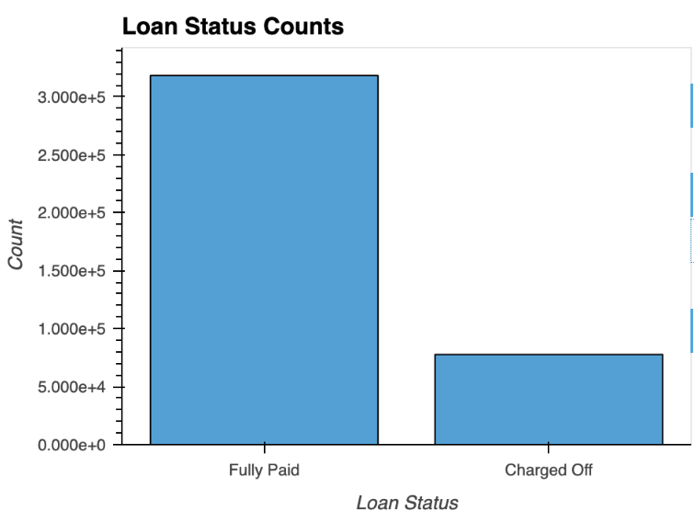
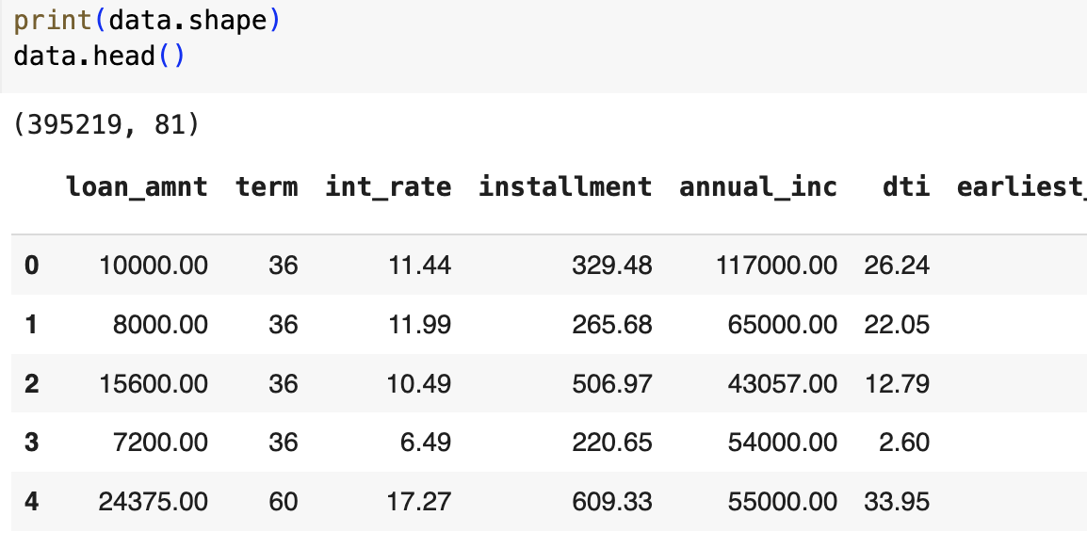
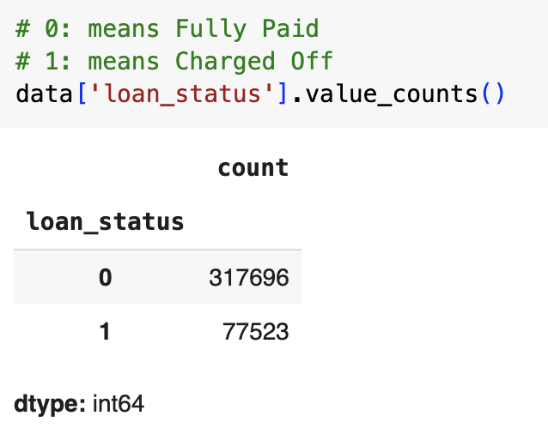
1. Data preprocessing & cleaning.
Load Data:

Slide 10
2. Feature selection & engineering.
Split train and test data
Remove outliers in the training dataset
Separate feature and label
Scale the feature data and ensuring that all arrays are in the correct format and data type (float32)
Fit: The fit part calculates the minimum and maximum values for each feature in the training set.
Transform: It then uses these values to scale the training data so that each feature value falls within the range [0, 1].
Applies the same scaling transformation to the test set using the min and max values computed from the training set. This ensures consistency between training and testing data.

Slide 11
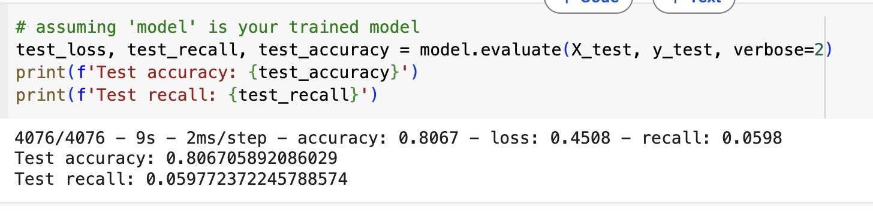
3. Model training & validation.
Build a simple neural network model and Compile the model
Train the model using training data
model.fit(X_train, y_train, epochs=5, batch_size=128, validation_split=0.2)
Evaluate Model using test data and check different matrix.
Evaluation Metrics:
Accuracy, Precision, Recall, F1-score, AUC-ROC (focus on balancing false positives and false negatives).

Slide 12
ML Approaches & Techniques
Potential Models:
Logistic Regression, Decision Trees, Random Forest, XGBoost.
Handling Class Imbalance:
Techniques like SMOTE, adjusting class weights, or threshold tuning.
Evaluation Metrics:
Accuracy, Precision, Recall, F1-score, AUC-ROC (focus on balancing false positives and false negatives).
Notes:
2 example:
One get money back
One defaulter

