Slide 1
Introduction to Recurrent Neural Network (RNN) and Long Short-Term Memory (LSTM)
Gordon Gao
Carey Business School Professor

Slide 2
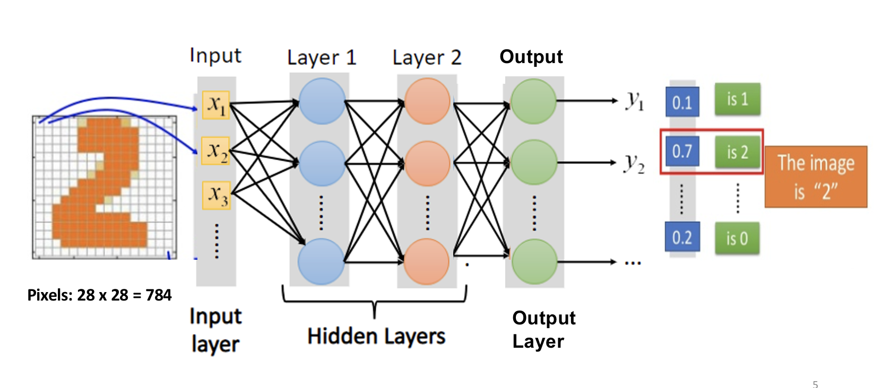
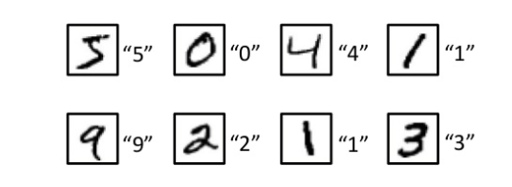
Non-Sequential information
Image recognition
Each input is independent

Slide 3
Sequential information
Predict sentiment towards the movie:
I like the actor but hate the movie.
VS
I like the movie but hate the actor.

Slide 4
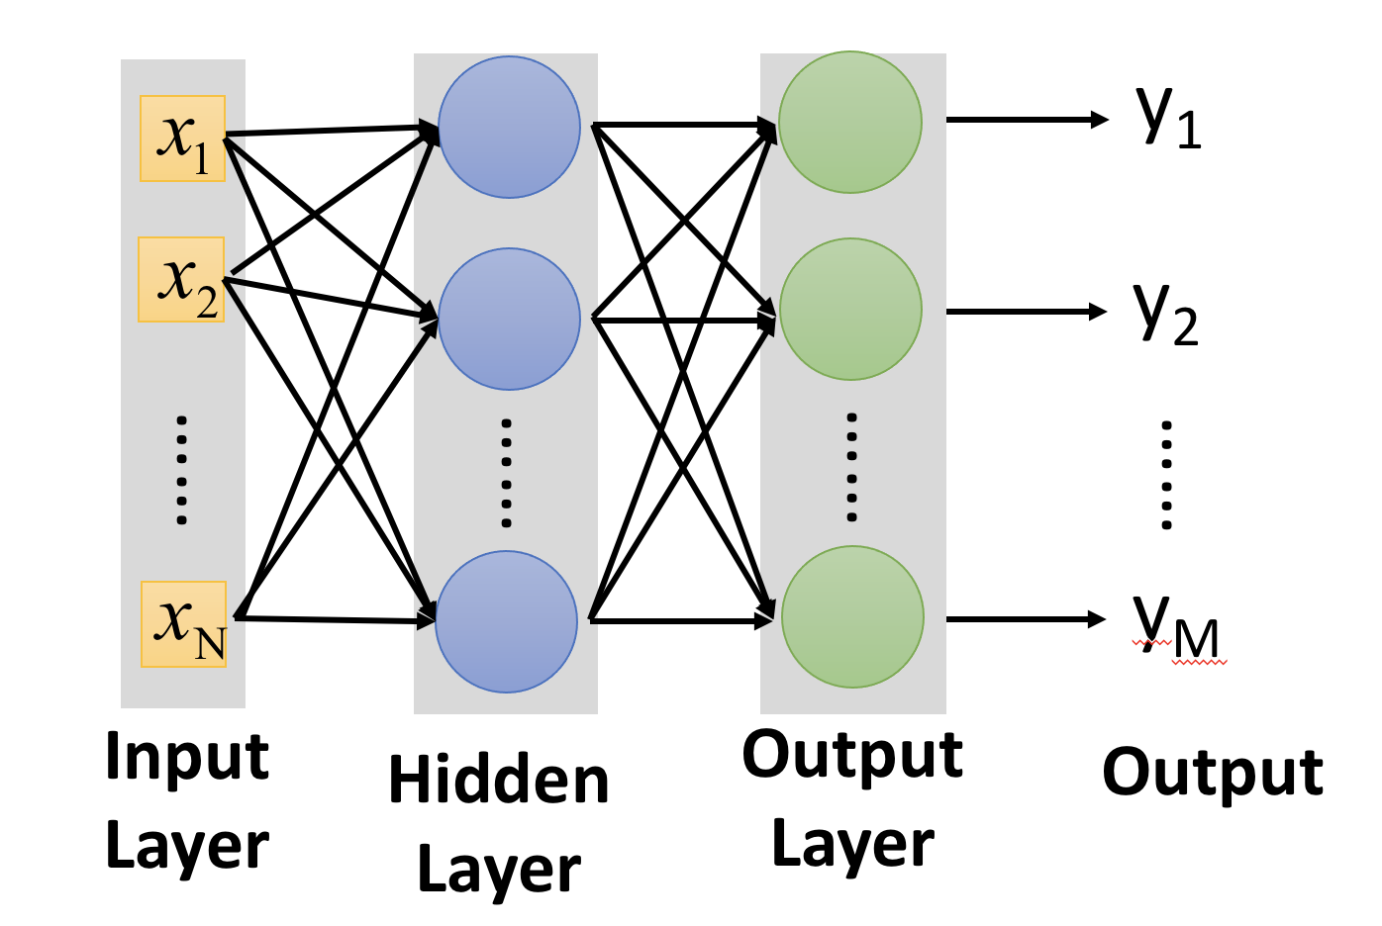
Big idea of Recurrent Neural Network
Create memory
what has happened previously
-> hidden state
“hidden” because it is simply the output of the hidden layer in the previous step
-> not to be confused with the actual output
hidden state serves as the working memory
Combine hidden state and the current input for future prediction
Hidden State

Slide 5
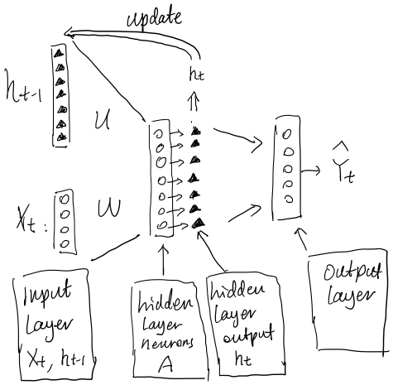
RNN:
ht-1 is the hidden state, or the working memory

Slide 6
























Step 1: Forward to calculate y
actor
the
hate
but
movie
the
like
I
The initial hidden state (h₀) is the starting point for the hidden states in an RNN.
I
$$x_{t1}^{1}$$
$$h_{t0}^{1}$$
$$x_{t1}^{2}$$
$$h_{t0}^{2}$$
$$x_{t1}^{3}$$
$$h_{t0}^{3}$$
$$x_{t1}^{4}$$
$$h_{t0}^{4}$$
$$U$$
$$t_{8}$$
$$t_{7}$$
$$t_{6}$$
$$t_{5}$$
$$t_{4}$$
$$t_{3}$$
$$t_{2}$$
$$t_{1}$$
$$h_{t1}^{1}$$
$$h_{t1}^{2}$$
$$V$$
$$y_{t=1}$$
$$W$$
$$h_{t1}^{3}$$
$$h_{t1}^{4}$$
6
Notes:
It can be initialized in different ways depending on the specific application and implementation. Here are a few common approaches:
Zero Initialization: Setting ℎ0h0​ to a vector of zeros is a common practice. This is simple and often effective.
Random Initialization: Initializing ℎ0h0​ with small random values, typically drawn from a normal or uniform distribution, can be used to break symmetry and encourage learning.
Learned Initialization: Treating ℎ0h0​ as a learnable parameter that is optimized during the training process.
Context-Specific Initialization: In some cases, ℎ0h0​ can be set based on some context-specific information, such as using the output of another neural network.
The choice of initialization method can affect the performance of the RNN and might require experimentation to find the best approach for a particular task.

Slide 7




Step 1: Update $h_{t0}$ to $h_{t1}$
actor
the
hate
but
movie
the
like
I
I
$$h_{t0}^{1}$$
update
$$h_{t0}^{2}$$
$$h_{t0}^{3}$$
$$h_{t0}^{4}$$
$$U$$
$$t_{8}$$
$$t_{7}$$
$$t_{6}$$
$$t_{5}$$
$$t_{4}$$
$$t_{3}$$
$$t_{2}$$
$$t_{1}$$
$$h_{t1}^{1}$$
$$h_{t1}^{2}$$
$$V$$
$$y_{t=1}$$
$$W$$
$$h_{t1}^{3}$$
$$x_{t1}^{1}$$
$$h_{t1}^{4}$$
$$x_{t1}^{2}$$
$$x_{t1}^{3}$$
$$x_{t1}^{4}$$
7
Notes:
Ht0=? In RNN, what is the ht0

Slide 8













Step 2: Forward to calculate y
actor
the
hate
but
movie
the
like
I
$$x_{t2}^{1}$$
I
$$h_{t1}^{1}$$
$$x_{t2}^{2}$$
$$h_{t1}^{2}$$
$$x_{t2}^{3}$$
$$h_{t1}^{3}$$
$$x_{t2}^{4}$$
$$h_{t1}^{4}$$
$$U$$
$$t_{8}$$
$$t_{7}$$
$$t_{6}$$
$$t_{5}$$
$$t_{4}$$
$$t_{3}$$
$$t_{2}$$
$$t_{1}$$
$$h_{t2}^{1}$$
$$h_{t2}^{2}$$
$$V$$
$$y_{t=2}$$
$$W$$
$$h_{t2}^{3}$$
$$h_{t2}^{4}$$
8
Notes:
It can be initialized in different ways depending on the specific application and implementation. Here are a few common approaches:
Zero Initialization: Setting ℎ0h0​ to a vector of zeros is a common practice. This is simple and often effective.
Random Initialization: Initializing ℎ0h0​ with small random values, typically drawn from a normal or uniform distribution, can be used to break symmetry and encourage learning.
Learned Initialization: Treating ℎ0h0​ as a learnable parameter that is optimized during the training process.
Context-Specific Initialization: In some cases, ℎ0h0​ can be set based on some context-specific information, such as using the output of another neural network.
The choice of initialization method can affect the performance of the RNN and might require experimentation to find the best approach for a particular task.

Slide 9




Step 2: Update $h_{t1}$ to $h_{t2}$
actor
the
hate
but
movie
the
like
I
I
$$h_{t1}^{1}$$
update
$$h_{t1}^{2}$$
$$h_{t1}^{3}$$
$$h_{t1}^{4}$$
$$U$$
$$t_{8}$$
$$t_{7}$$
$$t_{6}$$
$$t_{5}$$
$$t_{4}$$
$$t_{3}$$
$$t_{2}$$
$$t_{1}$$
$$h_{t2}^{1}$$
$$h_{t2}^{2}$$
$$V$$
$$y_{t=2}$$
$$W$$
$$h_{t2}^{3}$$
$$x_{t2}^{1}$$
$$h_{t2}^{4}$$
$$x_{t2}^{2}$$
$$x_{t2}^{3}$$
$$x_{t2}^{4}$$
9
Notes:
Ht0=? In RNN, what is the ht0

Slide 10













Step 3: Forward to calculate y
actor
the
hate
but
movie
the
like
I
$$x_{t3}^{1}$$
I
$$h_{t2}^{1}$$
$$x_{t3}^{2}$$
$$h_{t2}^{2}$$
$$x_{t3}^{3}$$
$$h_{t2}^{3}$$
$$x_{t3}^{4}$$
$$h_{t2}^{4}$$
$$U$$
$$t_{8}$$
$$t_{7}$$
$$t_{6}$$
$$t_{5}$$
$$t_{4}$$
$$t_{3}$$
$$t_{2}$$
$$t_{1}$$
$$h_{t3}^{1}$$
$$h_{t3}^{2}$$
$$V$$
$$y_{t=3}$$
$$W$$
$$h_{t3}^{3}$$
$$h_{t3}^{4}$$
10
Notes:
It can be initialized in different ways depending on the specific application and implementation. Here are a few common approaches:
Zero Initialization: Setting ℎ0h0​ to a vector of zeros is a common practice. This is simple and often effective.
Random Initialization: Initializing ℎ0h0​ with small random values, typically drawn from a normal or uniform distribution, can be used to break symmetry and encourage learning.
Learned Initialization: Treating ℎ0h0​ as a learnable parameter that is optimized during the training process.
Context-Specific Initialization: In some cases, ℎ0h0​ can be set based on some context-specific information, such as using the output of another neural network.
The choice of initialization method can affect the performance of the RNN and might require experimentation to find the best approach for a particular task.

Slide 11




Step 3: Update $h_{t2}$ to $h_{t3}$
actor
the
hate
but
movie
the
like
I
I
$$h_{t2}^{1}$$
update
$$h_{t2}^{2}$$
$$h_{t2}^{3}$$
$$h_{t2}^{4}$$
$$U$$
$$t_{8}$$
$$t_{7}$$
$$t_{6}$$
$$t_{5}$$
$$t_{4}$$
$$t_{3}$$
$$t_{2}$$
$$t_{1}$$
$$h_{t3}^{1}$$
$$h_{t3}^{2}$$
$$V$$
$$y_{t=3}$$
$$W$$
$$h_{t3}^{3}$$
$$x_{t3}^{1}$$
$$h_{t3}^{4}$$
$$x_{t3}^{2}$$
$$x_{t3}^{3}$$
$$x_{t3}^{4}$$
11
Notes:
Ht0=? In RNN, what is the ht0

Slide 12













Step 8: Forward to calculate y
actor
the
hate
but
movie
the
like
I
$$x_{t8}^{1}$$
I
$$h_{t7}^{1}$$
$$x_{t8}^{2}$$
$$h_{t7}^{2}$$
$$x_{t8}^{3}$$
$$h_{t7}^{3}$$
$$x_{t8}^{4}$$
$$U$$
$$h_{t7}^{4}$$
$$t_{8}$$
$$t_{7}$$
$$t_{6}$$
$$t_{5}$$
$$t_{4}$$
$$t_{3}$$
$$t_{2}$$
$$t_{1}$$
$$h_{t8}^{1}$$
$$h_{t8}^{2}$$
$$V$$
$$y_{t=8}$$
$$W$$
$$h_{t8}^{3}$$
$$h_{t8}^{4}$$
12
Notes:
It can be initialized in different ways depending on the specific application and implementation. Here are a few common approaches:
Zero Initialization: Setting ℎ0h0​ to a vector of zeros is a common practice. This is simple and often effective.
Random Initialization: Initializing ℎ0h0​ with small random values, typically drawn from a normal or uniform distribution, can be used to break symmetry and encourage learning.
Learned Initialization: Treating ℎ0h0​ as a learnable parameter that is optimized during the training process.
Context-Specific Initialization: In some cases, ℎ0h0​ can be set based on some context-specific information, such as using the output of another neural network.
The choice of initialization method can affect the performance of the RNN and might require experimentation to find the best approach for a particular task.

Slide 13




Step 8: Update $h_{t7}$ to $h_{t8}$
actor
the
hate
but
movie
the
like
I
$$h_{t7}^{1}$$
update
$$h_{t7}^{2}$$
$$h_{t7}^{3}$$
$$h_{t7}^{4}$$
$$U$$
$$t_{8}$$
$$t_{7}$$
$$t_{6}$$
$$t_{5}$$
$$t_{4}$$
$$t_{3}$$
$$t_{2}$$
$$t_{1}$$
$$h_{t8}^{1}$$
$$h_{t8}^{2}$$
$$V$$
$$y_{t=8}$$
$$W$$
$$h_{t8}^{3}$$
$$x_{t8}^{1}$$
$$h_{t8}^{4}$$
$$x_{t8}^{2}$$
$$x_{t8}^{3}$$
$$x_{t8}^{4}$$
13
Notes:
Ht0=? In RNN, what is the ht0

Slide 14
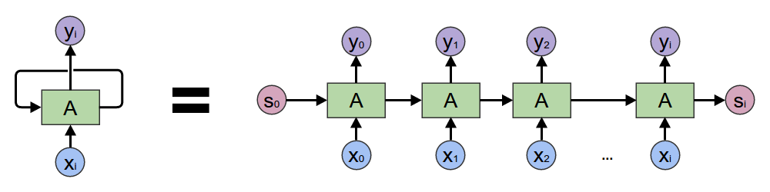
A popular way to present RNN

Slide 15
A popular way to present RNN

Slide 16
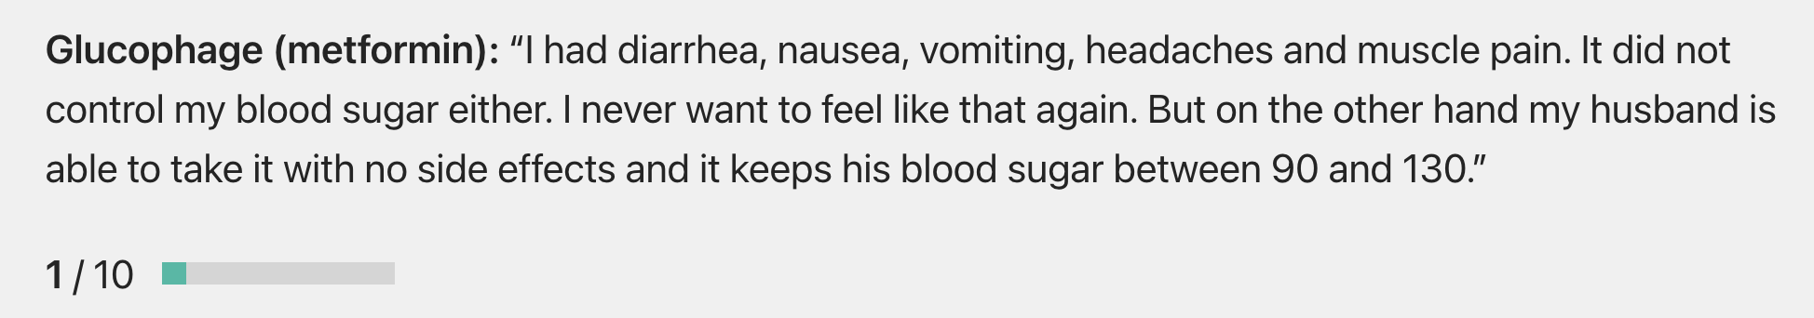
How to make memory work better?
Solution: Long Short-Term Memory (LSTM) model
-add dedicated long-term memory to the RNN model to store important information that will not fade away
-the hidden states in RNN is now called the short-term memory, or working memory
Notes:
Glucophage (metformin): “I had diarrhea, nausea, vomiting, headaches and muscle pain. It did not control my blood sugar either. I never want to feel like that again. But on the other hand my husband is able to take it with no side effects and it keeps his blood sugar between 90 and 130.”

Slide 17
How to make long-term memory work better?
Need to decide whether to take the input to update the memory
Garbage in, garbage out
Solution:
=> Input gate:
a sigmoid function to determine whether to take that input or discard it

Slide 18
How to make long-term memory work better?
Need to forget
Retire old memory
So new information can be incorporated into memory
Solution:
=> forget gate:
use the input data and memory to determine the mix of old memory and new information
The forget gate determines how to update the memory
Notes:
This is when the new information is in, how much it should replace the old information (which is just a matrix)

Slide 19
Updating the short-term memory
Need to decide whether to update the short-term memory (i.e, update the hidden state)
Solution:
=> output gate:
a small neural network to use the input data and memory to predict whether to update the hidden state

Slide 20
Long Short-term Memory (LSTM)
Hidden State/Short-term memory
Output Gate
Memory
Cell
Forget Gate
Input Gate
LSTM
input
Notes:
Normal neuron
1 input, 1 output
This one
4 input, 1 output

Slide 21
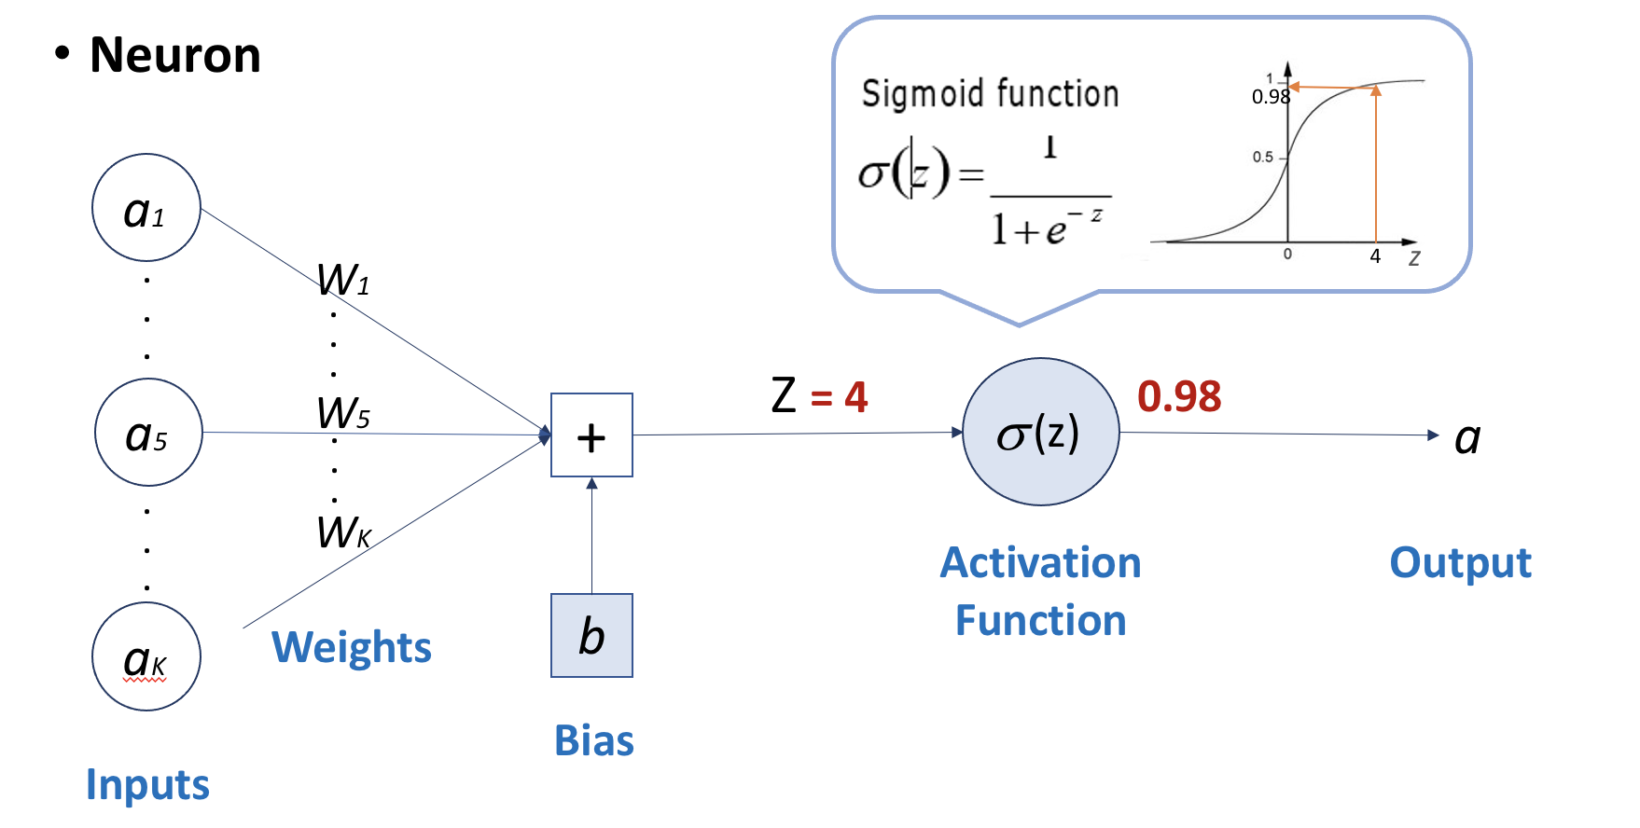
How does the “input gate” work?
The “Gate” sounds fancy, but it is actually a simple sigmoid neural net layer with an output between 0 and 1, which then multiplies the input information
-0: no information goes through, as multiple any number with zero, we get zero
-1: let all information go through, as multiple any number with one, we get the original value.
-we can also have a value between 0 and 1, which means partial information goes through the gate
Ditto to all other gates

