Slide 1




RAG: Retrival Augmented Generation with GPT-4o
Piyush Agrawal, Jingyao, Wie wie , Hao Li, Jayda
AIEB 2025

Slide 2



Key Capabilities
Upload and process multiple PDF documents
Natural language Q&A interface with GPT-4o
Retrieval-augmented generation for accurate answers
Financial analyst persona for specialized responses
Get Started

Slide 3


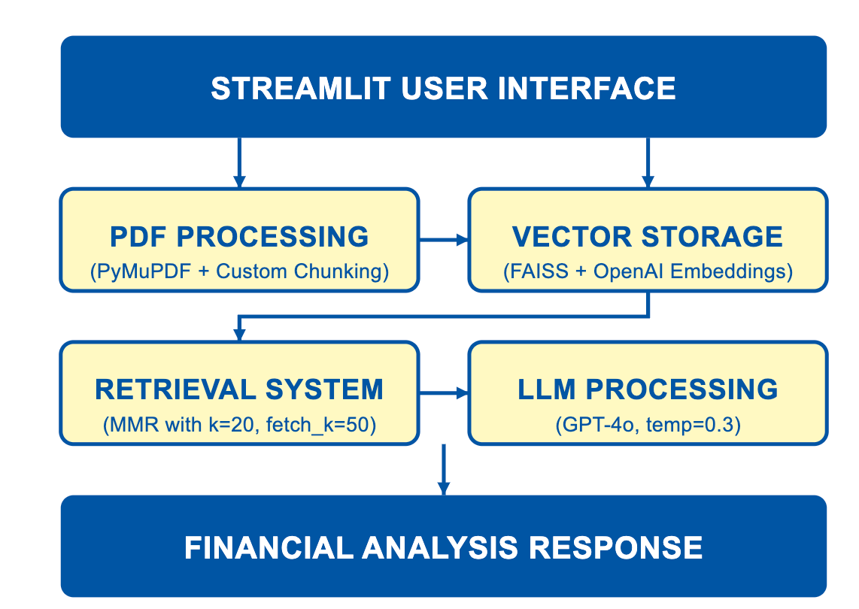

Architecture Overview

Slide 4
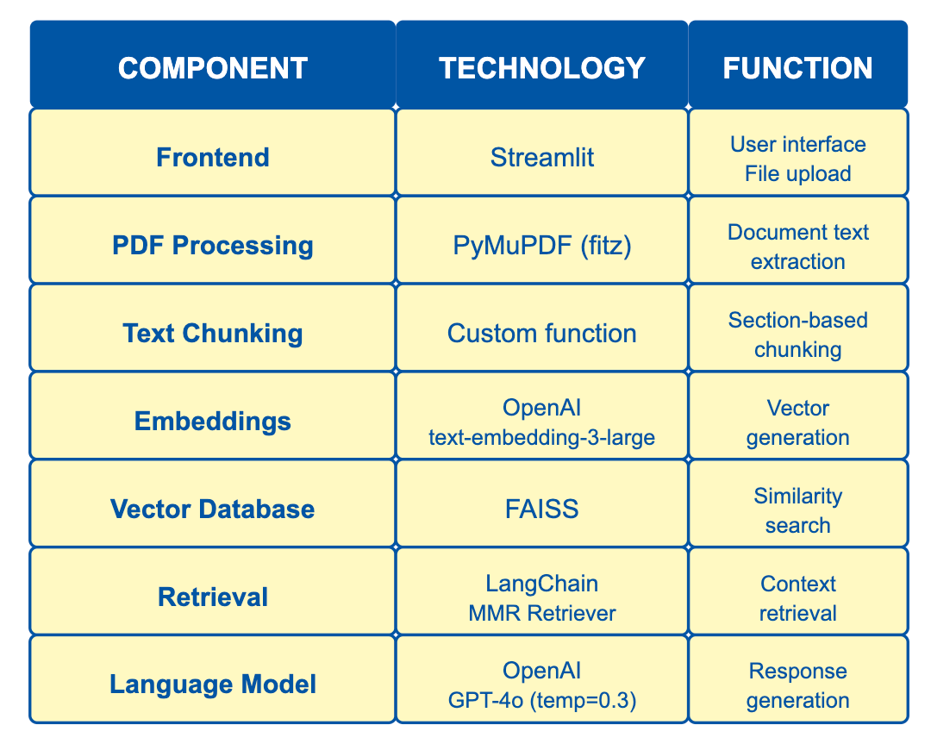
Technology Stack

Slide 5


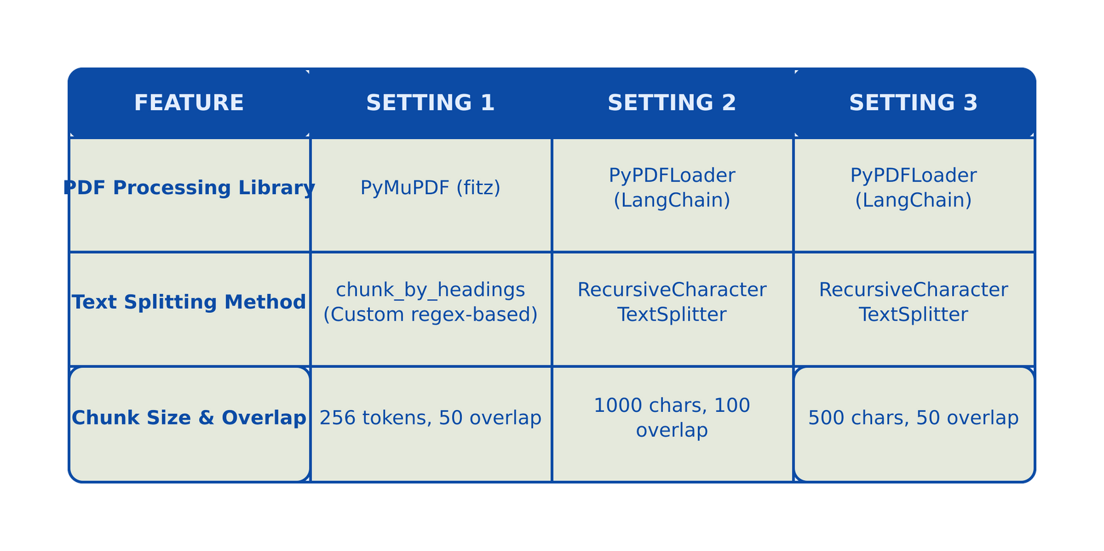
Testing under Different Settings
Document Processing & Chunking

Slide 6
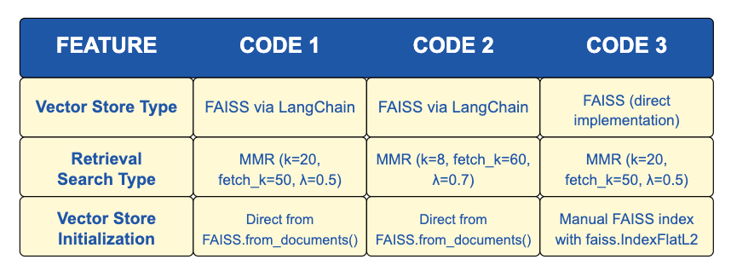
Testing under Different Settings
Vector Store & Retrieval

Slide 7
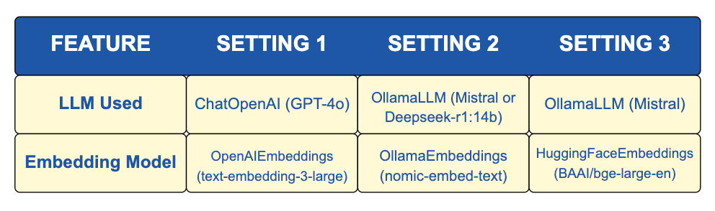
Testing under Different Settings
Language Model & Embeddings

Slide 8
Boundary Exploration and Hallucination Analysis
Testing for hallucination and Boundaries
Testing Hallucination with Non-Existent Facts
What was Amazon’s reported Bitcoin investment in Q3 2024?
Testing Ambiguous Queries
How much did Microsoft spend on technology?
Testing Edge Cases in Numerical or Financial Data
Did Amazon report $1 trillion in net sales for Q3 2024?
Get Started

Slide 9
Boundary Exploration and Hallucination Analysis
Testing for hallucination and Boundaries(Cont)
Testing Misleading Comparisons
Did Alphabet generate more revenue than Amazon in Q3 2024?
Testing Legal and Policy-Related Inquiries
Has Amazon been fined $10 billion for data privacy violations in 2024?
Testing Future Predictions (Speculative Queries)
Will Microsoft acquire Tesla in 2025?
Get Started

Slide 10


Challenges &
Technical Implmentations
Challenge #1: PDF Data extraction
Complex financial table extraction
SEC filing formatting inconsistencies
Multi-column layout detection

Slide 11
Challenges &
Technical Implmentations
Challenge #2: Chunking Strategy
Risks of data may be scattered
Ensures precise retrieval from a paragraph
Retains section-wise context and allows logical retrieval.

Slide 12
Challenges &
Technical Implmentations
Challenge #3: Retriever Optimization
Balancing similarity vs diversity
Prevent hallucination in case data is present
Don’t contain too much redundancy

Slide 13
Future Enhancements
Improved Document Chunking:
Table structure preservation
Financial data extraction and normalization
Additional metadata for better context
Advanced retrieval mechanisms:
Hybrid keyword + semantic search
Re-ranking implementation
Query decomposition for complex financial questions

Slide 14
Future Enhancements
UI/UX Improvements:
Enhanced citation with direct document references
Financial data visualization capabilities
Customization for different SEC filing types
Performance optimizations:
Caching frequent queries
Precomputed embeddings for common SEC filings
Asynchronous processing for faster response times

Slide 15
Demo

