Slide 1
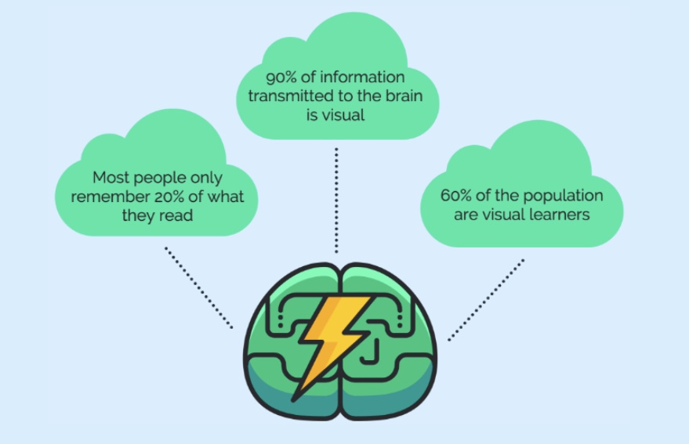
Why Infographics?
Notes:
What do you know about infographics? What did you learn from Venngage?

Slide 2
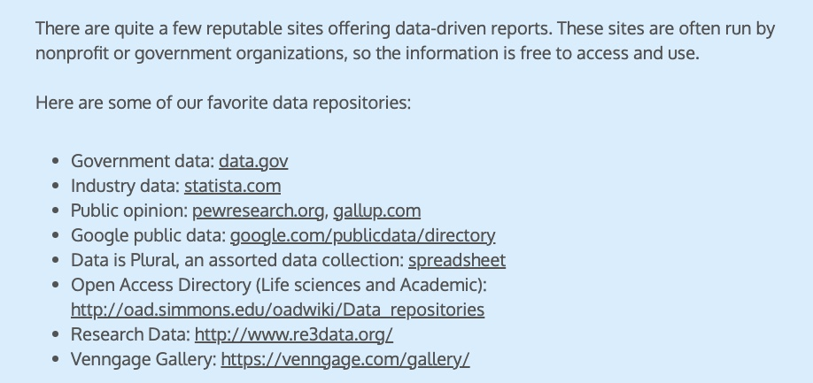
Support your argument with data

Slide 3
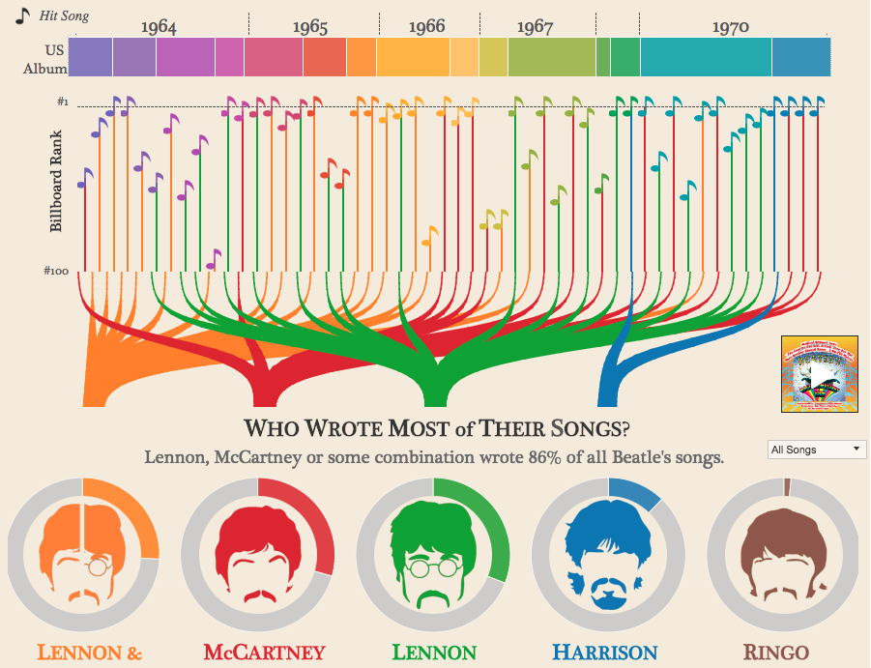
How to communicate data?
Data must be placed in its proper context.
Infographics can assist with that.
Source: https://www.creativebloq.com/graphic-design-tips/information-graphics-1232836

Slide 4
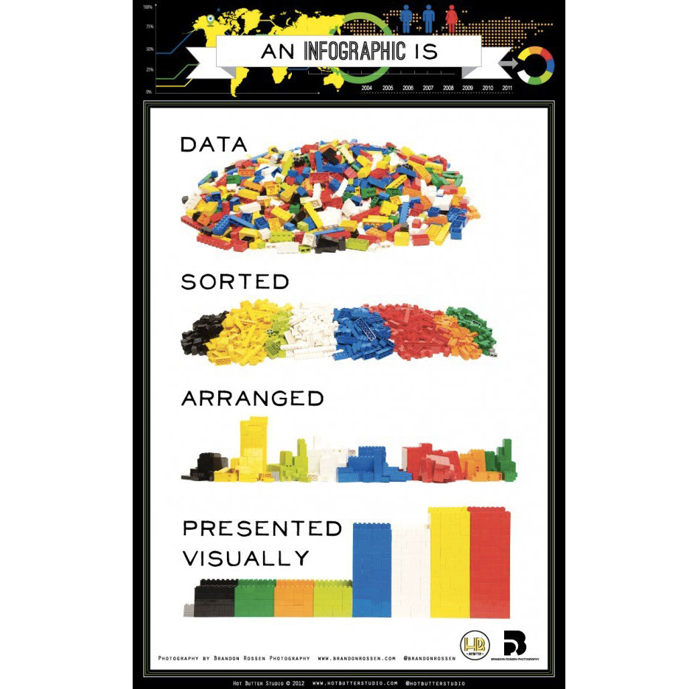
Support your argument with data VISUALLY

Slide 5
The clever use of Lego made it certain that we'd include this on our list of best infographics. It was created by Hot Butter Studio's Beth Kanter, a visual marketer who used it in her blog, and it explains how enforcing visual order upon data can help you and your audience to draw conclusions and use them constructively.

Slide 6

LINK

Slide 7
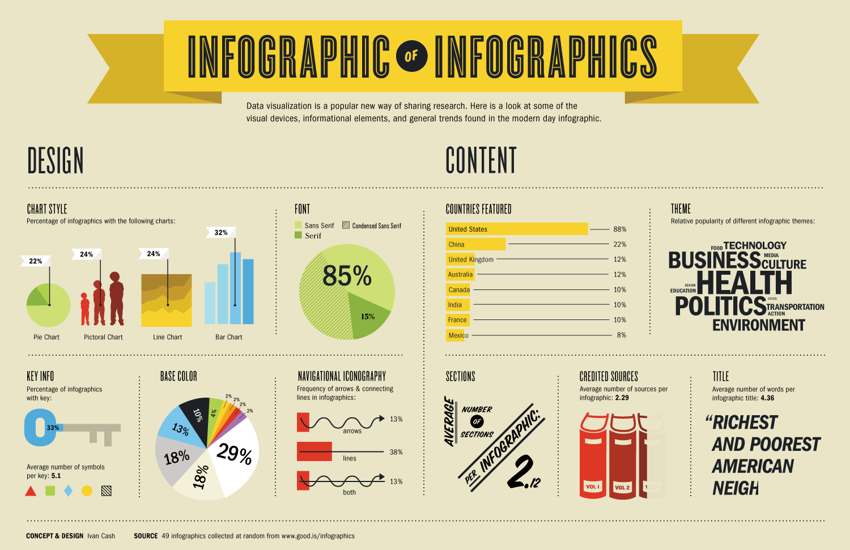
The Infographic of Infographics

Slide 8
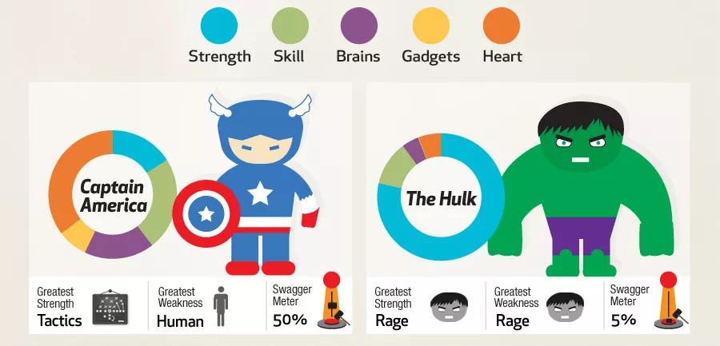
LINK

Slide 9


Slide 10

LINK

Slide 11

LINK

Slide 12

Remember: Busy executives!

Slide 13

LINK

