Slide 1
Presentation Day Dr. Clara Ma Class 4 and 8

Slide 2
Feedback w/ Radical Candor
Situation – Behavior – Impact

Slide 3
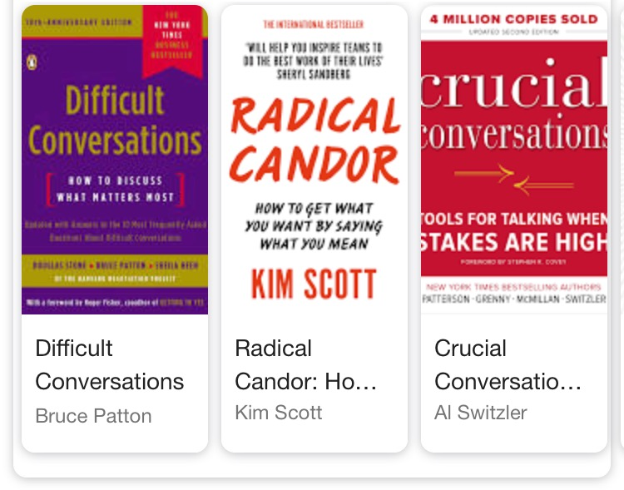
Books on giving and receiving feedback…
…from organizational behavior researchers

Slide 4
Where are you?
Care personally
Ruinous empathy
Radical candor
Challenge directly
Manipulative insincerity
Obnoxious aggression
Notes:
Two dimensions: Care Personally: Showing genuine concern for your team members as people.
Challenge Directly: Providing direct and honest feedback, even when it's difficult.
Four quadrants: These are created by the intersection of the two dimensions: a) Radical Candor: High care personally, high challenge directly The ideal state where managers provide honest feedback while showing they care.
b) Obnoxious Aggression: Low care personally, high challenge directly Providing criticism without showing care, which can be perceived as mean or unhelpful.
c) Ruinous Empathy: High care personally, low challenge directly Being too nice to give necessary criticism, which can hinder growth and improvement.
d) Manipulative Insincerity: Low care personally, low challenge directly Avoiding difficult conversations and not providing genuine feedback or care.
Key practices: Get, Give, and Encourage feedback
Create a culture of open communication
Understand what motivates each team member
Drive results collaboratively
Guidance and feedback techniques: Praise in public, criticize in private
Be specific and timely with feedback
Focus on behaviors, not personality
Offer guidance on how to improve

Slide 5
Radical Candor (High care personally, high challenge directly): Scenario: A team member gives a presentation with some inaccurate data. Manager's response: "Sarah, I appreciate the effort you put into that presentation. The overall structure was clear and engaging. However, I noticed some data discrepancies on slides 5 and 7. Let's review those together and make sure we have the correct information. This attention to detail will make your great work even stronger. How can I help you verify the data for next time?"
Obnoxious Aggression (Low care personally, high challenge directly): Scenario: An employee consistently arrives late to meetings. Manager's response: "John, you're always late. It's unprofessional and disrespectful to the team. If you can't manage to show up on time, maybe you shouldn't be in these meetings at all. Shape up or ship out."
Ruinous Empathy (High care personally, low challenge directly): Scenario: A team member's project is behind schedule. Manager's response: "Don't worry too much about the deadline, Lisa. I know you're working hard and these things happen. Just do your best and we'll figure it out somehow. Would you like to grab coffee and chat about how you're feeling?"
Manipulative Insincerity (Low care personally, low challenge directly): Scenario: An employee's work quality has been declining. Manager's response: (To the employee) "Everything looks fine, keep up the good work." (Later, to a colleague) "Mark's performance is really slipping. I hope someone else deals with it because I don't want to have that awkward conversation."

Slide 6
Situation – Behavior – Impact
Situation – what the context was, in specific terms
Behavior – the behavior you witnessed
Impact – the impact you observed
The key is to not introduce any judgments or attributions.
You are stating three sets of observations only.

Slide 7
Situation – Behavior – Impact
Example:
Situation – “I’ve got an increasing number of responsibilities and demands on my time, including from your subordinates.”
Behavior – “You leave earlier and spend less time on group work and mentoring.”
Impact – “I’m feeling overwhelmed and increasingly angry.”

Slide 8
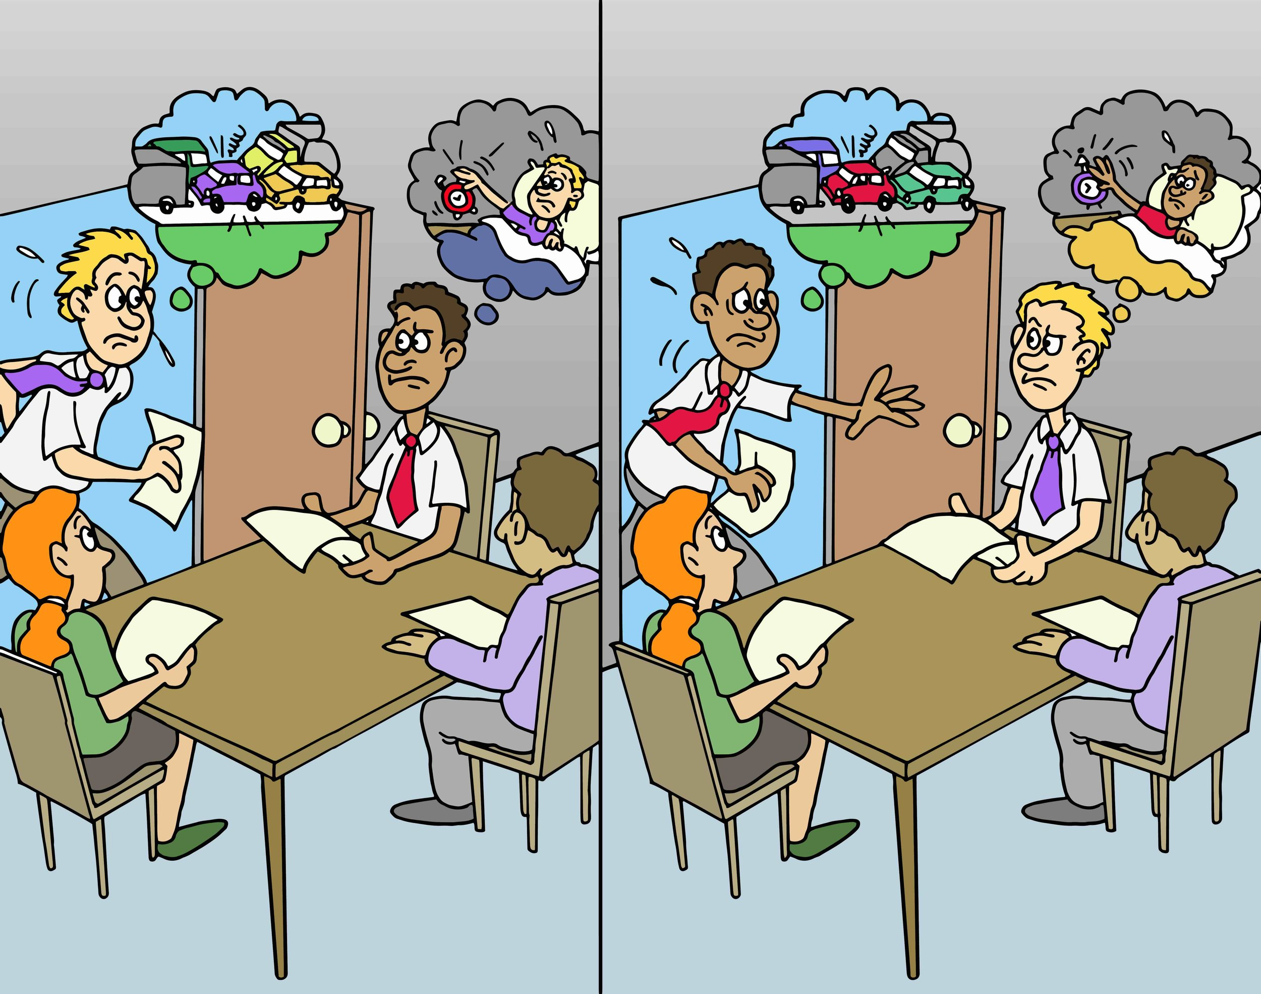
Try to avoid the Fundamental Attribution Error

Slide 9
Other considerations:
What’s
In
It
For
Them
→ Can you add WIIFT to your feedback?
Why are you offering this feedback?
What good could come to the person if they follow your advice?

Slide 10
Modify your feedback
Assignment MUST use situation-behavior-impact

Slide 11
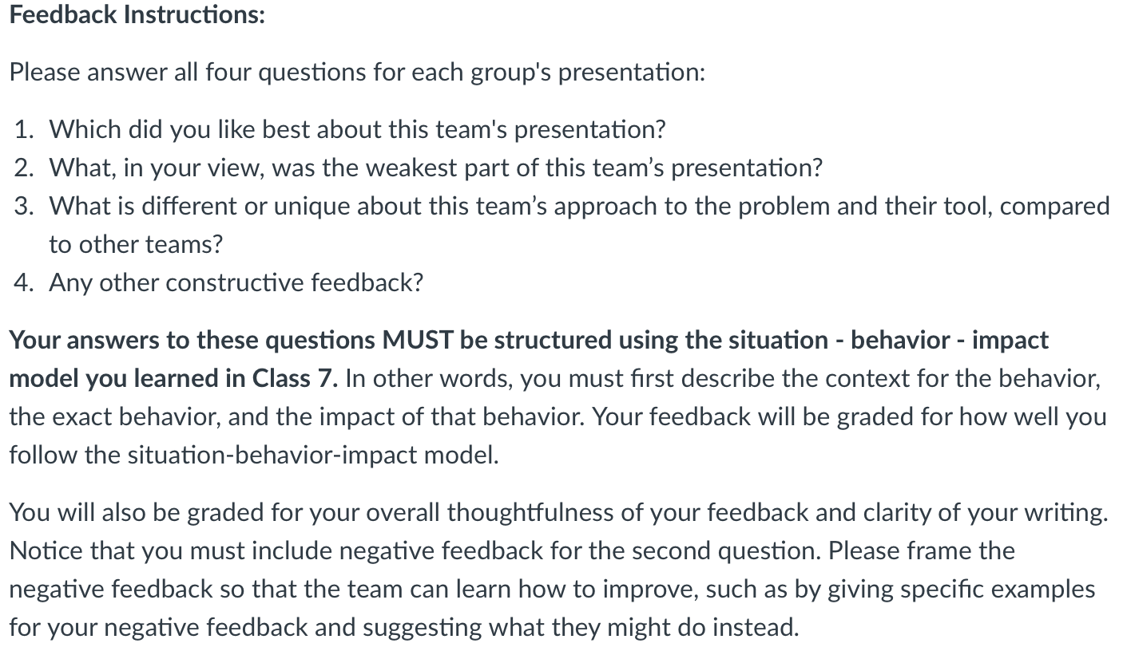
This time, use Situation-Behavior-Impact
Feedback = team assignment
Feedback quality = graded
Detailed instructions → Canvas
Submit → 2 places!
1. Assignments
(for professor)
2. Discussions
(for team)

Slide 12
Breath + Posture
Prepare to present

Slide 13
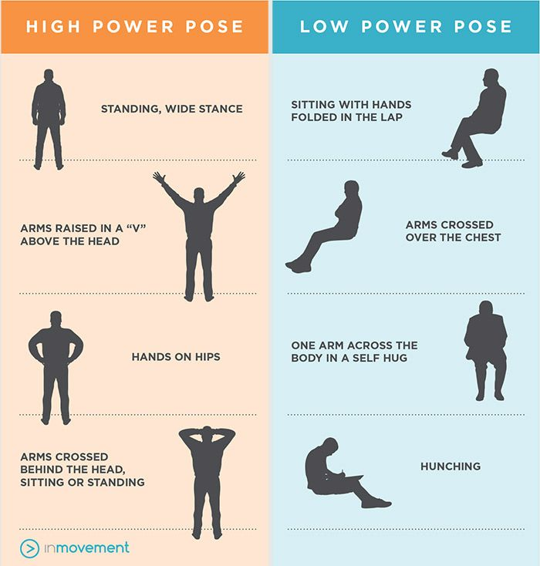

Slide 15
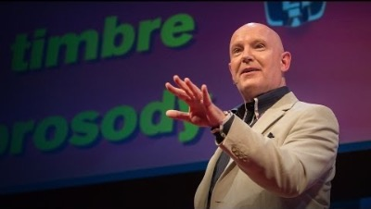
Warm Up Your Voice!
Notes:
https://www.youtube.com/watch?v=eIho2S0ZahI
Vocal warm up exercises start at 7:50
Turn on CC!

