Slide 1

Week 2 Random Variables
Statistical Analysis

Slide 2
Topic List
Random Variable Overview
Developing Discrete Probability Distributions
Expected Value and Variance
Binomial Probability Distribution
Poisson Probability Distribution
Normal Probability Distribution

Slide 3
Introduction to Random Variables (RV)
A random variable is the result of a chance event (experiment) that you can count or measure.
We use random variables to analyze events (sales, employee turnover, mortgage defaults)
Two types of random variables:
Discrete and Continuous

Slide 4
Two Types of Random Variables (RV)
Discrete (counting)
may assume either a finite number of values
or an infinite sequence of values.
RV
Continuous (measuring)
Random
Event
X = {
Possible
Values
may assume any numerical value in an interval
or collection of intervals.
Random
Variable

Slide 5
Two Types of Random Variables (RV) - Visually
Probability
Distribution
Function
Discrete
RV
Probability
Density
Function
Continuous

Slide 6

Random Variable with a Finite Number of Values
Example: JSL Appliances
Let x = number of TVs sold at the store in one day,
where x can take on 5 values (0, 1, 2, 3, 4)
o
We can count the TVs sold, and there is a finite
upper limit on the number that might be sold (which
is the number of TVs in stock).
Discrete or Continuous Random Variable?
Discrete

Slide 7

Discrete Random Variable with an Infinite Sequence of Values
Example: JSL Appliances
Let x = number of customers arriving in one day,
where x can take on the values 0, 1, 2, . . .
We can count the customers arriving, but there is
no finite upper limit (theoretically) on the number that might arrive.

Slide 8
Discrete Random Variables
Binomial Probability Distribution
Poisson Probability Distribution

Slide 9
Discrete Probability Distributions
The probability distribution is defined by a
probability function, denoted by p(x), that provides
the probability for each value of the random variable.
sometimes f(x)
The required conditions for a discrete probability
function are:
p(x) > 0
1.
Σ p(x) = 1
2.

Slide 10
Discrete Probability Distributions
Example: JSL Appliances
Using past data on TV sales, a tabular representation
of the probability distribution for sales was developed.
“probability of zero TV sales”
Number
Units Sold of Days
0 80
1 50
2 40
3 10
4 20
200
x p(x)
0 .40
1
2
3
4
1.00
Your Turn!
.25
.20
.05
.10

Slide 11
Discrete Probability Distributions
“probability of zero TV sales”
Example: JSL Appliances
.50
.40
.30
Graphical
representation
of probability
distribution
Probability
.20
.10
0 1 2 3 4
Values of Random Variable x (TV sales)

Slide 12
Discrete Uniform Probability Distribution
The discrete uniform probability distribution is the
simplest example of a discrete probability
distribution given by a formula.
p(x) = 1/n
“the values of the
random variable
are equally likely”
where:
n = the number of values the random
variable may assume
Your turn!
Probability of rolling a fair die and getting a 5
p(x=5) = 1/6

Slide 13
Expected Value
The expected value, or mean, of a random variable
is a measure of its central location.
E(x) = μ_{x} = Σ xp(x)
The expected value is a weighted average of the
values the random variable may assume. The
weights are the probabilities.

Slide 14
Variance and Standard Deviation
The variance summarizes the variability in the
values of a random variable.
Var(x) = σ²_{x} = Σ(x - μ _{x})² p(x)
The variance is a weighted average of the squared
deviations of a random variable from its mean.
The weights are the probabilities.
The standard deviation, σ , is defined as the
positive square root of the variance.

Slide 15
Expected Value
The expected value is a weighted average of the
values the random variable may assume
Example: JSL Appliances
x p(x) xp(x)
0 .40 .00
1 .25 .25
2 .20 .40
3 .05 .15
4 .10 .40
E(x) = 1.20
expected number of TVs sold in a day

Slide 16
Binomial Probability Distribution
Four Properties of a Binomial Experiment
1. The experiment consists of a sequence of n
identical trials.
2. Two outcomes, success and failure, are possible
on each trial.
3. The probability of a success, denoted by p, does
not change from trial to trial. Thus, the probability of
failure is denoted as (1-p) or q and also does not change
from trial to trial.
4. The trials are independent.

Slide 17
Binomial Probability Distribution Sample Cases
Cox, Ross, and Rubinstein (1979), in which they use a binomial distribution to provide a discrete model for derivatives prices
A house will either “get the contract” or “not get the contract”
A research firm receives survey responses of “yes, I will buy” or “no, I will not”.

Slide 18
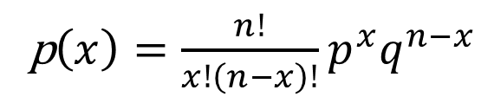
Binomial Probability Distribution
Binomial Probability Function
p$\left(x\right)=\frac{n!}{x!\left(n−x\right)!}p^{x}q^{n−x}$
where:
x = the number of successes
p = the probability of a success on one trial
q = 1 - p
n = the number of trials
p(x) = the probability of x successes in n trials
n! = n(n – 1)(n – 2) ….. (2)(1)

Slide 19
Binomial Probability Distribution
Example: Evans Electronics
Evans Electronics is concerned about a low
retention rate for its employees. In recent years,
management has seen a turnover of 10% of the
hourly employees, annually.
Thus, for any hourly employee chosen at random,
management estimates a probability of 0.1 that the
person will not be with the company next year? (p = 0.1) and (1-p) or (q) = (1 - 0.10)
Choosing 3 hourly employees at random, what is
the probability that 1 of them will leave the company
this year?

Slide 20
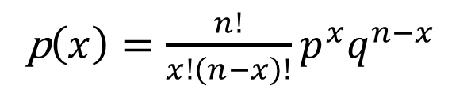
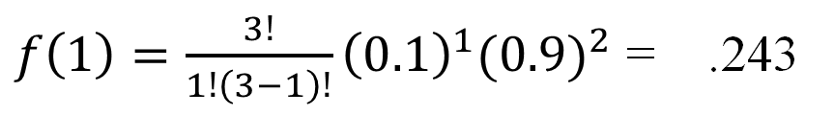
Binomial Probability Distribution
Using Probability Function
Example: Evans Electronics
Using the
probability
function
Let: p = .10, n = 3, x = 1
p$\left(x\right)=\frac{n!}{x!\left(n−x\right)!}p^{x}q^{n−x}$
$f\left(1\right)=\frac{3!}{1!\left(3−1\right)!}{\left(0.1\right)}^{1}(0.9)^{2}$ = .243

Slide 21
Using Excel to Compute Binomial Probabilities – Using Excel (preferred)
Excel Formula Worksheet
A
B
1
3
= Number of Trials (
n
)
2
0.1
= Probability of Success (
p
)
3
4
x
p
(
x
)
5
0
=BINOM.DIST(A5,$A$1,$A$2,
FALSE
)
6
1
=BINOM.DIST(A6,$A$1,$A$2,
FALSE
)
7
2
=BINOM.DIST(A7,$A$1,$A$2,
FALSE
)
8
3
=BINOM.DIST(A8,$A$1,$A$2,
FALSE
)
9
Trials
Number (x)
Probability

Slide 22
Using Excel to Compute Binomial Probabilities
Excel Value Worksheet
A
B
1
3
= Number of Trials (
n
)
2
0.1
= Probability of Success (
p
)
3
4
x
f
(
x
)
5
0
0.729
6
1
0.243
7
2
0.027
8
3
0.001
9
Probability one person out of three randomly picked employees leaves the company

Slide 23
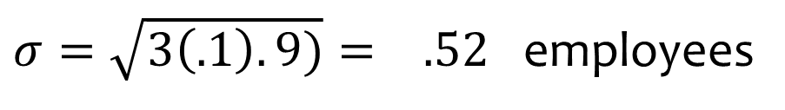
Binomial Probability Distribution
Example: Evans Electronics
Expected Value
E(x) = np = 3(.1) = .3 employees out of 3
Variance
Var(x) = np(1 – p) = 3(.1)(.9) = .27
Standard Deviation
$σ=\sqrt{3\left(.1\right).9)}= .52$ employees

Slide 24
Practice Problem # 1 Binomial Probability Distribution Use Formula and Check with Excel
According to reports, approximately 20% of the households in the Detroit metropolitan area were in some stage of foreclosure during the mortgage crisis (they have the highest foreclosure rate in the nation). Suppose 3 mortgage-holding households in the Detroit area were sampled.
A. What is the probability that exactly 1 of these households were in some stage of foreclosure?
B. What is the probability that more than 1 of these households were in some stage of foreclosure?

Slide 25
Poisson Probability Distribution
A Poisson distributed random variable is often
useful in estimating the number of occurrences
over a specified interval of time or space
It is a discrete random variable that may assume
an infinite sequence of values (x = 0, 1, 2, . . . ).

Slide 26
Poisson Probability Distribution
Two Properties of a Poisson Experiment
The probability of an occurrence is the same
for any two intervals of equal length.
The occurrence or nonoccurrence in any
interval is independent of the occurrence or
nonoccurrence in any other interval.

Slide 27


Poisson Probability Distribution
Poisson Probability Function
$$p\left(x\right)=\frac{μ^{x}e^{−μ}}{x!}$$
where:
x = the number of occurrences in an interval
p(x) = the probability of x occurrences in an interval
$μ$ = mean number of occurrences in an interval
e = 2.71828
x! = x(x – 1)(x – 2) . . . (2)(1)

Slide 28
Poisson Probability Distribution
Poisson Probability Function
Since there is no stated upper limit for the number
of occurrences, the probability function f(x) is
applicable for values x = 0, 1, 2, … without limit.
In practical applications, x will eventually become
large enough so that f(x) is approximately zero
and the probability of any larger values of x
becomes negligible.

Slide 29
Poisson Probability Distribution
Example: Mercy Hospital
Patients arrive at the emergency room of Mercy
Hospital at the average rate of 6 per hour on
weekend evenings.
What is the probability of 4 arrivals in 30 minutes
on a weekend evening?

Slide 30
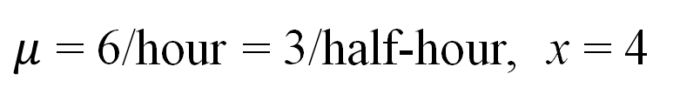
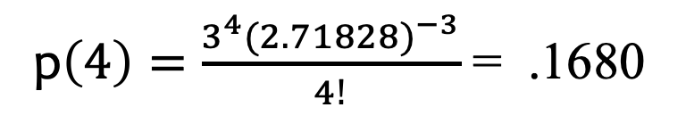
Poisson Probability Distribution
Example: Mercy Hospital
30 minutes (or half-hour) is what the problem is asking us
60 minutes (or an hour) is what the problem gave us
$μ$ = 6/hour = 3/half-hour, x = 4
p$\left(4\right)=\frac{3^{4}(2.71828)^{−3}}{4!}$ = .1680
Using the
probability
function

Slide 31
Using Excel to Compute Poisson Probabilities
Excel Formula Worksheet
A
B
1
3
= Mean No. of Occurrences (µ)
2
Number of
3
Arrivals (
x
)
Probability
f
(
x
)
4
0
=POISSON.DIST(A4,$A$1,FALSE)
5
1
=POISSON.DIST(A5,$A$1,FALSE)
6
2
=POISSON.DIST(A6,$A$1,FALSE)
7
3
=POISSON.DIST(A7,$A$1,FALSE)
8
4
=POISSON.DIST(A8,$A$1,FALSE)
9
5
=POISSON.DIST(A9,$A$1,FALSE)
10
6
=POISSON.DIST(A10,$A$1,FALSE)
… and so on … and so on

Slide 32
Using Excel to Compute Poisson Probabilities
Excel Value Worksheet
A
B
1
3
= Mean No. of Occurrences (µ)
2
Number of
3
Arrivals (
x
)
Probability
f
(
x
)
4
0
0.0498
5
1
0.1494
6
2
0.2240
7
3
0.2240
8
4
0.1680
9
5
0.1008
10
6
0.0504
… and so on … and so on

Slide 33
Poisson Probability Distribution
Example: Mercy Hospital
Poisson Probabilities
0.25
0.20
Actually,
the sequence
continues:
11, 12, 13 …
0.15
Probability
0.10
0.05
0.00
0
1
2
3
4
5
6
7
8
9
10
Number of Arrivals in 30 Minutes

Slide 34
Using Excel to Compute Cumulative Poisson Probabilities
Excel Formula Worksheet
A
B
1
3
= Mean No. of Occurrences (m )
2
Number of
3
Arrivals (
x
)
Cumulative Probability
4
0
=POISSON.DIST(A4,$A$1,
TRUE)
5
1
=POISSON.DIST(A5,$A$1,
TRUE)
NOTE the difference
6
2
=POISSON.DIST(A6,$A$1,
TRUE)
7
3
=POISSON.DIST(A7,$A$1,
TRUE)
8
4
=POISSON.DIST(A8,$A$1,
TRUE)
9
5
=POISSON.DIST(A9,$A$1,
TRUE)
10
6
=POISSON.DIST(A10,$A$1,
TRUE)
… and so on … and so on

Slide 35
Using Excel to Compute Cumulative Poisson Probabilities
Excel Value Worksheet
A
B
1
3
= Mean No. of Occurrences (m )
2
Number of
3
Arrivals (
x)
Cumulative Probability
4
0
0.0498
5
1
0.1991
6
2
0.4232
7
3
0.6472
8
4
0.8153
9
5
0.9161
10
6
0.9665
… and so on … and so on

Slide 36
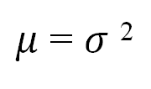
Poisson Probability Distribution
A property of the Poisson distribution is that
the mean and variance are equal (trust me ☺)
$μ$ = $σ$ ²

Slide 37
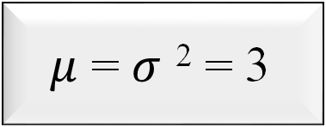
Poisson Probability Distribution (check)
Example: Mercy Hospital
Variance for Number of Arrivals
During 30-Minute Periods
$μ$ = $σ$ ² = 3

Slide 38
Practice Problem # 2 Poisson Probability Distribution Use Formula and Check with Excel
A local bank’s branch has a drive-through window. On average, 12 customers per hour arrive at the window, and we’ll assume these arrivals follow a Poisson distribution.
A. What is the probability that exactly four customers will arrive during the next 30 minutes?

Slide 39
Chapter 6 Continuous Random Variables

Slide 40
Continuous Random Variables
Uniform Probability Distribution
Normal Probability Distribution
Exponential Probability Distribution
f (x)
Exponential
Uniform
f (x)
Normal
f (x)
x
x
x

Slide 41
Continuous Probability Distributions
The probability of the random variable assuming a value within some given interval from x₁ to x₂ is defined to be the area under the graph of the probability density function between x₁ and x₂.
f (x)
Exponential
Uniform
f (x)
Normal
f (x)
x₂
x
x₁
x
x₁
x₂
x
x₁
x₂

Slide 42
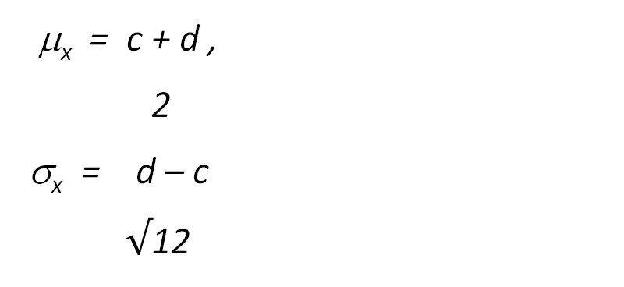
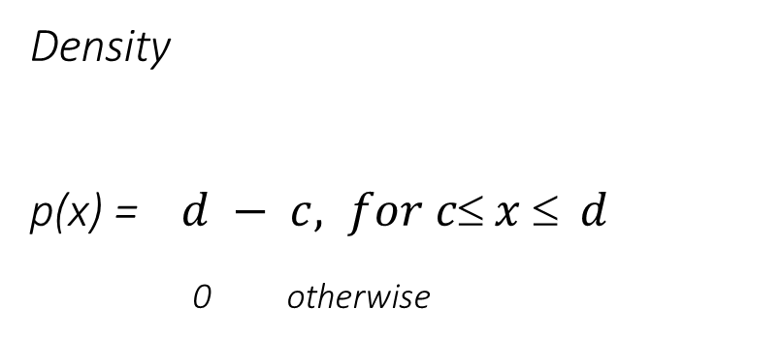
Continuous Uniform Distribution
Probability never changes
Density
p(x) = $d − c, for c x  d$
0 otherwise
p(x)
1
c d x→
μ_{x} = c + d ,
2
σ_{x} = d – c
$√$12

Slide 43
Uniform Probability Distribution
Example: Slater's Buffet
Slater customers are charged for the amount of
salad they take. Sampling suggests that the amount
of salad taken is uniformly distributed between 5
ounces and 15 ounces.

Slide 44
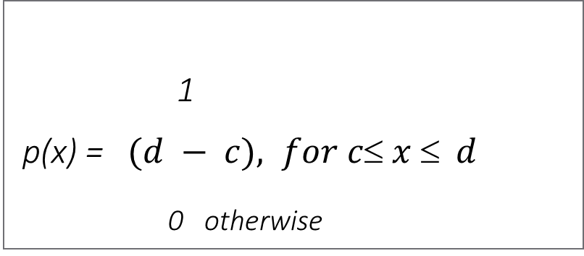
Uniform Probability Distribution
Uniform Probability Density Function
The Math:
1
(15 – 5)
p(x) = 1/10 for 5 < x < 15
= 0 otherwise
where:
x = salad plate filling weight
1
p(x) = $(d − c), for c x  d$
0 otherwise

Slide 45
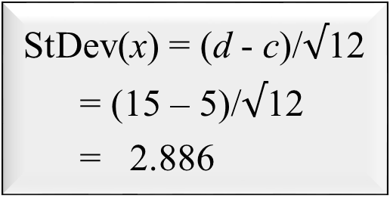
Uniform Probability Distribution
Expected Value of x
E(x) = (c + d)/2
= (5 + 15)/2
= 10
“expected salad weight”
Standard Deviation x
StDev(x) = (d - c)/$√$12
= (15 – 5)/$√$12
= 2.886

Slide 46
Uniform Probability Distribution
What is the probability that a customer
will take between 12 and 15 ounces of salad?
f(x)
P(12 < x < 15) = 1/10(3) = .3
1/10
x
0
5
10
12
15
Salad Weight (oz.)

Slide 47
Practice Problem # 3 Continuous Uniform Probability Distribution
A manager of a local drugstore is projecting next month’s sales for a particular cosmetic line. She knows from historical data that sales follow a continuous uniform distribution with a lower limit of $2,500 and an upper limit of $5,000.
A. What are the mean and the standard deviation for this continuous probability distribution?
B. What is the probability that sales exceed 4,000?
C. What is the probability that sales are between $3,200 and $3,800?

Slide 48
Normal Probability Distribution
It is widely used in statistical inference.
It is used in a wide variety of applications
including:
Heights of people
Rainfall amounts
Test scores
Scientific measurements

Slide 49
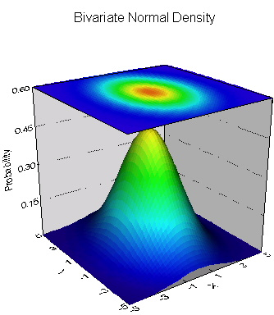
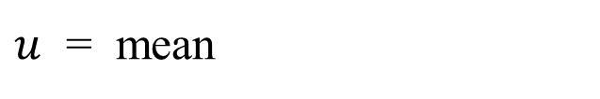
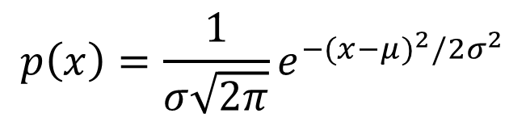
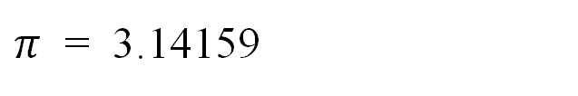
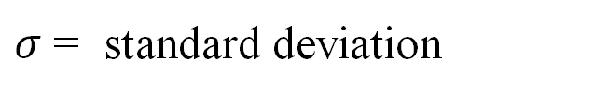
Normal Probability Distribution
Normal Probability Density Function
$$p\left(x\right)=\frac{1}{σ\sqrt{2π}}e^{−(x−μ)^{2}/2σ^{2}}$$
where:
$u$ = mean
$σ$ = standard deviation
$π$ = 3.14159
e = 2.71828

Slide 50
Normal Probability Distribution
Characteristics
The distribution is symmetric; its skewness
measure is zero.
x

Slide 51
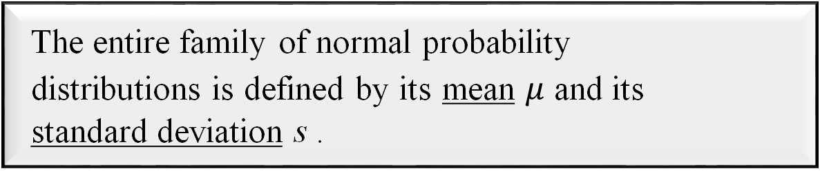

Normal Probability Distribution
Characteristics
The entire family of normal probability
distributions is defined by its mean $μ$ and its
standard deviation s .
Standard Deviation s
$$μ$$
x

Slide 52
Normal Probability Distribution
Characteristics
The highest point on the normal curve is at the
mean, which is also the median and mode.
x

Slide 53
Normal Probability Distribution
Characteristics
The mean can be any numerical value: negative,
zero, or positive.
x
-10
0
25

Slide 54
Normal Probability Distribution
Characteristics
The standard deviation determines the width of the
curve: larger values result in wider, flatter curves.
s = 15
s = 25
x

Slide 55
Normal Probability Distribution
Characteristics
Probabilities for the normal random variable are
given by areas under the curve. The total area
under the curve is 1 (.5 to the left of the mean and
.5 to the right).
.5
.5
x

Slide 56







Normal Probability Distribution
Characteristics (basis for the empirical rule)
99.72%
95.44%
68.26%
x
$$μ$$
$μ$ + 3s
$μ$ – 3s
$μ$ – 1s
$μ$ + 1s
$μ$– 2s
$μ$ + 2s

Slide 57
Standard Normal Probability Distribution
Characteristics
A random variable having a normal distribution
with a mean of 0 and a standard deviation of 1 is
said to have a standard normal probability
distribution.

Slide 58

Standard Normal Probability Distribution
Characteristics
The letter z is used to designate the standard
normal random variable.
s = 1
z
0
Notice that this is not $μ$

Slide 59
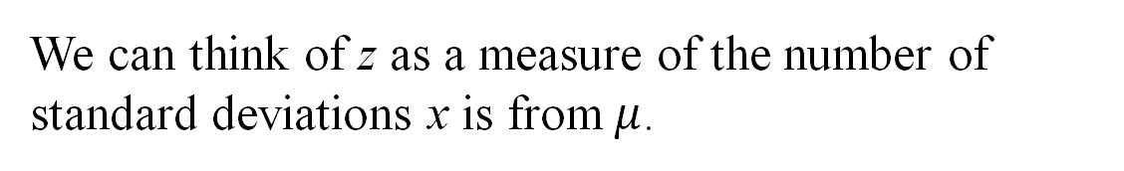
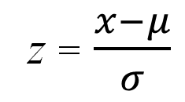
Standard Normal Probability Distribution
Converting to the Standard Normal Distribution
z = $\frac{x−μ}{σ}$
We can think of z as a measure of the number of
standard deviations x is from$μ$.

Slide 60
Using Excel to Compute Standard Normal Probabilities
Excel has two functions for computing probabilities and z values for a standard normal distribution:
is used to compute the cumulative
probability given a z value.
NORM.S.DIST
is used to compute the z value
given a cumulative probability.
NORM.S.INV
The “S” in the function names reminds
us that they relate to the standard
normal probability distribution.

Slide 61
Standard Normal Probability Distribution
Example: Pep Zone
Pep Zone sells auto parts and supplies including
a popular multi-grade motor oil. When the stock of
this oil drops to 20 gallons, a replenishment order is
placed.
The store manager is concerned that sales are
being lost due to stockouts while waiting for a
replenishment order.

Slide 62
Standard Normal Probability Distribution
Example: Pep Zone
It has been determined that demand during
replenishment lead-time is normally distributed
with a mean of 15 gallons and a standard deviation
of 6 gallons.
The manager would like to know the probability
of a stockout during replenishment lead-time. In
other words, what is the probability that demand
during lead-time will exceed 20 gallons?
P(x > 20) = ?

Slide 63
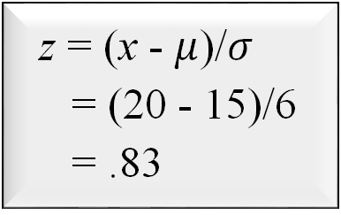
Standard Normal Probability Distribution
Solving for the Stockout Probability
Step 1: Convert x to the standard normal distribution.
z = (x - $μ$)/$σ$
= (20 - 15)/6
= .83
Step 2: Find the area under the standard normal
curve to the left of z = .83.
see next slide

Slide 64
Standard Normal Probability Distribution
Cumulative Probability Table for
the Standard Normal Distribution
z
.00
.01
.02
.03
.04
.05
.06
.07
.08
.09
.
.
.
.
.
.
.
.
.
.
.
.5
.6915
.6950
.6985
.7019
.7054
.7088
.7123
.7157
.7190
.7224
.6
.7257
.7291
.7324
.7357
.7389
.7422
.7454
.7486
.7517
.7549
.7
.7580
.7611
.7642
.7673
.7704
.7734
.7764
.7794
.7823
.7852
.8
.7881
.7910
.7939
.7967
.7995
.8023
.8051
.8078
.8106
.8133
.9
.8159
.8186
.8212
.8238
.8264
.8289
.8315
.8340
.8365
.8389
.
.
.
.
.
.
.
.
.
.
.
P(z < .83)

Slide 65
Standard Normal Probability Distribution
Solving for the Stockout Probability
Step 3: Compute the area under the standard normal
curve to the right of z = .83.
P(z > .83) = 1 – P(z < .83)
= 1- .7967
= .2033
Probability
of a stockout
P(x > 20)

Slide 66
Standard Normal Probability Distribution
Solving for the Stockout Probability
Area = 1 - .7967
= .2033
Area = .7967
z
0
.83

Slide 67
Standard Normal Probability Distribution (applications worksheet)
Scores on a management aptitude exam are normally distributed with a mean of 72 and a standard deviation of 8.
A. What is the probability that a randomly selected manager will score above 60?
B. What is the probability that a randomly selected manager will score between 68 and 84?

Slide 68
Poisson and Exponential Distributions
Both distributions relate to the same kind of process (a Poisson process), but they govern different aspects:
The Poisson distribution governs how many events happen in the given time-period and
The exponential distribution governs how much time elapses between consecutive events.
Poisson – Discrete
Exponential – Continuous The following has a POISSON DISTRIBUTION: * the number of events in the given time-period
The following have an EXPONENTIAL DISTRIBUTION: * the time until the first event * the time from now until the next occurrence of an event * the time interval between two successive events

