Slide 1

Week 3: Sampling Distributions
One of the most central and important topics in statistics but hard to comprehend!

Slide 2
Common Definitions
Population is described by parameters.
A parameter is a constant, whose value may be unknown.
Sample is described by statistics.
A statistic is a random variable whose value depends on the chosen random sample.
Statistics are used to make inferences about the population parameters.
Can draw multiple random samples of size n.
LO 7.3

Slide 3
Source: Google image

Slide 4
An Example
A marketing firm is interested in finding out the average yearly salary of all JHU students after completing MS degree
The population is the collection of all the salaries of MS degree students.
A sample includes a random selection of alumni.
The parameter is the average salary in the population
The statistic is the average salary the sample

Slide 5
Sampling Distributions
Problem: It’s impossible to survey all graduates.
Solution: Looking at a small grouping of data (sample) to draw conclusions.

Slide 6
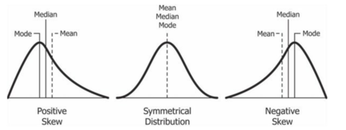
Different Population Distributions

Slide 7
The Sampling Distribution of the Means
Sampling Distribution of the Mean
Each random sample of size n drawn from the population provides an estimate of μ—the sample mean .
Drawing many samples of size n results in many different sample means, one for each sample.
The sampling distribution of the mean is the frequency or probability distribution of these sample means.
LO 7.3

Slide 8
The Sampling Distribution of the Means
Example
One simple random sample drawn from the population—a single distribution of values of X.
 | Random Variable
 | X₁ |  | X₂ |  | X₃ |  | X₄ |  | Mean of X
 | 6 |  | 10 |  | 8 |  | 4 |  | 5.57
 | 5 |  | 10 |  | 4 |  | 3 |  | 5.71
 | 1 |  | 8 |  | 4 |  | 3 |  | 6.36
 | 4 |  | 1 |  | 6 |  | 2 |  | 4.07
 | 6 |  | 6 |  | 8 |  | 4
 | 7 |  | 7 |  | 8 |  | 6
 | 1 |  | 5 |  | 10 |  | 5
 | 5 |  | 5 |  | 9 |  | 1
 | 4 |  | 6 |  | 4 |  | 2
 | 7 |  | 4 |  | 9 |  | 5
 | 8 |  | 5 |  | 8 |  | 6
 | 9 |  | 2 |  | 7 |  | 7
 | 9 |  | 1 |  | 2 |  | 3
 | 6 |  | 10 |  | 2 |  | 6
Means | 5.57 |  | 5.71 |  | 6.36 |  | 4.07 |  | 5.43
A distribution of means from each random draw from the population—a sampling distribution.
Means from each distribution (random draw) from the population.
LO 7.3

Slide 9
Example 1
There are 1000 machines in a factory that produce product A. We calculate the number of A’s per machine produced in one hour.
Data (pop mean = 75, pop stdev = 15)
Machine | Number of A’s in 1 hour
1 | 93
2 | 53
3 | 97
.
.
1000 | 83

Slide 10
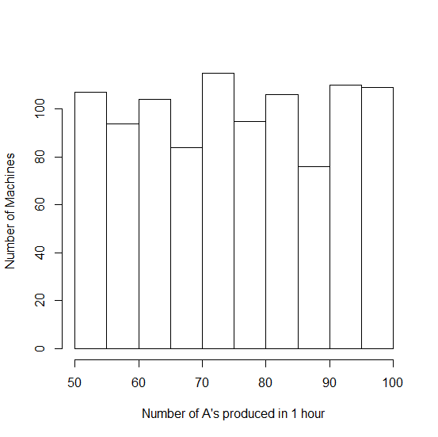
Example 2 - Population
Not a normal distribution

Slide 11
Central Limit Theorem
For (almost) any population,
if the sample size n is large enough (30 or more),
the population of all possible sample means is approximately normal.
The larger the sample size n, the better the approximation.

Slide 12
Example 2
Take 100 different RANDOM samples of n=50 from the 1000 data points
Calculate the mean of each of these 100 samples
Sample (n=50) | Average Number of A’s produced in 1 hour
1 | 71
2 | 76
3 | 76
.
.
100 | 78

Slide 13
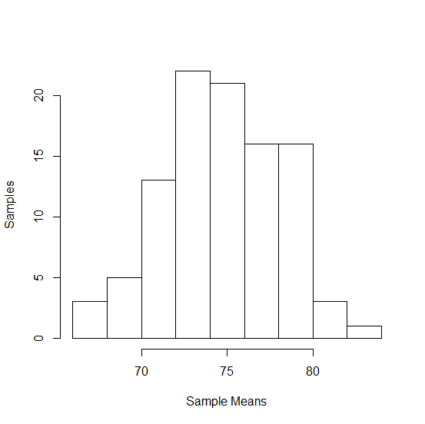
Example 2: Sampling Distribution of the Sample Means
Normal Distribution!

Slide 14
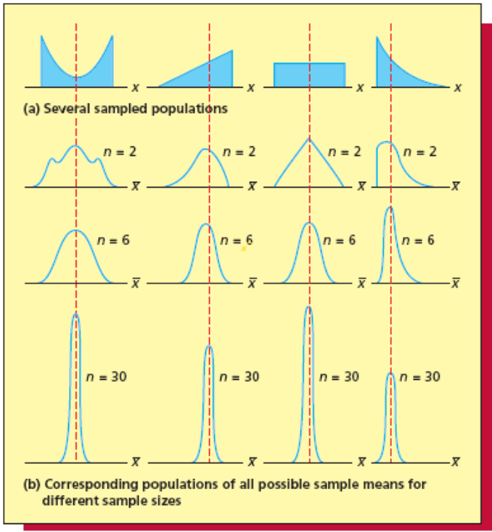
Effects of Sample Size

Slide 15
Sampling Error Difference between sample average and population average
Sample average
Population average

Slide 16
Properties of the Sampling Distribution of the Sample Means
If the population being sampled is normal, then the sampling distribution of the sample mean is also normal
Has
That is, the mean of all possible sample means is the same as the population mean
And…

Slide 17
Properties of the Sampling Distribution of the Sample Means
The standard deviation (aka standard error of sample mean) is:
The formula holds exactly if the sample population is infinite. It holds approximately* (under certain conditions) if is the sample population is finite.

Slide 18
Normal Distribution
The normal curve is symmetrical about its mean μ.
-∝ ←x μ x→∝
When μ =0 and σ = 1, we have a special case of the normal distribution called “the standard normal distribution”. We use variable z instead of x to denote the standard normal.
To calculate probabilities, we convert a normal distribution to the standard normal and use the standard normal probability table.

Slide 19
Normal Distribution to Standard Normal
To convert to standard normal:
“standard” way of converting to Z
For the sampling distribution:

Slide 20
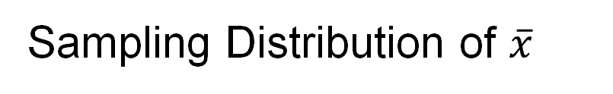
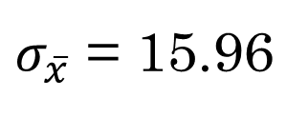


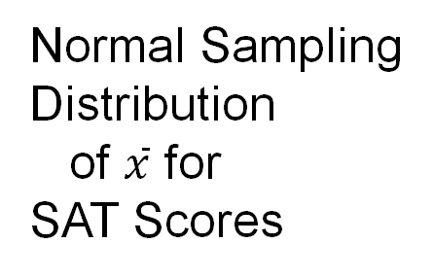
Sampling Distribution of $\overline{x}$
Example: St. Andrew’s College
Normal Sampling
Distribution
of $\overline{x}$ for
SAT Scores
$σ_{\overline{x}}$ = 15.96
$$\overline{x}$$
$$E\left(\overline{x}\right)=1697$$

Slide 21
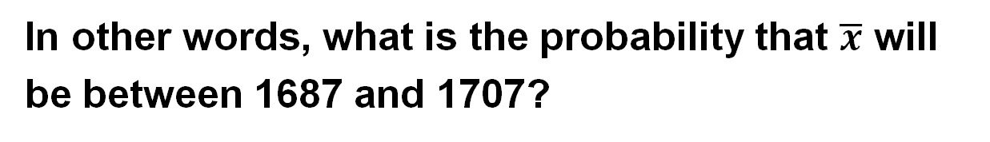
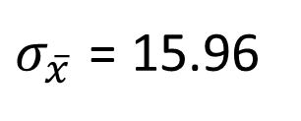
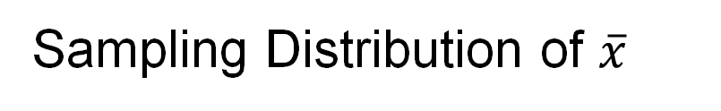
Sampling Distribution of $\overline{x}$
$σ_{\overline{x}}$ = 15.96
Example: St. Andrew’s College
What is the probability that a simple random
sample of 30 applicants will provide an estimate of
the population mean SAT score that between 1687 1707 of the actual population mean μ ?
In other words, what is the probability that $\overline{x}$ will
be between 1687 and 1707?

Slide 22
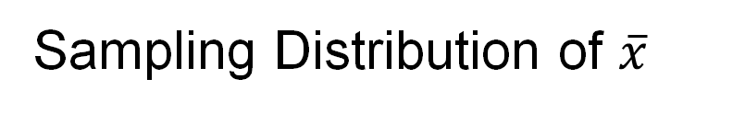
Sampling Distribution of $\overline{x}$
Example: St. Andrew’s College
Step 1: Calculate the z-value at the upper endpoint of
the interval.
z = (1707 - 1697)/15.96 = .63
Step 2: Find the area under the curve to the left of the
upper endpoint.
P(z < .63) = .7357

Slide 23
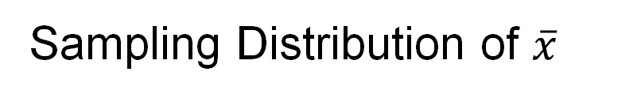
Sampling Distribution of $\overline{x}$
Example: St. Andrew’s College
Cumulative Probabilities for
the Standard Normal Distribution
z
.00
.01
.02
.03
.04
.05
.06
.07
.08
.09
.
.
.
.
.
.
.
.
.
.
.
.5
.6915
.6950
.6985
.7019
.7054
.7088
.7123
.7157
.7190
.7224
.6
.7257
.7291
.7324
.7357
.7389
.7422
.7454
.7486
.7517
.7549
.7
.7580
.7611
.7642
.7673
.7704
.7734
.7764
.7794
.7823
.7852
.8
.7881
.7910
.7939
.7967
.7995
.8023
.8051
.8078
.8106
.8133
.9
.8159
.8186
.8212
.8238
.8264
.8289
.8315
.8340
.8365
.8389
.
.
.
.
.
.
.
.
.
.
.

Slide 24
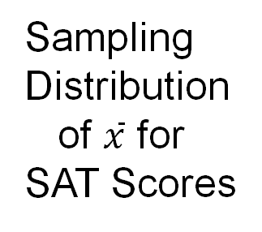
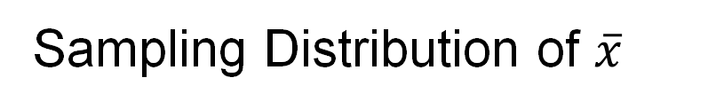

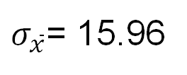
Sampling Distribution of $\overline{x}$
Example: St. Andrew’s College
Sampling
Distribution
of $\overline{x}$ for
SAT Scores
$σ_{\overline{x}}$= 15.96
Area = .7357
$$\overline{x}$$
1697
1707

Slide 25
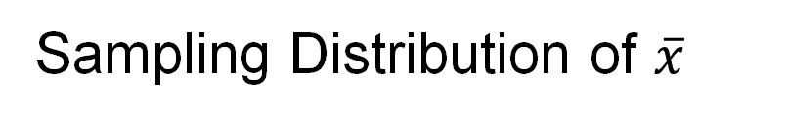
Sampling Distribution of $\overline{x}$
Example: St. Andrew’s College
Step 3: Calculate the z-value at the lower endpoint of
the interval.
z = (1687 - 1697)/15.96 = - .63
Step 4: Find the area under the curve to the left of the
lower endpoint.
P(z < -.63) = .2643

Slide 26
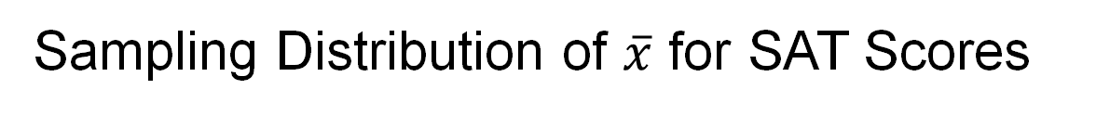
Sampling Distribution of $\overline{x}$ for SAT Scores
Example: St. Andrew’s College
Sampling
Distribution
of $\overline{x}$ for
SAT Scores
$σ_{\overline{x}}$= 15.96
Area = .2643
$$\overline{x}$$
1687
1697

Slide 27
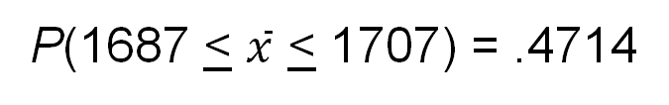
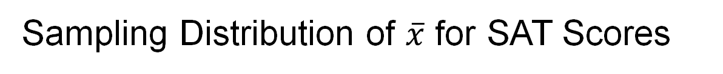
Sampling Distribution of $\overline{x}$ for SAT Scores
Example: St. Andrew’s College
Step 5: Calculate the area under the curve between
the lower and upper endpoints of the interval.
P(-.63 < z < .63) = P(z < .63) - P(z < -.63)
= .7357 - .2643
= .4714
The probability that the sample mean SAT score will
be between 1687 and 1707 is:
P(1687 < $\overline{x}$ < 1707) = .4714

Slide 28
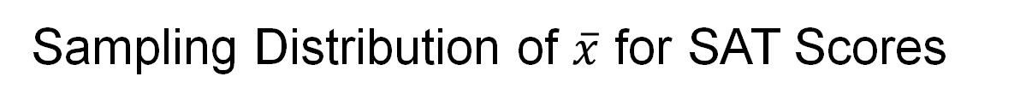
Sampling Distribution of $\overline{x}$ for SAT Scores
Example: St. Andrew’s College
Sampling
Distribution
of $\overline{x}$ for
SAT Scores
$σ_{\overline{x}}$= 15.96
Area = .4714
$$\overline{x}$$
1687
1697
1707

Slide 29
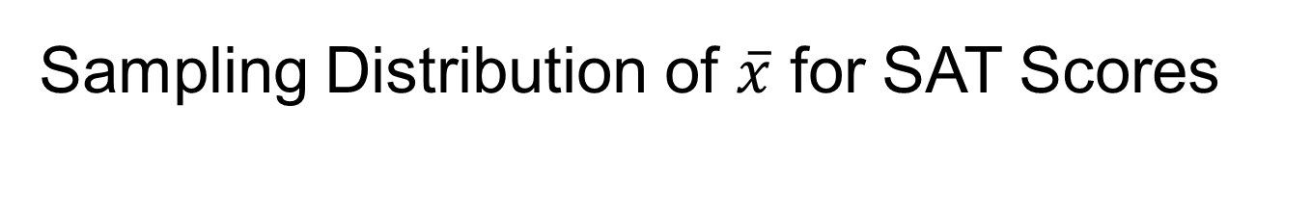
Sampling Distribution of $\overline{x}$ for SAT Scores
The probability that x-bar is between 1687 – 1707 is 0.4714
How would we interpret this information?
How can we improve this estimate?

Slide 30
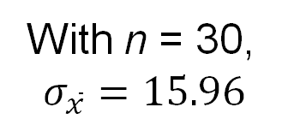
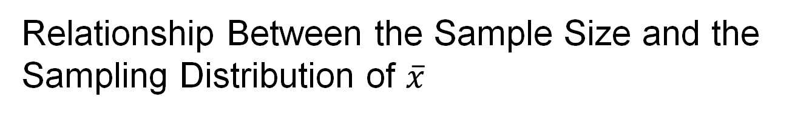

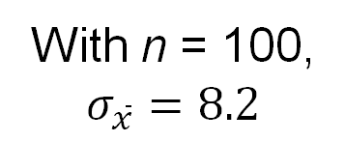
Relationship Between the Sample Size and the Sampling Distribution of $\overline{x}$
Example: St. Andrew’s College
With n = 100,
$$σ_{\overline{x}}=8.2$$
With n = 30,
$$σ_{\overline{x}}=15.96$$
$$\overline{x}$$
$$E\left(\overline{x}\right)=1697$$

Slide 31
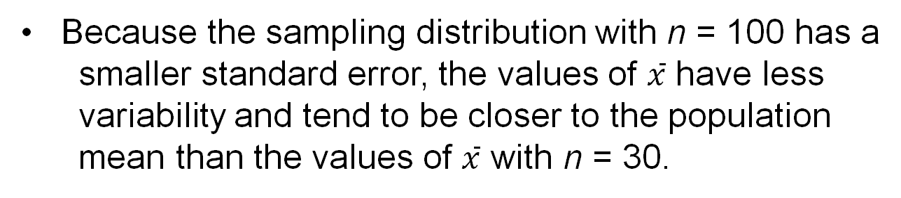
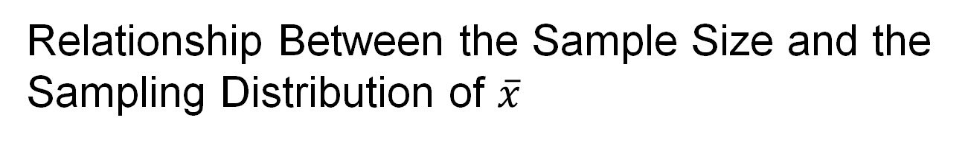
Relationship Between the Sample Size and the Sampling Distribution of $\overline{x}$
Example: St. Andrew’s College
Because the sampling distribution with n = 100 has a
smaller standard error, the values of $\overline{x}$ have less
variability and tend to be closer to the population
mean than the values of $\overline{x}$ with n = 30.

Slide 32
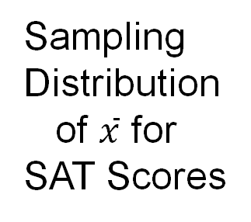


Relationship Between the Sample Size and the Sampling Distribution of $\overline{x}$
Example: St. Andrew’s College
Sampling
Distribution
of $\overline{x}$ for
SAT Scores
$$σ_{\overline{x}}=8.2$$
Area = .7776
$$\overline{x}$$
1687
1697
1707

Slide 33
Minimum Variance Estimates
Want the sample statistic to have a small standard deviation
All values of the sample statistic should be clustered around the population parameter
Then, the statistic from any sample should be close to the population parameter

Slide 34
Practice Problem # 1 Sampling Distribution
In an article in the Journal of Management, Joseph Martocchio studied and estimated the costs of employee absences. Based on a sample of 176 blue-collar workers, Martocchio estimated that the mean amount of paid time lost during a three-month period was 1.0 days per employee with a standard deviation of 1.4 days. Martocchio also estimated that the mean amount of unpaid time lost during a three-month period was 1.1 day per employee with a standard deviation of 1.7 days. Suppose we randomly select a sample of 100 blue-collar workers. Based on Martocchio’s estimates:
What is the probability that the average amount of paid time lost during a three-month period for the 100 blue-collar workers will exceed 1.5 days?
What is the probability that the average amount of unpaid time lost during a three-month period for the 100 blue-collar workers will exceed 1.5 days?
Suppose we randomly select a sample of 100 blue-collar workers, and suppose the sample mean amount of unpaid time lost during a three-month period actually exceeds 1.5 days. Would it be reasonable to conclude that the mean amount of unpaid time lost has increased above the previously estimated 1.1 days?

Slide 35
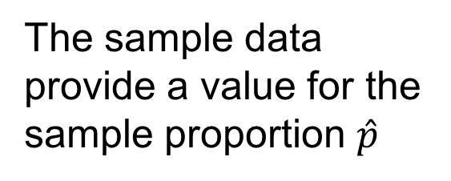

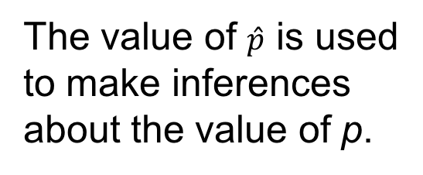
Sampling Distribution of $\hat{p}$
Making Inferences about a Population Proportion
Population
with proportion
p = ?
A simple random sample
of n elements is selected
from the population.
The value of $\hat{p}$ is used
to make inferences
about the value of p.
The sample data
provide a value for the
sample proportion $\hat{p}$

Slide 36
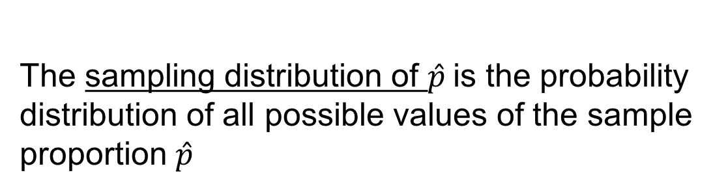



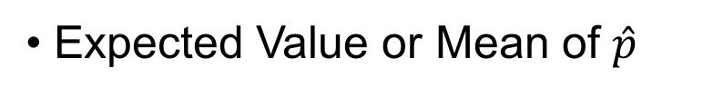
Sampling Distribution of $\hat{p}$
The sampling distribution of $\hat{p}$is the probability
distribution of all possible values of the sample
proportion $\hat{p}$
Expected Value or Mean of $\hat{p}$
$$μ$$
$$\hat{p}=p$$
where:
p = the population proportion

Slide 37


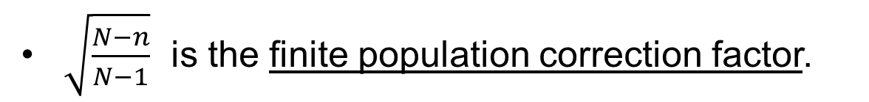
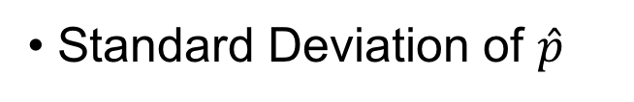
Sampling Distribution of $\hat{p}$
Standard Deviation of $\hat{p}$
Finite Population
Infinite Population
$$σ_{\hat{p}}=\sqrt{\frac{N−n}{N−1}}\sqrt{\frac{p(1−p)}{n}}$$
$$σ_{\hat{p}}=\sqrt{\frac{p(1−p)}{n}}$$
$\sqrt{\frac{N−n}{N−1}}$ is the finite population correction factor.

Slide 38

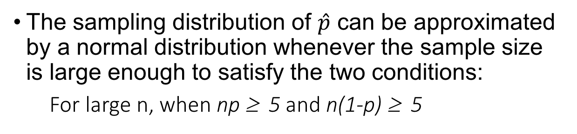
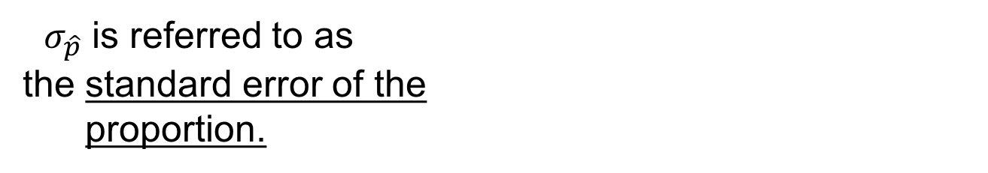
Sampling Distribution of $\hat{p}$
Standard Deviation of $\hat{p}$
$$σ_{\hat{p}}=\sqrt{\frac{p(1−p)}{n}}$$
$σ_{\hat{p}}$ is referred to as
the standard error of the
proportion.
The sampling distribution of $\hat{p}$ can be approximated by a normal distribution whenever the sample size is large enough to satisfy the two conditions:
For large n, when np ≥ 5 and n(1-p) ≥ 5
n = sample size
p = probability of success on a single trial

Slide 39
Sampling Distribution of $\hat{p}$
Example: St. Andrew’s College
Given survey results, we know that 72% of the prospective students applying to St. Andrew’s College desire on-campus housing.
What is the probability that a simple random sample
of 30 applicants will provide an estimate of the
population proportion of applicant desiring on-campus
housing that is within plus or minus .05 of the actual
population proportion?

Slide 40
Sampling Distribution of $\hat{p}$
Example: St. Andrew’s College
For our example, with n = 30 and p = .72, the
normal distribution is an acceptable approximation
because:
np = 30(.72) = 21.6 > 5
and
n(1 - p) = 30(.28) = 8.4 > 5

Slide 41

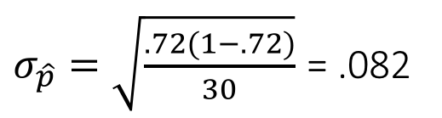


Sampling Distribution of $\hat{p}$
Example: St. Andrew’s College
Sampling
Distribution
of $\hat{p}$
$σ_{\hat{p}}=\sqrt{\frac{.72(1−.72)}{30}}$ = .082
$$\hat{p}$$
$$E\left(\hat{p}\right)=.72$$

Slide 42

Sampling Distribution of $\hat{p}$
Example: St. Andrew’s College
Step 1: Calculate the z-value at the upper endpoint
of the interval.
z = (.77 - .72)/.082 = .61
Step 2: Find the area under the curve to the left of
the upper endpoint.
P(z < .61) = .7291

Slide 43
Sampling Distribution of $\hat{p}$
Example: St. Andrew’s College
Cumulative Probabilities for
the Standard Normal Distribution
z
.00
.01
.02
.03
.04
.05
.06
.07
.08
.09
.
.
.
.
.
.
.
.
.
.
.
.5
.6915
.6950
.6985
.7019
.7054
.7088
.7123
.7157
.7190
.7224
.6
.7257
.7291
.7324
.7357
.7389
.7422
.7454
.7486
.7517
.7549
.7
.7580
.7611
.7642
.7673
.7704
.7734
.7764
.7794
.7823
.7852
.8
.7881
.7910
.7939
.7967
.7995
.8023
.8051
.8078
.8106
.8133
.9
.8159
.8186
.8212
.8238
.8264
.8289
.8315
.8340
.8365
.8389
.
.
.
.
.
.
.
.
.
.
.

Slide 44

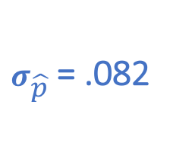

Sampling Distribution of $\hat{p}$
Example: St. Andrew’s College
Sampling
Distribution
of $\hat{p}$
$σ_{\hat{p}}$= .082
Area = .7291
$$σ_{\hat{p}}=\sqrt{\frac{p(1−p)}{n}}$$
$$\hat{p}$$
.72
.77

Slide 45

Sampling Distribution of $\hat{p}$
Example: St. Andrew’s College
Step 3: Calculate the z-value at the lower endpoint of
the interval.
z = (.67 - .72)/.082 = - .61
Step 4: Find the area under the curve to the left of the
lower endpoint.
P(z < -.61) = .2709

Slide 46
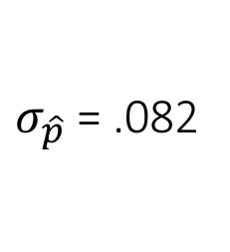
Sampling Distribution of $\hat{p}$
Example: St. Andrew’s College
Sampling
Distribution
of $\hat{p}$
$σ_{\hat{p}}$= .082
Area = .2709
$$\hat{p}$$
.67
.72

Slide 47
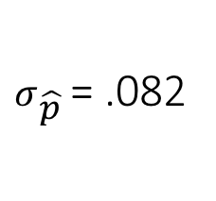
Sampling Distribution of $\hat{p}$
Example: St. Andrew’s College
Sampling
Distribution
of $\hat{p}$
$σ_{\hat{p}}$= .082
Area = .4582
$$\hat{p}$$
.67
.72
.77

Slide 48
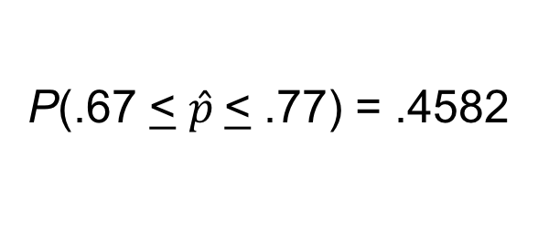
Sampling Distribution of $\hat{p}$
Example: St. Andrew’s College
Step 5: Calculate the area under the curve between
the lower and upper endpoints of the interval.
P(-.61 < z < .61) = P(z < .61) - P(z < -.61)
= .7291 - .2709
= .4582
The probability that the sample proportion of applicants
wanting on-campus housing will be within +/-.05 of the
actual population proportion :
P(.67 < $\hat{p}$< .77) = .4582

Slide 49
Errors Occurring in Surveys
Must be well designed
Target population: entire population of interest
Sample frame: a list of sampling elements
Sampling error: difference between population and sample
Random sampling should eliminate bias
Random sample may not be representative:
Under-coverage: too few sampled units or some of the population was excluded
Non-response: when a sampled unit cannot be contacted or refuses to participate
Response bias: responses of selected units are not truthful

