Slide 1

We have been building....

Slide 2
The Foundation:
A sampling distribution helps you understand how a sample relates to the whole population. It does this by showing all the different outcomes when repeating your sampling process.
The probabilities that we calculate describe the likelihood of various outcomes or events.
The probability of seeing a certain statistic (x-bar or mu) helps us to determine the likelihood of drawing a sample of that value from the population.
If the probability of that value is low: unlikely that it's a true representation of the population parameter (mu or p)

Slide 3
The Walls: Confidence Intervals

Slide 4

Why do we need confidence intervals?
Point Estimator (Chapter 7)
$\overline{x}$ is the best predictor for μ, but it’s not perfect!
A point estimator cannot be expected to provide the
exact value of the population parameter in every case.

Slide 5
Margin of Error and the Interval Estimate
An interval estimate can be computed by adding and
subtracting a margin of error to the point estimate.
Point Estimate +/- Margin of Error
The purpose of an interval estimate is to provide
information about how close the point estimate is to
the value of the parameter.

Slide 6
Interval Estimate of a Population Mean: σ Known
In order to develop an interval estimate of a population mean, the margin of error must be computed using either:
the population standard deviation σ , or
the sample standard deviation s
σ is rarely known exactly, but often a good estimate can be obtained based on historical data or other information.
We refer to such cases as the σ known case.

Slide 7
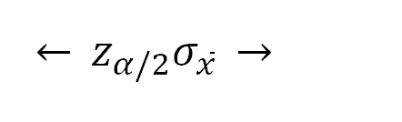
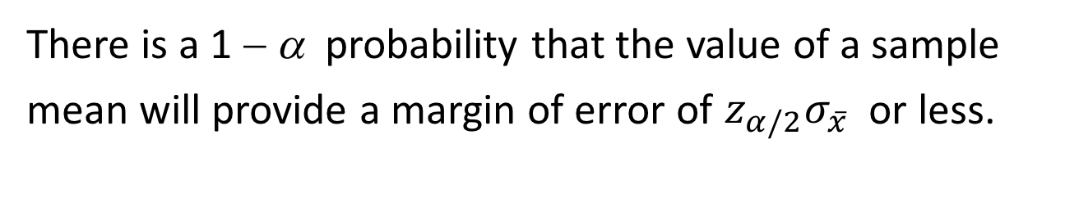
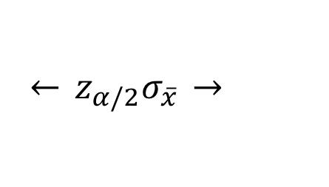

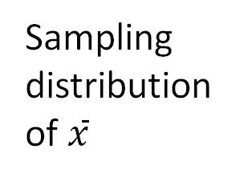
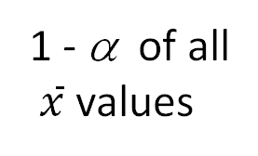
Interval Estimate of a Population Mean: σ Known
There is a 1 − α probability that the value of a sample
mean will provide a margin of error of $z_{α/2}σ_{\overline{x}}$ or less.
Sampling
distribution
of $\overline{x}$
α/2
1 - α of all
$\overline{x}$ values
α/2
$$\overline{x}$$
μ
$$\overset{←}{} z_{α/2}σ_{\overline{x}} \overset{→}{}$$
$$\overset{←}{} z_{α/2}σ_{\overline{x}} \overset{→}{}$$

Slide 8

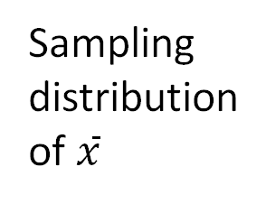
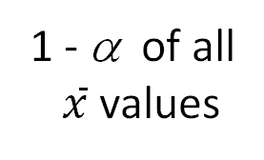
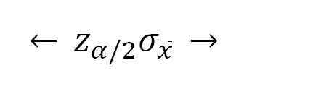
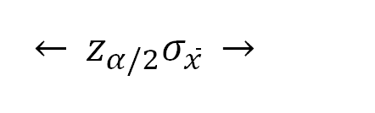


Interval Estimate of a Population Mean: σ Known
Sampling
distribution
of $\overline{x}$
1 - α of all
$\overline{x}$ values
α/2
α/2
does not
include μ
$$\overline{x}$$
includes μ
μ
$$\overset{←}{} z_{α/2}σ_{\overline{x}} \overset{→}{}$$
$$\overset{←}{} z_{α/2}σ_{\overline{x}} \overset{→}{}$$
$$\left[−−−−−−\overline{x}−−−−−−\right]$$
$$\left[−−−−−−\overline{x}−−−−−−\right]$$

Slide 9
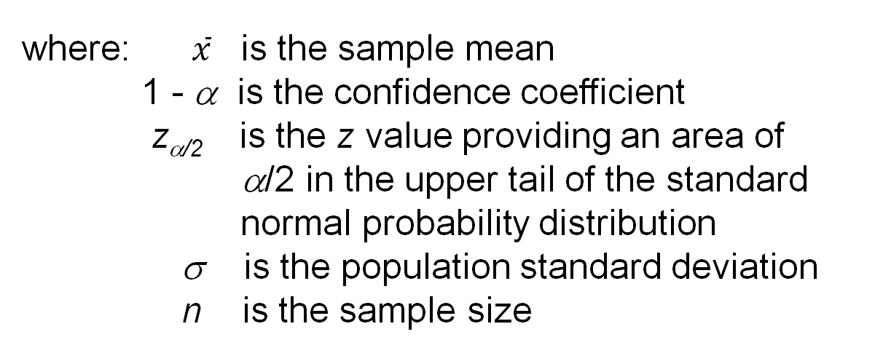

Interval Estimate of a Population Mean: σ Known
Interval Estimate of μ
$$\overline{x}{± z}_{α/2}\frac{σ}{\sqrt{n}}$$
where: $\overline{x}$ is the sample mean
1 - α is the confidence coefficient
z_{α/2} is the z value providing an area of
α/2 in the upper tail of the standard
normal probability distribution
σ is the population standard deviation
n is the sample size

Slide 10
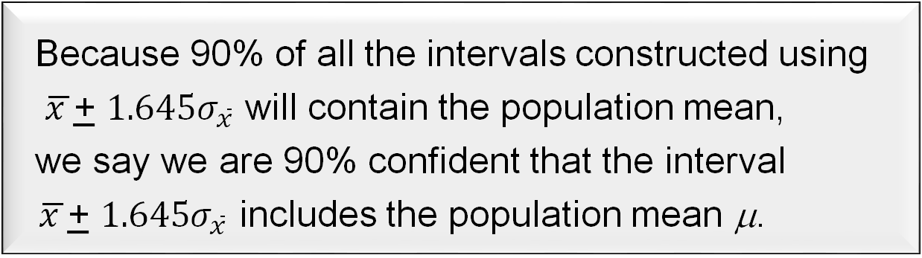
Meaning of Confidence
Because 90% of all the intervals constructed using
$\overline{x }$+ $1.645σ_{\overline{x} }$will contain the population mean,
we say we are 90% confident that the interval
$\overline{x }$+ $1.645σ_{\overline{x} }$includes the population mean μ.
We say that this interval has been established at the
90% confidence level.
The value .90 is referred to as the confidence
coefficient.

Slide 11
Interval Estimate of a Population Mean: σ Known
Example: Discount Sounds
Discount Sounds has 260 retail outlets throughout
the United States. The firm is evaluating a potential
location for a new outlet, based in part, on the mean
annual income of the individuals in the marketing
area of the new location.
A sample of size n = 36 was taken; the sample
mean income is $41,100. The population is not
believed to be highly skewed. The population
standard deviation is estimated to be $4,500, and the
confidence coefficient to be used in the interval
estimate is 0.95.

Slide 12

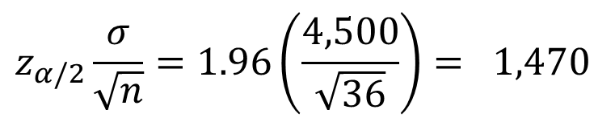
Interval Estimate of a Population Mean: σ Known
Example: Discount Sounds
95% of the sample means that can be observed
are within + 1.96 $σ_{\overline{x}}$ of the population mean μ.
The margin of error is:
$$z_{α/2}\frac{σ}{\sqrt{n}}=1.96\left(\frac{4,500}{\sqrt{36}}\right)= 1,470$$
Thus, at 95% confidence,
the margin of error is $1,470.

Slide 13
Interval Estimate of a Population Mean: σ Known
Example: Discount Sounds
interval estimate of μ is:
$41,100 + $1,470
or
$39,630 to $42,570
We are 95% confident that the interval contains the
population mean.

Slide 14
Interval Estimate of a Population Mean: σ Known
Example: Discount Sounds
Confidence Margin
Level of Error Interval Estimate
90% 1,234 $39,866 to $42,334
95% 1,470 $39,630 to $42,570
99% 1,932 $39,168 to $43,032
In order to have a higher degree of confidence,
the margin of error and thus the width of the
confidence interval must be larger.

Slide 15
Interval Estimate of a Population Mean: σ Unknown
If an estimate of the population standard deviation σ cannot be developed prior to sampling, we use the sample standard deviation s to estimate σ .
This is the σ unknown case.
In this case, the interval estimate for μ is based on the t distribution.
(We’ll assume for now that the population is normally distributed.)

Slide 16
t Distribution
The t distribution is a family of similar probability
distributions.
A specific t distribution depends on a parameter
known as the degrees of freedom.
Degrees of freedom refer to the number of
independent pieces of information that go into the
computation of s.

Slide 17
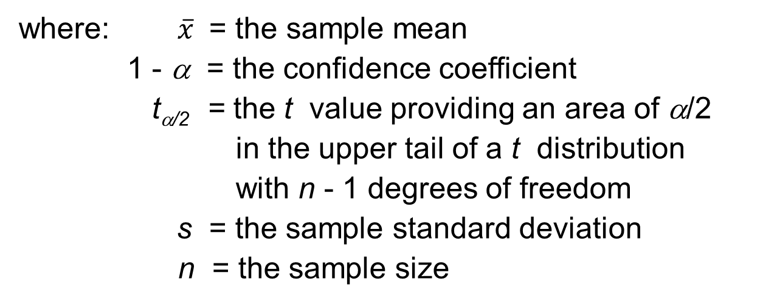

Interval Estimate of a Population Mean: σ Unknown
Interval Estimate
$$\overline{x}{ ± t}_{α/2}\frac{s}{\sqrt{n}}$$
where: $\overline{x}$ = the sample mean
1 - α = the confidence coefficient
t_{α/2} = the t value providing an area of α/2
in the upper tail of a t distribution
with n - 1 degrees of freedom
s = the sample standard deviation
n = the sample size

Slide 18
Interval Estimate of a Population Mean: σ Unknown
Example: Apartment Rents – FIND EXCEL TITLED Rents
A reporter for a student newspaper is writing an
article on the cost of off-campus housing. A sample of
16 one-bedroom apartments within a half-mile of
campus resulted in a sample mean of $750 per month
and a sample standard deviation of $55.
Let us provide a 95% confidence interval estimate
of the mean rent per month for the population of one-
bedroom apartments within a half-mile of campus.
We will assume this population to be normally
distributed.

Slide 19

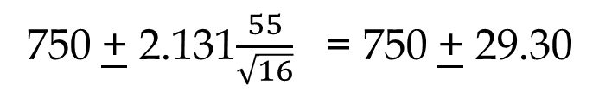
Interval Estimate of a Population Mean: σ Unknown
Interval Estimate
$$\overline{x}{ ± t}_{.025}\frac{s}{\sqrt{n}}$$
Margin
of Error
750 + 2.131$\frac{55}{\sqrt{16}}$ = 750 + 29.30
We are 95% confident that the mean rent per month
for the population of one-bedroom apartments within
a half-mile of campus is between $720.70 and $779.30.

Slide 20
Sample Size for an Interval Estimate of a Population Mean
Let E = the desired margin of error.
E is the amount added to and subtracted from the
point estimate to obtain an interval estimate.
If a desired margin of error is selected prior to
sampling, the sample size necessary to satisfy the
margin of error can be determined.

Slide 21


Sample Size for an Interval Estimate of a Population Mean
Margin of Error
$$E=z_{α/2}\frac{σ}{\sqrt{n}}$$
Necessary Sample Size
n = $\frac{(z_{α/2})^{2}σ^{2}}{E^{2}}$

Slide 22
Sample Size for an Interval Estimate of a Population Mean
Example: Discount Sounds
Discount Sounds is evaluating a
potential location for a new retail outlet, based in
part, on the mean annual income of the individuals in
the marketing area of the new location.
Suppose that Discount Sounds’ management team
wants an estimate of the population mean such that
there is a .95 probability that the sampling error is
$500 or less when population standard deviation is 4,500.
How large a sample size is needed to meet the
required precision?

Slide 23
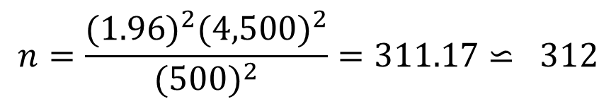
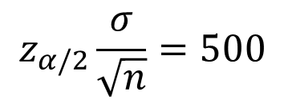
Sample Size for an Interval Estimate of a Population Mean
$$z_{α/2}\frac{σ}{\sqrt{n}}=500$$
At 95% confidence, z_{.025} = 1.96. Recall that σ = 4,500.
$$n=\frac{(1.96)^{2}(4,500)^{2}}{(500)^{2}}=311.17⋍ 312$$
A sample of size 312 is needed to reach a desired
precision of + $500 at 95% confidence.

Slide 24


Summary of Interval Estimation Procedures
for a Population Mean
Can the
population standard
deviation σ be assumed
known ?
Yes
No
Use the sample
standard deviation
s to estimate σ
σ Known
Case
Use
Use
$$\overline{x}{± z}_{α/2}\frac{σ}{\sqrt{n}}$$
σ Unknown
Case
$$\overline{x}{ ± t}_{α/2}\frac{s}{\sqrt{n}}$$

Slide 25
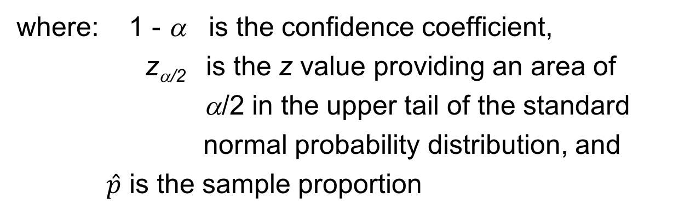

Interval Estimate of a Population Proportion
Interval Estimate
$$\hat{p}±z_{α/2}\sqrt{\frac{\hat{p} (1−\hat{p})}{n}}$$
where: 1 - α is the confidence coefficient,
z_{α/2} is the z value providing an area of
α/2 in the upper tail of the standard
normal probability distribution, and
$\hat{p}$ is the sample proportion

Slide 26

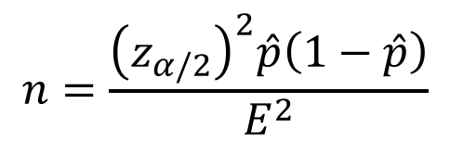
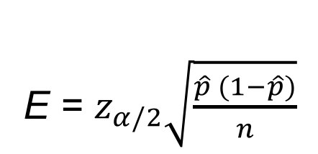
Sample Size for an Interval Estimate of a Population Proportion
Margin of Error
E = $z_{α/2}\sqrt{\frac{\hat{p} (1−\hat{p})}{n}}$
Solving for the necessary sample size n, we get
$$n=\frac{{\left(z_{α/2}\right)}^{2}\hat{p}\left(1−\hat{p}\right)}{E^{2}}$$
However, $\hat{p}$ will not be known until after we have selected the sample. We will use the planning value p* for $\hat{p}$.

Slide 27

Interval Estimate of a Population Proportion
The general form of an interval estimate of a
population proportion is
$\hat{p}$
+ Margin of Error

Slide 28
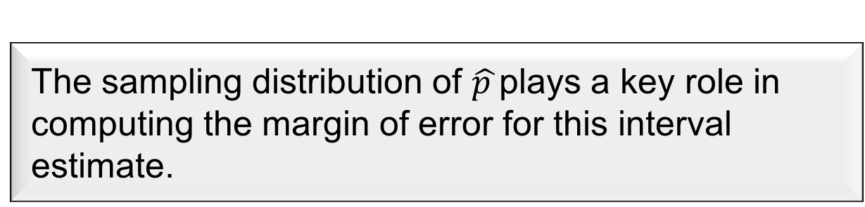
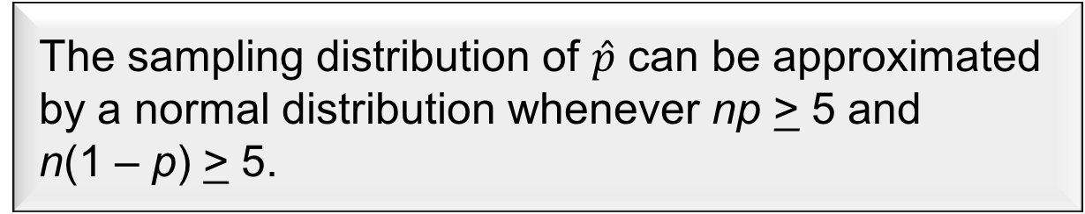
Interval Estimate of a Population Proportion
The sampling distribution of $\hat{p }$plays a key role in
computing the margin of error for this interval
estimate.
The sampling distribution of $\hat{p}$ can be approximated
by a normal distribution whenever np > 5 and
n(1 – p) > 5.

Slide 29
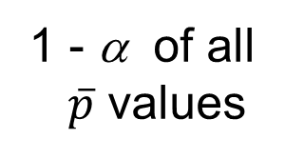





Interval Estimate of a Population Proportion
Normal Approximation of Sampling Distribution of $\hat{p}$
Sampling
distribution
of $\hat{p}$
$$σ_{\hat{p}}$$
α/2
1 - α of all
$\overline{p}$ values
α/2
$$\hat{p}$$
p
$$←z_{α/2}σ_{\hat{p}}→$$
$$←z_{α/2}σ_{\hat{p}}→$$

Slide 30
Interval Estimate of a Population Proportion
Example: Political Science, Inc.
Political Science, Inc. (PSI) specializes in voter polls
and surveys designed to keep political office seekers
informed of their position in a race.
Using telephone surveys, PSI interviewers ask
registered voters who they would vote for if the
election were held that day.

Slide 31
Interval Estimate of a Population Proportion
Example: Political Science, Inc.
In a current election campaign, PSI has just found
that 220 registered voters, out of 500 contacted, favor
a particular candidate. PSI wants to develop a 95%
confidence interval estimate for the proportion of the
population of registered voters that favor the
candidate.

Slide 32
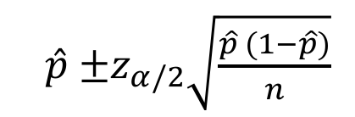
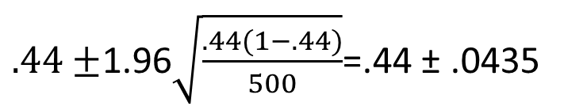
Interval Estimate of a Population Proportion
$\hat{p}$ $±z_{α/2}\sqrt{\frac{\hat{p} (1−\hat{p})}{n}}$
where: n = 500, $\hat{p}$= 220/500 = .44, z_{α/2} = 1.96
$.44±$1.96$\sqrt{\frac{.44(1−.44)}{500}}$=.44 ± .0435
PSI is 95% confident that the proportion of all voters
that favor the candidate is between .3965 and .4835.

Slide 33
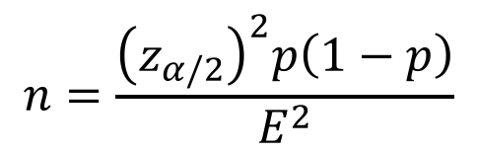
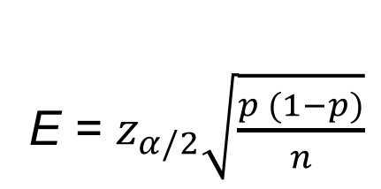
Sample Size for an Interval Estimate of a Population Proportion
Margin of Error
E = $z_{α/2}\sqrt{\frac{p (1−p)}{n}}$
Solving for the necessary sample size n, we get
$$n=\frac{{\left(z_{α/2}\right)}^{2}p\left(1−p\right)}{E^{2}}$$
However, $\hat{p}$ will not be known until after we have selected the sample. We will use the planning value p* for $\hat{p}$.

Slide 34
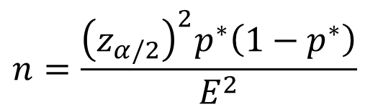
Sample Size for an Interval Estimate of a Population Proportion
Necessary Sample Size
$$n=\frac{{\left(z_{α/2}\right)}^{2}p^{∗}\left(1−p^{∗}\right)}{E^{2}}$$
The planning value p* can be chosen by:
1. Using the sample proportion from a previous sample of the same or similar units, or
2. Selecting a preliminary sample and using the
sample proportion from this sample.
3. Use judgment or a “best guess” for a p* value.
4. Otherwise, use .50 as the p* value.

Slide 35
Sample Size for an Interval Estimate of a Population Proportion
Example: Political Science, Inc.
Suppose that PSI would like a .99 probability that
the sample proportion is within + .03 of the
population proportion.
How large a sample size is needed to meet the
required precision? (A previous sample of similar
units yielded .44 for the sample proportion.)

Slide 36
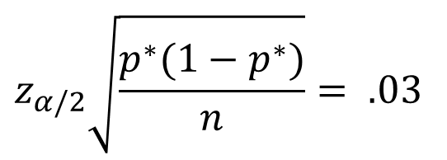
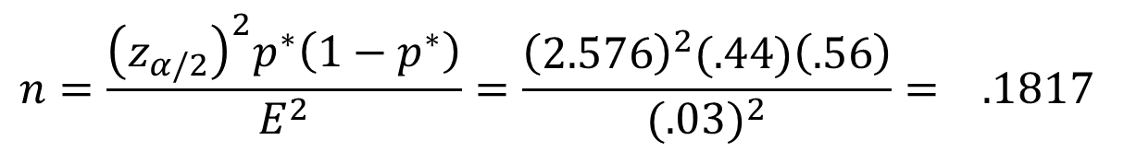
Sample Size for an Interval Estimate of a Population Proportion
$$z_{α/2}\sqrt{\frac{p^{∗}(1−p^{∗})}{n}}= .03$$
At 99% confidence, z_{.005} = 2.576. Recall that p* = .44.
$$n=\frac{{\left(z_{α/2}\right)}^{2}p^{∗}\left(1−p^{∗}\right)}{E^{2}}=\frac{{\left(2.576\right)}^{2}(.44)\left(.56\right)}{{(.03)}^{2}}= .1817$$
A sample of size 1817 is needed to reach a desired
precision of + .03 at 99% confidence.

Slide 37
Sample Size for an Interval Estimate of a Population Proportion
Note: We used .44 as the best estimate of p in the
preceding expression. If no information is available
about p, then .5 is often assumed because it provides
the highest possible sample size. If we had used
p = .5, the recommended n would have been 1843.

Slide 38
Hypothesis Testing

Slide 39
Hypothesis Testing
Developing Null and Alternative Hypotheses
Population Mean: σ Known
Population Mean: σ Unknown
Population Proportion
Type I and Type II Errors

Slide 40
Hypothesis Testing
Hypothesis testing can be used to determine whether
a statement about the value of a population parameter
should or should not be rejected.
The null hypothesis, denoted by H₀ , is a tentative
assumption about a population parameter.
The alternative hypothesis, denoted by H_{a}, is the
opposite of what is stated in the null hypothesis.
The hypothesis testing procedure uses data from a
sample to test the two competing statements
indicated by H₀ and H_{a}.

Slide 41
Developing Null and Alternative Hypotheses
Alternative Hypothesis as a Research Hypothesis
Example:
A new teaching method is developed that is
believed to be better than the current method.
Alternative Hypothesis:
The new teaching method is better.
Null Hypothesis:
The new method is no better than the old method.

Slide 42
Developing Null and Alternative Hypotheses
Alternative Hypothesis as a Research Hypothesis
Example:
A new drug is developed with the goal of lowering
blood pressure more than the existing drug.
Alternative Hypothesis:
The new drug lowers blood pressure more than
the existing drug.
Null Hypothesis:
The new drug does not lower blood pressure more
than the existing drug.

Slide 43
Summary of Forms for Null and Alternative Hypotheses about a Population Mean
The equality part of the hypotheses always appears
in the null hypothesis.
In general, a hypothesis test about the value of a
population mean μ must take one of the following
three forms (where μ₀ is the hypothesized value of
the population mean).
$H_{0}: μ$≥$μ_{0}$
$H_{0}: μ$≤$μ_{0}$
$H_{0}: μ$=$μ_{0}$
$H_{a}: μ$<$μ_{0}$
$H_{a}: μ$>$μ_{0}$
$H_{a}: μ$≠$μ_{0}$
One-tailed
(lower-tail)
One-tailed
(upper-tail)
Two-tailed

Slide 44
p-Value Approach to
One-Tailed Hypothesis Testing
The p-value is the probability, computed using the
test statistic, that measures the support (or lack of
support) provided by the sample for the null
hypothesis.
If the p-value is less than or equal to the level of
significance α, the value of the test statistic is in the
rejection region.
Reject H₀ if the p-value < α .

Slide 45
Lower-Tailed Test About a Population Mean:
σ Known (sample)
p-Value Approach
p-Value < α ,
so reject H₀.
α = .10
Sampling
distribution
of
$$z=\frac{\overline{x}−μ_{0}}{σ/{\sqrt{n}}}$$
p-value
= .0721
z
z =
-1.46
-z_{α} =
-1.28
0

Slide 46
Upper-Tailed Test About a Population Mean:
σ Known (sample)
p-Value Approach
p-Value < α ,
so reject H₀.
Sampling
distribution
of
α = .04
$$z=\frac{\overline{x}−μ_{0}}{σ/{\sqrt{n}}}$$
p-Value
= .011
z
0
z_{α} =
1.75
z =
2.29

Slide 47
Critical Value Approach to
One-Tailed Hypothesis Testing
The test statistic z has a standard normal probability
distribution.
We can use the standard normal probability
distribution table to find the z-value with an area
of α in the lower (or upper) tail of the distribution.
The value of the test statistic that established the
boundary of the rejection region is called the
critical value for the test.
The rejection rule is:
Lower tail: Reject H₀ if z < -z_{α}
Upper tail: Reject H₀ if z > z_{α}

Slide 48

Lower-Tailed Test About a Population Mean:
σ Known (sample)
Critical Value Approach
Sampling
distribution
of
$$z=\frac{\overline{x}−μ_{0}}{σ/{\sqrt{n}}}$$
Reject H₀
α = .10
Do Not Reject H₀
z
-z_{α} = -1.28
0

Slide 49

Upper-Tailed Test About a Population Mean:
σ Known (sample)
Critical Value Approach
Sampling
distribution
of
$$z=\frac{\overline{x}−μ_{0}}{σ/{\sqrt{n}}}$$
Reject H₀
Do Not Reject H₀
α = .05
z
0
z_{α} = 1.645

Slide 50
Steps of Hypothesis Testing
Step 1. Develop the null and alternative hypotheses.
Step 2. Specify the level of significance α.
Step 3. Collect the sample data and compute the value of the test statistic.
p-Value Approach
Step 4. Use the value of the test statistic to compute the
p-value.
Step 5. Reject H₀ if p-value < α.

Slide 51
Steps of Hypothesis Testing
Critical Value Approach
Step 4. Use the level of significance to determine the critical value and the rejection rule.
Step 5. Use the value of the test statistic and the rejection
rule to determine whether to reject H₀.

Slide 52
One-Tailed Tests About a Population Mean:
σ Known
Example: Metro EMS
The response times for a random sample of 40
medical emergencies were tabulated. The sample
mean is 13.25 minutes. The population standard
deviation is believed to be 3.2 minutes.
The EMS director wants to perform a hypothesis
test, with a .05 level of significance, to determine
whether the service goal of 12 minutes or less is
being achieved.

Slide 53
One-Tailed Tests About a Population Mean:
σ Known
p -Value and Critical Value Approaches
1. Develop the hypotheses.
H₀: μ < 12
H_{a}: μ > 12
2. Specify the level of significance.
α = .05
3. Compute the value of the test statistic.
$z=\frac{\overline{x}−μ_{0}}{σ/{\sqrt{n}}}=\frac{13.25−12}{3.2/\sqrt{40}}$= 2.47

Slide 54
One-Tailed Tests About a Population Mean:
σ Known
p –Value Approach
4. Compute the p –value.
For z = 2.47, cumulative probability = .9932.
p-value = 1 - .9932 = .0068
5. Determine whether to reject H₀.
Because p-value = .0068 < α = .05, we reject H₀.
There is sufficient statistical evidence
to infer that Metro EMS is not meeting
the response goal of 12 minutes.

Slide 55

One-Tailed Tests About a Population Mean:
σ Known
p-Value < α,
so reject H₀.
p –Value Approach
Sampling
distribution
of
α = .05
$$z=\frac{\overline{x}−μ_{0}}{σ/{\sqrt{n}}}$$
p-value
= .0068
z
0
z_{α} =
1.645
z =
2.47

Slide 56
One-Tailed Tests About a Population Mean:
σ Known
Critical Value Approach
4. Determine the critical value and rejection rule.
For α = .05, z_{.05} = 1.645
Reject H₀ if z > 1.645
5. Determine whether to reject H₀.
Because 2.47 > 1.645, we reject H₀.
There is sufficient statistical evidence
to infer that Metro EMS is not meeting
the response goal of 12 minutes.

Slide 57
Two-Tailed Tests About a Population Mean:
σ Known
Example: Glow Toothpaste
The production line for Glow toothpaste is
designed to fill tubes with a mean weight of 6 oz.
Periodically, a sample of 30 tubes will be selected in
order to check the filling process.
Quality assurance procedures call for the
continuation of the filling process if the sample
results are consistent with the assumption that the
mean filling weight for the population of toothpaste
tubes is 6 oz.; otherwise the process will be adjusted.

Slide 58
Two-Tailed Tests About a Population Mean:
σ Known
Example: Glow Toothpaste
Assume that a sample of 30 toothpaste tubes
provides a sample mean of 6.1 oz. The population
standard deviation is believed to be 0.2 oz.
Perform a hypothesis test, at the .03 level of
significance, to help determine whether the filling
process should continue operating or be stopped and
corrected.

Slide 59
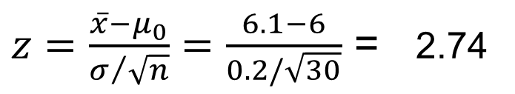
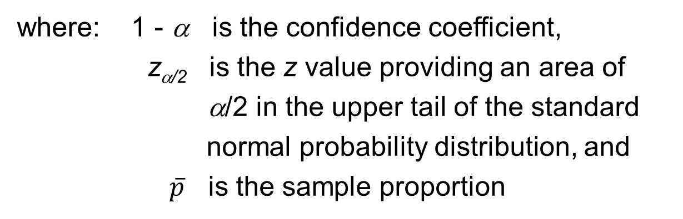
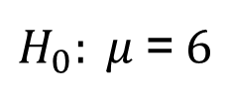
Two-Tailed Tests About a Population Mean:
σ Known
p –Value and Critical Value Approaches
1. Determine the hypotheses.
$H_{0}: μ$=$6$
$H_{a}: μ$≠$6$
2. Specify the level of significance.
α = .03
3. Compute the value of the test statistic.
$z=\frac{\overline{x}−μ_{0}}{σ/{\sqrt{n}}}=\frac{6.1−6}{0.2/\sqrt{30}}$ = 2.74

Slide 60
Two-Tailed Tests About a Population Mean:
σ Known
p –Value Approach
4. Compute the p –value.
For z = 2.74, cumulative probability = .9969
p-value = 2(1 - .9969) = .0062
5. Determine whether to reject H₀.
Because p-value = .0062 < α = .03, we reject H₀.
There is sufficient statistical evidence to
infer that the alternative hypothesis is true
(i.e. the mean filling weight is not 6 ounces).

Slide 61
Two-Tailed Tests About a Population Mean:
σ Known
p-Value Approach
1/2
p-value
= .0031
1/2
p-value
= .0031
α/2 =
.015
α/2 =
.015
z
z = -2.74
0
z = 2.74
-z_{α/2} = -2.17
z_{α/2} = 2.17

Slide 62
Two-Tailed Tests About a Population Mean:
σ Known
Critical Value Approach
4. Determine the critical value and rejection rule.
For α/2 = .03/2 = .015, z_{.015} = 2.17
Reject H₀ if z < -2.17 or z > 2.17
5. Determine whether to reject H₀.
Because 2.74 > 2.17, we reject H₀.
There is sufficient statistical evidence to
infer that the alternative hypothesis is true
(i.e. the mean filling weight is not 6 ounces).

Slide 63

Two-Tailed Tests About a Population Mean:
σ Known
Critical Value Approach
Sampling
distribution
of
$$z=\frac{\overline{x}−μ_{0}}{σ/{\sqrt{n}}}$$
Reject H₀
Do Not Reject H₀
Reject H₀
α/2 = .015
α/2 = .015
z
-2.17
0
2.17

Slide 64

Tests About a Population Mean: σ Unknown
Test Statistic
$$t=\frac{\overline{x}−μ_{0}}{s/{\sqrt{n}}}$$
This test statistic has a t distribution
with n - 1 degrees of freedom.

Slide 65
Tests About a Population Mean: σ Unknown
Rejection Rule: p -Value Approach
Reject H₀ if p –value < α
Rejection Rule: Critical Value Approach
H₀: μ > μ₀
Reject H₀ if t < -t_{α}
H₀: μ < μ₀
Reject H₀ if t > t_{α}
H₀: μ = μ₀
Reject H₀ if t < - t_{α/2} or t > t_{α/2}

Slide 66
Example: Highway Patrol
One-Tailed Test About a Population Mean: σ Unknown
A State Highway Patrol periodically samples
vehicle speeds at various locations on a particular
roadway. The sample of vehicle speeds is used to
test the hypothesis H₀: μ < 65.
The locations where H₀ is rejected are deemed the
best locations for radar traps. At Location F, a sample
of 64 vehicles shows a mean speed of 66.2 mph with a
standard deviation of 4.2 mph. Use α = .05 to test the
hypothesis.

Slide 67
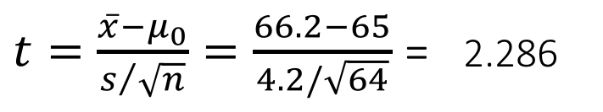
One-Tailed Test About a Population Mean: σ Unknown
p –Value and Critical Value Approaches
1. Determine the hypotheses.
H₀: μ < 65
H_{a}: μ > 65
2. Specify the level of significance.
α = .05
3. Compute the value of the test statistic.
$t=\frac{\overline{x}−μ_{0}}{s/{\sqrt{n}}}=\frac{66.2−65}{4.2/\sqrt{64}}$ = 2.286

Slide 68
One-Tailed Test About a Population Mean: σ Unknown
p –Value Approach
4. Compute the p –value.
For t = 2.286, the p-value must be less than .025
(for t = 1.998) and greater than .01 (for t = 2.387).
.01 < p–value < .025
5. Determine whether to reject H₀.
Because p-value < α = .05, we reject H₀.
We are at least 95% confident that the mean speed
of vehicles at Location F is greater than 65 mph.

Slide 69
One-Tailed Test About a Population Mean: σ Unknown
Critical Value Approach
4. Determine the critical value and rejection rule.
For α = .05 and d.f. = 64 – 1 = 63, t_{.05} = 1.669
Reject H₀ if t > 1.669
5. Determine whether to reject H₀.
Because 2.286 > 1.669, we reject H₀.
We are at least 95% confident that the mean speed of vehicles at Location F is greater than 65 mph. Location F is a good candidate for a radar trap.

Slide 70
One-Tailed Test About a Population Mean: σ Unknown
p-Value < α ,
so reject H₀.
Reject H₀
(α = .05)
Do Not Reject H₀
p-value
< .025
t
0
t_{α} =
1.669
t =
2.286

Slide 71
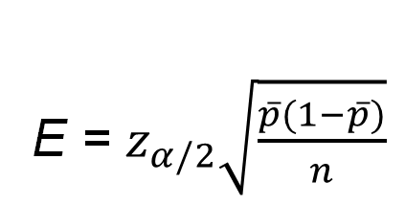

A Summary of Forms for Null and Alternative Hypotheses About a Population Proportion
The equality part of the hypotheses always appears
in the null hypothesis.
In general, a hypothesis test about the value of a
population proportion p must take one of the
following three forms (where p₀ is the hypothesized
value of the population proportion).
$H_{0}:p$≥$p_{0}$
$H_{0}:p$≤$p_{0}$
$H_{0}:p$=$p_{0}$
$H_{a}:p$<$p_{0}$
$H_{a}:p$>$p_{0}$
$H_{a}:p$≠$p_{0}$
One-tailed
(lower tail)
One-tailed
(upper tail)
Two-tailed

Slide 72


Tests About a Population Proportion
Test Statistic
$$z=\frac{\hat{p}−p_{0}}{σ_{\overline{p}}}$$
where:
$$σ_{\hat{p}}=\sqrt{\frac{p_{0}\left(1−p_{0}\right)}{n}}$$
assuming np > 5 and n(1 – p) > 5

Slide 73
Tests About a Population Proportion
Rejection Rule: p –Value Approach
Reject H₀ if p –value < α
Rejection Rule: Critical Value Approach
H₀: p < p₀
Reject H₀ if z > z_{α}
H₀: p > p₀
Reject H₀ if z < -z_{α}
H₀: p = p₀
Reject H₀ if z < -z_{α/2} or z > z_{α/2}

Slide 74
Two-Tailed Test About a
Population Proportion
Example: National Safety Council (NSC)
For a Christmas and New Year’s week, the
National Safety Council estimated that 500 people
would be killed and 25,000 injured on the nation’s
roads. The NSC claimed that 50% of the accidents
would be caused by drunk driving.
A sample of 120 accidents showed that 67 were
caused by drunk driving. Use these data to test the
NSC’s claim with α = .05.

Slide 75
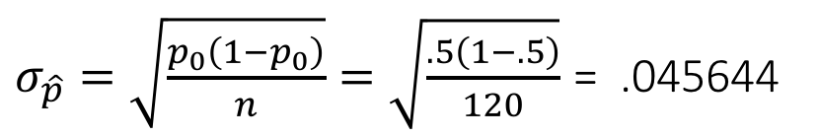


Two-Tailed Test About a
Population Proportion
p –Value and Critical Value Approaches
1. Determine the hypotheses.
$H_{0}:p$=$.5 and{ H}_{a}:p \text{≠} .5$
2. Specify the level of significance.
α = .05
3. Compute the value of the test statistic.
$σ_{\hat{p}}=\sqrt{\frac{p_{0}\left(1−p_{0}\right)}{n}}=\sqrt{\frac{.5\left(1−.5\right)}{120}}$ = .045644
a common
error is using
$\hat{p}$ in this formula
$z=\frac{\hat{p}−p_{0}}{σ_{\hat{p}}}=\frac{\left(\frac{67}{120}\right)−.5}{.045644}$ = 1.28

Slide 76
Two-Tailed Test About a
Population Proportion
p-Value Approach
4. Compute the p -value.
For z = 1.28, cumulative probability = .8997
p-value = 2(1 - .8997) = .2006
5. Determine whether to reject H₀.
Because p-value = .2006 > α = .05,
we cannot reject H₀.

Slide 77
Two-Tailed Test About a
Population Proportion
Critical Value Approach
4. Determine the criticals value and rejection rule.
For α/2 = .05/2 = .025, z_{.025} = 1.96
Reject H₀ if z < -1.96 or z > 1.96
5. Determine whether to reject H₀.
Because 1.278 > -1.96 and < 1.96,
we cannot reject H₀.

Slide 78
Type I Error
Because hypothesis tests are based on sample data,
we must allow for the possibility of errors.
A Type I error is rejecting H₀ when it is true.
The probability of making a Type I error when the
null hypothesis is true as an equality is called the
level of significance.
Applications of hypothesis testing that only control
the Type I error are often called significance tests.

Slide 79
Type II Error
A Type II error is accepting H₀ when it is false.
It is difficult to control for the probability of making
a Type II error.
Statisticians avoid the risk of making a Type II
error by using “do not reject H₀” and not “accept H₀”.

