Slide 1
Two Samples Hypothesis Testing
BU.510.601

Slide 2
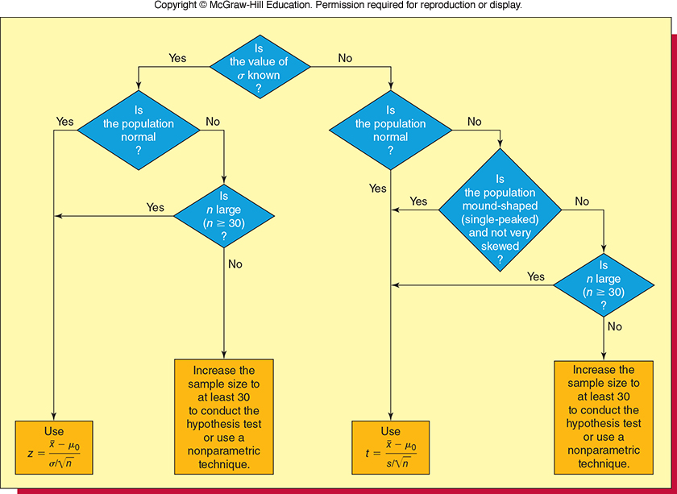
Selecting the Appropriate Test Statistic

Slide 3
Statistical Inferences Based on Two Samples
Chapter 11

Slide 4
Hypothesis Testing: Two Parameters
Population Means →
Independent and Paired Samples
z test, t test, paired t test
Population Variance →
F test
Population proportion →
Advanced Statistics

Slide 5
Hypothesis Testing: Two Population Means
One sided
OR
Two sided
OR
One sided
OR
We can also test H₀: µ₁ - µ₂ = D₀ and H_{A}: µ₁ - µ₂ ≠ D₀
Matched-Pair Sampling

Slide 6
Two parameter testing: Means Refrigerator Longevity Excel File
A consumer advocate researches the length of life between two brands of refrigerators Brand A and Brand B. He collects data (measured in years) on the longevity of 40 refrigerators for Brand A and repeats the Sampling for Brand B. Assume that σ²_{A}= 4.4 and σ²_{B}=5.2
Develop the null and alternative hypothesis to test whether the average lengths of life differs between the two brands.
At the 5% significance level, what is the conclusion?

Slide 7
Hypothesis Testing: Two Population Means: Z test
Excel’s “z-Test: Two Sample for Means” Tool
Step 1 Click the Data tab on the Ribbon
Step 2 Click Data Analysis
Step 3 Choose z-Test: Two Sample for Means
from the list of Analysis Tools
Step 4 When the z-Test: Two Sample for Means
dialog box appears:

Slide 8
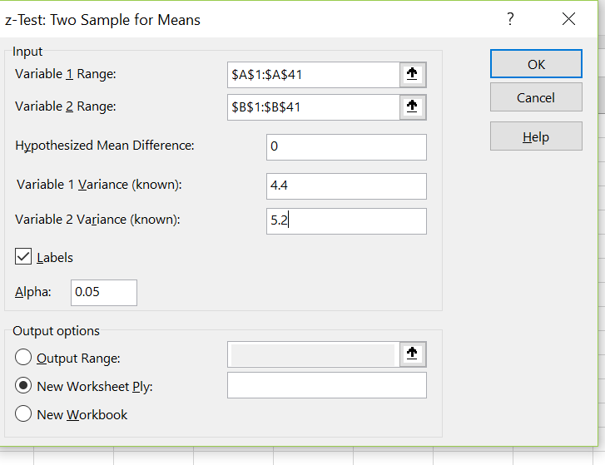
Hypothesis Tests About μ ₁ - μ ₂: St. Dev Known
Excel Dialog Box

Slide 9
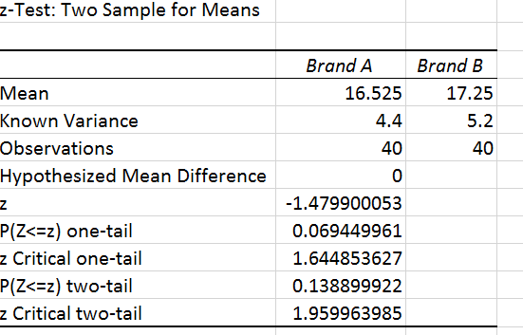
Hypothesis Tests About μ ₁ - μ ₂: St. Dev Known (Results)

Slide 10
Comparing Two Population Means: σ ₁ and σ ₂ unknown
When σ₁² and σ₂² are unknown we will:
use the sample variances s²₁ and s²₂
as estimates of σ²₁ and σ² ₂
When sample variances are different it makes it questionable to
assume that the population variances are equal (this matters for the type of
test we use in Excel).
Many statisticians believe that it is best to use the unequal variance
procedure in almost every situation. In this class we will be making
a choice based on the information presented.

Slide 11
Excel’s “T-Test: Two-Sample Assuming Unequal Variances” Tool
Step 1 Click the Data tab on the Ribbon
Step 2 Click Data Analysis
Step 3 Choose t-Test: Two-Sample Assuming
Unequal Variances from the list of
Analysis Tools
Step 4 When the t-Test: Two-Sample Assuming
Unequal Variances dialog box appears:
(see details on next slide)

Slide 12
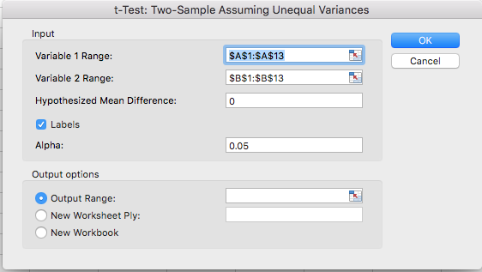
Hypothesis Tests About μ ₁ - μ ₂: σ ₁ and σ ₂ Unknown
Excel Dialog Box

Slide 13
Application – Excel File: Software Test
Consider a new computer software package developed to help systems analysts reduce the time required to design, develop, and implement an information system. To evaluate the benefits of the new software package, a random sample of 24 systems analysts is selected and data can be found in the excel filed mentioned above. Each analyst is given specifications for a hypothetical information system. Then 12 of the analysts are instructed to produce the information system by using current technology. The other 12 analysts are trained in the use of the new software package and then instructed to use it to produce the information system. The researcher in charge of the new software evaluation project hopes to show that the new software package will provide a shorter mean project completion time. Thus, the researcher is looking for evidence to conclude that the mean project completion time for systems analysts using the new software package is less than those using the current technology.
Develop the null and alternative hypothesis to test whether the mean project completion time for the new software is less than the current technology.
On the basis of the sample results can we conclude that the mean completion time is shorter using the new software package at a 95% level of confidence?

Slide 14
Inferences About the Difference Between Two Population Means: Paired (or matched) Samples
With paired-sample design each sampled item
provides a pair of data values.
Two samples are tested under similar conditions.
Two cars are taken to the same two different mechanics for price estimates
This design often leads to a smaller sampling error
than the independent-sample design because
variation between sampled items is eliminated as a
source of sampling error.
Variations in the cars (different estimates based on different type of car damage) is eliminated when both are taken to the same shops.

Slide 15
Matched Pair Sampling
Such samples are useful in evaluating strategies because the comparison is made between apples and apples.
Example: Assessing the benefits of a new medical treatment by evaluating the same patients before and after the treatment.
If only one group of people is given the treatment, then it is not clear if the observed differences are due to the treatment or due to other differences between the groups.

Slide 16
Recognizing Matched-Pairs Experiment
The first type of matched-pairs sample is characterized by a measurement, an intervention of some type, and then another measurement. We generally refer to these experiments as “before” and “after” studies.
The second type of matched-pairs sample is characterized by a pairing of observations, where it is not the same individual who gets sampled twice.
Suppose an agronomist wishes to switch to an organic fertilizer but is unsure what the effects might be on his crop yield. It is important to the agronomist that the yields be similar. He matches 20 adjacent plots of land using the nonorganic fertilizer on one half of the plot and the organic fertilizer on the other.

Slide 17
Inferences About the Difference Between Two Population Means: Paired Samples
Excel’s “t-Test: Paired Two Sample for Means” Tool
Step 1 Click the Data tab on the Ribbon
Step 2 Click Data Analysis
Step 3 Choose t-Test: Paired Two Sample for Means
from the list of Analysis Tools
… continued

Slide 18
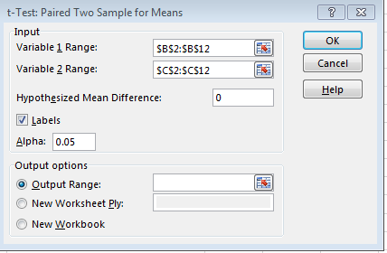
Inferences About the Difference Between Two Population Means: Paired Samples
Excel Dialog Box

Slide 19
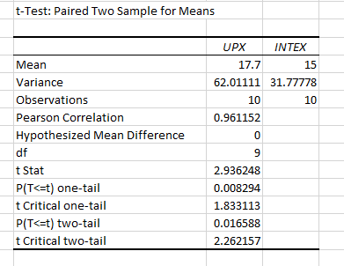
Inferences About the Difference Between Two Population Means: Paired Samples
Excel Value Worksheet

Slide 20
Inferences About the Difference Between Two Population Means: Paired Samples
Critical Value Approach
4. Determine the critical value and rejection rule.
For α = .05 and df = 9, t_{.025} = 2.262.
Reject H₀ if t > 2.262
5. Determine whether to reject H₀.
Because t = 2.944 > 2.262, we reject H₀.
We are at least 95% confident that there is a difference in mean delivery times for the two services

Slide 21
Inferences About the Difference Between Two Population Means: Paired Samples
p –Value Approach
using table
4. Compute the p-value.
For t = 2.944 and df = 9, the p-value is between
.02 and .01 (This is a two-tailed test, so we double the upper-tail areas)
From data analysis output: p-value = 0.0165.
5. Determine whether to reject H₀.
Because 0.0165 < α = .05, we reject H₀.
We are at least 95% confident that there is a difference in mean delivery times for the two services.

Slide 22
Summary
Hypothesis Testing – One & Two Sided
One Parameter
Two Parameters
Mean
Variance
F
Mean
z or t
Variance
χ²
Proportions
z
Independent
Samples
z or t
(conditions apply)
Paired
Samples
paired t

Slide 23
Analysis of Variance
Chapter 11

Slide 24
ANOVA Assumptions:
Normality
the values in each of the groups (as a population) follow the normal curve
Independence
the values in each of the groups do not depend on one another
Homogeneity
the values in each of the groups (as a population) have the same variance

Slide 25
Why study variance?
Population variances are often used in quality control studies to measure the variability of the weight, size, or volume of a product.
Example: a bottler who wishes its production line to fill a certain amount of beverage amount, but also to keep the variability amount filled below some tolerance limit.
Example: with variance used as a quantitative measure of risk, an investor may want to evaluate his/her risk in a particular investment.

Slide 26
Analysis of Variance: A Conceptual Overview
Analysis of Variance (ANOVA) can be used to test
for the equality of three or more population means.
Data obtained from observational or experimental
studies can be used for the analysis.
We want to use the sample results to test the
following hypotheses:
H₀: μ₁ = μ₂ = μ₃ = . . . = μ_{k}
H_{a}: At least two of μ_{1,} μ_{2, …..} μ_{k} differ

Slide 27
Analysis of Variance: A Conceptual Overview
H₀: μ₁ = μ₂ = μ₃ = . . . = μ_{k}
H_{a}: At least two of μ_{1,} μ_{2, …..} μ_{k} differ
If H₀ is rejected, we cannot conclude that all
population means are different.
Rejecting H₀ means that at least two population
means have different values.

Slide 28




Analysis of Variance: A Conceptual Overview
Sampling Distribution of $\overline{x}$ Given H₀ is True
Sample means are close together
because there is only
one sampling distribution
when H₀ is true.
$${σ_{\overline{x}}}^{2}=\frac{σ^{2}}{n}$$
$${\overline{x}}_{2}$$
μ
$${\overline{x}}_{1}$$
$${\overline{x}}_{3}$$

Slide 29



Analysis of Variance: A Conceptual Overview
Sampling Distribution of $\overline{x}$ Given H₀ is False
Sample means come from
different sampling distributions
and are not as close together
when H₀ is false.
$${\overline{x}}_{3}$$
μ₃
$${\overline{x}}_{1}$$
μ₁
μ₂
$${\overline{x}}_{2}$$

Slide 30
Example:
Suppose you are a manager and you have 4 groups of employees based on previous work experience:
Group 1: < 3 years
Group 2: 3-5 years
Group 3: 5-10 years
Group 4: > 10 years

Slide 31
Example 1a: Salaries of Employees in each Group (n=40)
Group 1 | Group 2 | Group 3 | Group 4
$39,142 | $58,319 | $81,955 | $82,940
$39,388 | $61,029 | $81,786 | $86,546
$41,929 | $61,513 | $78,887 | $91,407
$43,834 | $57,372 | $86,108 | $77,838
$34,662 | $58,282 | $74,714 | $109,550
$43,255 | $62,119 | $76,732 | $105,983
$35,921 | $66,749 | $77,024 | $114,159
$36,135 | $60,632 | $85,409 | $108,117
$37,676 | $61,425 | $71,161 | $108,746
$40,700 | $56,612 | $83,441 | $87,706

Slide 32
Process
Are the mean salaries in these four groups (µ₁, µ₂, µ₃ and µ₄) different from one another?
H₀: µ₁ = µ₂ = µ₃ ₌ µ₄
H_{a}: at least one of µ₁, µ₂, µ₃, µ₄ differs
*sorry! This alternative hypothesis deviates from what is in your textbook—honestly it’s the most often used alternative hypothesis and I made up the example with what I’m used to.

Slide 33
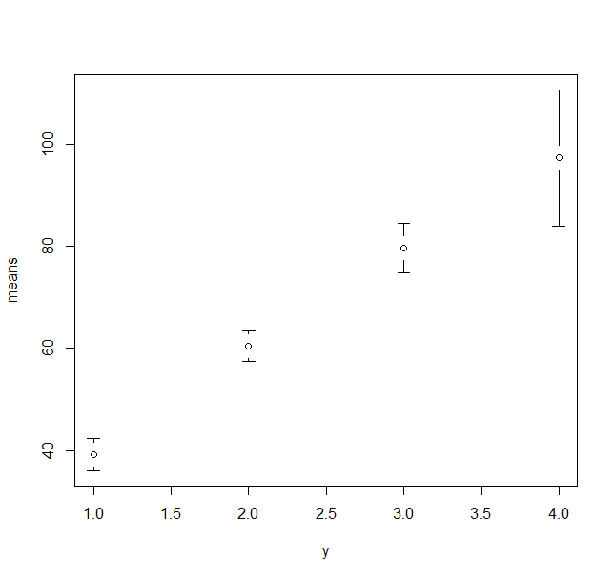
Example 1a:
Salary in 1000s
Group 1
Group 2
Group 3
Group 4

Slide 34
ANOVA
Variance between groups
Variance among groups

Slide 35
ANOVA: Example 1a
Group 1 | Group 2 | Group 3 | Group 4
$39,142 | $58,319 | $81,955 | $82,940
$39,388 | $61,029 | $81,786 | $86,546
$41,929 | $61,513 | $78,887 | $91,407
$43,834 | $57,372 | $86,108 | $77,838
$34,662 | $58,282 | $74,714 | $109,550
$43,255 | $62,119 | $76,732 | $105,983
$35,921 | $66,749 | $77,024 | $114,159
$36,135 | $60,632 | $85,409 | $108,117
$37,676 | $61,425 | $71,161 | $108,746
$40,700 | $56,612 | $83,441 | $87,706
$39,264 | $60,405 | $79,722 | $97,299
Mean μ
H₀: µ₁ = µ₂ = µ₃ ₌ µ₄

Slide 36
ANOVA Example 1a:

Slide 37
ANOVA Example 1a:
Where:
p: is the # of populations (4)
n_{i} : sample size of the ith population (10)
Variance Between Groups : SST

Slide 38
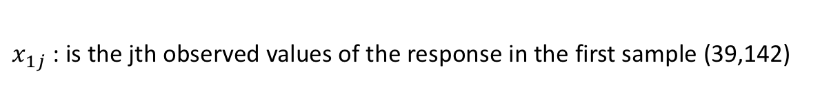
ANOVA Example 1a:
Variance within Groups
Where:
$x_{1j}$ : is the jth observed values of the response in the first sample (39,142)

Slide 39
ANOVA Example 1a:

Slide 40
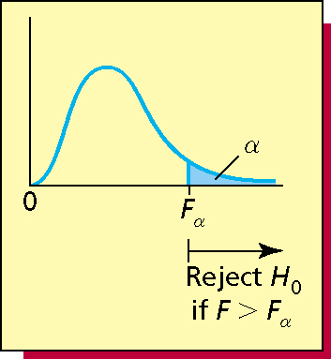
ANOVA Example 1a:
F Statistic = MST / MSE
α=0.05
F_{α}=2.86 (F table)
F=114.4
Reject H₀ at 95% confidence

Slide 41
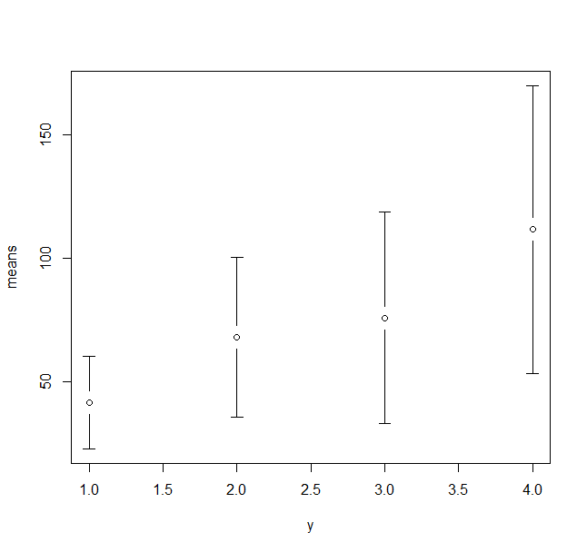
Example 1b: Same Groups: Larger within Group Variances
Salary in 1000s
Group 1
Group 2
Group 3
Group 4

Slide 42
ANOVA
Variable | Example 1a | Example 1b
SST | 1.87E+10 | 2.49E+10
SSE | 0.197E+10 | 5.93E+10
MST | 6.25E+09 | 8.31E+09
MSE | 0.06E+09 | 1.65E+09
F Statistic | 114.4 | 5.04
You need to know how to interpret F statistic for ANOVA.

Slide 43
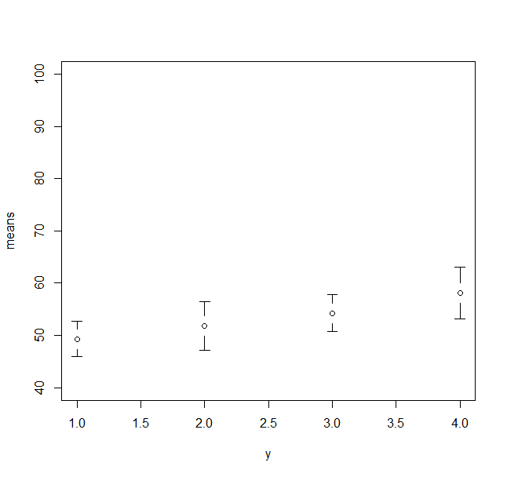
Example Ic: Smaller Between Group Variances
Salary in 1000s
Group 1
Group 2
Group 3
Group 4

Slide 44
ANOVA Table
Variable | Example 1a | Example 1b | Example 1c
SST | 1.87E+10 | 2.49E+10 | 0.2E+10
SSE | 0.2E+10 | 5.93E+10 | 0.3E+10
MST | 6.25E+09 | 8.31E+09 | 0.7E+09
MSE | 0.06E+09 | 1.65E+09 | 0.09E+09
F Statistic | 114.4 | 5.04 | 7.9
What happens to F?

Slide 45
More ways to use ANOVA.
Evaluating the consistency of an athlete or a team
The variability of speeds on a highway
The variability of repair costs of certain automobiles;
Etc.

