Slide 1


COMPANY INFORMATION SYSTEM
Presented By- Group A16
(20cse038, PIYUSH KUMAR)
(20cse053, RISHABH RAJ)
(20cse054, PRIYA KHETAN)
Class Teacher:- Mr. Anil Kumar Meher
Project Co-Ordinator:- Mr. Bhabani Shankar Panda
HoD(CSE):- Mr. Sanjay Kunar

Slide 2

What is CIS?
Company Information System is distributed command line interface, developed to maintain the details of employees working in any organisation. The CIS has been developed to override the problems prevailing in the practicing manual system. It maintains the information about the personal and official details of the employees. By CIS, you can also edit the data of any employee like edit the data, retrieve the data, delete the data of any employee. This app is used to add details of a new employee, delete details of an old employee, edit details, search for an employee.

Slide 3
Abstract
In today’s world, man struggles to make his life easier. The need for tracking has assumed high importance because of varied and diverse resources. They have to wander from room to room, floor to floor to perform their work. In such cases, it becomes extremely difficult to keep a track of people and find them when they are needed.
Solution for the above problem is as further a tracking system which can track an individual when they enter a room would suffice the need. This process should take place in a hassle free manner and therefore a wireless system would be advantageous. A receiver can be placed in each of the rooms in the building and connected to a computer system which can take input from the connected receiver and enter it in a database of all individuals or personnel in the building.
The receiver would receive input from a transmitter which would be given to all the people working in the building. Since all the information is logged in a database, any person in the building will be able to access this information through any computer connected to this system and come to know the location of the person he or she is seeking for. The system architecture consists of simple format of Central system and peripheral system.
1. Peripheral systems: It includes nodes, desktops that accept information from the RFID readers which are mounted on the doors or at entry to any department.
2. Central systems: It includes server that handles all information of desktops. Server also controls time, attendance, log and manage database.
3. Front end consist of GUI for administrator that do tracking.
4. Back end consist of Database that maintaining log and database, Time and attendance of employee

Slide 4
Objectives
This project aims to simplify the task of maintaining records of the employees of Company.
To develop an well-designed database to store employee information.
Provides full functional reports to management to company.
The objectives of this project is to provide a comprehensive approach towards the management of employee information.

Slide 5
Used elements
Software used: Hardware used:
.>Operating System – Windows 11 .>Monitor
.>Developing Tools- JDK, JRE .>Ryzen 7 processor
.>Languages- JAVA .>RGB keyboard
.>Compiler- Dcoder .>RAM(512 mb)

Slide 6
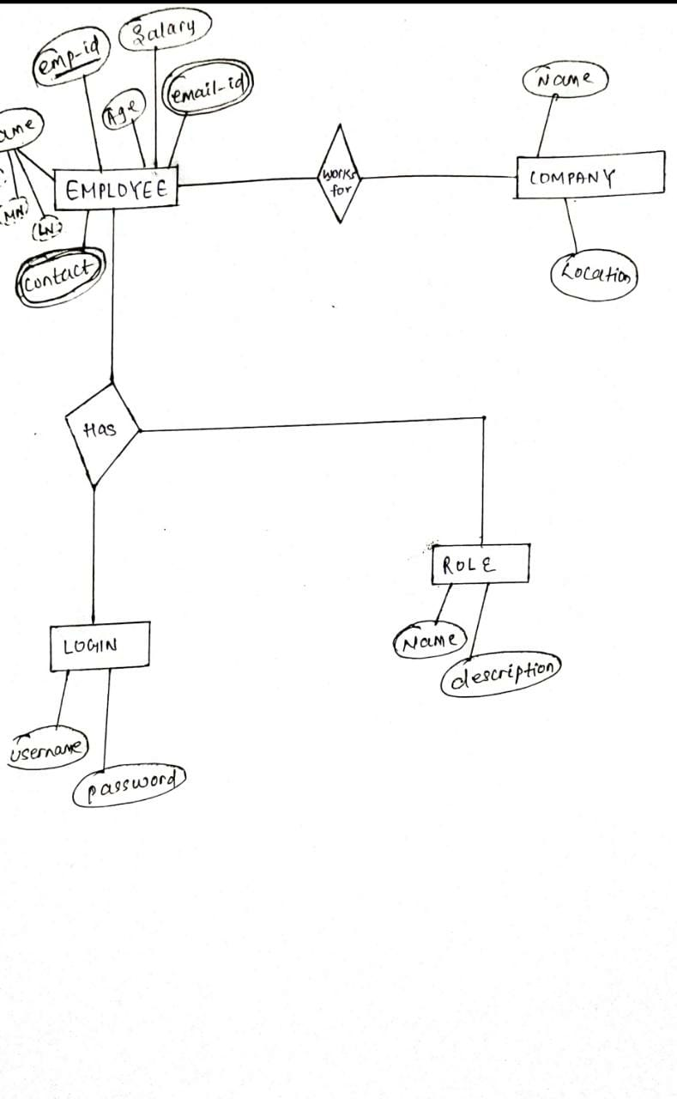
E-R Diagram

Slide 7
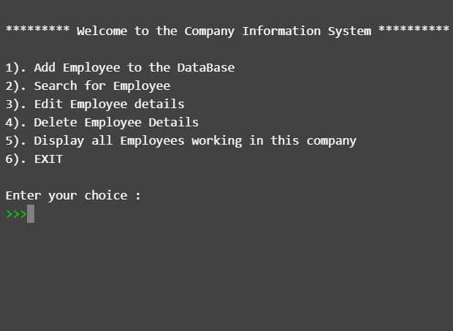
This is the main menu of project. Here you can all the 6 options. Here you can add the details of new employee, delete the data of an old employee and also edition of data is possible here.

Slide 8
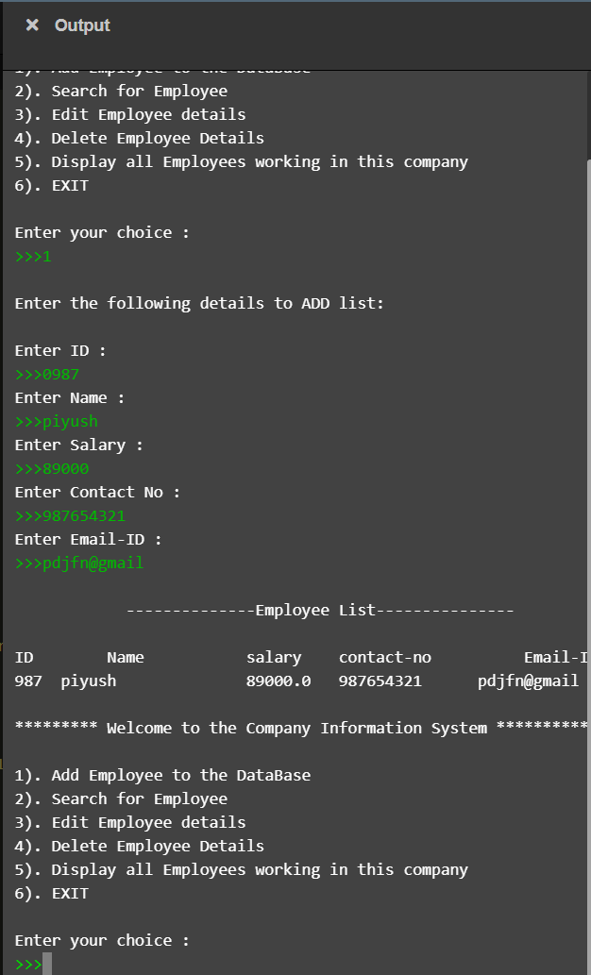
On clicking on 1st option you will get options to enter the details of the employee, here you have to fill all these necessary details if you are an employee of this firm .

Slide 9
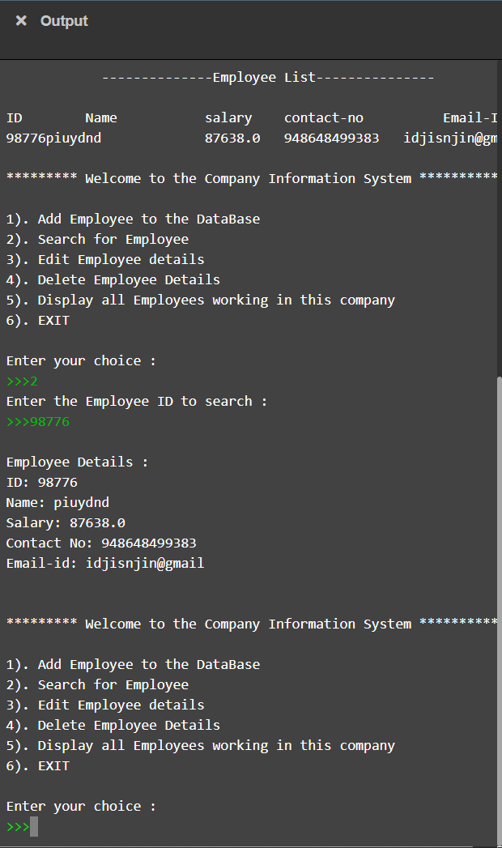
Here in this page, you can search for any employee working in this company, by using their employee id which is also our primary key. As you can see in this screenshot, we are searching for the employee who is having employee id 98776.

Slide 10
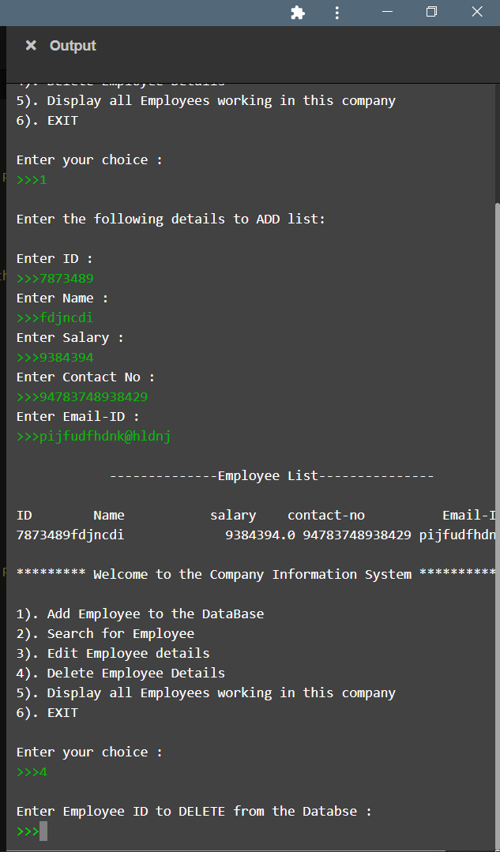
As you can see in this page, we have taken the option 4, and you are seeing here that deletion part is also running successfully.

Slide 11
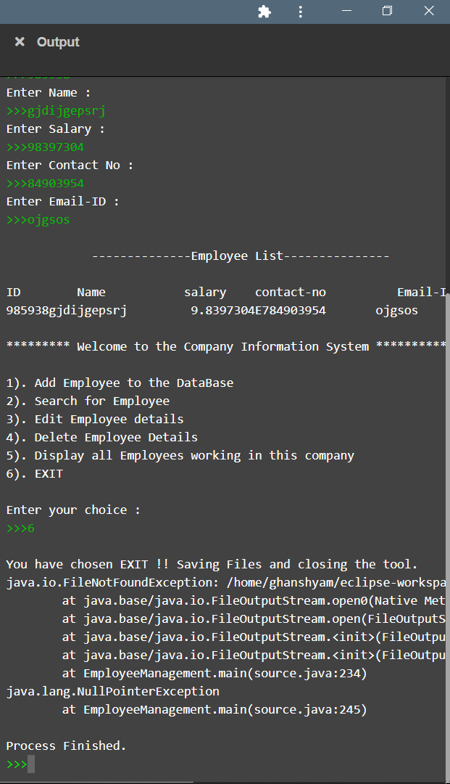
And, This is the last part of our project in which you have seen that all the features of this project are running successfully and last part is all about the exit part in which you are able of leaving this page.

Slide 12
THANK YOU 🤗

