Slide 1

IILM UNIVERSITY, GREATER NOIDA
I N T E R N S H I P R E P O R T P R E S E N T A T I O N
Web Developer
Internship
Codec Technologies Pvt. Ltd.
AICTE & ICAC Approved Internship Program
PIYUSH DUBEY
Roll No. 25SCS1003004086 | B.Tech CSE | Batch 2025–2029
01/06/2026 – 01/08/2026 • Hybrid Mode
Web Developer Internship • Piyush Dubey
01

Slide 2
ABOUT THE STUDENT
Candidate Profile
▣
Roll Number
PIYUSH
DUBEY
25SCS1003004086
⌂
Institute
B.Tech – Computer Science & Engineering
IILM University, Greater Noida, U.P.
◆
Programme
B.Tech CSE, Batch 2025–2029
◎
Internship Domain
Web Development
▦
Duration
2 Months | June – August 2026
Web Developer Internship • Piyush Dubey
02

Slide 3
ABOUT THE INTERNSHIP
Codec Technologies & the Web Developer Internship
Codec Technologies provided a structured web development internship focused on practical front-end and back-end fundamentals. The program combined conceptual learning, hands-on tasks, project work, weekly check-ins and a final review.
●
Organization
●
Mode & Duration
●
Program Focus
Codec Technologies Pvt. Ltd.
Hybrid • 2 Months
Web Development Workflow
Structured internship platform with IT and business consultancy exposure.
01/06/2026 to 01/08/2026 • Web Developer Intern
HTML/CSS → JavaScript → APIs → Git/GitHub → Testing → Deployment
Web Developer Internship • Piyush Dubey
03

Slide 4
PROBLEM STATEMENT
Bridging Theory and Real-World Web Development
Students may understand HTML, CSS, JavaScript and related concepts academically, yet often get limited exposure to building, testing and handing off a complete web project. This internship addressed that gap through an end-to-end development workflow.
1
DESIGN
2
BUILD
3
INTERACT
4
INTEGRATE
5
DELIVER
→
→
→
→
Responsive page structure
HTML + CSS + Bootstrap
JavaScript + DOM
REST APIs + JSON
Git + testing + deployment
Web Developer Internship • Piyush Dubey
04

Slide 5
PROJECT OBJECTIVES
What the Internship Set Out to Achieve
◆
HTML5 & CSS3
◆
JavaScript
◆
Responsive UI
Build well-structured, responsive web pages using semantic HTML and modern CSS.
Add interactivity with DOM manipulation, events, functions and ES6 features.
Create mobile-first layouts using Flexbox, CSS Grid and Bootstrap.
◆
Version Control
◆
API Integration
◆
Testing & Deployment
Use Git and GitHub for versioning, branching and collaboration.
Understand client-server communication and work with REST APIs and JSON.
Test across browsers, debug issues and prepare a functional project for deployment.
Web Developer Internship • Piyush Dubey
05

Slide 6
TECHNOLOGIES & TOOLS
The Toolkit Behind the Internship
•
HTML5
•
CSS3
•
JavaScript (ES6)
•
Bootstrap
Page structure & semantics
Styling & responsive layouts
Logic & interactivity
Rapid responsive UI
•
Git & GitHub
•
VS Code + DevTools
•
REST APIs + JSON
•
Chrome & Cross-browser Testing
Version control & collaboration
Development, debugging & testing
Back-end/data integration
Compatibility & quality assurance
Web Developer Internship • Piyush Dubey
06

Slide 7
SYSTEM ARCHITECTURE
From Web Page to Tested Deployment
1
Presentation Layer
HTML + CSS structure the page
↓
2
Interaction Layer
JavaScript handles DOM, forms and events
↓
3
Data Layer
REST APIs and JSON provide dynamic data
↓
4
Version Control Layer
Git/GitHub manage source code and collaboration
↓
5
Testing & Deployment
Browser testing, debugging and deployment preparation
Web Developer Internship • Piyush Dubey
07

Slide 8
METHODOLOGY
The 8-Week Learning Journey
1
WEEK
2
WEEK
3
WEEK
4
WEEK
Orientation & Fundamentals
Responsive Web Design
JavaScript Essentials
Front-End Project Work
HTML5, CSS3, semantic markup and project guidelines
Flexbox, CSS Grid and Bootstrap layouts
DOM manipulation, events, functions and ES6
Build an assigned landing page / portfolio-style site
5
WEEK
6
WEEK
7
WEEK
8
WEEK
Version Control
Back-End Basics
Integration & Testing
Final Submission & Review
Git, GitHub, branching and code review practices
REST APIs, JSON and server-side concepts
Connect data, cross-browser testing and debugging
Deployment preparation, documentation and final review
Web Developer Internship • Piyush Dubey
08

Slide 9
EXPECTED OUTCOMES
Skills & Capabilities Gained
01
Responsive Development
Ability to build clean, responsive web pages using HTML5, CSS3 and Bootstrap.
02
JavaScript Practice
Practical understanding of interactive UI behavior, DOM manipulation and ES6 syntax.
03
Git & Collaboration
Hands-on experience with Git/GitHub for version control and collaborative work.
04
API Integration
Working knowledge of connecting front-end pages with APIs and JSON data.
05
Testing & Debugging
Experience with browser tools, cross-browser testing and issue resolution.
06
Project Completion
A completed front-end project, reviewed with the assigned Project Head, plus internship certification.
Web Developer Internship • Piyush Dubey
09

Slide 10
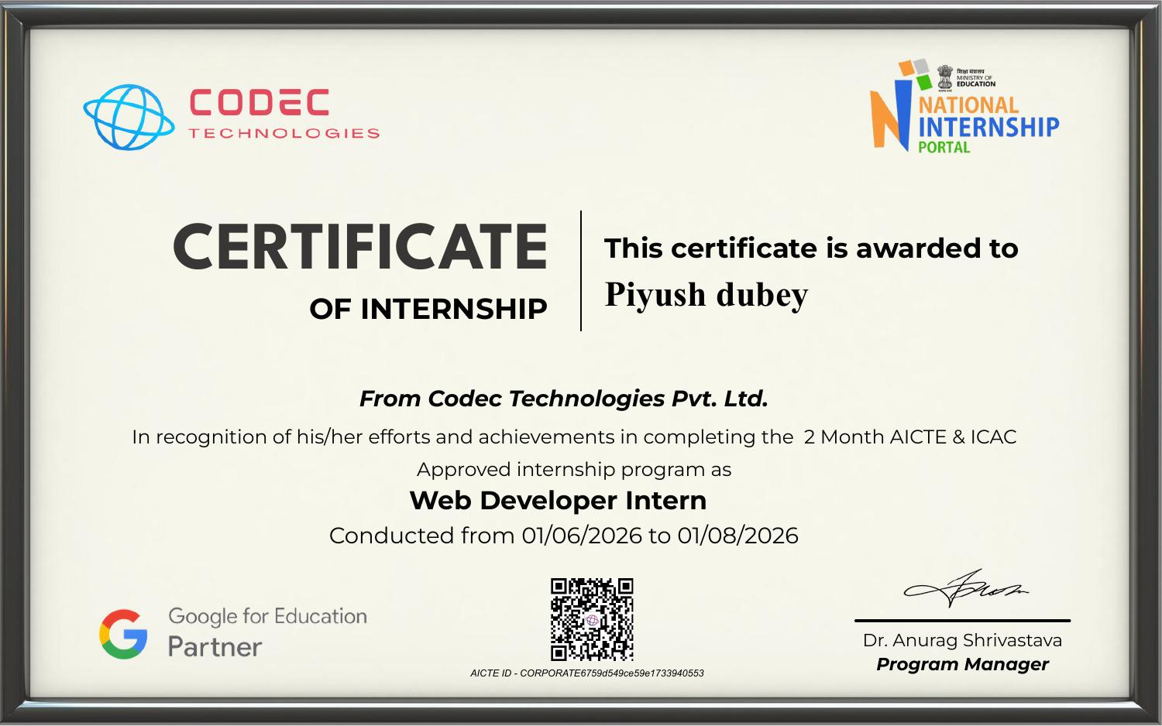
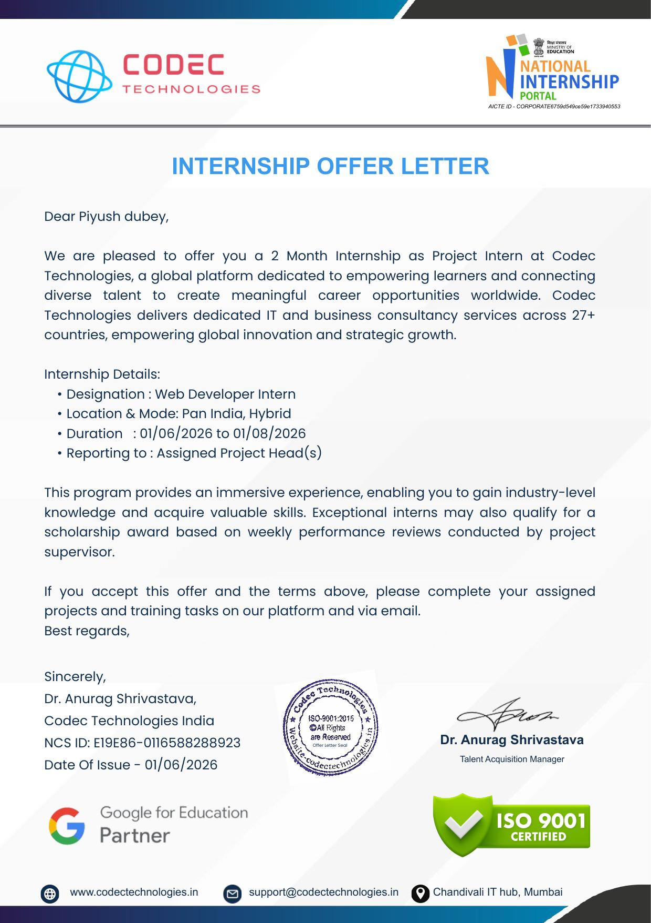
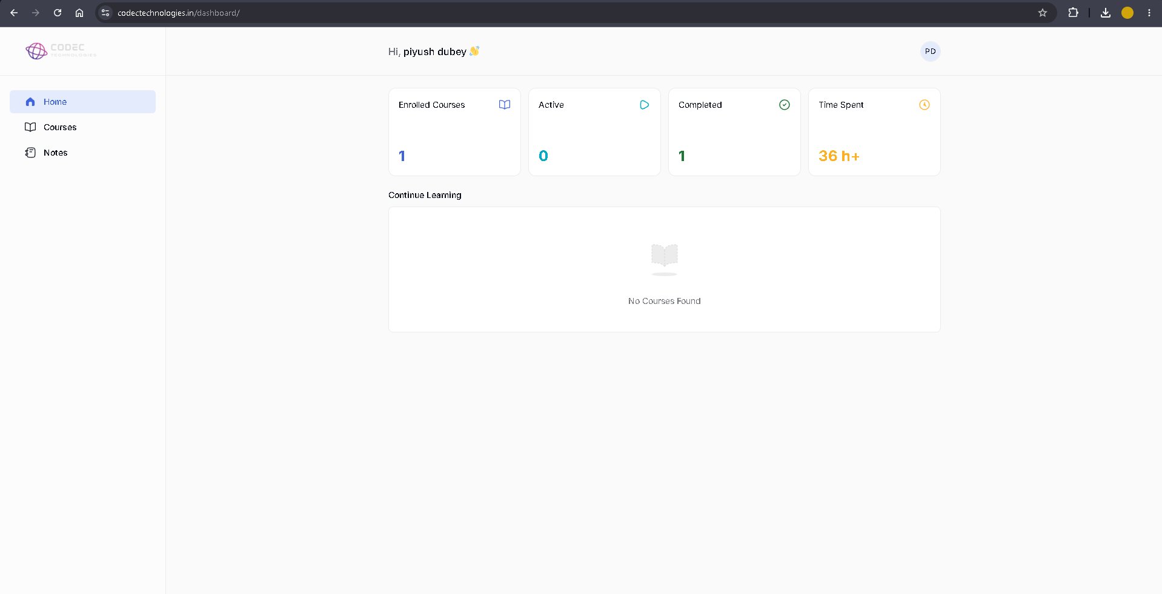
CERTIFICATION & PROOF
Successfully Completed
Designation
Web Developer Intern
Duration
2 Months | June – August 2026
Organization
Codec Technologies Pvt. Ltd.
Certificate
Internship Completion Certificate
AICTE / ICAC
Approved internship program
Supporting evidence
Offer Letter
Completed Dashboard
Web Developer Internship • Piyush Dubey
10

Slide 11
Thank You
Web Developer Internship
Codec Technologies Pvt. Ltd. • IILM University, Greater Noida
PIYUSH DUBEY
Roll No. 25SCS1003004086 | B.Tech CSE
June – August 2026
Web Developer Internship • Piyush Dubey
11

