Slide 1
Quiz-Up A Quiz Application
SUBMITTED BY: UNDER THE MENTORSHIP OF :
Name: Piyush Kathait Ms. Tanusha Mittal
University Roll no. : 2019423 Assistant Professor
Course: B.Tech AI & DS

Slide 2
INTRODUCTION
Nowadays the interactive way of learning is getting popular. Quizzes, in particular, offer an entertaining and educational way to test knowledge, promote learning, and foster social interaction. The objective of our mini project is to develop a quiz application that gives an enjoyable experience for users.
Quizzes have gained immense popularity due to their ability to engage users and enhance their knowledge on various subjects. Traditional learning methods often can fail to captivate learners effectively. since the demand for these learning platforms is increasing. Our quiz application aims to fill this gap by providing an engaging and educational tool that can be accessed anytime, anywhere.

Slide 3
PROBLEM STATEMENT
The primary objective of our quiz application is to create a platform that offers an entertaining and educational experience for users. By including informative questions, we aim to give an enjoyable learning environment for our users, including students and professionals.
Our goal is to encourage knowledge enhancement, promote critical thinking, and foster a sense of healthy competition among participants.
Our Quiz Application will be developed with the help of java because of its rich set of features, platform independence and extensive libraries make it a preferred choice for building a wide range of applications, including apps like our quiz application.

Slide 4
METHODOLOGY
The development of the quiz application followed a structured and iterative approach, The methodology can be broken down into the following key stages:
Requirements gathering and analysis: conducted initial brainstorming sessions to identify the core features and objectives of the quiz application. Requirements were gathered through existing quiz applications
Technology Selection: After evaluating various technology options, Java for Quiz App development was chosen as the primary programming language. Visual Studio Code was selected as the Integrated Development Environment (IDE).
User Interface (UI) Design: The UI design was developed and Wireframes were created to visualize the app's layout, navigation, and interactive elements. The design aimed to provide a seamless and enjoyable user experience.

Slide 5
Functionality Implementation: Key functionalities, such as user registration, scoring, and result display, were implemented in line with the defined requirements. Java classes were developed to handle user interactions and data manipulation.
Testing: Thorough testing was carried out to identify and fix any bugs or issues. The application underwent usability testing to ensure it was user-friendly and bug-free.
Operation: The QuizUp application was made available for users to run on their devices. Ongoing monitoring and maintenance were conducted to provide a smooth user experience.

Slide 6
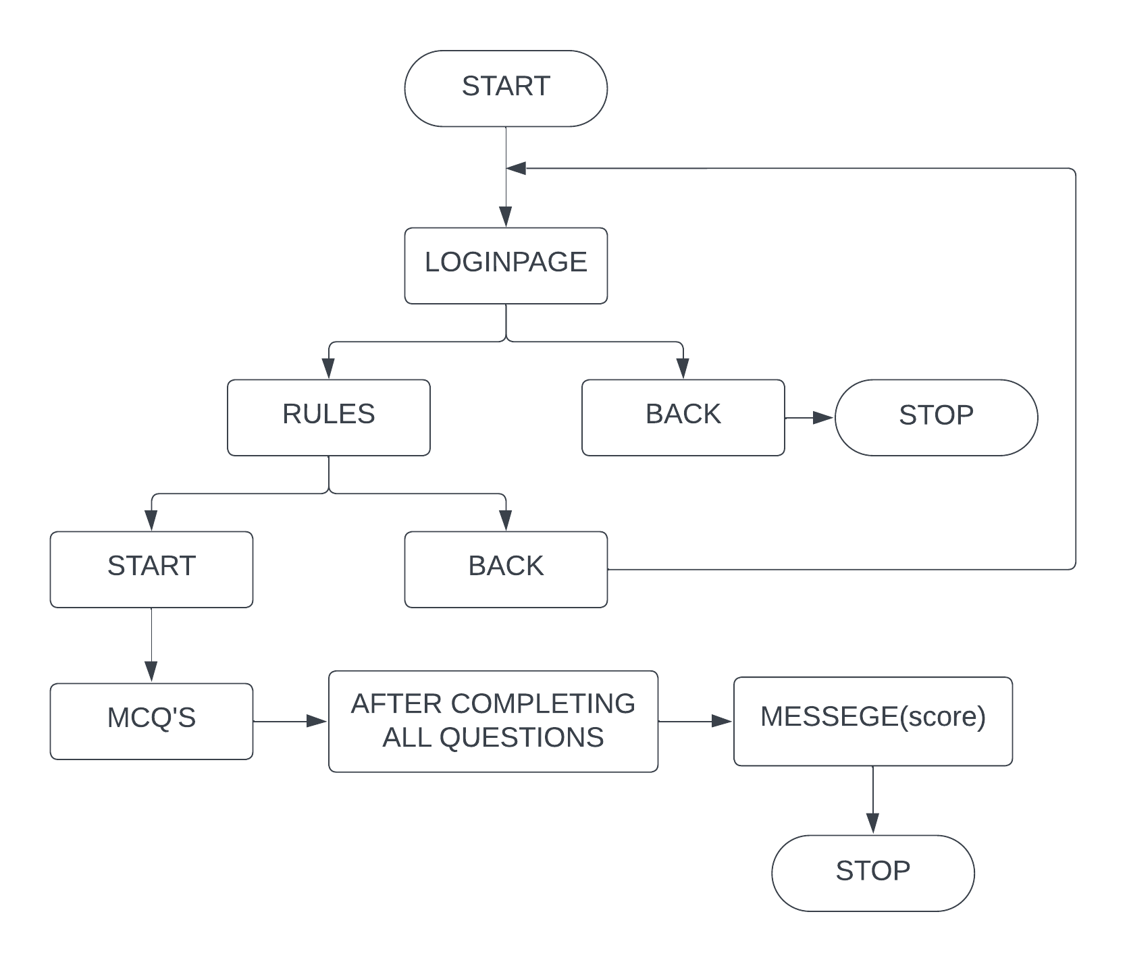
FLOW DIAGRAM :

Slide 7
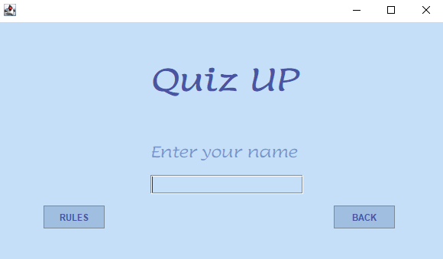
RESULT AND DISCUSSION
After completion of the project we can access this application by running the .java file
-> The user login:
login(fig1.2)

Slide 8
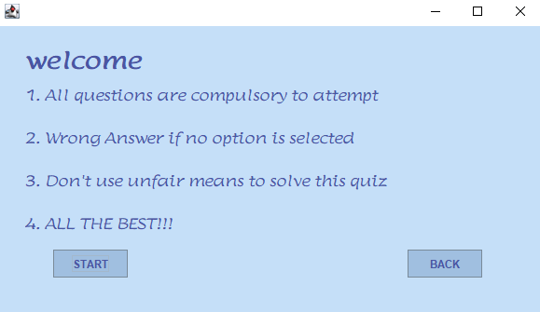
-> after the user logins after providing his/her name, the user can choose to exit the app or to go to the rules section.
Rules section (fig1.2)

Slide 9
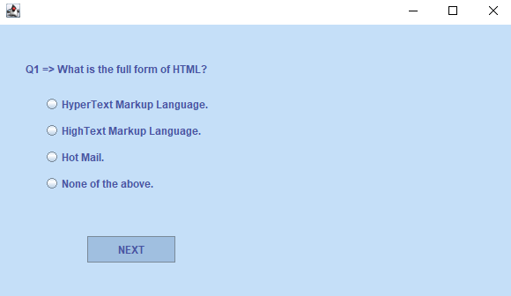
-> the user then either go back to the login window or can start the quiz
Questions (fig1.5)

Slide 10
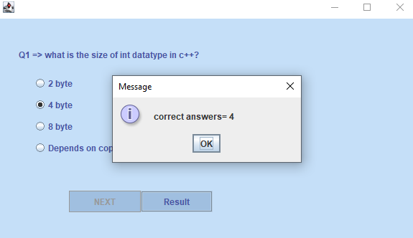
-> When the user attempts all the questions the at the last question, the user can see his result and how he performed in this quiz.
Questions (fig1.5)

Slide 11
CONCLUSION AND FUTURE WORK
The development of the quiz app has been a huge success as the main goal of creating an interactive and engaging platform that allows users to test their knowledge, promote learning, and enjoy challenging quizzes has been achieved. Through systematic methodology and rigorous testing, we have successfully created a user-friendly and feature-rich quiz app suitable for a wide audience.
In addition to this, I am interested in making this quiz application available for androids, will make this application online, will add a question timer.
Furthermore while working on this project my interest java applications has increased an I am eager to continue exploring this field by creating similar projects like this one

Slide 12
THANK YOU
The Presentation ends here

