Slide 1

PITCH-A-BOT Piyush Kumar Satpathy
SMART IRRIGATION

Slide 2
IDEA AND APPROACH
When there is not enough water (falls below a certain moisture level) in the soil , the water MOTOR will get automatically turned on and the agricultural field will automatically GET irrigated. WHEN THERE IS ENOUGH WATER IN THE SOIL THE MOTOR WILL AUTOMATICALLY GET TURNED OFF TO PREVENT ANY EXCESS OF WATER IN THE SOIL.

Slide 3
componentS REQUIRED
1.Arduino
2.Connecting wires
3.Moisture sensor
4.water pump
5.Usb connector

Slide 4
CONNECTIONS AND CIRCUIT DIAGRAMS
=================================================================

Slide 5
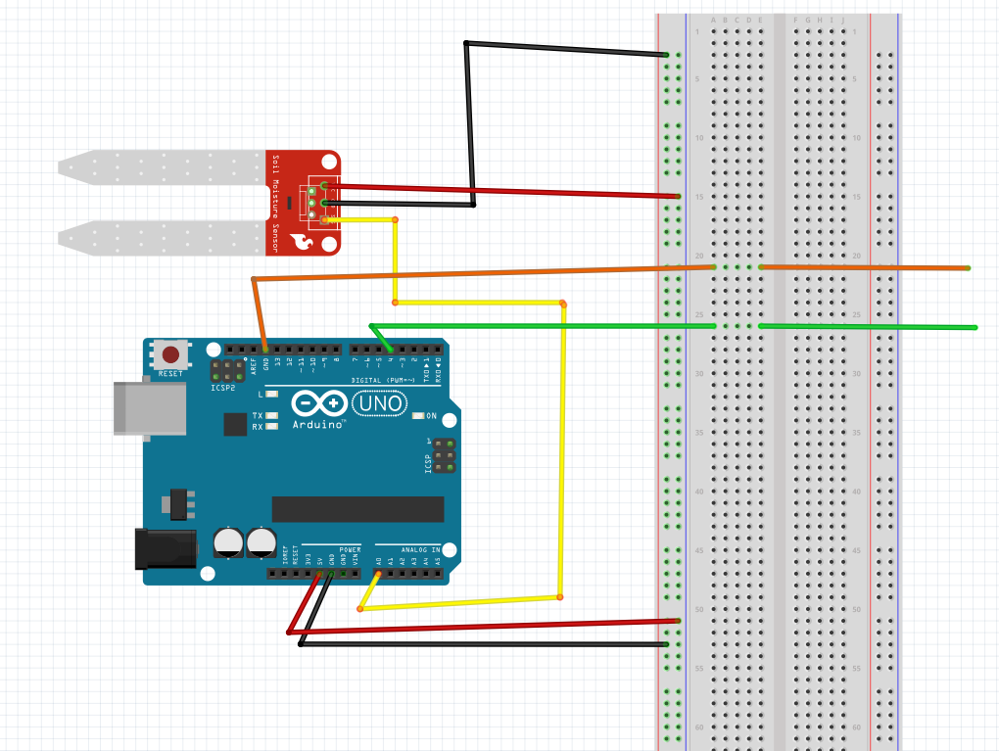
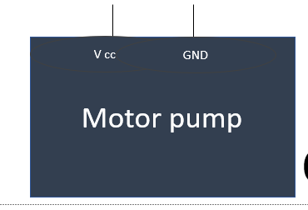
--------------------------

Slide 6
PSEUDOCODE
int sensor_pin = A0; // Soil Sensor input at Analog PIN A0
int output_value ;
void setup() {
// put your setup code here, to run once:
pinMode(4,OUTPUT);
Serial.begin(9600);
Serial.println("Reading From the Sensor ...");
delay(2000);
}
// put your main code here, to run repeatedly:
void loop() {
output_value = analogRead(sensor_pin);
output_value = map(output_value,550,10,0,100);
Serial.print("Moisture : ");
Serial.print(output_value);
Serial.println("%");
if(output_value<0){
digitalWrite(4,HIGH);
}
else{
digitalWrite(4,LOW);
}
delay(1000);
}

Slide 7
TAKEAWAY AND RESOURCES
In this project , I learnt some more predefined functions of Arduino programming. I think I could implement some more sensors and write appropriate programs for reporting weather conditions in the agricultural land along with moisture level . i took help from google and watched few youtube videos of Arduino.
https://www.hackerearth.com/blog/developers/arduino-programming-for-beginners/

