Slide 1
VRP with different vehicle capacities and pickup drop
Piyush Panchariya

Slide 2
Problem Statement:
We have to describe a VRP in which each vehicle having different capacities picks up items at various locations and drops them off at others. The problem is to assign routes for the vehicles to pick up and deliver all the items, while minimizing the length of the longest route.
Vehicle Capacities:
Vehicle 1 : 10
Vehicle 2: 15
Vehicle 3: 20
Vehicle 4: 25
Piyush Panchariya

Slide 3
Pictorial representation of problem statement:
1
2
1
4
3
4
2
4
5
6
8
**Note:
Number above node represents pickup quantity
0 is Depot
7
8
0
9
10
11
12
13
14
4
8
15
16
8
Piyush Panchariya

Slide 4
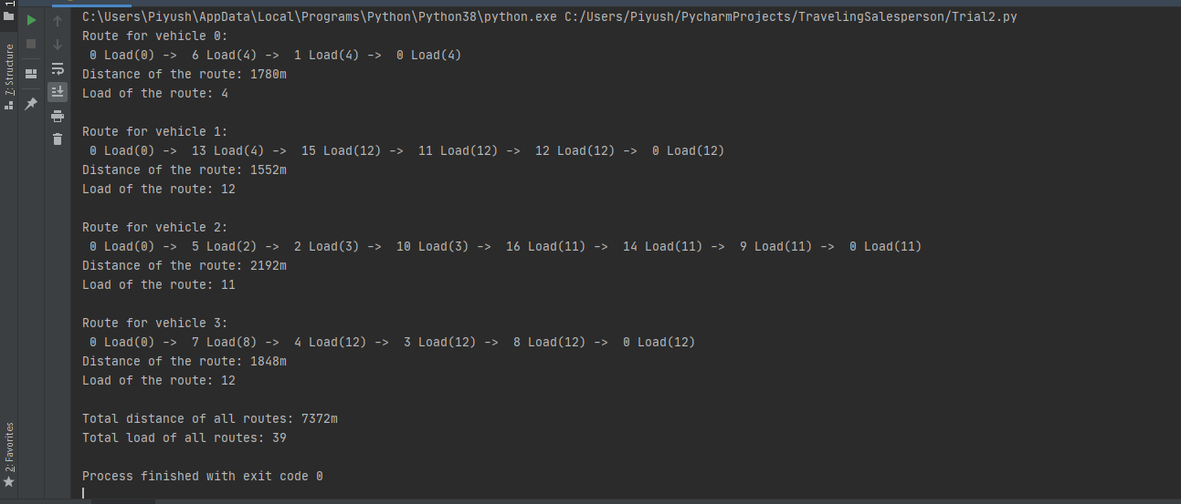
Output of Program:
Piyush Panchariya

Slide 5
Pictorial representation of solution:
1
2
1
4
3
4
2
4
5
6
8
7
8
0
9
10
11
12
13
14
4
8
15
16
8
Piyush Panchariya

