Slide 1
Introduction to Recurrent Neural Networks (RNNs)
Definition: A type of deep learning model for sequential data.
Applications:
Virtual assistants (e.g., Siri, Alexa)
Grammarly and Google Autocomplete
Language translation
Named entity recognition

Slide 2
Why Use RNNs?
Challenges with Artificial Neural Networks (ANNs):
Fixed-length input/output makes handling variable-length sequences difficult.
Lack of consideration for word order in sequences.
Solution with RNNs:
Handles varying sequence lengths.
Accounts for word order using activation states.

Slide 3
RNN Structure
Key Feature: Recurrent – passes activations through time.
Mechanism:
Input: One word at a time.
Output: Predictions for each input, influenced by previous inputs.
Diagrams: Unrolled and rolled views of RNNs.

Slide 4
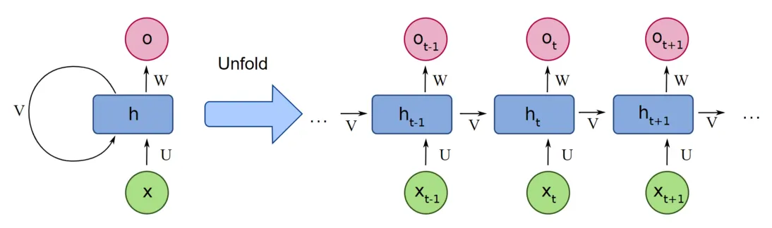
RNN Structure Unfolded

Slide 5
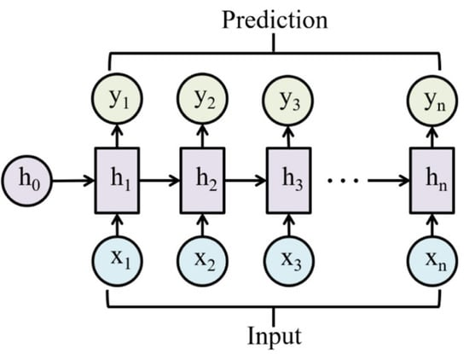
RNN Structure Unfolded

Slide 6
Named Entity Recognition Example
Use Case: Identifying entities (e.g., people, organizations, locations) in text.
Process:
Pass each word into the RNN.
Outputs: Entity label for each word, influenced by prior inputs.
Example:
Input: "Google is based in San Francisco."
Google: Organization
San Francisco: Location

Slide 7
Benefits of RNNs
Handles varying input and output sequence lengths.
Considers context by incorporating previous inputs into predictions.
Enables advanced NLP applications.

Slide 8
Introduction to Types of RNNs
RNNs are versatile models for sequential data.
Different RNN architectures cater to varied application needs.
We'll explore several types based on input-output sequence structures.

Slide 9
Many-to-One RNN
Example: Movie Rating System
Input: Variable-length comment.
Output: Single rating (e.g., 1 to 5).
Mechanism:
Processes all inputs sequentially.
Generates output only at the final step.

Slide 10
One-to-Many RNN
Example: Baby Name Generator
Input: Single feature (e.g., gender).
Output: Sequence (name).
Mechanism:
Processes input once.
Generates sequence until end condition is met.
Output from each step feeds into the next.

Slide 11
Many-to-Many RNN (Equal Input-Output Length)
Example: Named Entity Recognition (NER).
Input: Variable-length sentence.
Output: Tags for each input word (e.g., PERSON, LOCATION).
Mechanism:
Generates output for each input sequentially.
Input-output lengths are equal.

Slide 12
Many-to-Many RNN (Variable Input-Output Length)
Example: English-to-Spanish Translation.
Input: English sentence of any length.
Output: Spanish sentence of any length.
Mechanism:
Encoder processes input sequence.
Decoder generates output sequence.
Input-output lengths are independent.

Slide 13
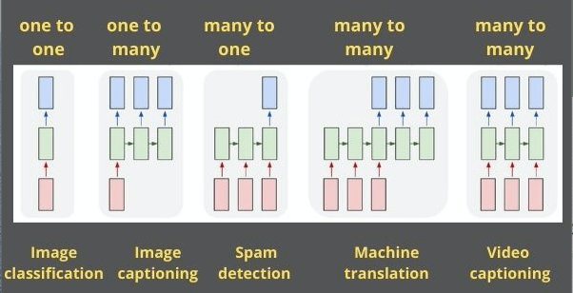
Visual Representation of Types of RNN

Slide 14
Summary of RNN Types
Many-to-One: Variable input, fixed output length.
One-to-Many: Fixed input, variable output length.
Many-to-Many (Equal Length): Input and output lengths are the same.
Many-to-Many (Variable Length): Input and output lengths differ.

Slide 15
RNN Model Details & Architecture
A detailed walkthrough of Recurrent Neural Network (RNN) architecture and its operations.

Slide 16
Introduction
In this video, we explore the inner workings of the RNN model, its cell architecture, and the mathematical details involved. Key points include:
Limitations of simple neural networks for NLP tasks.
Overview of RNN architecture.
Understanding activations and input processing.

Slide 17
Input Processing
1. Words are converted into numbers using a vocabulary.
2. Numbers are transformed into one-hot vectors:
Example: Vocabulary position of a word corresponds to '1' in the vector.
3. One-hot vectors are fed into the RNN cell.

Slide 18
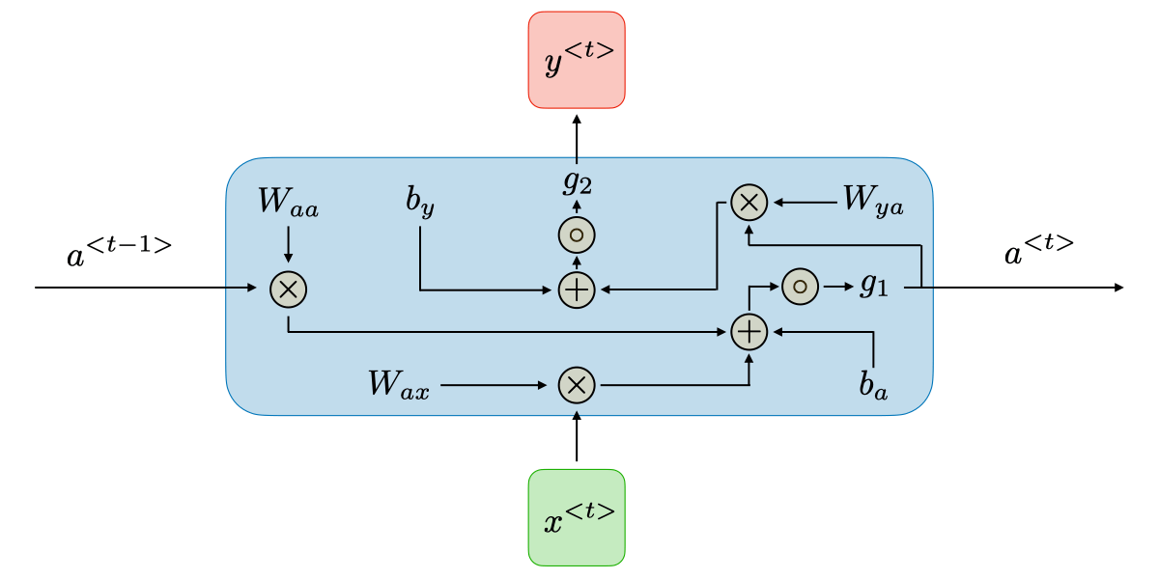
RNN Cell Diagram

Slide 19
RNN Cell Details
RNN cells perform the following operations:
Activation from the previous timestamp and input word are processed.
Equations:
a(t) = tanh(Waa·a(t-1) + Wax·x(t) + ba)
y(t) = activation_function(Wya·a(t) + by)
Outputs and activations are computed and passed to the next cell.

Slide 20
Two RNN Cells in a Network
Instead of a single cell, multiple RNN cells can be used in parallel.
Activations from one cell are fed to the next cell in the same time step.
This architecture allows for deeper processing of input data.

Slide 21
Backpropagation in Recurrent Neural Networks (RNNs)
A Step-by-Step Explanation

Slide 22
Introduction to Backpropagation in RNNs
Backpropagation helps minimize errors in neural networks.
Focus: Understanding backpropagation in Many-to-One RNNs.
Application: Movie rating prediction (rating 1 to 5 based on a comment).

Slide 23
Movie Rating System Example
Input: Comments about movies.
Output: Predicted movie rating (1–5).
Type: Many-to-One RNN model.
Time Steps: Analyze three timestamps: t=1, t=2, t=3.

Slide 24
Forward Propagation
Goal: Compute activations and predictions step by step.
Equation: a^(t) = f(W * x^(t) + U * a^(t-1) + b).
At t=3: Use Softmax to compute the prediction (O).

Slide 25
Loss Function
Type: Categorical Cross-Entropy.
Equation: L = -∑ y log(ŷ), where y is the actual label and ŷ is the predicted label.
Loss is computed at the final timestamp (t=3).
Purpose: Quantify prediction error for backpropagation.

Slide 26
Backpropagation Overview
Objective: Minimize loss by updating weights:
W_new = W_old - η * (∂L/∂W).
Steps:
1. Compute gradient ∂L/∂W for all weights.
2. Update weights using the learning rate (η).
Challenges: Recurrent weights (W_AA and W_AX) span multiple time steps.

Slide 27
Gradient Computation for W_YA
Dependence Chain: L → O → W_YA.
Equation: ∂L/∂W_YA = (O - Y) * A^(3), where:
O: Prediction, Y: Actual label, A^(3): Final activation.
Simplification: Update W_YA: W_YA = W_YA - η * ∂L/∂W_YA.

Slide 28
Gradient for W_AA (Recurrent Weight)
W_AA impacts all activations: A^(1), A^(2), A^(3).
Dependence Chain: L → O → A^(3) → A^(2) → A^(1) → W_AA.
Equation: ∂L/∂W_AA = ∑(∂L/∂A^(t) * ∂A^(t)/∂W_AA) for t=1 to T.

Slide 29
Gradient for W_AX (Input Weight)
Similar Story: W_AX impacts all activations through X^(1), X^(2), X^(3).
Equation: ∂L/∂W_AX = ∑(∂L/∂A^(t) * ∂A^(t)/∂W_AX) for t=1 to T.

Slide 30
Key Backpropagation Equations
1. ∂L/∂W_YA = (O - Y) * A^(T).
2. ∂L/∂W_AA = ∑(∂L/∂A^(t) * ∂A^(t)/∂W_AA) for t=1 to T.
3. ∂L/∂W_AX = ∑(∂L/∂A^(t) * ∂A^(t)/∂W_AX) for t=1 to T.

Slide 31
Challenges in RNN Backpropagation
Gradients flow through multiple time steps (vanishing/exploding gradients).
Weight sharing complicates updates for W_AA and W_AX.
Solutions: Gradient clipping, advanced architectures (e.g., LSTMs, GRUs).

Slide 32
Conclusion
Backpropagation in RNNs relies on the chain rule and weight sharing.
Key challenge: Managing dependencies across multiple time steps.
Practical applications: Language models, sentiment analysis, time-series prediction.
Explore advanced RNN variants for better performance.

Slide 33
Why Learn LSTMs?
Problems with Recurrent Neural Networks (RNNs).
LSTM as a solution for long-term dependencies.
Intuition and mathematical foundations explained in simple terms.
Takeaway: LSTM is crucial for solving real-world sequence problems.

Slide 34
RNN Limitations
Example: Grammar Checker fails to maintain context (e.g., 'his' vs. 'her').
Key Issue: RNNs lose early information in long sequences.
Reason: Activations a_t are updated repeatedly.
Earlier inputs' influence diminishes (vanishing gradient problem).

Slide 35
Vanishing Gradient Problem
Why Do RNNs Forget?
Gradients shrink during backpropagation: Multiplication of small numbers over time leads to values close to zero.
Earlier words have little impact on weights.
Visual: Simple diagram showing gradient shrinking across layers.

Slide 36
What is LSTM?
A New Perspective
Definition: Long Short-Term Memory network retains long-term context.
Core Difference: RNN: Short-term memory. LSTM: Long-term + short-term memory.
Visual: Diagram contrasting RNN and LSTM cell.

Slide 37
LSTM Components
Inside an LSTM
Two States:
Memory Cell State (C_t): Retains long-term information.
Hidden State (h_t): Processes new input and influences output.

Slide 38
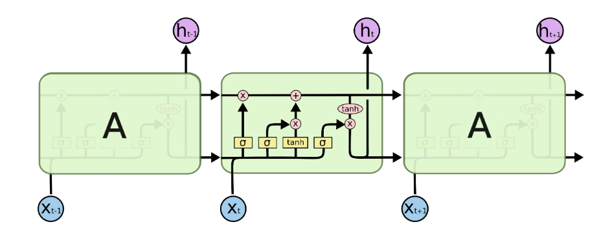
LSTM Block Diagram

Slide 39
LSTM Gates
Controlling Information Flow
Three Gates:
Forget Gate (f_t): Decide what to forget.
Input Gate (i_t): Decide what new information to add.
Output Gate (o_t): Decide what to output.
Visual: Annotated LSTM cell diagram.

Slide 40
Forget Gate
Retain or Discard?
Equation: f_t = σ(W_f [h_(t-1), x_t] + b_f)
Multiplies with previous cell state (C_(t-1)): 1: Retain information, 0: Forget information.
Example: Retaining 'Mr. Watson' across context.

Slide 41
Input Gate
Adding New Information
Equation: i_t = σ(W_i [h_(t-1), x_t] + b_i)
C_t~ = tanh(W_C [h_(t-1), x_t] + b_C)
C_t = f_t * C_(t-1) + i_t * C_t~
Filters candidate values before adding them to the memory.
Example: Adding the information 'tomorrow' to context.

Slide 42
Output Gate
Deciding the Output
Equation: o_t = σ(W_o [h_(t-1), x_t] + b_o)
h_t = o_t * tanh(C_t)
Filters and passes information for prediction.
Example: Correcting grammar output based on retained context.

Slide 43
Advantages of LSTM
Solves the vanishing gradient problem.
Retains long-term dependencies effectively.
Useful for real-world applications like:
Grammar checkers.
Language translation.
Time-series forecasting.

Slide 44
Key Takeaways
LSTMs extend RNNs by introducing memory cells and gates.
Addresses the limitations of RNNs (context loss, vanishing gradient).
Foundational for sequence modeling tasks.

