Slide 1
Understanding Bag of Words (BoW)
A Simple Method for Text Representation

Slide 2
Why Do We Need Word Embedding Techniques?
Text data is inherently non-numerical and cannot be processed by machine learning models directly.
Word embedding techniques convert text into numerical formats (vectors) to represent words and their relationships.
They enable models to capture semantic meaning, context, and relationships between words.

Slide 3
What is Bag of Words?
A BoW is a simple method to convert text into numerical vectors.
It represents text data based on the frequency of words, ignoring grammar and word order.
Useful for text classification, sentiment analysis, and document similarity tasks.

Slide 4
How Do We Apply Bag of Words?
1. Tokenization: Split the text into individual words (tokens).
Example: 'The cat sat on the mat' → [The, cat, sat, on, the, mat]
2. Vocabulary Creation: List unique words from the corpus.
Example: [The, cat, sat, on, mat]
3. Vectorization: Create a vector where each element represents a word's frequency in a sentence/document.
Example: [The: 2, cat: 1, sat: 1, on: 1, mat: 1]

Slide 5
Detailed Example of Bag of Words
Example Corpus:
1. Sentence 1: 'I love programming.'
2. Sentence 2: 'Programming is fun.'
3. Sentence 3: 'I enjoy coding.'
Steps:
1. Vocabulary Creation: Unique words → [I, love, programming, is, fun, enjoy, coding]
2. Vectorization:
Sentence 1 → [1, 1, 1, 0, 0, 0, 0]
Sentence 2 → [0, 0, 1, 1, 1, 0, 0]
Sentence 3 → [1, 0, 0, 0, 0, 1, 1]
3. Mathematical Representation: Construct a document-term matrix:

Slide 6
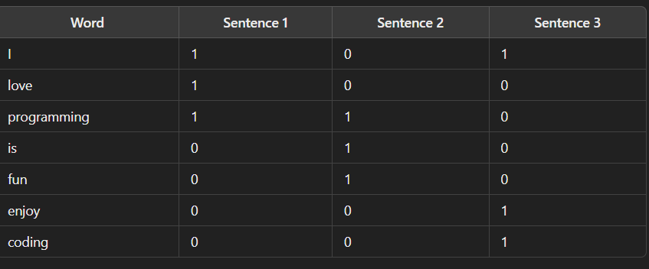
Document-Term Matrix

Slide 7
Limitations of Bag of Words
Context Ignorance: Ignores the sequence and meaning of words.
Example: 'The dog chased the cat' vs. 'The cat chased the dog' are treated similarly.
High Dimensionality: Large vocabularies lead to sparse and large matrices.
Inability to Handle Synonyms: Words with similar meanings (e.g., happy and joyful) are treated independently.
Fails to Capture Semantics: Cannot determine relationships between words.

Slide 8
Introduction to TF-IDF
Understanding Term Frequency-Inverse Document Frequency for Text Analysis

Slide 9
Why Do We Need TF-IDF?
Bag of Words (BoW) captures word frequency but ignores word importance.
Common words (e.g., 'the,' 'and') dominate BoW models despite providing little meaning.
TF-IDF assigns importance to words based on their rarity and relevance to a document.

Slide 10
What is TF-IDF?
1. Term Frequency (TF): Measures how often a word occurs in a document.
Formula: TF(t, d) = (Occurrences of t in d) / (Total words in d).
2. Inverse Document Frequency (IDF): Measures word rarity across documents.
Formula: IDF(t) = log(N / (1 + n_t)), where:
N = Total number of documents.
n_t = Number of documents containing t.
3. TF-IDF: Combines the two:
TF-IDF(t, d) = TF(t, d) × IDF(t).

Slide 11
How to Apply TF-IDF?
1. Preprocess the text: Remove stopwords, tokenize, etc.
2. Compute Term Frequency (TF) for each term in each document.
3. Compute IDF for each term across all documents.
4. Multiply TF and IDF to get the TF-IDF score for each term.
5. Represent the text as a matrix with TF-IDF scores.

Slide 12
Detailed Example with Calculations
Example Dataset:
Document 1: 'The cat sat on the mat.'
Document 2: 'The dog sat on the mat.'
Step-by-Step Calculation:
1. TF Calculation:
TF('cat', Doc1) = 1/6; TF('dog', Doc2) = 1/6.
2. IDF Calculation:
IDF('cat') = log(2 / (1 + 1)) = 0.301.
IDF('the') = log(2 / (1 + 2)) = 0 (common word).
3. TF-IDF:
TF-IDF('cat', Doc1) = 1/6 × 0.301 = 0.050.
TF-IDF('dog', Doc2) = 1/6 × 0.301 = 0.050.

Slide 13
Limitations of TF-IDF
Assumes word importance is independent of context.
Struggles with synonyms or semantic meaning (e.g., 'car' vs. 'automobile').
High-dimensional representation may be computationally expensive for large datasets.

Slide 14
Word Embeddings in Python
Understanding Word Representation in Machine Learning

Slide 15
Introduction
Text as input to models (e.g., RNN, LSTM).
Computers process numbers, not words.
Challenge: Can computers understand relationships between words like humans do?
Example: Knowing 'apple' and 'orange' are fruits.

Slide 16
Why Word Embeddings?
Text needs to be converted into numerical data.
Computers struggle to infer relationships like 'king' and 'prince.'
How can we address these gaps in understanding?

Slide 17
One-Hot Encoding
Words converted to numerical indices using a vocabulary.
Example:
' the': 8989
'king': 3456
Converted into a one-hot encoded vector.
Vector size = Vocabulary size (e.g., 10,000 words).

Slide 18
Limitations of One-Hot Encoding
No relationship between words (e.g., 'king' and 'prince').
Computational inefficiency due to high dimensionality.
Vocabulary size increases matrix size exponentially.

Slide 19
Introducing Word Embeddings
Word embeddings create featurized vector representations.
Enables computers to infer relationships and context.
Example:
'apple' and 'orange' → Similar vectors.
'king' and 'orange' → Dissimilar vectors.

Slide 20
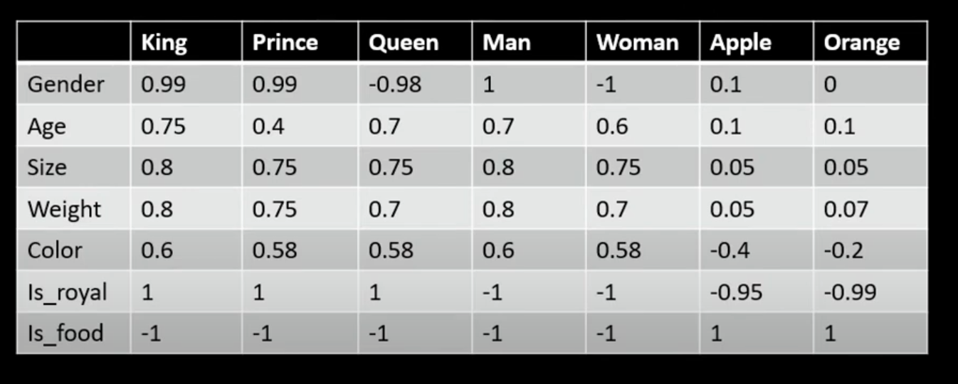
Introducing Word Embeddings

Slide 21
Understanding Word Embeddings
Features like gender, size, or contextual similarity.
Close vectors indicate related words (e.g., 'king' and 'prince').
Opposite vectors represent unrelated concepts (e.g., 'king' vs. 'apple').

Slide 22
Word Embeddings in Action
Analogies: 'Man' is to 'woman' as 'king' is to 'queen.'
Clustering: Similar words grouped (e.g., fruits, animals).
Visual representation: 2D plane projection.

Slide 23
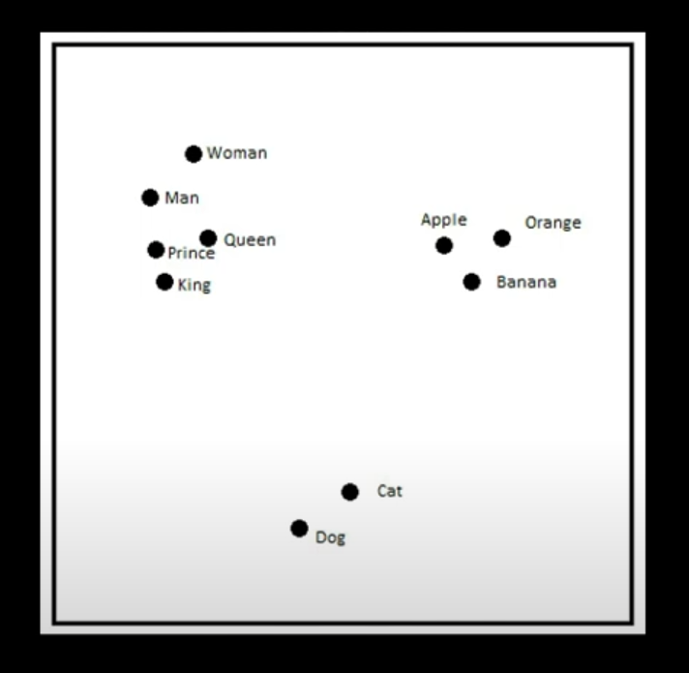
Word Embeddings in Action

Slide 24
Training Word Embeddings
Models automatically generate feature vectors.
Features are not manually assigned but learned through context.
Vocabulary represented efficiently in lower-dimensional spaces.

Slide 25
Techniques for Word Embeddings
Word2Vec
GloVe
Learn to train embeddings in Word2Vec.
Implement word embeddings in Python.

Slide 26
Conclusion
Word embeddings address one-hot encoding limitations.
Capture relationships and context between words.
Foundational for advanced NLP applications.

