Slide 1
Project: BuzzChaT – A Chat Application
Subject Name: BEE (22CS026)
Submitted By:
1. Piyush Arora (2210992040)
2. Paramveer Singh Udawat (2210992019)
3. Partha Pratim Tamuly (2210992031)
4. Nikhil Verma (2210991983)
Department of Computer Science and Engineering
Chitkara University, Punjab

Slide 2
Problem Statement
The increasing demand for real-time communication highlights the need for efficient platforms that connect individuals and groups across geographical boundaries.
Many existing chat applications lack essential features, face performance challenges, or fail to prioritize user privacy and security, leaving significant room for improvement.
This project focuses on creating a robust, user-friendly chat application that ensures secure instant messaging, effective group communication, and seamless multimedia sharing while prioritizing user experience and data protection.

Slide 3
Objectives
Achieve proficiency in backend development using Node.js and Express.js.
Understand the principles of data sharing between client and server machines, ensuring no loss of information.
Develop a robust backend infrastructure capable of handling real-time messaging and efficient data storage.
Ensure secure data transmission while prioritizing the protection of user privacy.
Gain expertise in frontend development technologies, including HTML, CSS, JavaScript, and React.
To have proficiency in backend development using Node.js and Express.js
Acquire knowledge of database management systems (MongoDB) for effective data storage and retrieval.
Implement real-time communication features for seamless interaction.
Gain hands-on experience in API design and development.

Slide 4
Features
Features a user-friendly interface, ensuring easy accessibility for all users.
Includes a powerful search functionality to quickly locate specific user chats.
Implements a secure authentication system to protect user accounts and data.
Provides a notification system to alert users about incoming messages in real time.
Offers a live typing indicator to display when other users are actively typing.
Enables the creation of group chats, facilitating communication with multiple users simultaneously.

Slide 5
Methodology
The project uses the following methodology/approach:
Building Frontend
Creating Database
Building Backend
Integration of Frontend and Backend
Testing and Interpretation

Slide 6
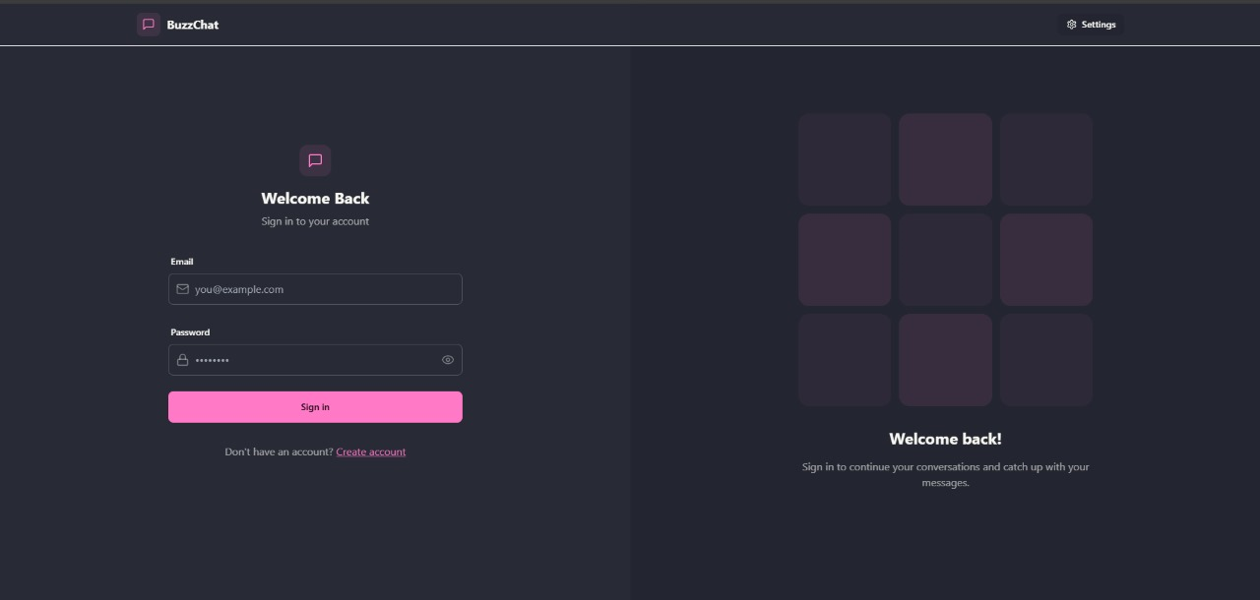
Code Snippets
Frontend

Slide 7
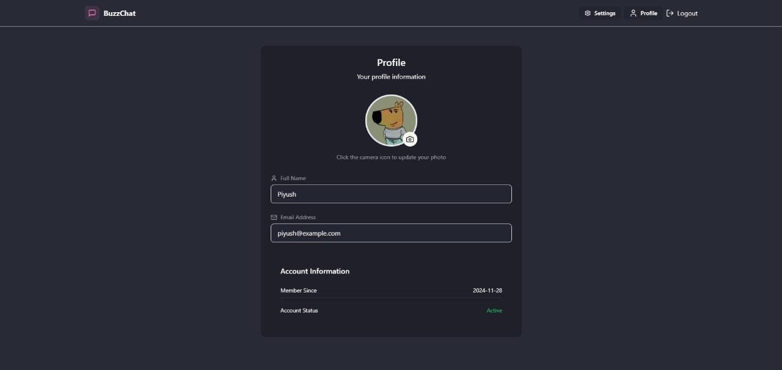
Code Snippet
UI

Slide 8
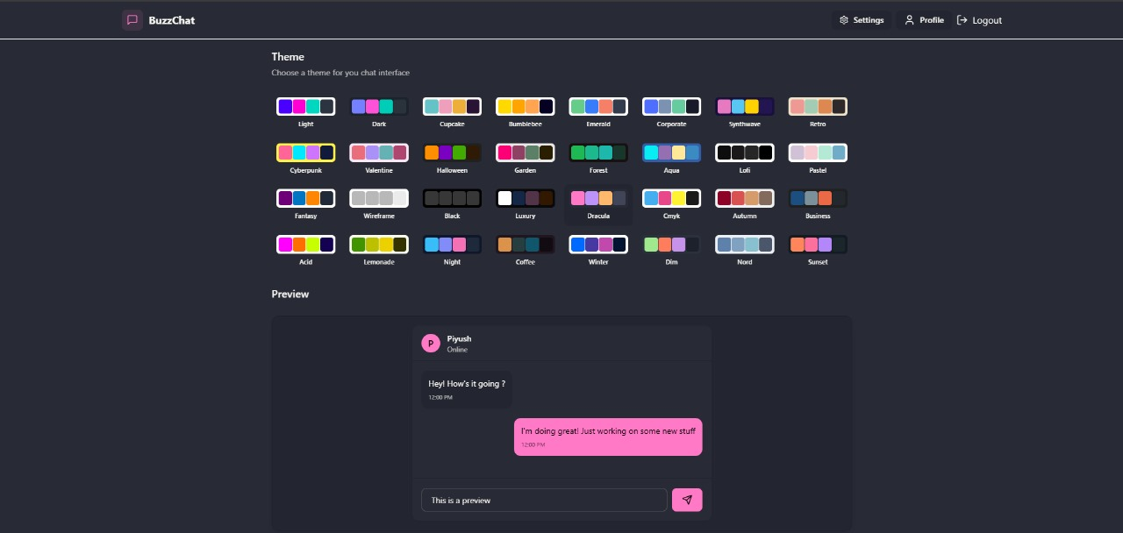
Code Snippet
UI

Slide 9
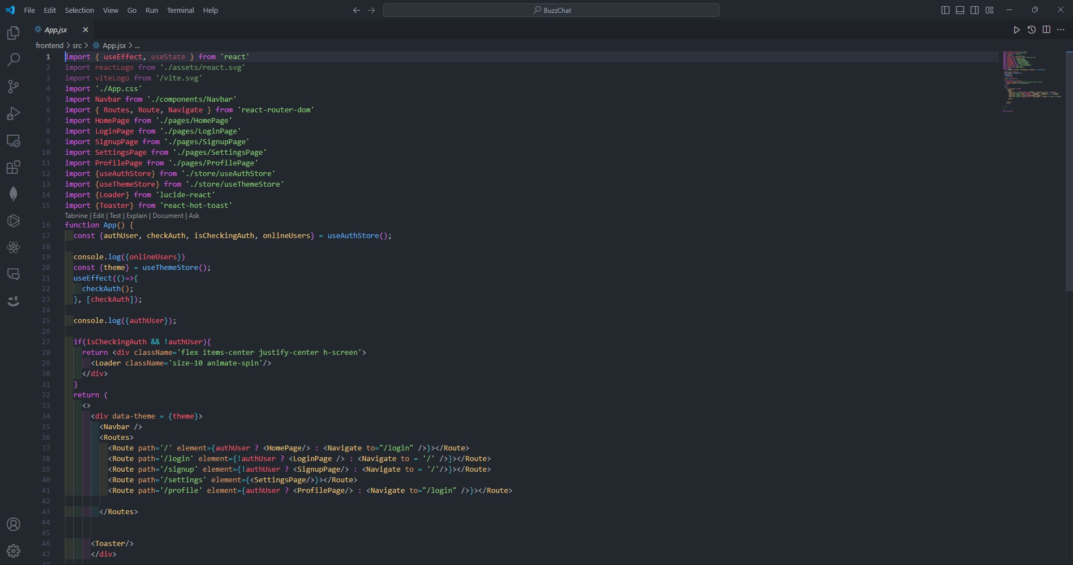
Code Snippets
App.jsx

Slide 10
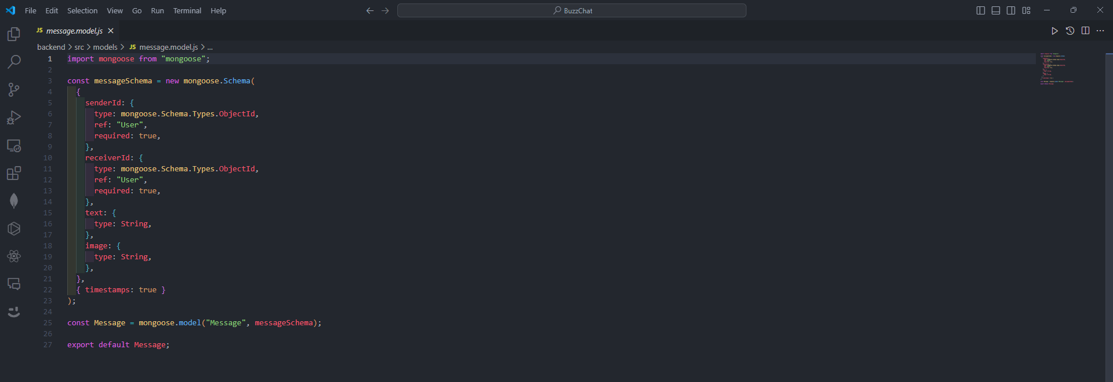
Code Snippets
db.js

Slide 11
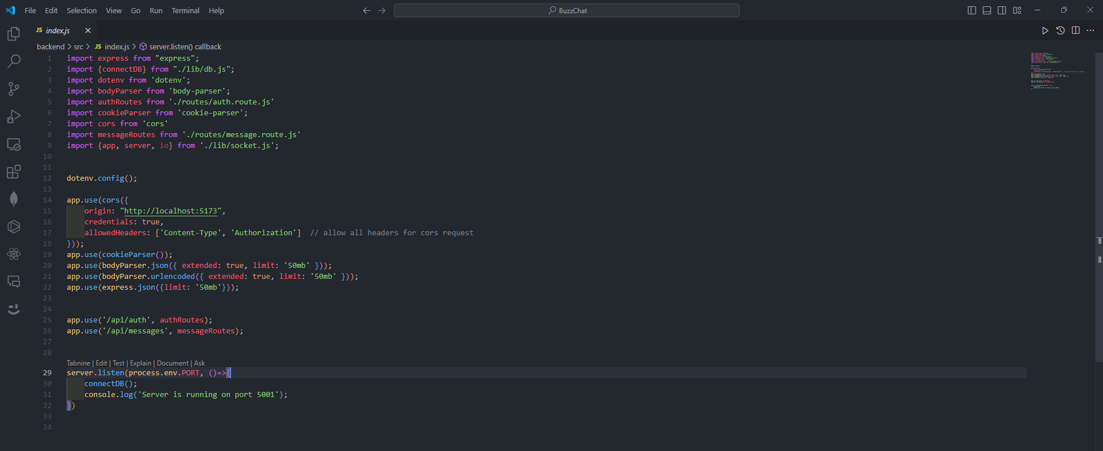
Code Snippets
index.js

Slide 12
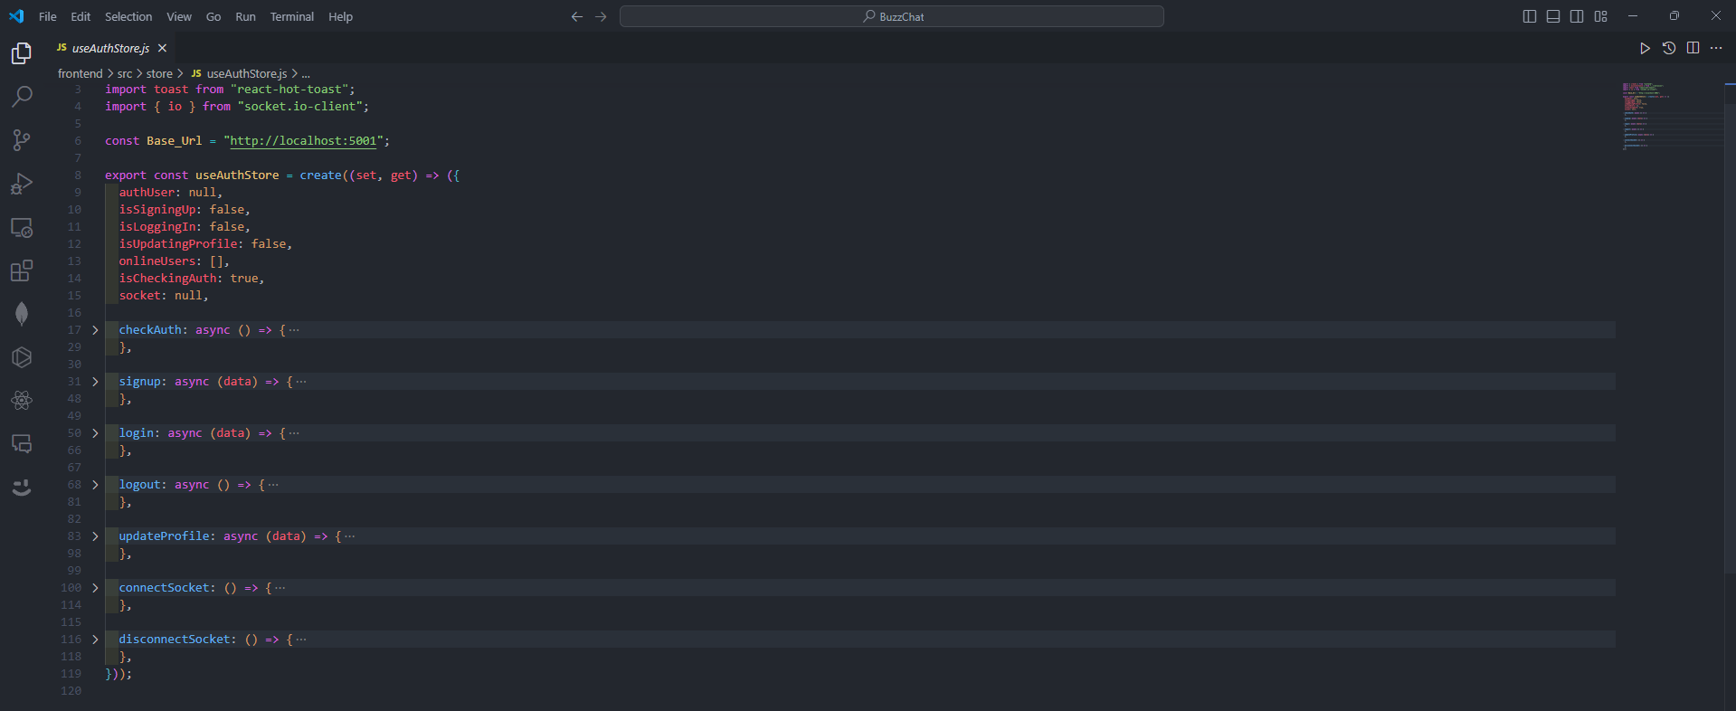
Code Snippets
UseAuthStore

Slide 13
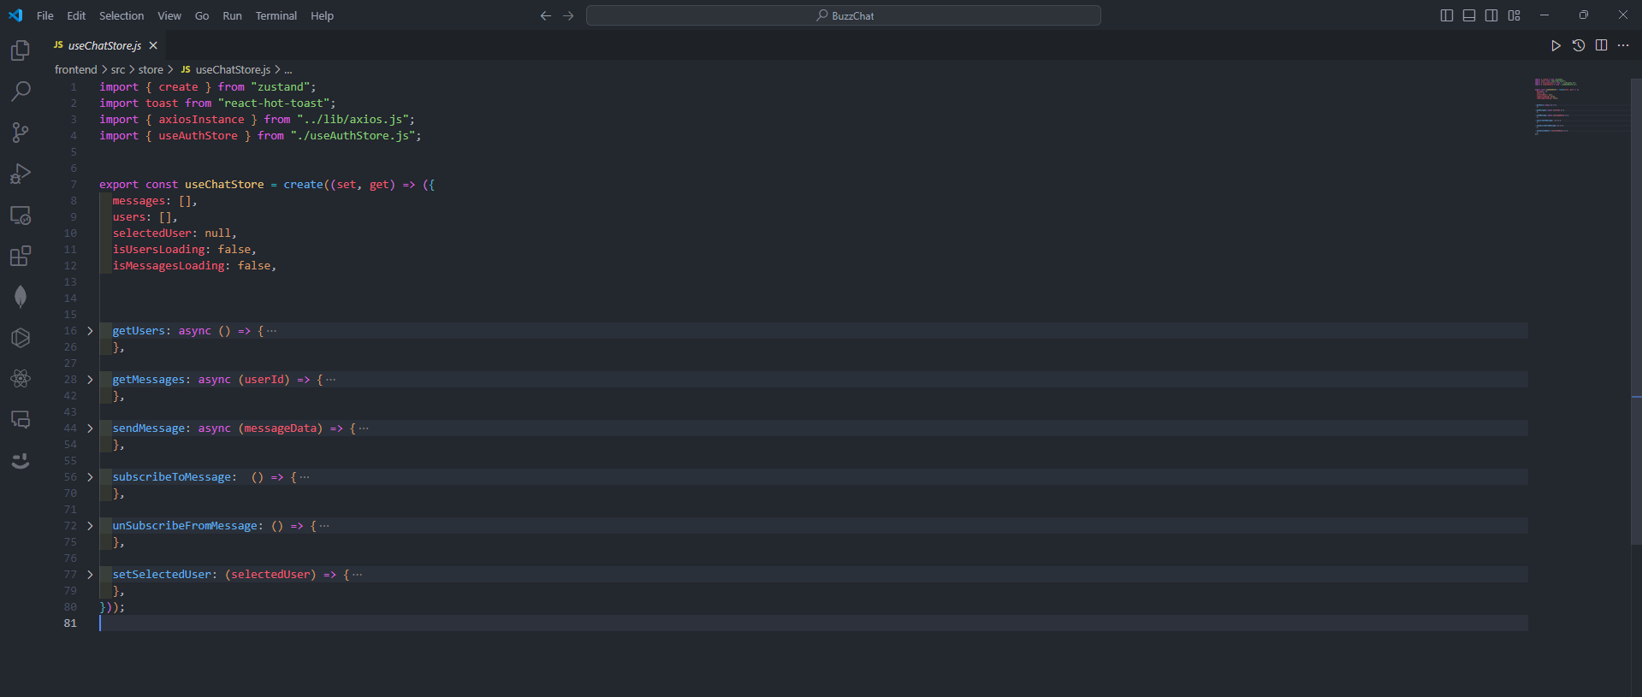
Code Snippets
UseChatStore

Slide 14
Conclusion
The proposed chat application overcomes key limitations of existing platforms by delivering a user-friendly interface, robust security measures, and essential features such as real-time notifications, group chats, and live typing indicators.
In an era where digital communication plays a pivotal role in personal and professional domains, the application holds significant potential for growth and widespread adoption.
With a strong vision for future enhancements, this chat application is well-positioned to become a preferred choice for individuals and organizations seeking a secure and dependable communication solution.

Slide 15
Future Scope
Application can be made scalable.
AI-driven chatbots can be incorporated to provide users with automated assistance.
Adding voice and video call functionality would allow users to switch from text to more interactive forms of communication seamlessly.
Implementing multilingual support with real-time translation features could break down language barriers.

Slide 16
References
React Documentation: https://react.dev
Express.js Documentation: https://expressjs.com/
Node.js Documentation: https://nodejs.org/docs/latest/api/
Tutorials from W3Schools: https://www.w3schools.com/nodejs/

