Slide 1

Personal Finance
Tracker
Submitted By : Piyush Prakash Sharma
Registration No. = 2427030222
Supervised By : Ms.Harshika Mathur

Slide 2
I. Introduction to Problem
(What, Why, How)
The ¹¹What ¹¹ The Problem of Personal Financial Management
:
When a person tries to manage their finances with the help of some web or mobile app they are met with possibilities of data leaks and enormous paywalls and NO normal Person wants to go through the hassle of transforming raw, unstructured financial transaction data provided by the banks usually in form of CSV files into useful, categorized ,,high-level financial insights .Information which would provide invaluable information on their spending habits ,financial spending and flow of their earnings etc.
The ¹¹Why¹¹ The Failure of Manual Methods
:
A significant gap exists in the current software market.
1. Commercial Saas (e.g., YNAB, Quicken): These tools are easy to use but require recurring subscription fees and significant data privacy compromises (linking live bank accounts to the cloud).
2. Open-Source (e.g., Firefly Ill): These solutions are free and private but are built for technical users, requiring skills in server self-hosting, database management, and scripting.
The ¹¹ How¹¹ Fragmentation of the Modern PFM Market
:
The proposed solution is the Finance Tracker, an Application based tool. It is a lightweight, offline Python application that operates only on a local, user-provided CSV file. It automates the most laborious tasks (data cleansing, categorization, and report generation) and outputs the final analysis into a universally familiar Microsoft Excel file.

Slide 3
II. Literature Survey
A survey of 10 existing solutions reveals the specific trade-offs in the current market.
Freemium Cloud Services
  Empower Personal Dashboard
0 Pros: Best-in-class for investment and net worth tracking (free).
0 Cons: Budgeting tools are rudimentary; primarily a lead-gen tool for advisors.
Wallet by BudgetBakers
0 Pros: Extensive international bank support.
0 Cons: Bank synchronization is often unstable; free version is heavily restricted.
A. Cloud-Based Subscription Platforms
e YNAB {You Need A Budget)
0 Pros: Excellent zero-based budgeting system.
0 Cons: High subscription cost ($109/yr) and steep learning curve.
Monarch Money
0 Pros: Comprehensive dashboard for net worth and investments.
0 Cons: Expensive ($99/yr) and fully cloud-dependent.
Quicken Simplifi
0 Pros: User-friendly interface and good reporting.
0 Cons: Requires recurring subscription; less powerful than desktop predecessors.
Copilot Money
0 Pros: Uses Machine Learning for auto-categorization; excellent UI.
0 Cons: Exclusive to Apple (iOS/Mac) ecosystem and US banks.
Rocket Money
0 Pros: Specializes in identifying and cancelling subscriptions.
0 Cons: Privacy concerns regarding data access permissions.
Spreadsheet & Local Alternatives
  Tiller Money
0 Pros: Pipes data directly into Google Sheets for maximum customization.
0 Cons: Requires high spreadsheet proficiency; paid subscription.
GnuCash
0 Pros: Free, open-source, local-first privacy, professional double-entry accounting.
0 Cons: Extremely complex UI; strictly manual data entry.
HomeBank
0 Pros: Free, lightweight, and simpler than GnuCash.
0 Cons: Lacks automation; relies entirely on manual file imports.

Slide 4
Ill. Comparative Study
Software | Hosting | Cost | Data Import | Key Feature | Key Weakness
YNAB | Cloud | High ($109/yr) | API Sync | Zero-Based Budgeting | Expensive
Monarch | Cloud | High ($99/yr) | API Sync | All-in-One Dashboard | Cloud Privacy Risk
Simplifi | Cloud | Medium | API Sync | Reporting | Subscriptio n Model
Empower | Cloud | Free | API Sync | Wealth Tracking | Weak Budgeting
Copilot | Cloud | High | API Sync | ML Categorizat ion | Mac/iOS Only
Rocket | Cloud | Freemium | API Sync | Sub. Manageme nt | Privacy Concerns
Tiller | Cloud | Medium | API Sync | Custom Sheets | High Difficulty
GnuCash | Local | Free | Manual | Double- Entry Books | Steep Learning Curve
HomeBank | Local | Free | Manual | Lightweight | No Automation
LocalFinTr acker | Local | Free | csv Import | Private and Automatic | Static Categories

Slide 5
IV. Problem Statement
To track their expenses, Users currently face only 2 choices:
Sacrifice privacy for the convenience of cloud-based automation.
OR
Go through the tedious process of manual entry for the security of offline software.
There is no streamlined, free tool that automates financial analysis from bank statements while guaranteeing 100% local data sovereignty.

Slide 6
V. Objective
1. Develop an Automated Program/Software: Create a Python application using pandas to clean and categorize raw bank CSV data into meaningful insights.
2. Generate Visual Reports: Utilize openpyxl to auto-generate Excel dashboards with summary tables and pie charts for immediate user feedback.
3. Ensure Data Sovereignty: Validate a local-execution model where all processing occurs on the client machine, eliminating third-party data risks.

Slide 7
VI. Planning of Work I Proposed Solution
  Current Implementation (Methodology)
The current system is a functional Python script executing a linear data pipeline:
    Input :The script accepts a raw CSV bank statement.
    Cleaning: The clean_amount_column function sanitizes currency strings (removing ··, commas) and standardizes data types.
    Categorization: A keyword-matching algorithm maps transaction descriptions to categories (e.g., "Swiggy" ---+ "Food") using a predefined dictionary.
    Reporting: The openpyxl library generates a structured .xlsx file containing a transaction log, a category summary table, and an embedded Pie Chart.
Future Enhancements
Intelligent ML Categorization: Replace static keywords with a scikit-learn Naive Bayes classifier. The system will learn from user corrections, creating a personalized model that improves over time without sharing data.
Predictive Forecasting: Implement time-series forecasting to predict future spending trends based on historical data, alerting users to potential budget overruns.

Slide 8
Improvements in PBL 2
Categorization using a ML model: Uses an NLP Machine Learning model (scikit-learn) to intelligently categorize transactions based on description.
Robust Fallback Logic: Automatically falls back to keyword-matching if the ML model is not available.
Data Generation: Includes a script (generate_large_csv.py) that uses Faker to generate synthetic transaction data for testing.
Smart Data Cleaning: Handles various currency formats, extracts negative/positive balances correctly, and tracks Income vs. Expenses.
Visual Excel Reporting: Generates a beautiful Excel workbook using openpyxl with:
  Transactions Sheet: Cleaned raw data, color-coded for income (green) and expenses (red).
  Summary Sheet: Financial overview and aggregated spending.
  Visualization: A built-in Pie Chart showing spending distribution based on categories.

Slide 9
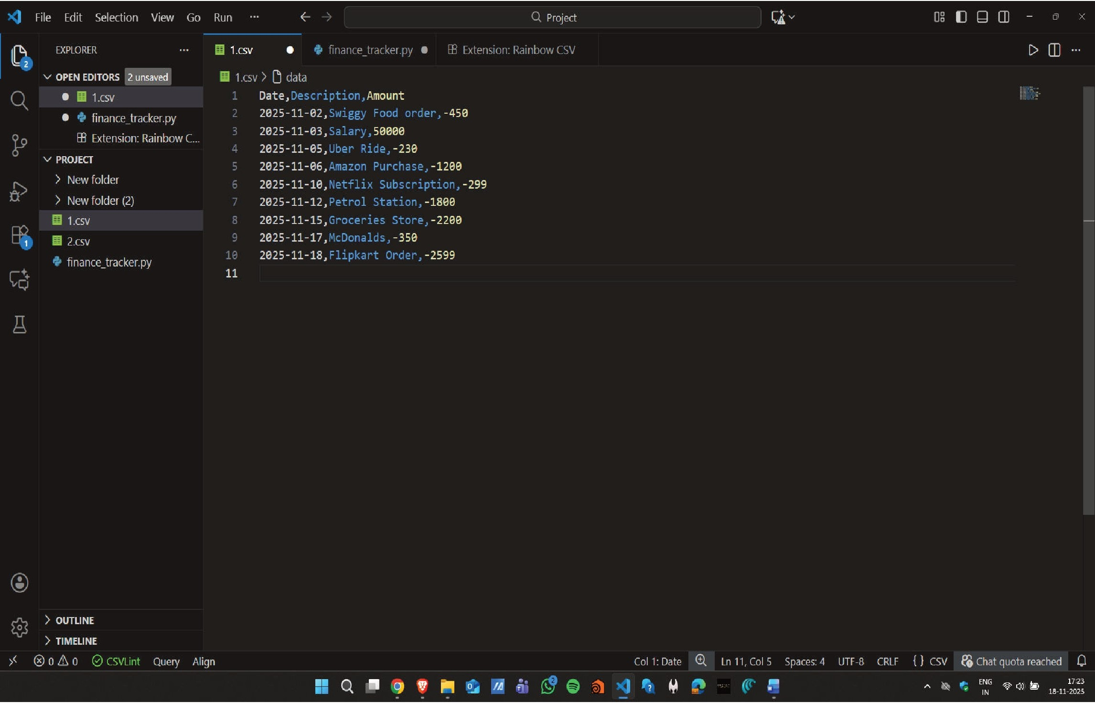
Screenshots

Slide 10
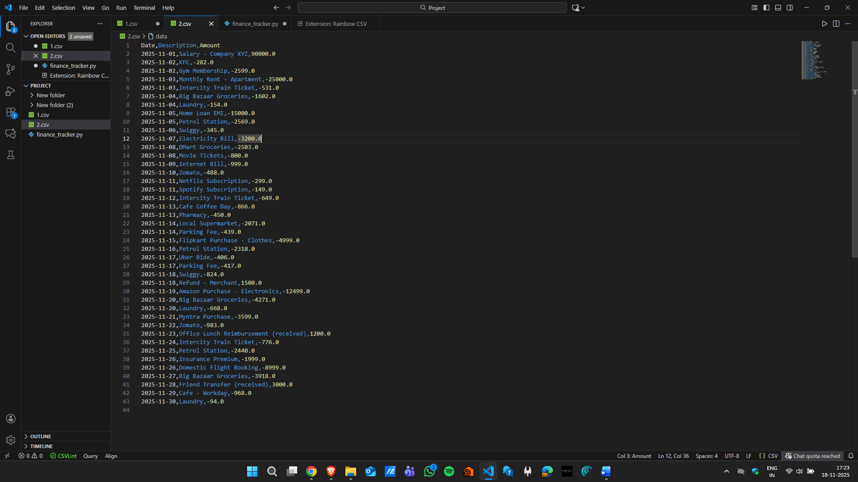

Slide 11
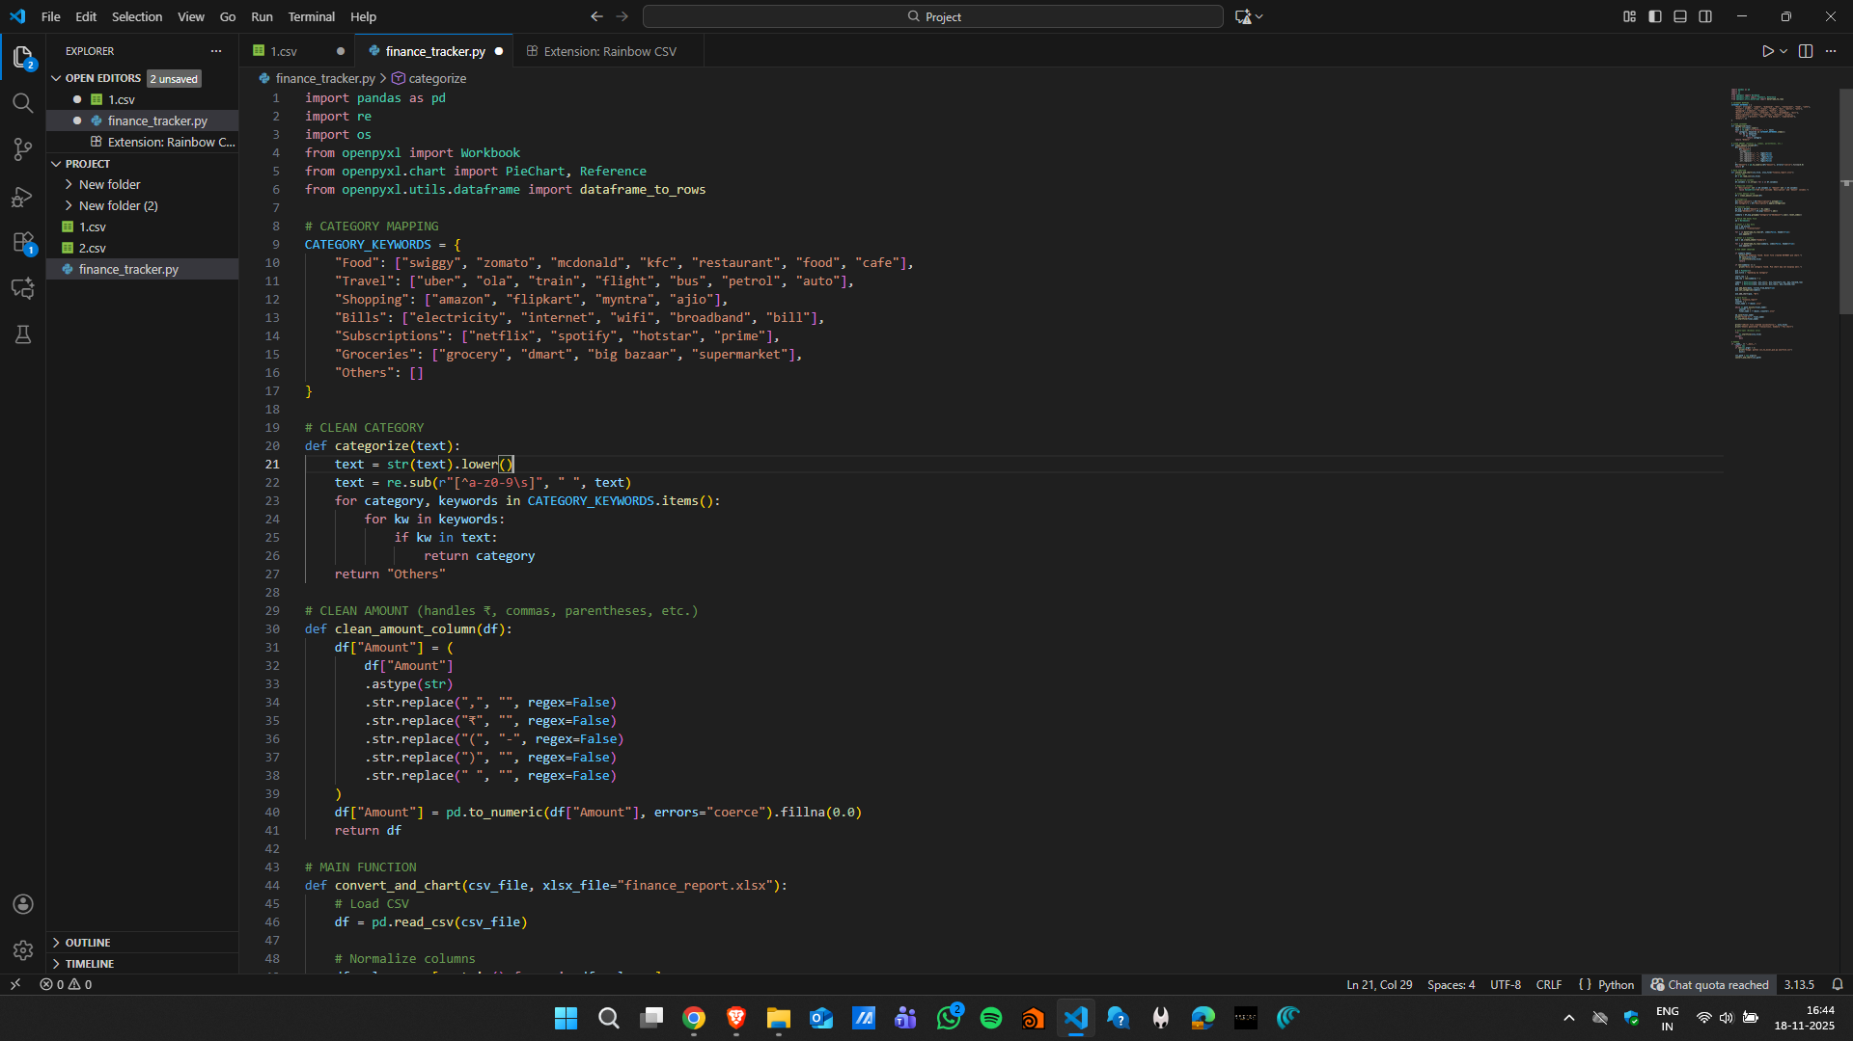

Slide 12
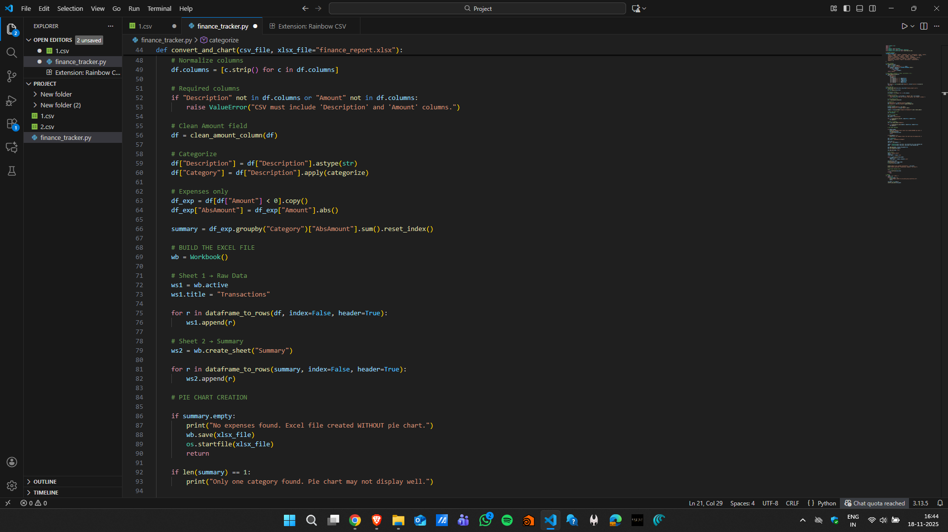

Slide 13
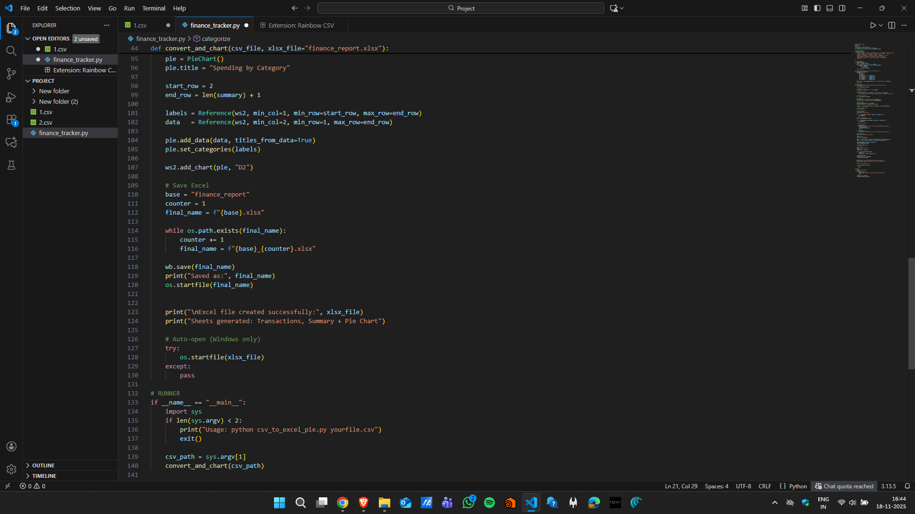

Slide 14
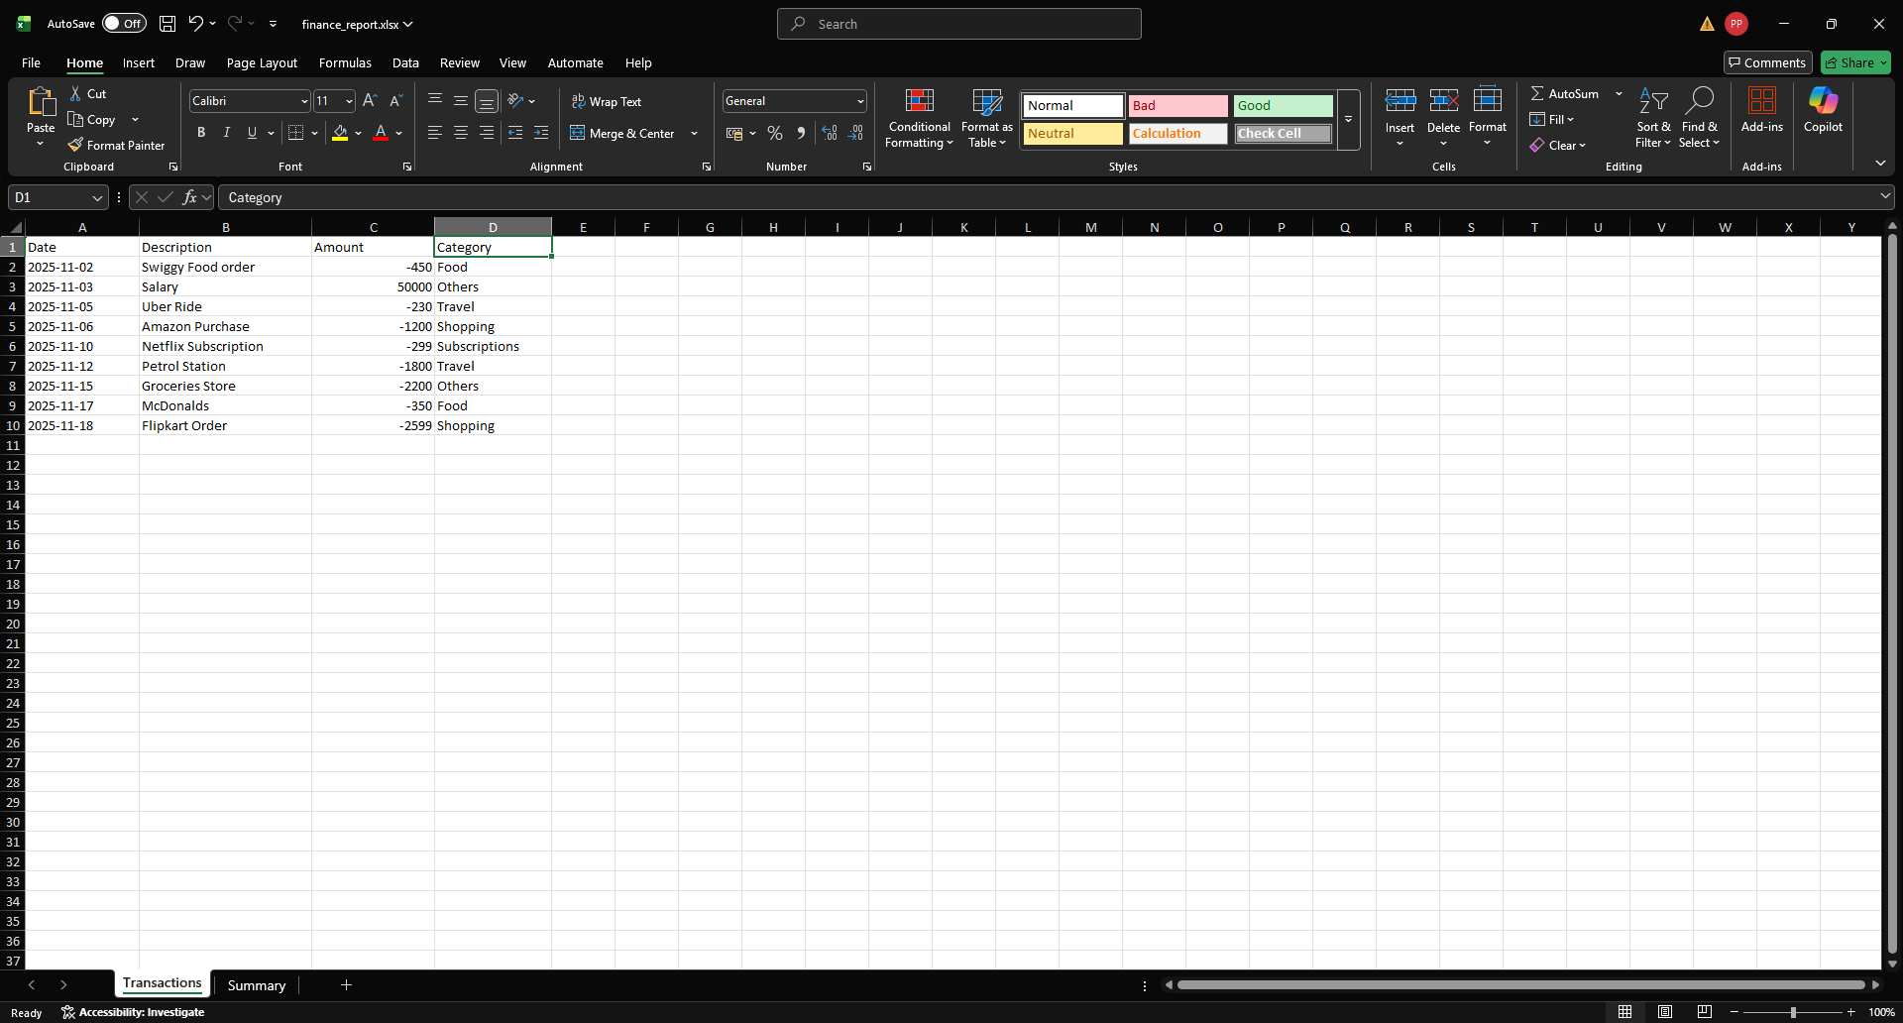

Slide 15
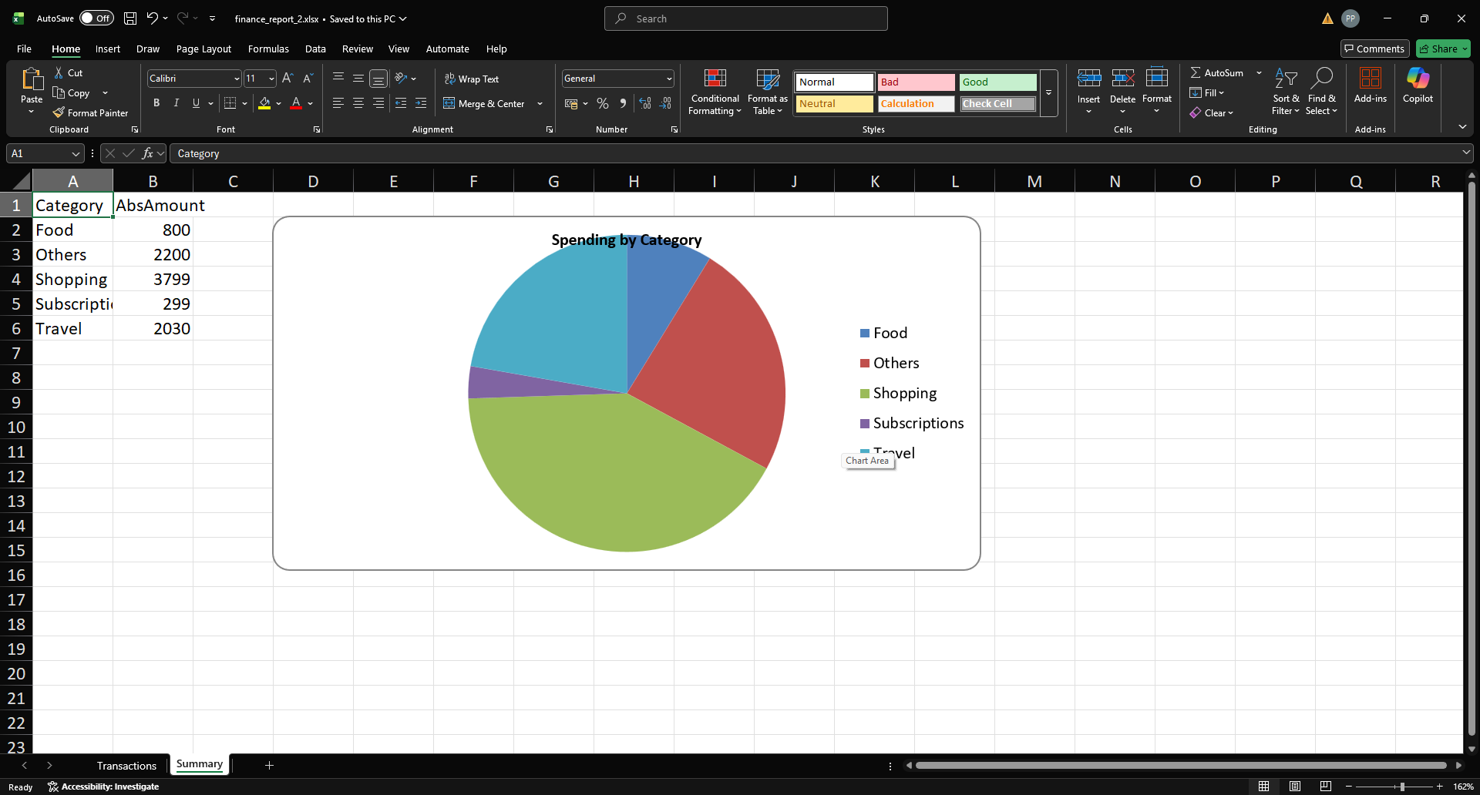

Slide 16
VIII. Bibliography
Pandas Development Team. (2024). pandas: powerful Python data analysis toolkit.
Available: https://pandas.pydata.org
Gazoni, E. & Clark, C. (2024). openpyxl: A Python library to read/write Excel 2010 xlsxlxlsm files. Available: https://openpyxl.readthedocs.io
Pedregosa, F. et al. (2011). Scikit-learn: Machine Learning in Python. Journal of Machine
Learning Research, 12, 2825-2830.
Plaid Inc. (2024). Plaid AP/ Documentation. Available: https://plaid.com/docs/
You Need A Budget (YNAB). (2024). The Four Rules of Budgeting. Available: https://www.ynab.com/the-fou r-rules

