Slide 1
Neural Network Dynamics
Analysis of Activity between Neurons due to Random Stimulation
Samson Mataraso, Cathy Wang, John Yang
Cluster 9
COSMOS UCD 2014

Slide 2
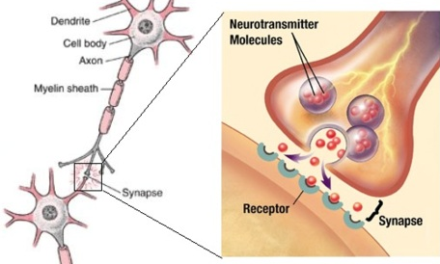
Neuron Structure
Dendrite receives stimulus
Nerve impulse travel down axon
Chemical transmission of neurotransmitters across synapse to next neuron
(http://captain-nitrogen.tumblr.com/post/14829664371/its-depressingly-confusing)
Notes:
John

Slide 3
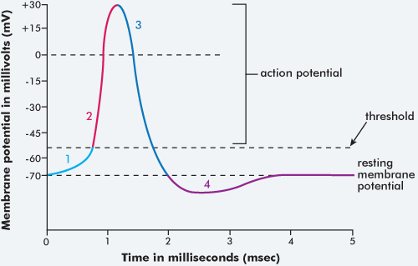
Neuron Interactions
(http://tle.westone.wa.gov.au)
Communicates electrochemically
Stimulus (change in concentration of charged ions) causes increase in voltage, passes threshold
Action potential (electrical impulse) allows information to be sent to nearby neurons
Notes:
John

Slide 4
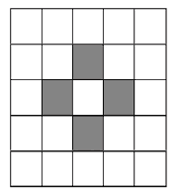
Cellular Automaton Model
Grid of units that change between states
Governed by certain set of rules
Rules applied iteratively for time steps
(http://www.economicsnetwork.ac.uk/cheer/ch17/hand.htm)
Notes:
Cathy

Slide 5
Model Description
Two-dimensional rectangular grid of neurons
Randomly stimulate neurons throughout time steps with probability P_{S}
Each neuron has a probability P_{C} of being connected to neurons within radius R_{C}
If neurons are connected, signal propagates
Notes:
Cathy

Slide 6
Neuron States
Resting (grey)
Active (red)
Refractory (black)
Varying periods of time R_{S} that neuron does not respond to stimulations
Notes:
Cathy

Slide 7
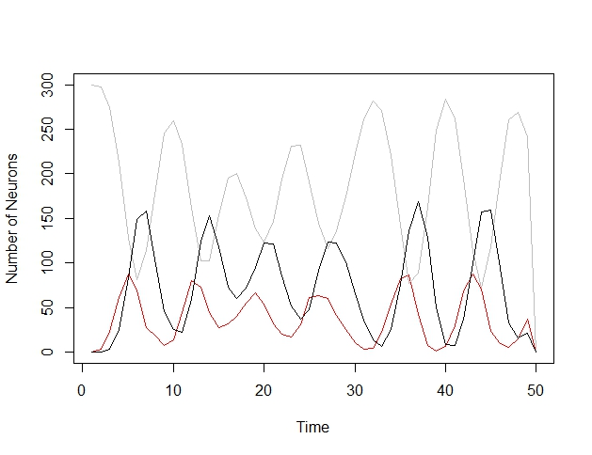
Controlled Set of Rules
15 x 20 grid of neurons
Time steps: 50
P_{C} = 0.5
R_{C} = 2
P_{S} = 0.01
R_{S} = 2
Notes:
Cathy

Slide 8
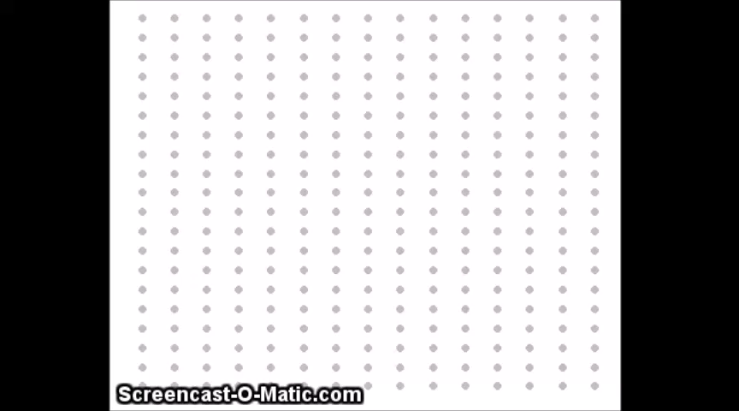
Base Case
Notes:
Cathy

Slide 9
Increasing Connectivity
Amplitude of oscillations increases and frequency slightly increases
Fewer neurons left out of cycles
Faster spread throughout system
Notes:
Sam

Slide 10
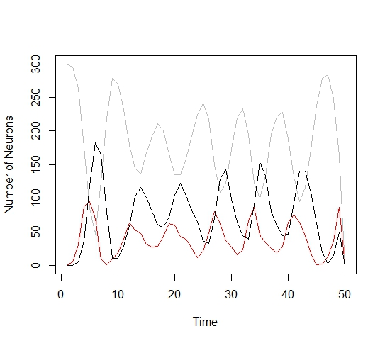
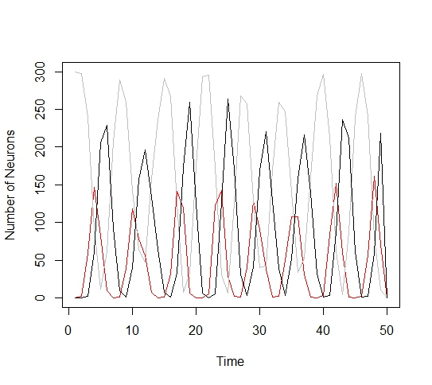
Increasing Connectivity
R_{C} : 4 P_{C}: 0.7
R_{C}: 2 P_{C}: 0.5
Notes:
Sam

Slide 11
Varying Connectivity
As R_{C} increases and Pc decreases proportionally:
R_{C} × P_{C} = 1
Amplitude of oscillations increases
Frequency increases
Notes:
Sam

Slide 12
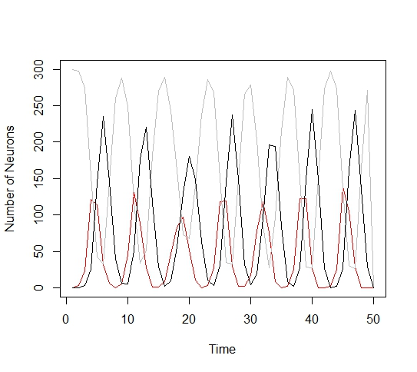
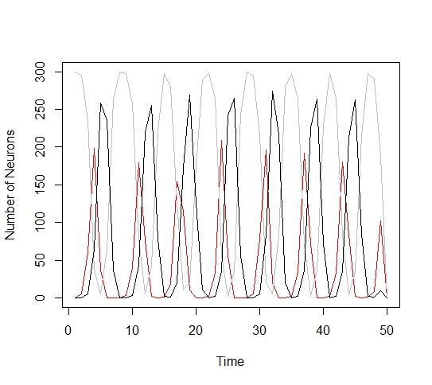
Varying Connectivity
R_{C}=2 P_{C}=0.5
R_{C}=6 P_{c}=0.17
R_{c}=4 P_{c}=0.25
Notes:
Sam

Slide 13
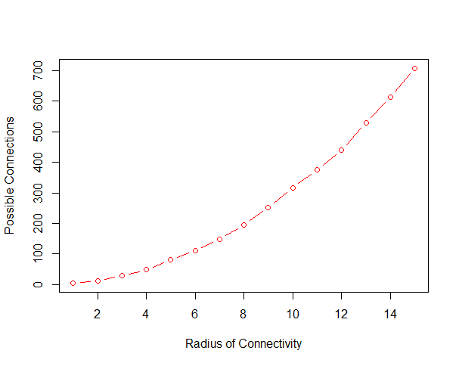
Why?
R_{C} does NOT scale linearly with number of possible connections
For neurons more than R_{C} away from edge:
R_{C}=2: 12 possible connections
R_{C}=3: 28 possible connections
R_{C}=4: 48 possible connections
R_{C}=5: 80 possible connections
R_{C}=6: 112 possible connections
Notes:
Sam

Slide 14
Varying Connectivity
Vary connectivity so that P_{C} × C = 1
C is the number of possible connections within R_{C}
Expected degree of each neuron is 1
Notes:
Sam

Slide 15
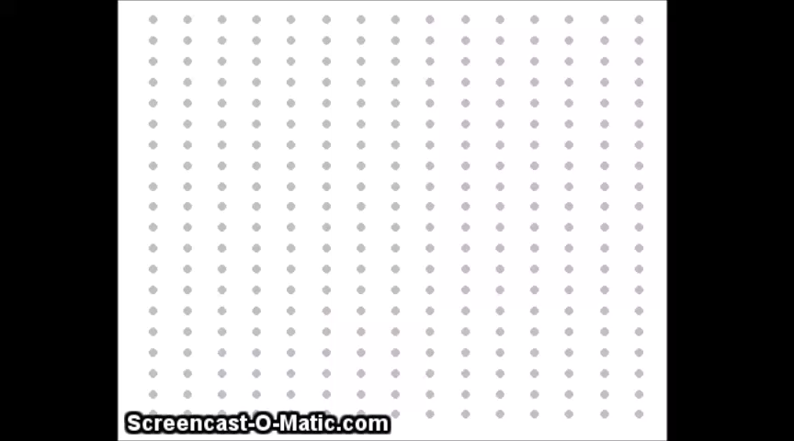
Average Degree of 1?
Notes:
Sam

Slide 16
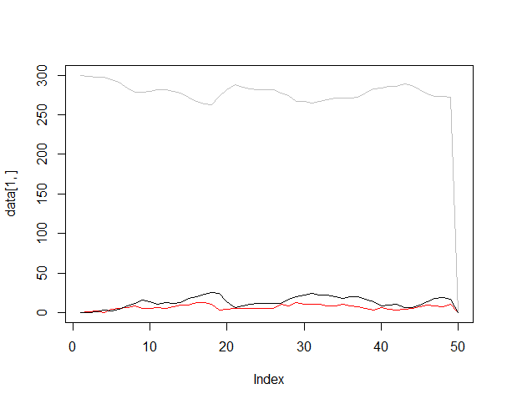
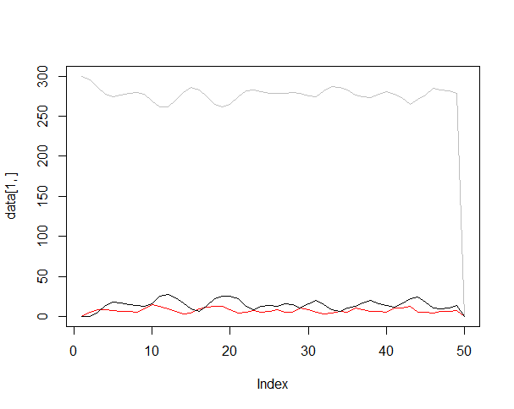
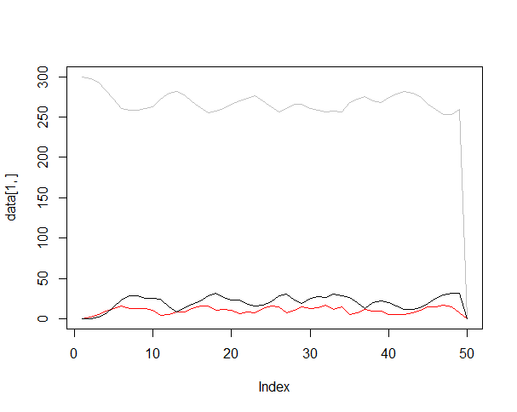
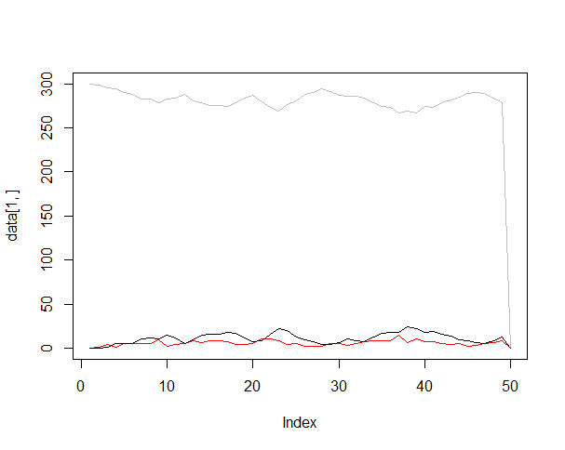
Average Degree of 1?
R_{C}=4
R_{c}=2
R_{c}=3
R_{C}=5
Notes:
Sam

Slide 17
Why?
Each neuron has, on average, one connection
NO propagation of waves
Notes:
Sam

Slide 18
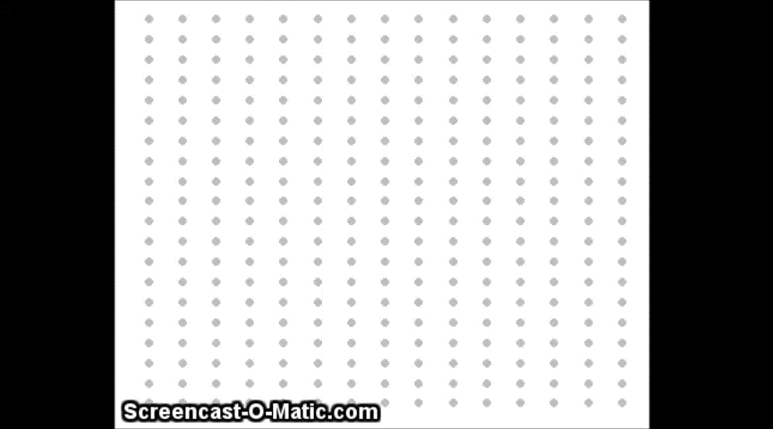
Greater Average Degree
Notes:
Sam

Slide 19
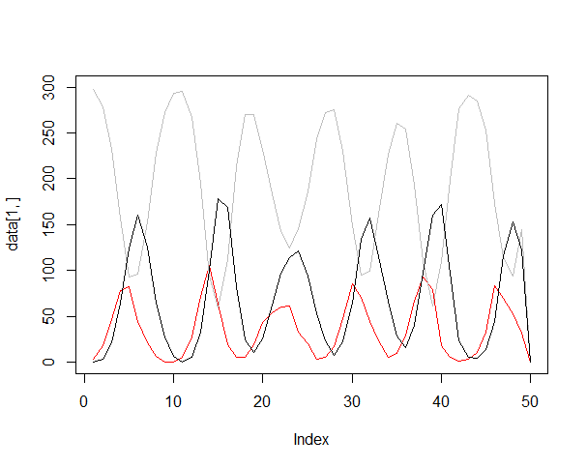
Greater Average Degree?
R_{C}=2 P_{C}=1/2
Notes:
Sam

Slide 20
Necessary Expected Degree?
Lots of stochastic behavior
Adjacency Matrix
Stimulation
Consistent oscillations typically seen with expected degree two
Notes:
Sam

Slide 21
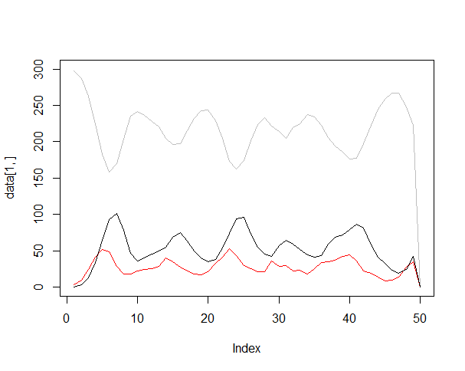
Expected Degree of 2
R_{c}=2 P_{c}=1/6
Notes:
Sam

Slide 22
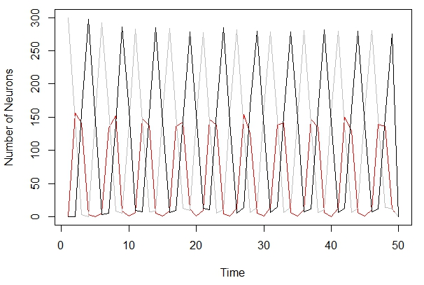
Increasing Probability of Stimulation
P_{S} = 0.01 P_{S} = 0.6
Period for all three states decrease
Increase amplitude refractory/active states
Oscillations become more regular, less variation in amplitude
Notes:
Cathy

Slide 23
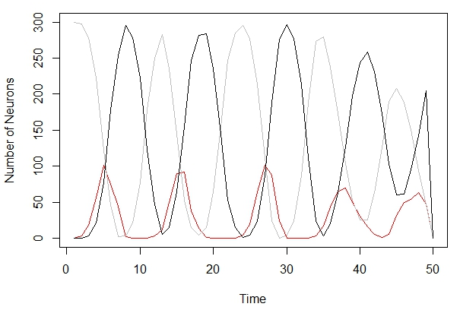
Increasing Refractory Period
R_{S} = 2 R_{S} = 5
Greater amplitude/period for refractory state
Amplitude/period of active state stay constant
Notes:
Cathy

Slide 24
Conclusions
Certain conditions necessary for wave propagation
As R_{C} increases, possible connections increase superlinearly
Random stimulation CANNOT result in wave propagation if R_{C} and P_{C} are too small
Notes:
John

Slide 25
Conclusions
As P_{S} increases, faster cycles between states
Smaller period
Greater amplitude for refractory/active states
As R_{S} increases, more refractory neurons at given time step
Greater amplitude/period of refractory state
More regular oscillations
Notes:
John

Slide 26
Importance of Neuro-Networks
Failure of neurotransmission
Deterioration of mental functions
Patterns that can be described by certain parameters seen in nature
Patterns on sea shells
Formation of crystals
Notes:
John

Slide 27
Further Experimentation
Simulate one-way blocks
Excitation cannot spread to certain regions
Forms a pattern (usually spiral)
Notes:
John

Slide 28
Questions?

Slide 29
Bibliography
Chudler, E. (2010, May 5). Neuroscience for Kids Retrieved from
https://faculty.washington.edu/chudler/ap.html
Lewis, T., & Rinzel, J. (2000, April 26). Self-organized synchronous oscillations in a network of excitable cells coupled by gap junctions. Retrieved from
https://www.math.ucdavis.edu/~tjlewis/pubs/net.pdf
Weisstein, E. (2002, March 23). Cellular Automaton from Mathworld - A Wolfram Web Resource. Retrieved from http://mathworld.wolfram.com/CellularAutomaton.html
Farndon, J. (2009, September 16). Nerve Signalling: Tracing the Wiring of Life. Nerve Signalling: Tracing the Wiring of Life. Retrieved July 26, 2014, from http://www.nobelprize.org/educational/medicine/
nerve_signaling/overview/index.html

