Slide 1
ACCENTURE INNOVATION CHALLENGE 2026 · ROUND 2
DigitalTwin.ai
Spatio-Temporal Graph Intelligence
for Vehicle Assembly Lines
Detailed Business Proposal
Prepared by Piyush Maji · September 2026
1/18

Slide 2
The Problem
Assembly lines are tightly coupled networks — but monitored as isolated stations.
Mixed Equipment
Multi-Causal Defects
Propagation Delay
Production Constraints
Stakeholder Gaps
40% legacy stations with
partial or no sensors
Equipment wear, operator
variation, environment
Defects introduced early
surface late downstream
PLC changes only during
maintenance windows
One dashboard fails
all user types
💰 Industry cost of status quo: $50K-$200K/hr in unplanned downtime · $8M-$15M/yr in rework · Total addressable waste: $15M-$25M per plant per year
2/18

Slide 3
Our Solution: DigitalTwin.ai
Model the assembly line as a dynamic graph — predict problems before they cascade.
Predictive Propagation
Virtual Sensing
What-If Simulation
Multi-Stakeholder UX
GATv2 + GRU forecasts
queue build-ups and defect
risk across downstream stations
Masked-node GNN infers state
at under-instrumented stations
via neighbor aggregation
Test interventions virtually
before execution (maintenance,
rerouting, takt changes)
Floor supervisor, plant manager,
leadership views from the
same underlying model
10-15 min advance warning
40-60% sensor HW savings
De-risk decisions safely
Drive adoption at all levels
3/18

Slide 4
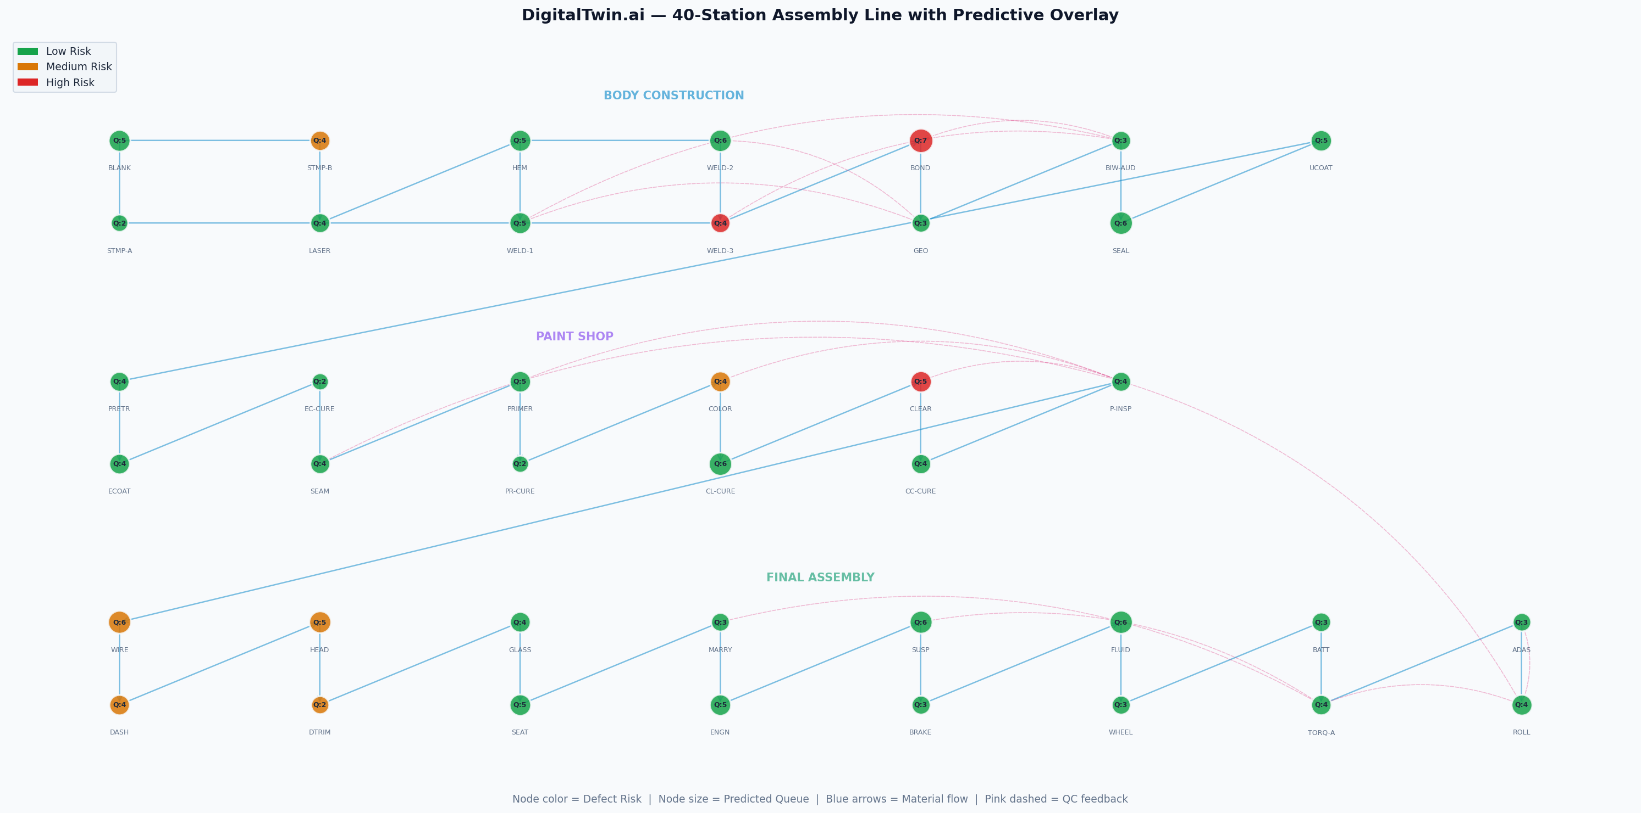
Graph-Based Assembly Line Model
40
56
3
12
Stations
Edges
Zones
Features/Node
Node color = defect risk (green/amber/red) · Node label = predicted queue · Blue = material flow · Pink dashed = QC feedback
4/18

Slide 5
ST-GNN Architecture
3 stacked Spatio-Temporal blocks · GATv2 (4 heads) + GRU · 438K parameters · 5 prediction heads
Spatial: GATv2
Temporal: GRU
Masked Training
• 4 attention heads
• Learns asymmetric influence
• Attention → root-cause
• Self-loops + residuals
• Per-node GRU cell
• Shift dynamics (ramp, breaks)
• Progressive anomaly tracking
• Hidden state carries context
• Random feature masking
• Forces neighbor inference
• Enables virtual sensing
• Confidence head output
Five Prediction Heads:
Queue Forecast
Defect Risk
Virtual Sensor
Anomaly Score
Root-Cause
Per-node regression
3-class classification
Feature reconstruction
Binary probability
Attention weights
5/18

Slide 6
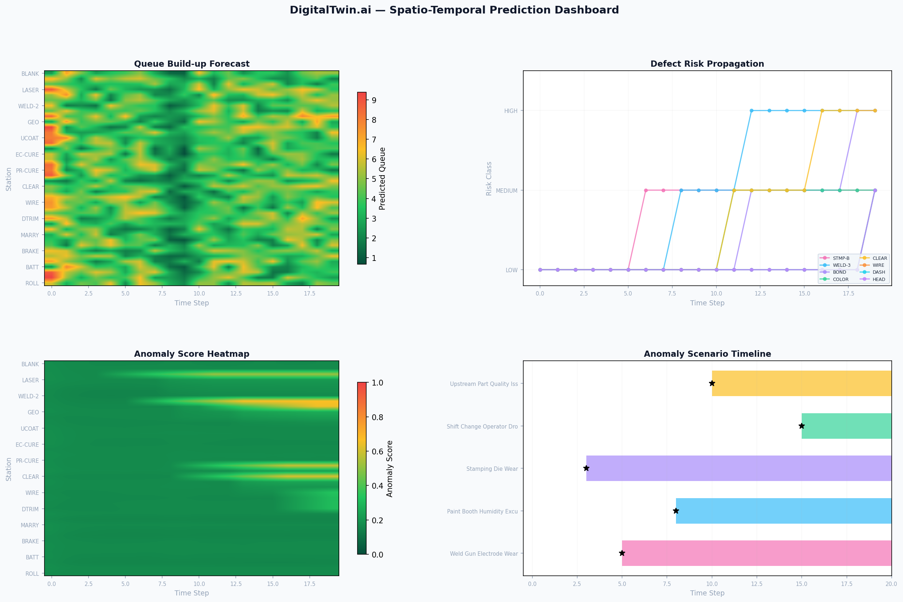
Spatio-Temporal Predictions
Queue forecasting, defect risk propagation, anomaly detection, and scenario tracking across 30 simulation steps.
6/18

Slide 7
Multi-Causal Anomaly Scenarios
5 realistic scenarios demonstrating equipment wear, environmental, operator, and supply chain anomalies with cascade propagation.
Weld Gun Electrode Wear
Stations: Spot Weld Cell 3 (legacy)
Onset: Step 5
Equipment Wear
Paint Booth Humidity
Stations: Color Booth, Clear Coat
Onset: Step 8
Environmental
Stamping Die Wear
Stations: Stamping Press B (legacy)
Onset: Step 3
Equipment Wear
Shift Change Operator Drop
Stations: Manual trim stations (4)
Onset: Step 15
Operator
Upstream Part Quality
Stations: Adhesive Bonding
Onset: Step 10
Supply Chain
7/18

Slide 8
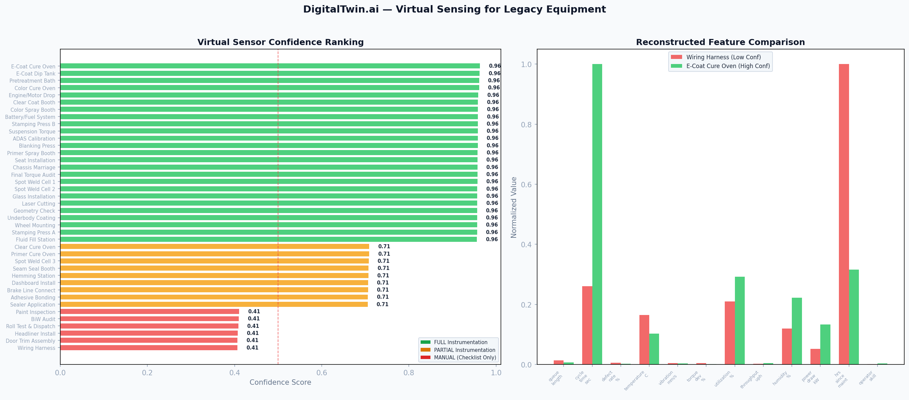
Virtual Sensing for Legacy Equipment
60%
25%
15%
FULL Instrumented
PARTIAL Coverage
MANUAL Only
FULL stations: 0.96 confidence · PARTIAL: 0.71 · MANUAL: 0.41 (flagged for manual inspection)
8/18

Slide 9
Multi-Stakeholder Dashboard
Three purpose-built views from the same underlying model — driving adoption at every organizational level.
🔧 Floor Supervisor
📊 Plant Manager
💼 Leadership
Real-Time Operations
Shift Planning & Trends
Business Case & ROI
✓ Live assembly graph (40 stations)
✓ Prioritized active alerts
✓ Station status matrix (sortable)
✓ Virtual sensing confidence panel
✓ Per-station risk + queue + anomaly
✓ 6 shift-level KPIs
✓ Risk heatmap (station × time)
✓ Bottleneck frequency ranking
✓ What-If simulation engine
✓ Anomaly scenario tracker
✓ ROI projection cards
✓ Live model validation metrics
✓ Multi-plant rollout plan
✓ Implementation roadmap
✓ Technical architecture overview
9/18

Slide 10
Non-Disruptive Integration
✅ Zero modification to existing PLCs or line control logic. Read-only overlay architecture.
Modern Equipment (60%)
Legacy Equipment (40%)
• Protocol: OPC-UA / MQTT
• Coverage: All 12 features
• Integration: Direct connection
• Latency: <100ms
• Protocol: Serial / 4-20mA analog
• Coverage: 3-8 features (rest via GNN)
• Integration: Edge gateway + translation
• Install: Maintenance windows only
Data Pipeline:
PLCs / Edge
Gateways
Apache
Kafka
TimescaleDB
Storage
GNN Inference
Service
WebSocket
Dashboard
→
→
→
→
10/18

Slide 11
Business Case & ROI
30-45%
$2.8M+
12 min
45%
6-9 mo
Downtime
Reduction
Annual Rework
Savings
Bottleneck
Lead Time
Sensor HW
Savings
Pilot
Payback
Annual Savings Breakdown (Per Plant)
Unplanned Downtime
$5M-$10M/yr
30-45% reduction
$1.5M-$4.5M
Rework & Scrap
$8M-$15M/yr
25-35% reduction
$2.0M-$5.3M
Sensor Hardware
$500K-$1M
Virtual sensing covers 40%
$200K-$600K
Quality Investigation
$1M-$2M/yr
Root-cause attribution
$300K-$800K
11/18

Slide 12
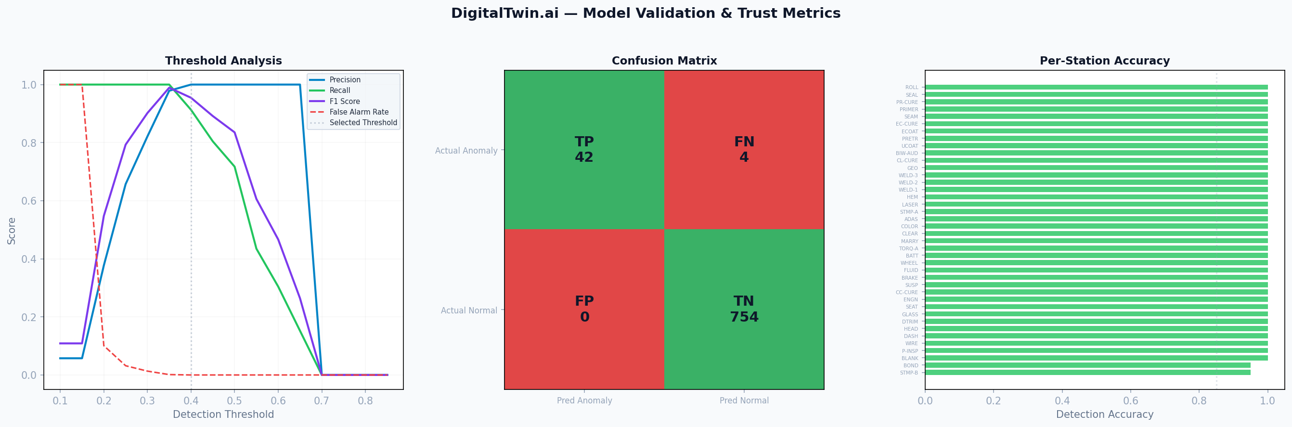
Model Validation & Trust
91.3%
100%
95.5%
0.0%
Recall
Precision
F1 Score
False Alarm Rate
⚠️ Trust strategy: Confidence scoring prevents blind trust · Tunable thresholds per station · Live validation dashboard shows ongoing accuracy against ground truth
12/18

Slide 13
Phased Implementation Roadmap
1
2
3
Phase 1 — Pilot
Phase 2 — Single Plant
Phase 3 — Enterprise
Q1-Q2 2027 · $150K
Q3-Q4 2027 · $400K cumul.
2028+ · $1.2M cumul.
✓ Single line, 40 stations
✓ Edge gateways for legacy equipment
✓ Core prediction + virtual sensing
✓ Floor Supervisor dashboard (one shift)
✓ All lines in pilot plant
✓ What-If simulation enabled
✓ All-shift dashboard rollout
✓ CMMS integration for work orders
✓ Multi-plant federation
✓ Cross-plant benchmarking
✓ Automated interventions (RL)
✓ MES/ERP closed-loop integration
13/18

Slide 14
Risks & Mitigations
False alarms eroding trust
HIGH
Confidence scoring, tunable thresholds, live validation dashboard
Legacy equipment integration
MED
Edge gateways + protocol translation; virtual sensing covers gaps
Data quality (manual stations)
HIGH
Masked-node GNN training; low-confidence flagging
Production disruption
LOW
Read-only data taps; overlay architecture; maintenance-window-only changes
Model drift over time
MED
Continuous validation; automated retraining when F1 drops
Organizational resistance
MED
Stakeholder-specific views; gradual rollout; pilot-first approach
Cybersecurity (OT-IT)
MED
Data diode architecture; no PLC write-back; network segmentation
14/18

Slide 15
Scalability & Generalization
Stations/Line
Lines/Plant
Plants
Inference
40 → 100+
1 → 5-10
1 → 10+
~50ms CPU
Hierarchical graph pooling
Shared backbone + fine-tuning
Graph-of-graphs federation
ONNX + TensorRT → <20ms GPU
Industry Generalization
Aerospace Assembly
Longer cycles, stricter QC
Low effort
Electronics / PCB
Parallel lines, high throughput
Medium effort
Pharmaceutical
Batch processes, regulatory
Medium effort
Food & Beverage
Hygiene, temperature-critical
Low effort
15/18

Slide 16
Technical Architecture
Data Layer
Intelligence Layer
Application Layer
• OPC-UA / MQTT from modern PLCs
• Edge gateways for legacy serial/analog
• Apache Kafka streaming pipeline
• TimescaleDB time-series storage
• Virtual sensor gap-filling
• Spatio-Temporal GATv2 + GRU
• Masked-node virtual sensing
• Multi-head prediction (5 heads)
• Root-cause attention extraction
• What-If simulation engine
• Multi-stakeholder dashboard
• Real-time alerting (floor view)
• Planning tools (manager view)
• ROI / validation (leadership)
• REST API for integration
Core Stack:
Python 3.9+
PyTorch 2.0+
PyTorch Geometric
Flask
NetworkX
JavaScript
16/18

Slide 17
3-Year Investment & Return
Year 1
Pilot
Year 2
Single Plant
Year 3
Enterprise
Investment
Investment
Investment
$150K
$400K
cumulative
$1.2M
cumulative
Annual Savings
Annual Savings
Annual Savings
$500K
(partial year)
$2.8M
$4.5M × N
plants
Cumulative ROI
Cumulative ROI
Cumulative ROI
+$350K
+$2.75M
>10× ROI
at 3+ plants
17/18

Slide 18
DigitalTwin.ai
From reactive firefighting to proactive optimization.
Piyush Maji
Accenture Innovation Challenge 2026
18/18

