Slide 1
Predictive Regression Modelling of Avian Disease Outbreaks
PRT564 - Data Analytics and Visualisation
Presented by:
Group Members:
Angana (s379183),
Kshitiz (s378077), Moomtahina (s375593)
Piyush (s377937)

Slide 2
Project Objectives
Develop regression models to predict avian disease outbreaks
Integrate surveillance data with environmental factors
Compare Linear, Ridge, and Random Forest Regression
Deliver actionable insights for biosecurity stakeholders

Slide 3
Dataset Description
Sources: Avian Dashboard & UK Weather Data
950 rows, ~30 features after encoding
Target: case_count
Heterogeneous: Combined epidemiological & environmental data

Slide 4
Data Preprocessing
One-hot encoding for categorical variables
StandardScaler for numerical features
No missing values
Prepared for regression modelling

Slide 5
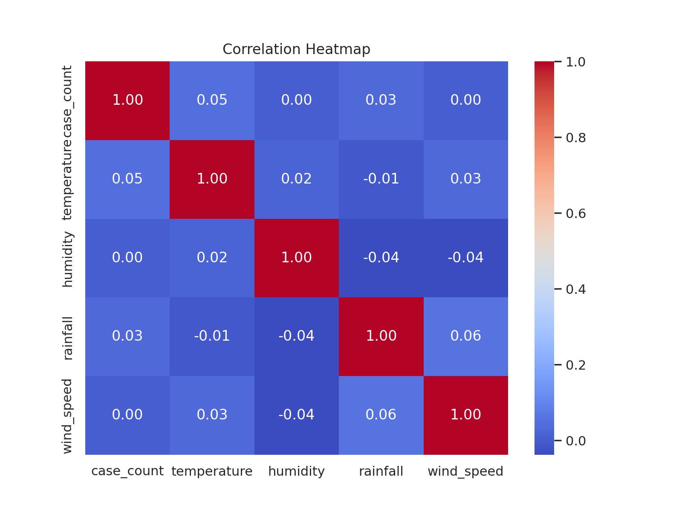

Slide 6

EDA: Target Variable Distribution
Right-skewed distribution of case_count
Most outbreaks report <5 cases
Indicates need for models handling skewed data

Slide 7

Regression Models Applied
Linear Regression: Simple baseline
Ridge Regression: Tackled multicollinearity
Random Forest: Captured non-linear patterns

Slide 8
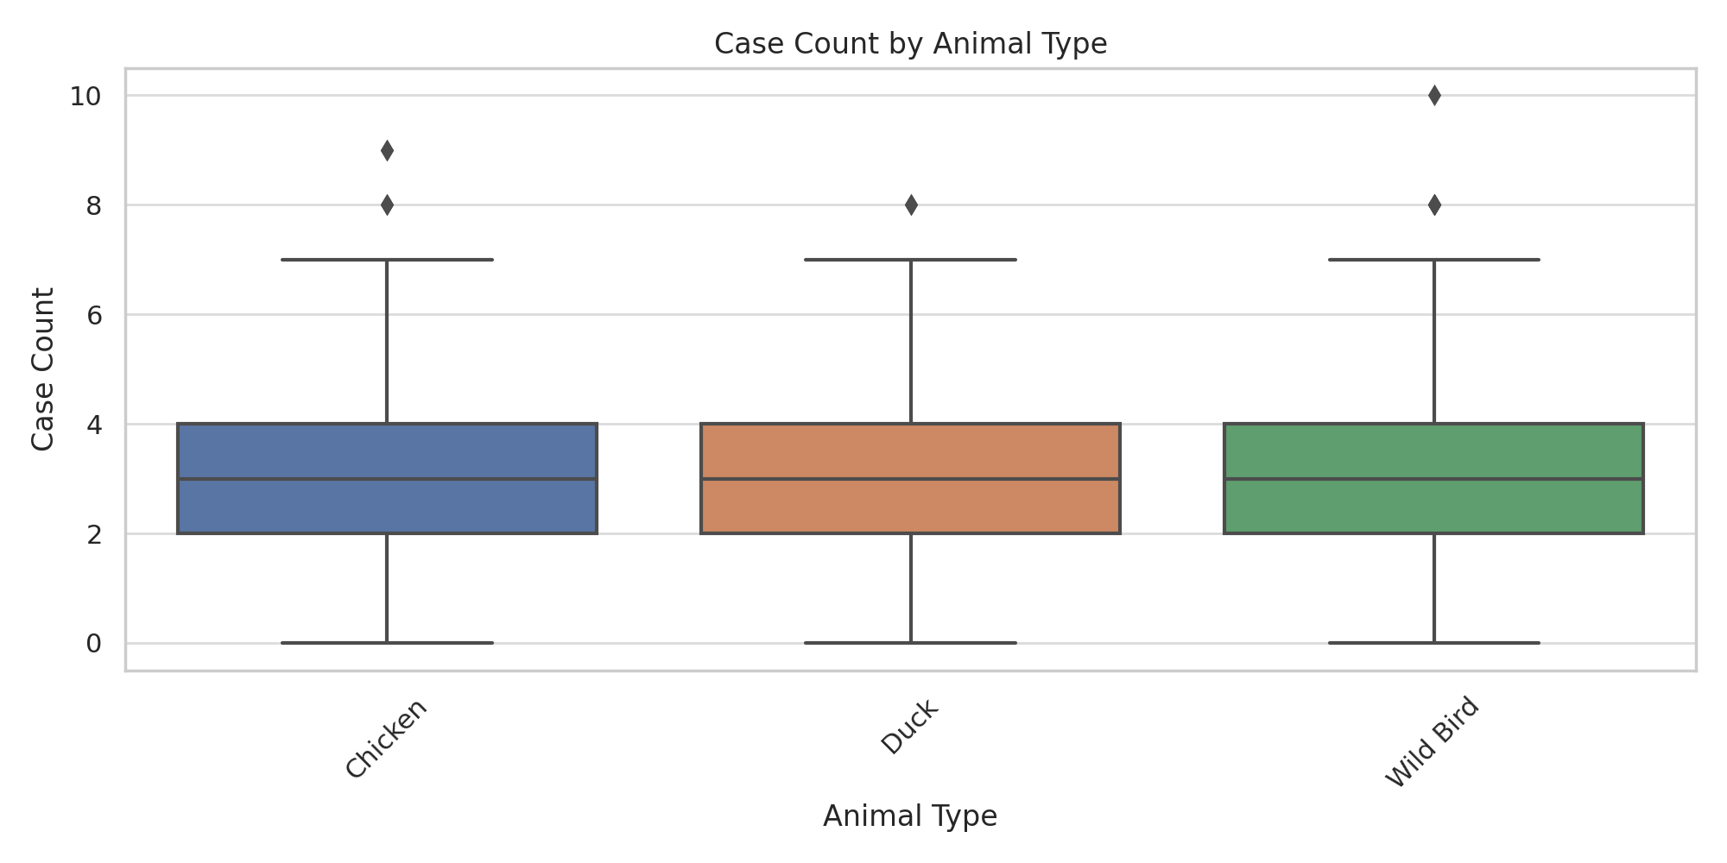
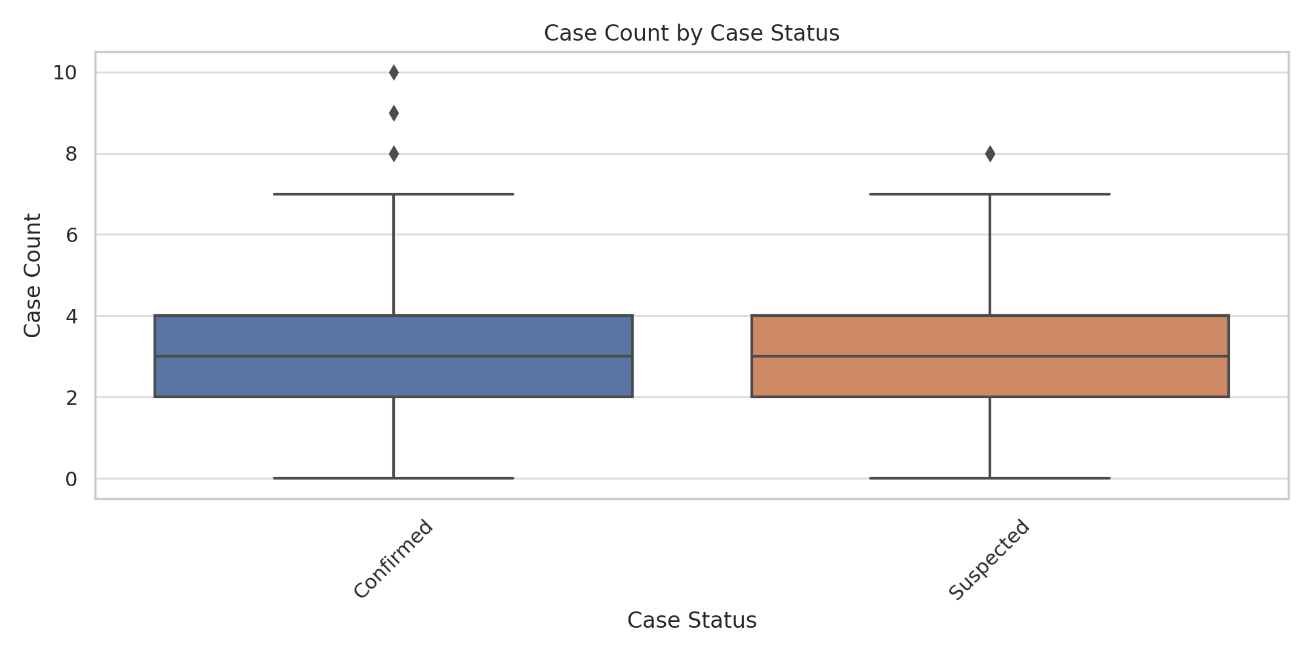

Slide 9
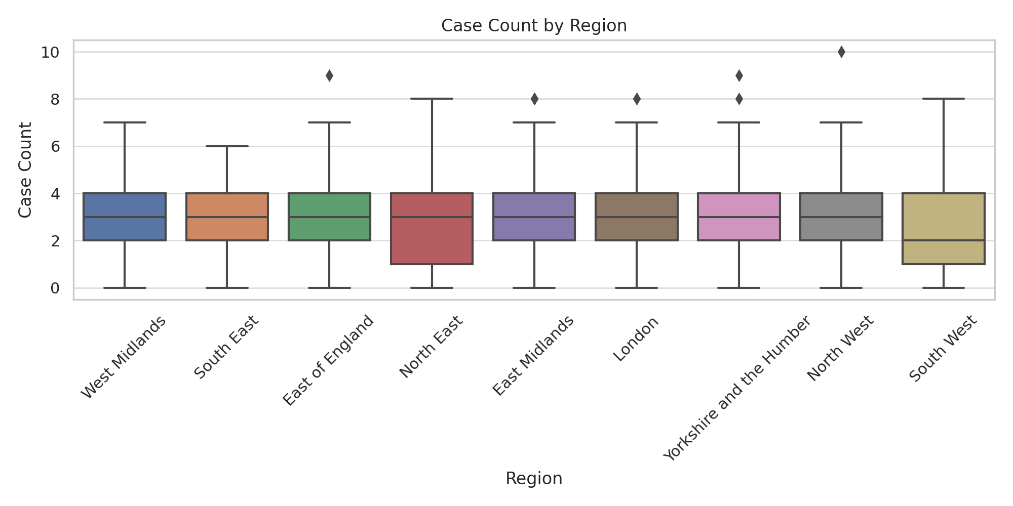
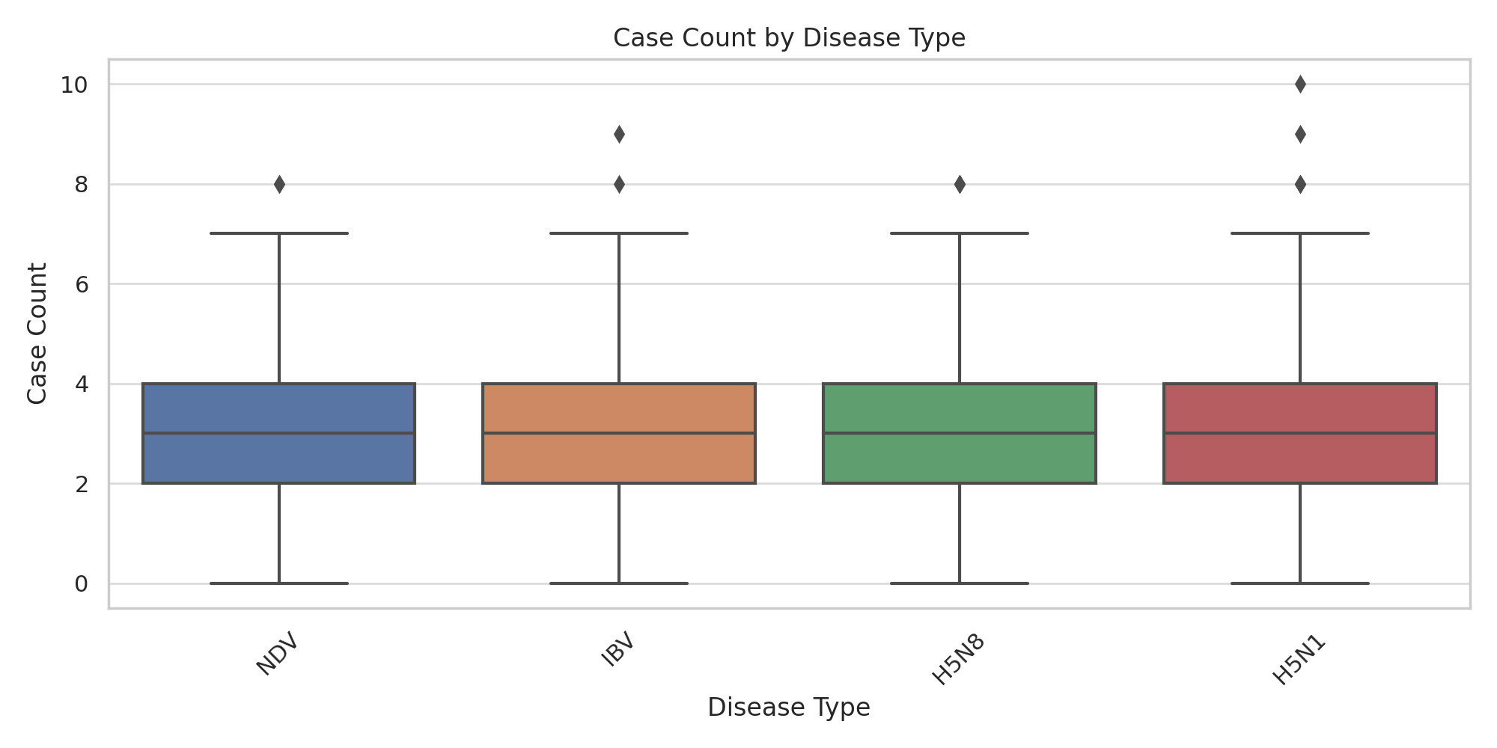

Slide 10
Model Performance
All models showed low R² scores
Random Forest had lowest MAE & RMSE
Data limitations impacted accuracy

Slide 11
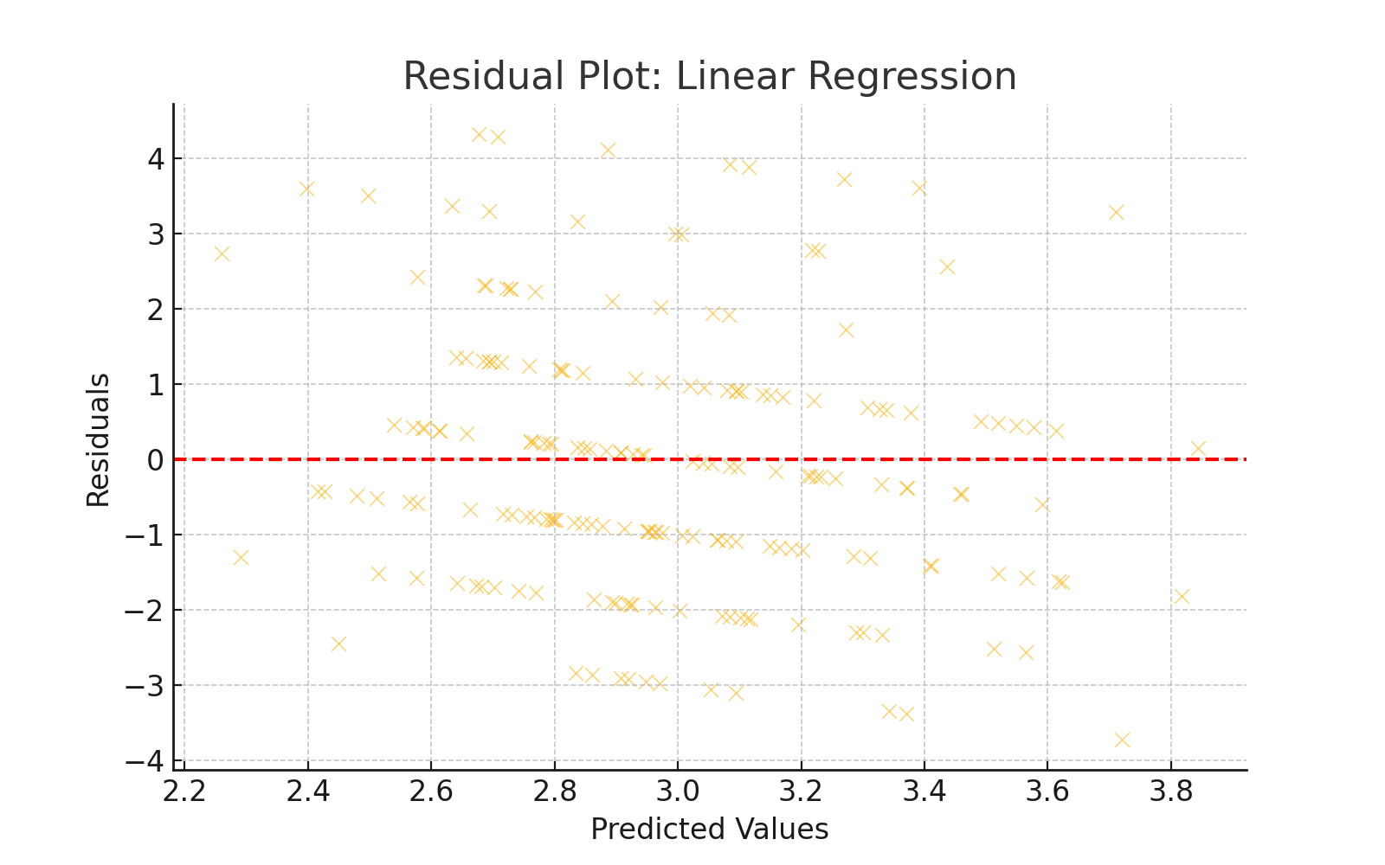

Slide 12
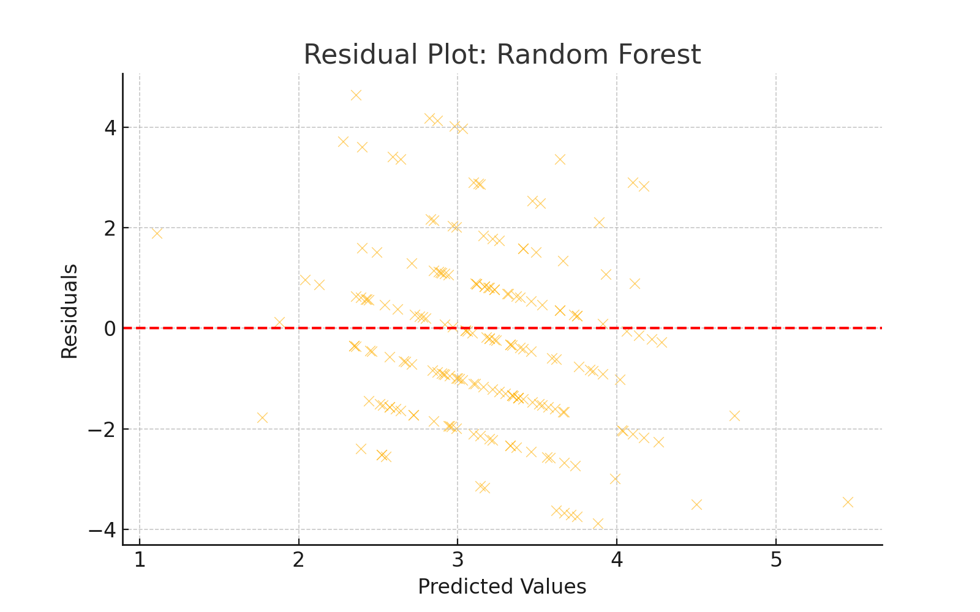

Slide 13
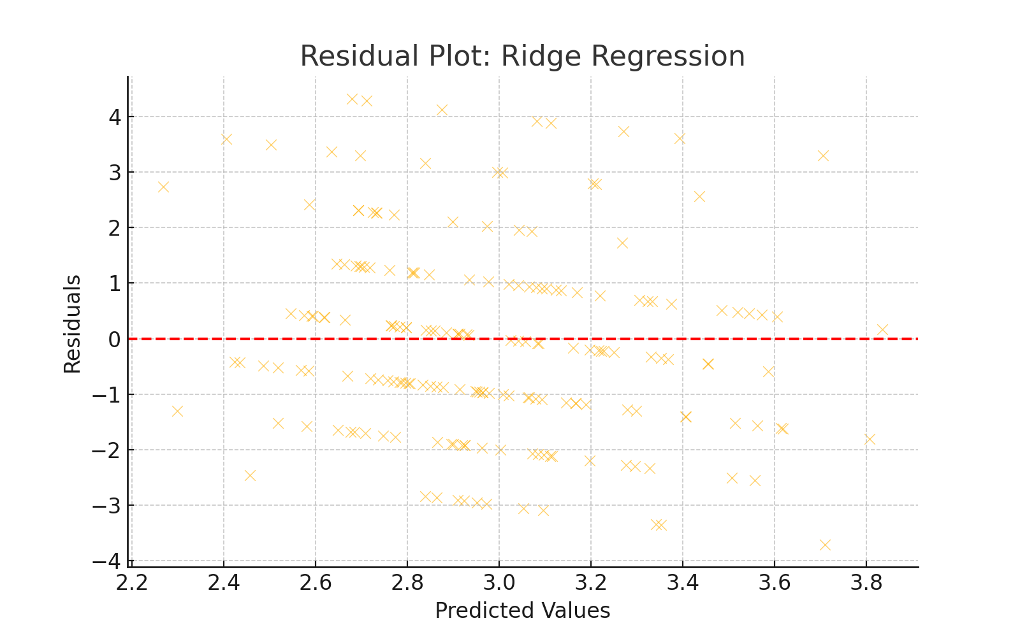

Slide 14
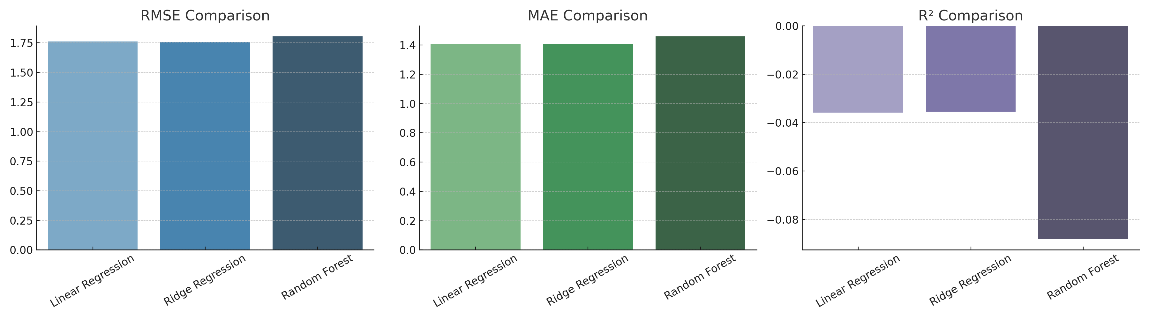

Slide 15
Key Feature Importances
Environmental feature Type were top predictors
Region and Disease Type had lesser impact
Highlights value of contextual data

Slide 16
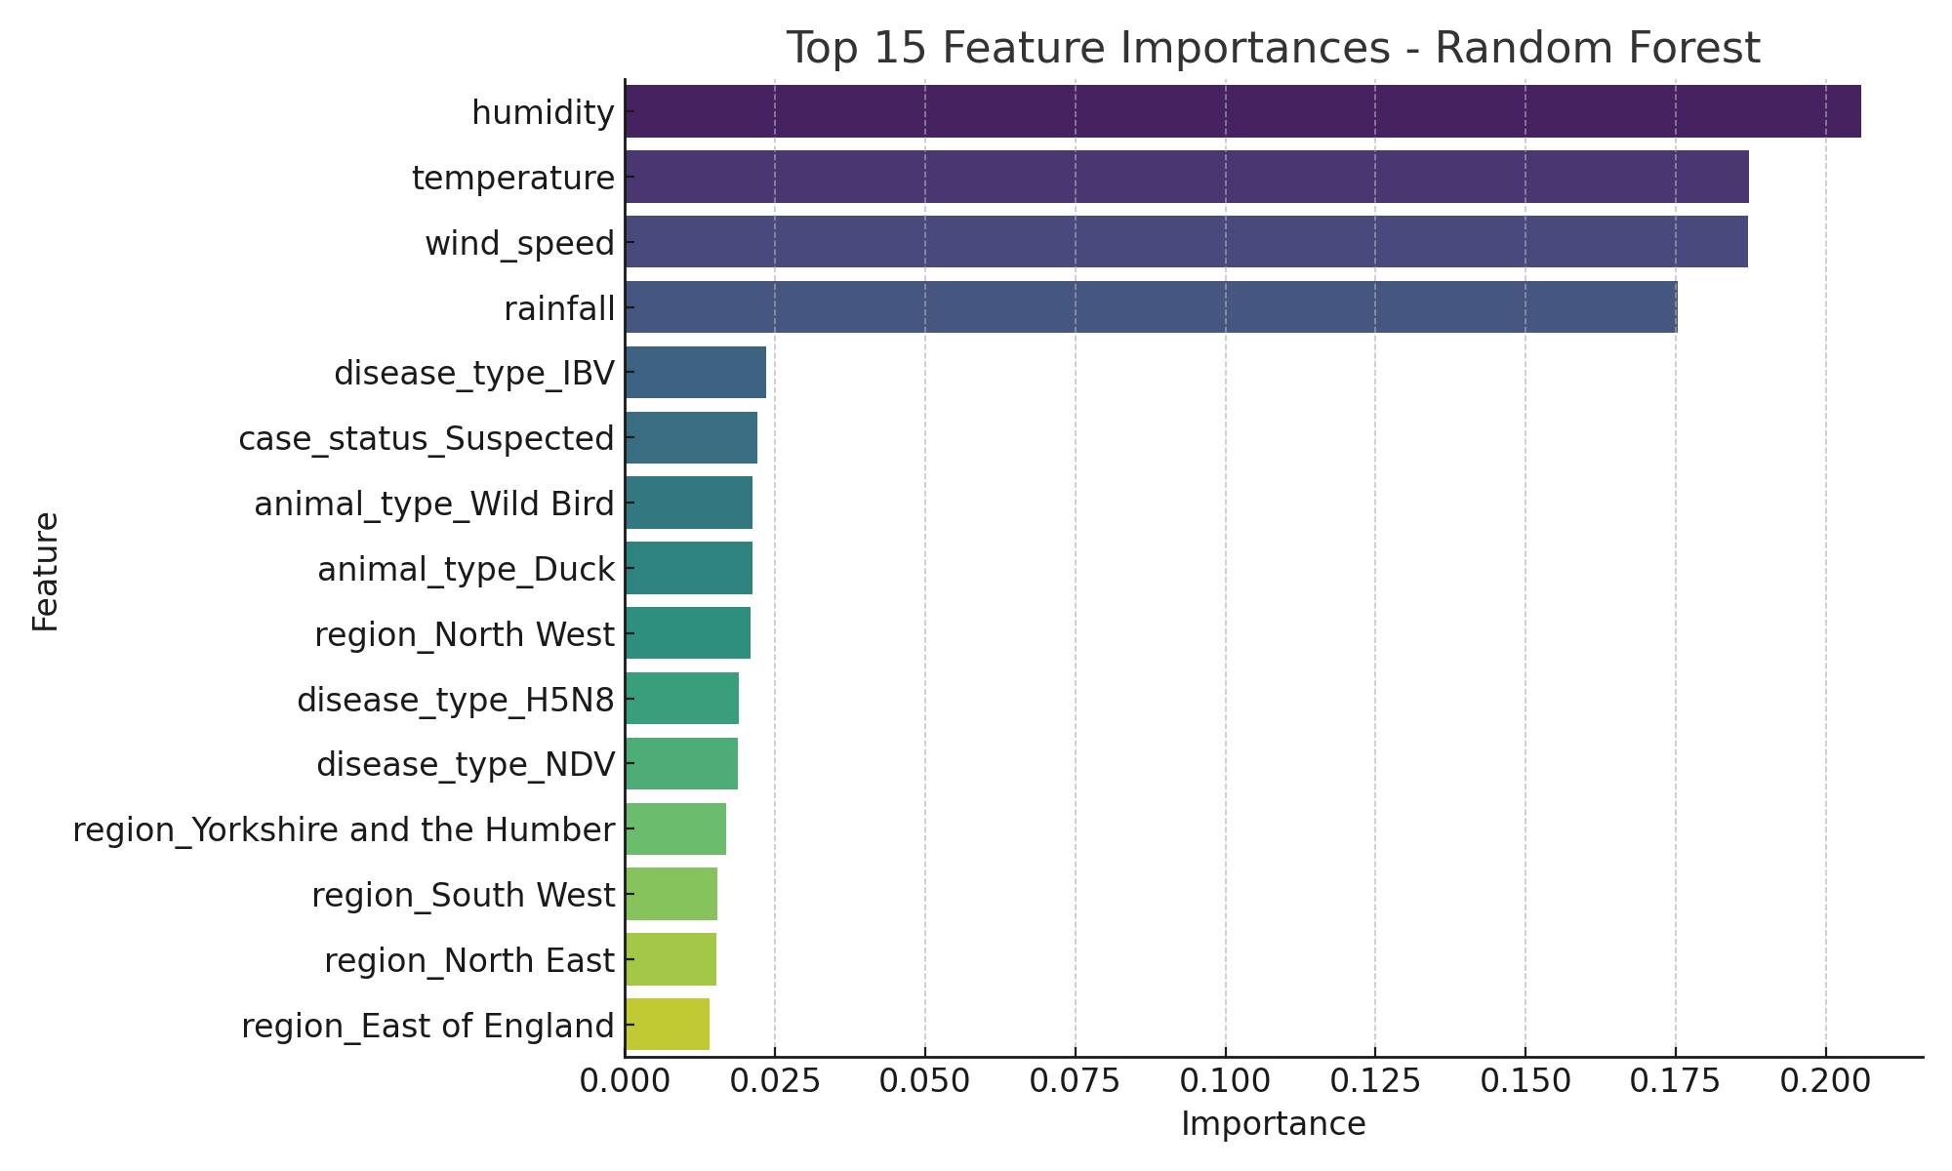

Slide 17
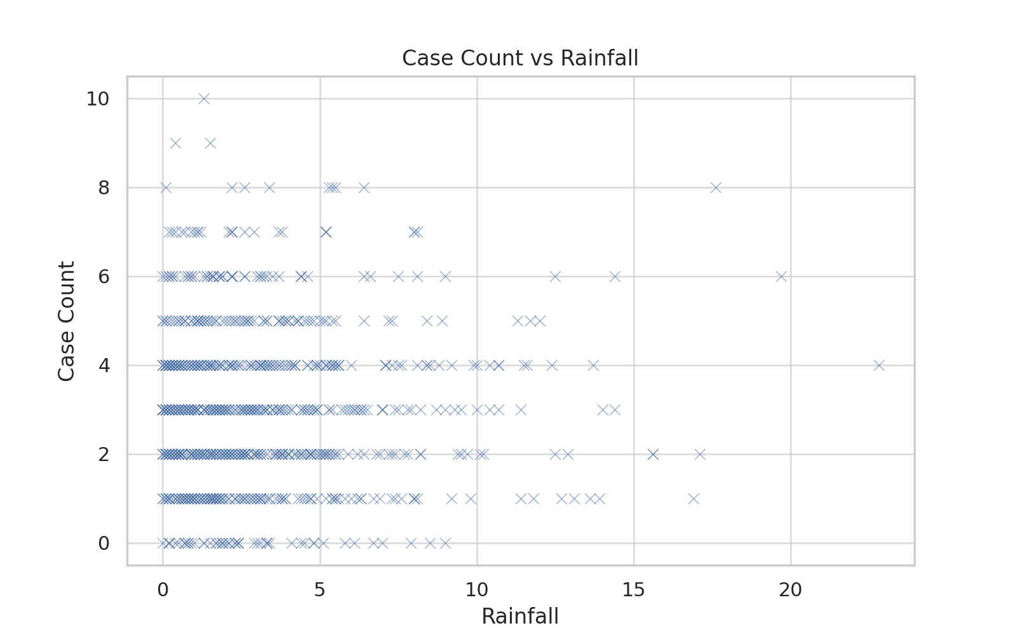

Slide 18
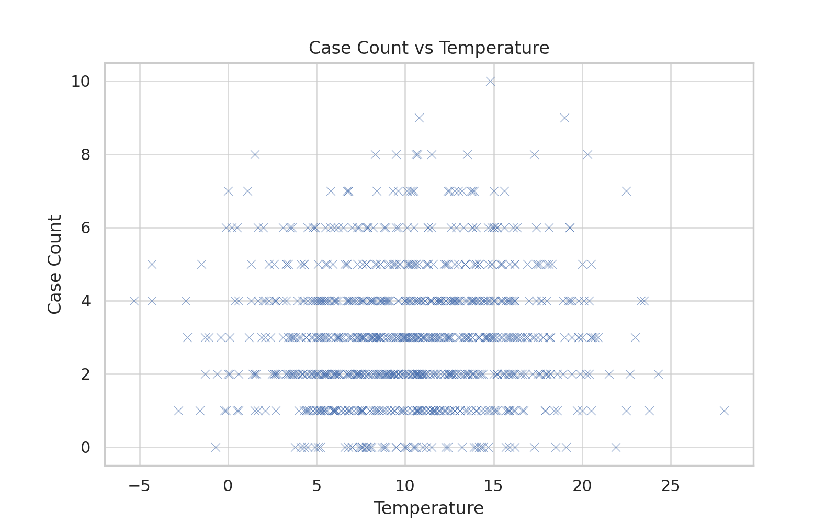

Slide 19
Statistical Significance Testing
Paired t-test between models
p-value = 0.188 (no significant difference)
Similar performance due to dataset noise

Slide 20
Discussion & Limitations
Strength: Complete ML pipeline with diagnostics
Limitation: Synthetic data & low predictive power
Need richer, real-time data for better accuracy

Slide 21
Organisational Context
Supports biosecurity agencies & poultry farms
Provides early warning insights
Identifies key data gaps for future surveillance

Slide 22
Conclusion
Random Forest recommended despite data limits
Data quality is critical for predictive success
Framework ready for real-world data integration

Slide 23
AI Usage Note
AI used for data simulation guidance & report structuring
All analysis conducted and validated by team
Transparent documentation maintained

