Slide 1



Data Analytics and Data Visualization (30310214)
Unit 1 : Introduction to Data Analytics
Prof. Manisha Chandramaully
Assistant Professor
Computer Science & Engineering

Slide 2
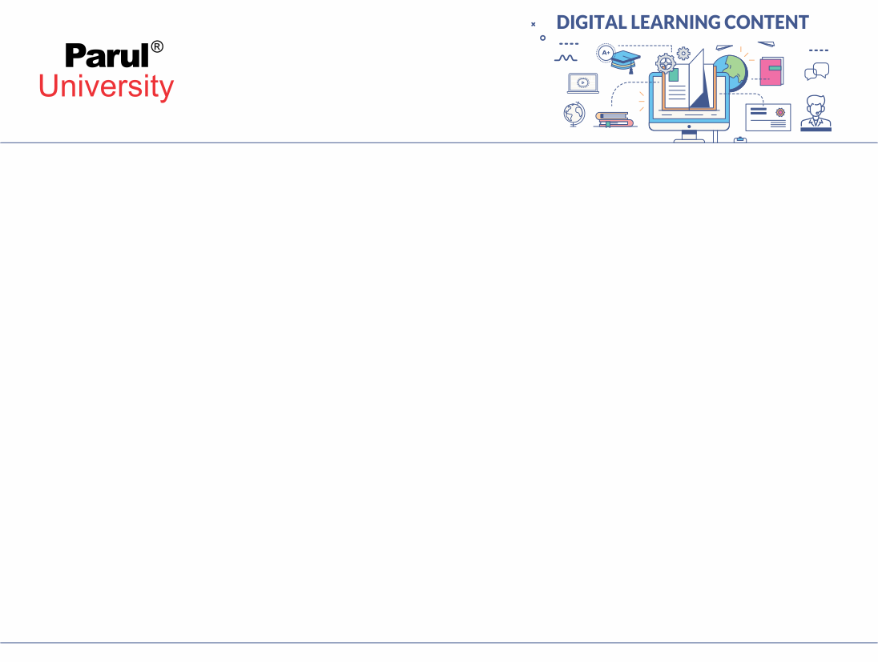

Outline
Introduction
Data and its importance
Data analytics and its types
Why data analytics is important
Data analysis Vs. Data analytics
Classification of data analytics
Elements of Data analytics
Data analyst Vs. Data scientist

Slide 3
Introduction
This is to introduce conceptual understanding using simple and practical examples.
Focus on:
Why to use a particular technique of procedure
how to choose the right technique
how to use it correctly
how to interpret the result.

Slide 4
Data and its importance
Three terms: Variable, measurement and Data
What is generating so much data?
How data add value to the business?
Why data is important?

Slide 5
Variable, Measurement and Data
Variable- is a characteristic of any entity being studied that is capable of taking on different values.
Measurements- is when a standard process is used to assign numbers to particular attributes or characteristics of a variable.
Data- data are recorded measurements

Slide 6
What is generating so much data?
Data can be generated by
Humans,
Machines or
Humans-machines combines
It can be generated anywhere where any information is generated and stored in structured or unstructured formats

Slide 7
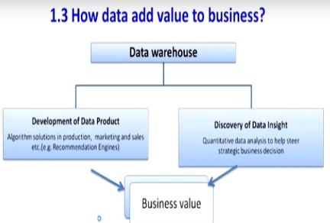
How data add value to business?

Slide 8
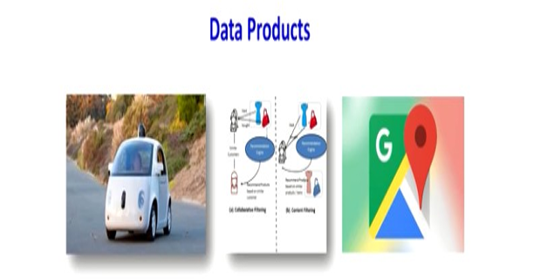
Example of Data products

Slide 9
Why data is important?
Data helps in make better decisions
Data helps in solve problems by finding the reason for underperformance
Data helps one to evaluate the performance
Data helps one improve processes
Data helps one understand consumers and the market

Slide 10
Define Data analytics and its types
Data analytics is defined as “the scientific process of transforming data into insights for making better decisions.”
Professor James Evans has defined the data analytics that “it is the use of the data information technology, statistical analysis, quantitative methods and mathematical or computer-based models to help managers gain improved insight about their business operations and make better, fact-based decisions.”

Slide 11
Why data analytics is important?
Opportunity abounds for the use of analytics and big data such as:
Determining credit risk
Developing new medicines
Finding more efficient ways to deliver products and services
Preventing fraud
Uncovering cyber threats
Retaining the most valuable customers

Slide 12
Data analysis
It is the process of examining, transforming, and arranging raw data in a specific way to generate useful information from it.
It allows for the evaluation of data through analytical and logical reasoning to lead to some sort of outcome or conclusion in some context.
It is a multi-faceted process that involves a number of steps, approaches, and diverse techniques.

Slide 13
Data analytics Vs. Data Analysis
Analysis
Explain
How?
Why?
Past
Data analysis it is something about -
what has happened in the past.
why that has happened?
how it has happened?
Example: Post mortem analysis

Slide 14
Data analytics Vs. Data Analysis
Analytics
Future
Analytics is studying about –
what will happen in future.
predict explore possible potential future events.

Slide 15
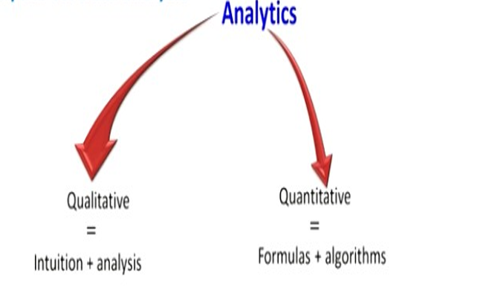
Data analytics Vs. Data Analysis

Slide 16
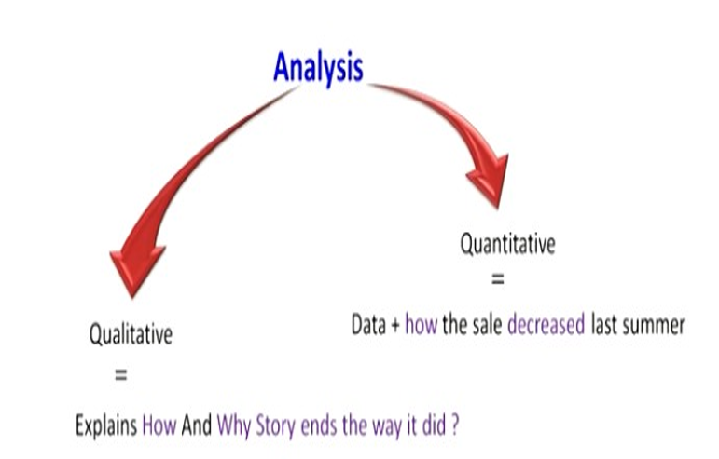
Data analytics Vs. Data Analysis

Slide 17
Classification of Data analytics
Based on the phase of workflow and kind of analysis required, there are four major types of data analytics:
Descriptive analytics
Diagnostic analytics
Predictive analytics
Prescriptive analytics

Slide 18
Classification of Data analytics
Descriptive analytics
(What happened?)
Diagnostics analytics
(Why did it happen?)
Prescriptive analytics
(How can we make it happen?)
Predictive analytics
(What will happen?)

Slide 19
Classification of Data analytics: Descriptive analytics
Descriptive analytics is the conventional form of business intelligence or data analysis.
It seeks to provide the depiction or summary view of facts and figures in an understandable format.
These either inform or prepare data for further analysis. so descriptive analysis or we can say another way in statistics can summarize raw data and convert it into your form that can be easily understood by humans.
They can describe in detail about an even that has occurred in the past.

Slide 20
Classification of Data analytics: Descriptive analytics
Descriptive analytics is the conventional form of business intelligence or data analysis.
It seeks to provide the depiction or summary view of facts and figures in an understandable format.
These either inform or prepare data for further analysis. so descriptive analysis or we can say another way in statistics can summarize raw data and convert it into your form that can be easily understood by humans.
They can describe in detail about an even that has occurred in the past.
Example: company reports that simply provide the historic review like: data queries, reports, descriptive statistics, data visualization and data dashboard.

Slide 21
Classification of Data analytics: Diagnostic analytics
Diagnostic analytics is a form of advanced analytics which examines data or content to answer the question why did it happen?
Diagnostic analytical tools aid an analyst to dig deeper into an issue. So that, they can arrive at the source of the problem.
In a structured business environment tools for both descriptive and diagnostic analytics go parallel.
Example: data discovery, data mining, and correlations.

Slide 22
Classification of Data analytics: Predictive analytics
Predictive analytics helps to forecast trends based on the current events.
Predicting the probability of an event happening in future are estimating accurate time it will happen can all be determined with the help of predictive analytical models.
Many different but co-dependent variables are analysed to predict a trend in this type of analysis.

Slide 23
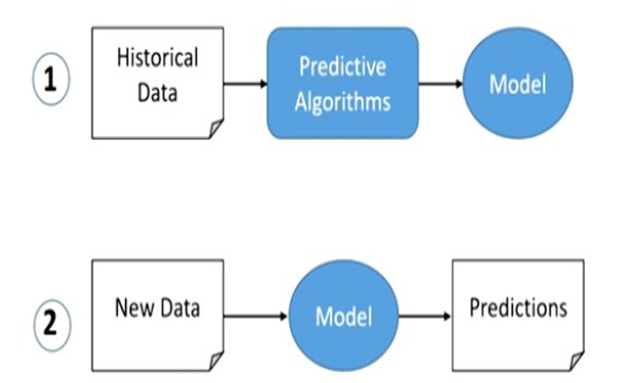
Classification of Data analytics: Predictive analytics
With the help of historical data by using different algorithm, predictive algorithms you can come with a model.
Once the model is developed a new data can be fit into this model so we can get some predictions about the past events.

Slide 24
Classification of Data analytics: Predictive analytics
Example: linear regression, time series analysis and forecasting and data mining.
These are the techniques for predictive analytics.

Slide 25
Classification of Data analytics: Prescriptive analytics
A set of techniques to indicate the best course of action.
It tells what decision to make to optimize the outcome.
The goal of prescriptive analytics is to enable: quality improvements, service enhancements, cost reductions and increasing productivity.
Examples: Some of the tools like optimization models, simulation model, and decision analysis.

Slide 26
Element of Data analytics
Element of Data Analytics
Statistics
Business intelligence/ information systems
Modelling and Optimizations
Simulation and risk

Slide 27
Data analyst Vs. Data scientist
Aspect | Data Analyst | Data Scientist
Primary Focus | Analyzing data to provide insights for business decisions. | Using advanced statistical and computational methods to solve complex problems.
Skills Required | – Data Cleaning and Preparation – Statistical Analysis – Data Visualization – SQL – Excel Skills – Problem-Solving – Domain Knowledge – Communication Skills – Attention to Detail – Time Management – Continuous Learning | – Machine Learning – Statistical Analysis – Data Cleaning and Preprocessing – Data Visualization – Big Data Technologies (e.g., Hadoop, Spark) – Deep Learning – Natural Language Processing (NLP) – SQL Database Management – Experiment Design and A/B Testing – Cloud Computing Platforms (e.g., AWS, Azure, Google Cloud) – Communication and Presentation Skills – Domain Knowledge – Time Series Analysis – Feature Engineering

Slide 28
Data analyst Vs. Data scientist
Aspect | Data Analyst | Data Scientist
Typical Tasks | Cleaning and organizing data, creating reports, generating dashboards, and performing descriptive analytics. | Building predictive models, conducting A/B testing, developing algorithms, and performing exploratory data analysis.
Example Scenario | Analyzing sales data to identify trends and optimize marketing strategies. | Developing a recommendation system for an e-commerce platform based on customer behavior.
Decision Making | Helps businesses make data-driven decisions by providing insights from existing data. | Involves both providing insights and developing solutions to complex problems using data.
Tools Used | Excel, SQL, Tableau, Power BI, Google Analytics. | Python, R, SQL, TensorFlow, PyTorch, Jupyter Notebooks, Big Data Technologies (e.g., Hadoop, Spark).

Slide 29


www.paruluniversity.ac.in

