Slide 1
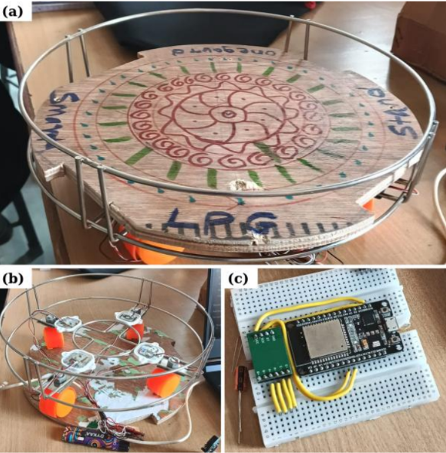
ONEGAURD • FINAL YEAR ENGINEERING PROJECT
SMART LPG
SAFETY RING
Leak detection • Gas-weight monitoring
Cloud alerts • Refill prediction
ESP32
MQ-6 SENSOR
LOAD CELLS
FIREBASE
PHYSICAL PROTOTYPE
Piyush Rohidas Sonawane (453)
Gaurav Dattatray Shinde (449)
Sakshi Dnyaneshwar Shinde (450)
Shailaja Ashok Sargam (443)
A retrofit platform combining
weight measurement and gas sensing.
PROJECT OVERVIEW
Guide: Prof. S. P. Tapkire | NBNSCOE, Solapur

Slide 2
ONEGAURD / SMART LPG SAFETY
02 / 08
The Problem & Our Proposed Solution
One device, three connected capabilities
THE PROBLEM
OUR SOLUTION
ENGINEERING PRINCIPLE
Users may not know how much LPG remains.
A developing leak needs a rapid local warning.
Standalone alarms often do not provide weight history or refill estimates.
Connectivity failures must not disable local safety.
MQ-6 sensor signal for suspected LPG leak detection.
Load cells + HX711 for mass measurement.
ESP32 runs local logic and uploads telemetry over Wi-Fi.
Mobile dashboard shows status, weight, events and refill estimate.
Local alarm first; cloud is supplemental.
Use tare correction for a real cylinder.
Label demo values separately from live measurements.
Prototype is not certified safety equipment.

Slide 3
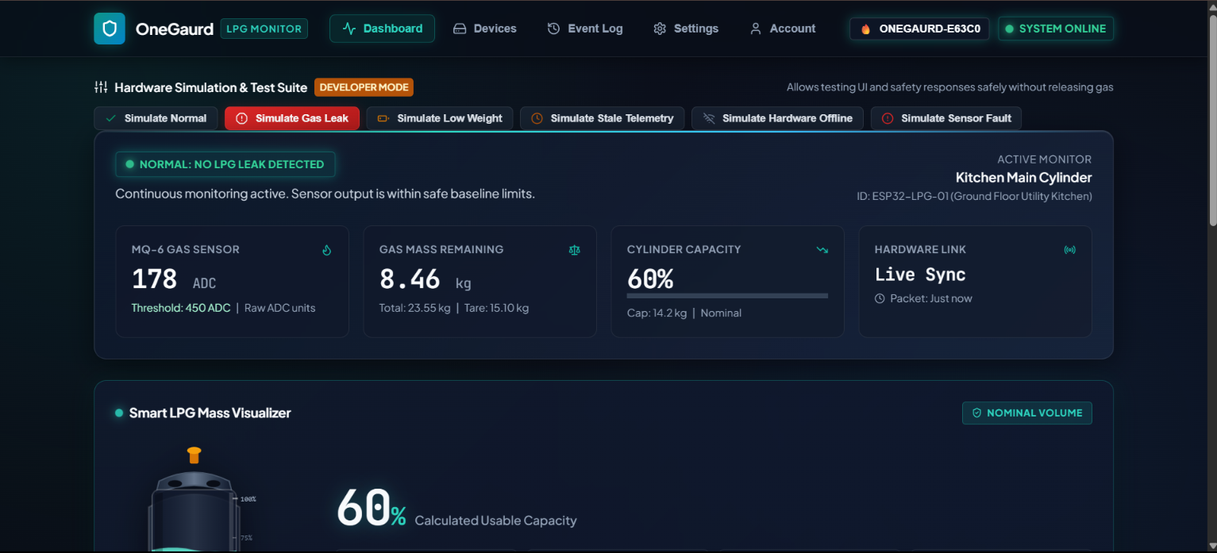
ONEGAURD / SMART LPG SAFETY
03 / 08
End-to-End System Architecture
Hardware → secure backend → per-user live dashboard
1 DEVICE LAYER
2 API & CLOUD
3 USER EXPERIENCE & ALERTS
Node.js / Express API
→
→
Firebase RTDB
Firebase Auth / Firestore
ESP32
MQ-6 + load cells/HX711
Buzzer / status LED
React Native Web / PWA dashboard
Latest state, history, device health
Twilio voice call + SMS (optional, configured)
Provider/network failures must be logged
Validate device secret
Enforce user ownership

Slide 4
ONEGAURD / SMART LPG SAFETY
04 / 08
Hardware & Mechanical Platform
Prototype elements and measurement chain
COMPONENT ROLES
ESP32: sensor sampling, local decisions and Wi-Fi.
MQ-6: combustible-gas sensor; warm-up and calibration required.
Load cells + HX711: strain-gauge mass measurement.
Buzzer/LED: local warning independent of the cloud.
Mechanical platform: stable load paths, anti-slip support and low off-centre error.
Optional DHT22, OLED, backup battery and GSM must be labelled proposed unless installed.
Prototype photo: ring/platform, support frame, load-cell arrangement and ESP32 wiring.

Slide 5
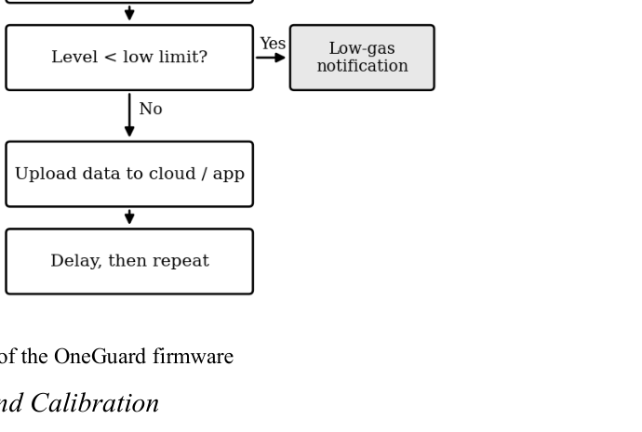
ONEGAURD / SMART LPG SAFETY
05 / 08
Firmware Workflow & Safety State Machine
Local response is independent of internet connectivity
LOCAL SAFETY LOOP
1. Initialize outputs to a defined safe state.
2. Warm up and validate sensor readings.
3. Filter readings and evaluate leak threshold with persistence/hysteresis.
4. Trigger local buzzer/indicator immediately when the leak condition is met.
5. Record sensor faults and stale/invalid measurements distinctly from normal.
6. Upload telemetry when Wi-Fi is available; retry later without blocking the safety loop.
Firmware flowchart from the supplied research paper.
OFFLINE-SAFE DESIGN
NO CLOUD DEPENDENCY

Slide 6
ONEGAURD / SMART LPG SAFETY
06 / 08
Application, Database & Calling/SMS Alerts
End-to-end product plan, including notification integration
WEB / MOBILE DASHBOARD
REMOTE ALERT PIPELINE
Pages: Dashboard, Devices, Event Log, Settings and Account.
Google + email/password login through Firebase Authentication.
Per-user records keyed by authenticated UID; rules deny cross-user access.
Realtime Database: latest telemetry and online state.
Firestore: device metadata, history/calibration and alert delivery records.
Demo mode for safe UI testing; live mode only after Firebase/device setup.
Leak event
ESP32 detects locally
Secure API
Validate device + owner
Alert policy
Deduplicate + cooldown
Twilio API
Voice call / SMS
Twilio credentials stay on server; calls/SMS can cost money and require verified destination setup.

Slide 7
ONEGAURD / SMART LPG SAFETY
07 / 08
Gas-Mass Calculations & Validation Plan
Show engineering evidence, not invented performance claims
WEIGHT AND CAPACITY
TESTS BEFORE CLAIMING SUCCESS
Real cylinder: net LPG = gross measured mass − cylinder tare mass.
Remaining % = net LPG ÷ configured full net capacity × 100.
Dashboard example: 23.55 − 15.10 = 8.45 kg; shown 8.46 kg needs reconciliation.
8.46 ÷ 14.2 ≈ 59.6%, consistent with a rounded 60%.
MQ-6 ADC is a raw reading, not ppm; threshold must be calibrated on the actual module.
Load-cell calibration at multiple known masses and platform positions.
Repeatability, zero drift and measurement error.
Safe, controlled MQ-6 sensor characterization; no uncontrolled LPG release.
Local alarm test with Wi-Fi/cloud disconnected.
API authentication, user-data isolation, stale telemetry and reconnection.
Twilio delivery/error logs, cooldown and destination verification.

Slide 8
ONEGAURD / SMART LPG SAFETY
08 / 08
Build Roadmap, Limitations & Conclusion
From working prototype to validated, secure system
BUILD IN THIS ORDER
CONTRIBUTION & FUTURE WORK
1. Finish mechanical mounting and sensor wiring.
2. Calibrate load cells and establish a validated gas-sensor threshold.
3. Verify ESP32 local safety behavior and fault handling.
4. Secure Firebase auth, database rules and device API.
5. Connect dashboard, event history and notifications.
6. Run end-to-end tests; document measured results and limitations.
OneGaurd unifies leak sensing, weight-based gas estimation and cloud monitoring.
Future: battery backup, GSM fallback, smart-home integration and validated refill prediction.
A simple consumption estimator comes before ML; AI requires real, evaluated history.
This prototype is not certified LPG safety equipment; use approved safety devices.
LOCAL SAFETY FIRST
VALIDATE BEFORE DEPLOYMENT
Thank you • Questions & Discussion

