Slide 1
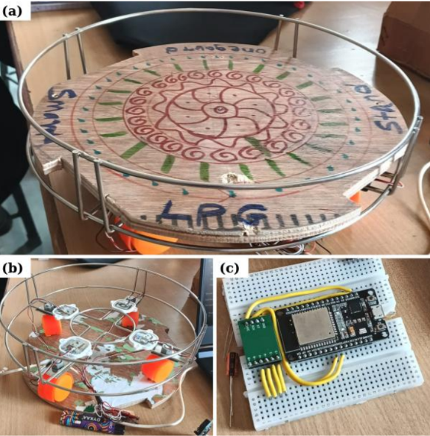
FINAL YEAR ENGINEERING PROJECT
SMART LPG
SAFETY RING
Leak detection • Weight-based gas monitoring
Cloud alerts • Refill prediction
ESP32
MQ-6 SENSOR
LOAD CELLS
FIREBASE
Piyush Rohidas Sonawane (453)
Gaurav Dattatray Shinde (449)
Sakshi Dnyaneshwar Shinde (450)
Shailaja Ashok Sargam (443)
PHYSICAL PROTOTYPE
One retrofit platform for gas safety + remaining-mass visibility.
Guide: Prof. S. P. Tapkire | NBNSCOE, Solapur
PROJECT OVERVIEW

Slide 2
ONEGAURD / SMART LPG SAFETY
02 / 08
Problem, Objectives & Proposed Solution
Three connected capabilities, with local safety taking priority
THE PROBLEM
OUR SOLUTION
CORE OBJECTIVES
• Unknown remaining gas; unexpected cylinder depletion
• Leaks may go unnoticed when people are away
• Standalone alarms do not track cylinder mass
• Cloud loss must never suppress local safety
• MQ-6 sensor provides a combustible-gas signal
• Load cells + HX711 estimate cylinder mass
• ESP32 runs local decision logic and Wi-Fi telemetry
• Dashboard shows status, history and refill estimate
• Detect suspected leak and trigger local alarm
• Calibrate mass and calculate net LPG remaining
• Securely show device state and event history
• Add voice/SMS alerts and prediction after validation

Slide 3
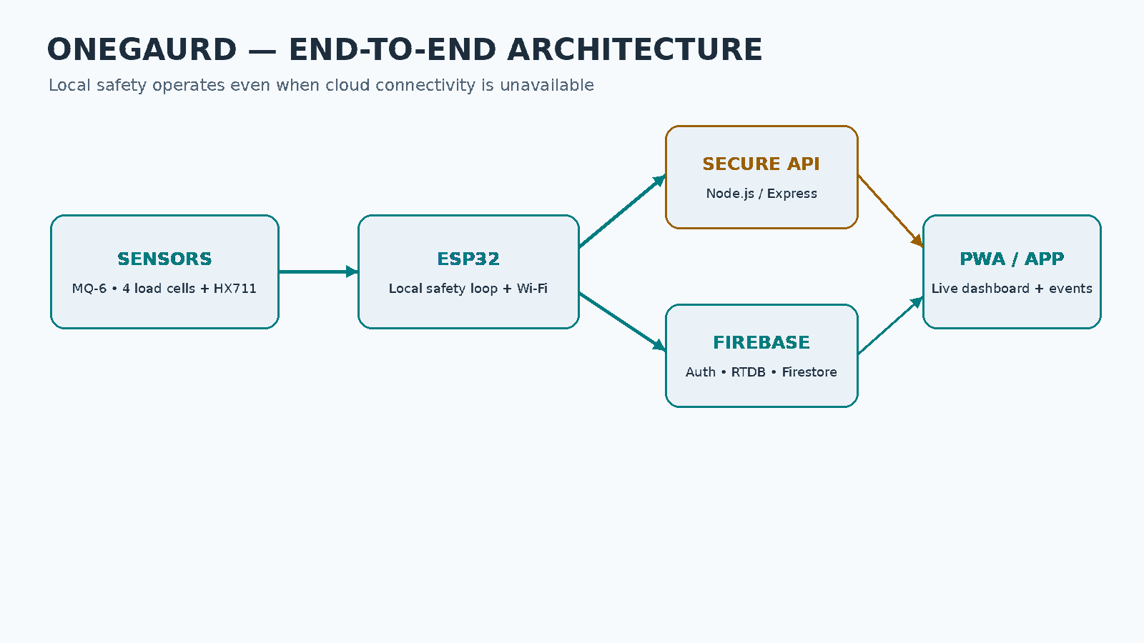
ONEGAURD / SMART LPG SAFETY
03 / 08
System Architecture & Data Flow
New architecture visual: device → secure API → Firebase → app
LIVE STATE + EVENT HISTORY
AUTH + DEVICE OWNERSHIP
LOCAL ALARM WORKS OFFLINE

Slide 4
ONEGAURD / SMART LPG SAFETY
04 / 08
Hardware Prototype & Sensor Chain
Photo of the project prototype plus practical implementation notes
COMPONENT ROLES
• ESP32: sampling, local safety logic and Wi-Fi
• MQ-6: analog combustible-gas signal; warm-up and calibration required
• Load cells + HX711: strain-gauge mass measurement
• Buzzer / indicator: local warning independent of cloud
• Platform: stable load paths and low off-centre measurement error
• DHT22, OLED, GSM, battery: proposed unless physically installed
Actual project prototype photo

Slide 5
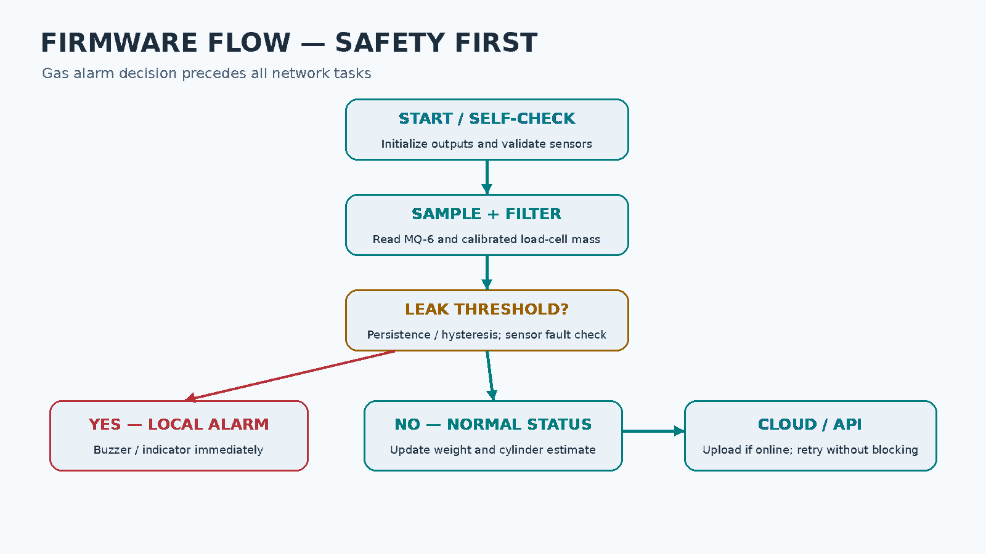
ONEGAURD / SMART LPG SAFETY
05 / 08
Firmware Workflow — Local Safety First
Leak evaluation runs before any network operation
LOCAL ALARM FIRST
SENSOR FAULT ≠ NORMAL
NETWORK IS OPTIONAL
RETRY WHEN ONLINE

Slide 6
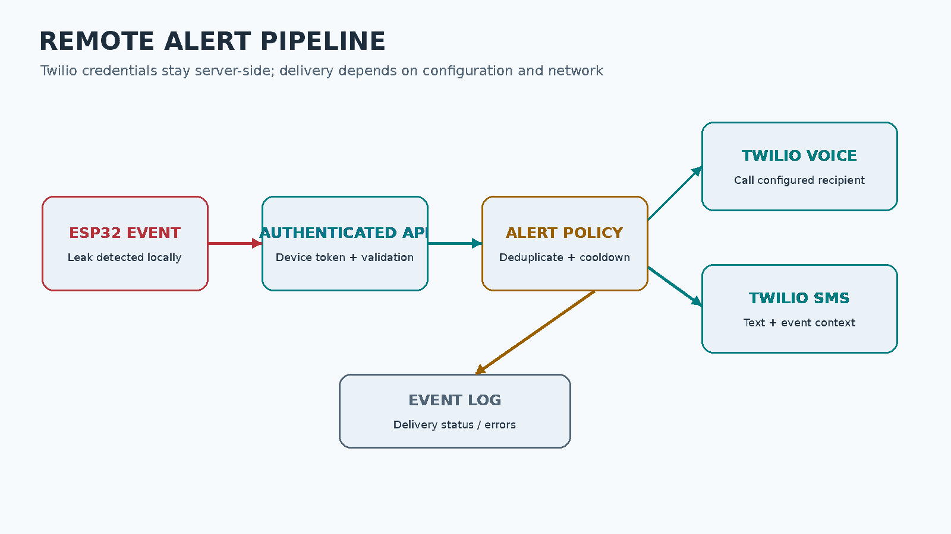
ONEGAURD / SMART LPG SAFETY
06 / 08
Dashboard, Firebase & Twilio Voice/SMS
New alert-pipeline visual; secrets remain on the backend
Dashboard: Dashboard • Devices • Event Log • Settings • Account
Twilio needs valid credentials, verified recipients and delivery tests

Slide 7
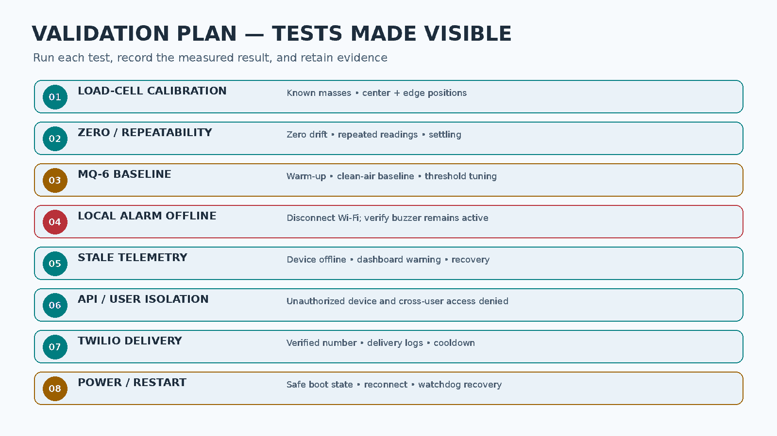
ONEGAURD / SMART LPG SAFETY
07 / 08
Testing & Validation — Evidence Before Claims
Larger test text and dedicated test-plan graphic for clear presentation

Slide 8
ONEGAURD / SMART LPG SAFETY
08 / 08
Calculations, Roadmap & Conclusion
Engineering calculations are explicit; unmeasured performance is not claimed
WEIGHT / CAPACITY CALCULATION
IMPLEMENTATION ROADMAP
Net LPG = Gross mass − Cylinder tare
Remaining % = Net LPG ÷ Rated net capacity × 100
• Calibrate each load-cell assembly and validate MQ-6 threshold
• Test local alarm with Wi-Fi disconnected
• Secure Firebase rules and device authentication
• Verify Twilio call/SMS delivery and error handling
Example dashboard: 23.55 − 15.10 = 8.45 kg
8.45 ÷ 14.2 ≈ 59.5% (about 60%)
MQ-6 ADC is a raw module reading—not ppm—until properly calibrated.
Prototype only — not certified safety equipment. Keep approved LPG safety devices.
Future: battery backup • GSM fallback • refill prediction

