Slide 1
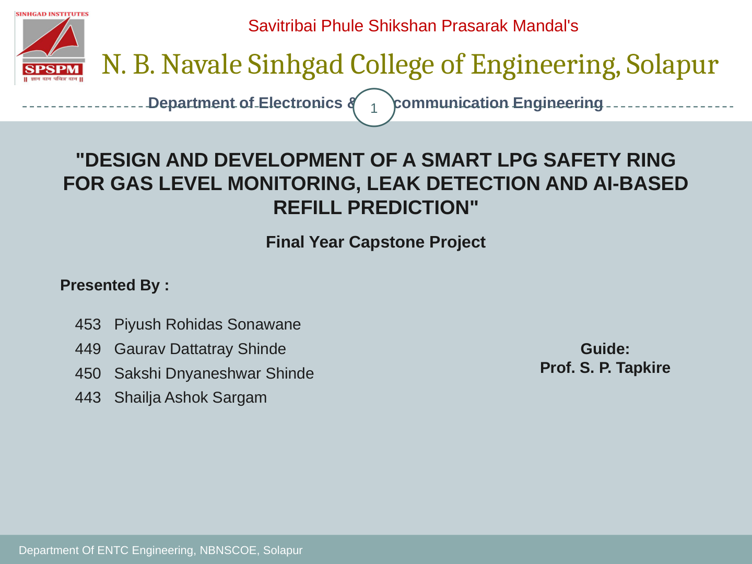
DESIGN AND DEVELOPMENT OF A SMART LPG SAFETY RING
FOR GAS LEVEL MONITORING, LEAK DETECTION AND AI-BASED REFILL PREDICTION
Final Year Capstone Project
Presented By:
453 Piyush Rohidas Sonawane
449 Gaurav Dattatray Shinde
450 Sakshi Dnyaneshwar Shinde
443 Shailaja Ashok Sargam
Project Guide:
Prof. S. P. Tapkire
Department of Electronics & Telecommunication Engineering • NBNSCOE, Solapur

Slide 2
Savitribai Phule Shikshan Prasarak Mandal's | N. B. Navale Sinhgad College of Engineering, Solapur
Introduction, Problem & Objectives
2
LPG is widely used in Indian kitchens, but users may not know the remaining quantity or notice a developing leak in time.
Proposed retrofit ring combines weight sensing, gas sensing, embedded processing and remote alerts.
Objectives: estimate remaining LPG, detect suspected leaks, alert locally and remotely, predict refill timing from usage history, and support backup power.
Research gap: many low-cost systems focus on leak alarms alone; the proposed concept combines leakage and quantity monitoring.
AI prediction and refill booking are proposed capabilities and require implementation and validation.
Department of Electronics & Telecommunication Engineering • NBNSCOE, Solapur

Slide 3
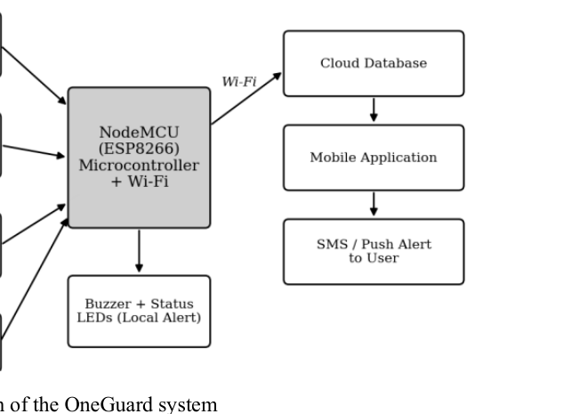
Savitribai Phule Shikshan Prasarak Mandal's | N. B. Navale Sinhgad College of Engineering, Solapur
Literature Review & System Block Diagram
3
Research paper cites IoT gas leakage detection, LPG weight tracking and machine-learning refill prediction.
Load cell + HX711 estimates mass; MQ-6 provides a combustible-gas sensor signal; ESP32 processes readings.
Optional modules in the paper: DHT22, GSM/SIM800L, OLED and battery backup.
Wi-Fi/cloud forwards telemetry to the mobile app; buzzer provides local warning.
Actual hardware must match the final diagram: confirm ESP32/ESP8266, amplifier, load-cell count and optional modules.
Block diagram from supplied research paper, page 6.
Department of Electronics & Telecommunication Engineering • NBNSCOE, Solapur

Slide 4
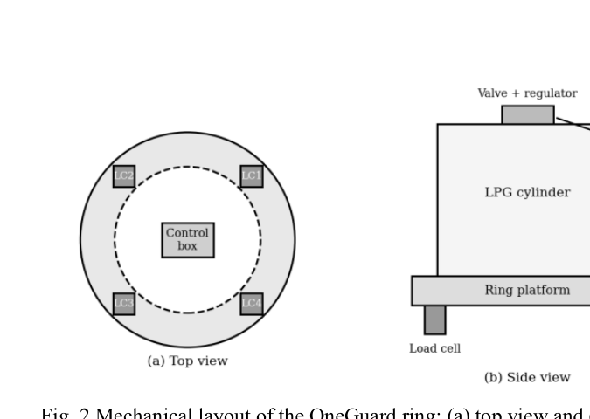
Savitribai Phule Shikshan Prasarak Mandal's | N. B. Navale Sinhgad College of Engineering, Solapur
Hardware Components & Ring Design
4
ESP32: sensor processing and Wi-Fi communication.
MQ-6: LPG-oriented combustible-gas sensing; requires warm-up, calibration and fault handling.
Load cells + HX711: cylinder/platform mass measurement.
Buzzer/LED: local warning; battery backup, GSM and OLED are proposed additions if installed.
Ring mechanics must distribute the load, prevent slipping and remain stable under off-centre placement.
Do not treat a hobby servo or 3D-printed part as a certified LPG shut-off valve.
Mechanical/ring layout from supplied research paper.
Department of Electronics & Telecommunication Engineering • NBNSCOE, Solapur

Slide 5
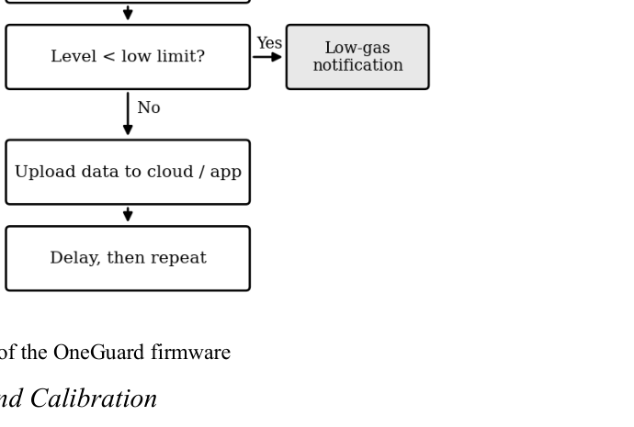
Savitribai Phule Shikshan Prasarak Mandal's | N. B. Navale Sinhgad College of Engineering, Solapur
Firmware Workflow & Safety Logic
5
Initialize ESP32, sensors and outputs in a defined safe state.
Warm up/validate sensors, then sample and filter gas and weight readings.
Evaluate suspected leak locally and activate the local alarm without waiting for internet.
Calculate net gas mass using tare correction; upload timestamped telemetry when connected.
Log events and estimate refill timing only when usage history is sufficient.
On network loss, local safety continues and the app must show stale/offline rather than old data as live.
Firmware flowchart from supplied research paper, page 7.
Department of Electronics & Telecommunication Engineering • NBNSCOE, Solapur

Slide 6
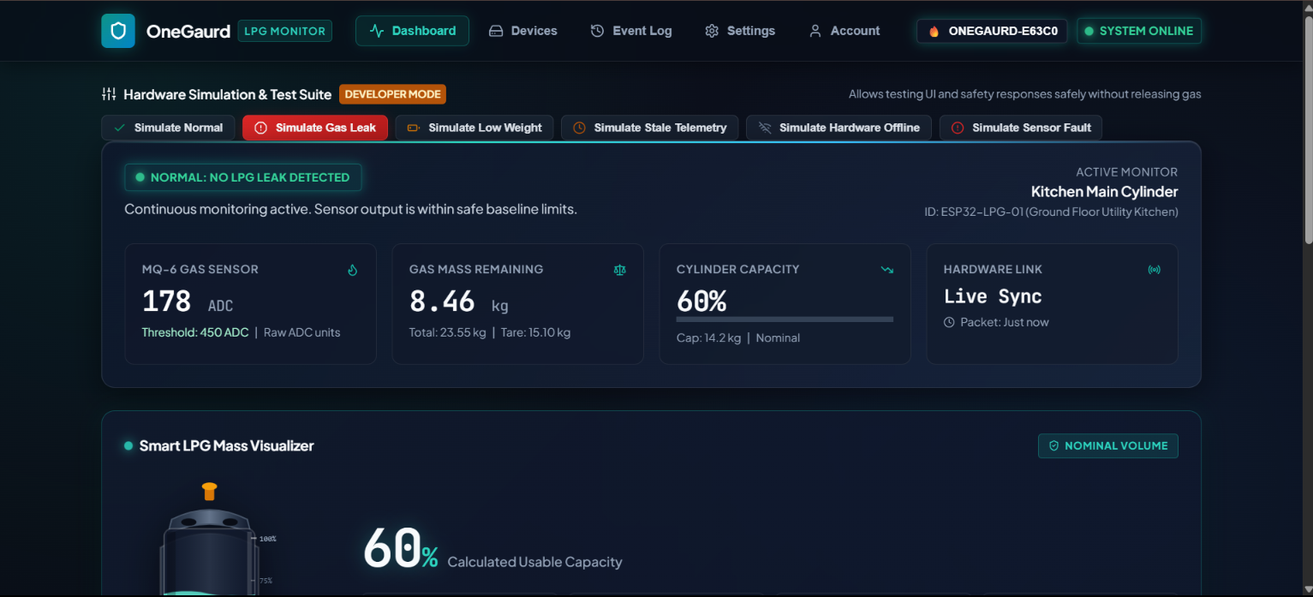
Savitribai Phule Shikshan Prasarak Mandal's | N. B. Navale Sinhgad College of Engineering, Solapur
Cloud, Mobile App & Dashboard
6
Firebase Authentication separates each user's devices and data by UID.
Realtime Database can hold latest telemetry; Firestore can store device metadata, event history and alert-delivery status.
Dashboard presents leak state, last-seen time, raw gas reading, gas mass/percentage, device link and history.
Optional push, SMS and voice alerts depend on network, provider configuration and potential charges.
Security: device credentials map to an owner on the server; never trust owner UID supplied by the device.
Dashboard screenshot values are UI examples; validate against live hardware before claiming measured results.
Dashboard screenshot supplied by the project team.
Department of Electronics & Telecommunication Engineering • NBNSCOE, Solapur

Slide 7
Savitribai Phule Shikshan Prasarak Mandal's | N. B. Navale Sinhgad College of Engineering, Solapur
Measurement Calculations, Testing & Visual QA
7
Measurement logic
Required validation
Net gas mass = total measured mass − cylinder tare.
Remaining % = net gas mass ÷ configured gas capacity × 100.
Example dashboard: 23.55 − 15.10 = 8.45 kg; displayed 8.46 kg should be reconciled.
8.46 ÷ 14.2 ≈ 59.6%, consistent with the displayed 60%.
Raw ADC is not ppm; calibrated concentration needs sensor-specific validation.
Calibrate load cells using known reference masses and record error/repeatability.
Test stale/offline behavior, reconnects, sensor faults and alert deduplication.
Measure response time and power consumption; do not invent results.
Never test by uncontrolled LPG release.
Local alarm must remain operational without Wi-Fi/cloud.
Department of Electronics & Telecommunication Engineering • NBNSCOE, Solapur

Slide 8
Savitribai Phule Shikshan Prasarak Mandal's | N. B. Navale Sinhgad College of Engineering, Solapur
Conclusion, Future Scope & References
8
OneGaurd aims to combine leak detection, weight-based gas estimation, remote monitoring and refill prediction in a retrofit ring.
Future scope from the research paper: smart-home integration, solar-assisted backup, voice assistant/SOS, distributor booking integration and improved ML anomaly detection.
Priorities: verify hardware, calibrate sensors, secure user/device data, and test local safety behavior offline.
References listed in the supplied paper include Manjunathan et al. (ICSCDS 2023), IoT gas leakage detection (2019), intelligent LPG regulator monitoring (2025), AI-enabled LPG monitoring (2025), and LPG refill-frequency prediction (Heliyon/ScienceDirect, 2023). Verify bibliographic metadata before submission.
Thank you — Questions & Discussion.
Department of Electronics & Telecommunication Engineering • NBNSCOE, Solapur

