Slide 1
Project- Name - My Study Point
Piyush mishra (2002900100105 / CSE / 3CSB)
Aman kumar verma (2002901540013 / csds / csds-a)

Slide 2
Objective
1:Academic Resources:
Showcase the wide range of academic resources available on Study Point. Emphasize the variety of subjects covered, for all branch.
2:Exam Preparation:
Demonstrate how Study Point can help students prepare for exams. Discuss the availability of past exam papers, sample questions, and revision materials.

Slide 3
Objective
3:Personalized Learning:
Highlight the personalized learning aspect of Study Point. Explain how the website adapts to each student's individual learning style, pace, and preferences. Discuss the use of algorithms and data analytics to provide tailored recommendations and suggestions for further study.
4:Student Success Stories:
Share success stories and testimonials from students who have benefited from using Study Point. Highlight their academic achievements, improved grades, and increased confidence as a result of utilizing the website's resources.

Slide 4

Layout Nav Bar

Slide 5
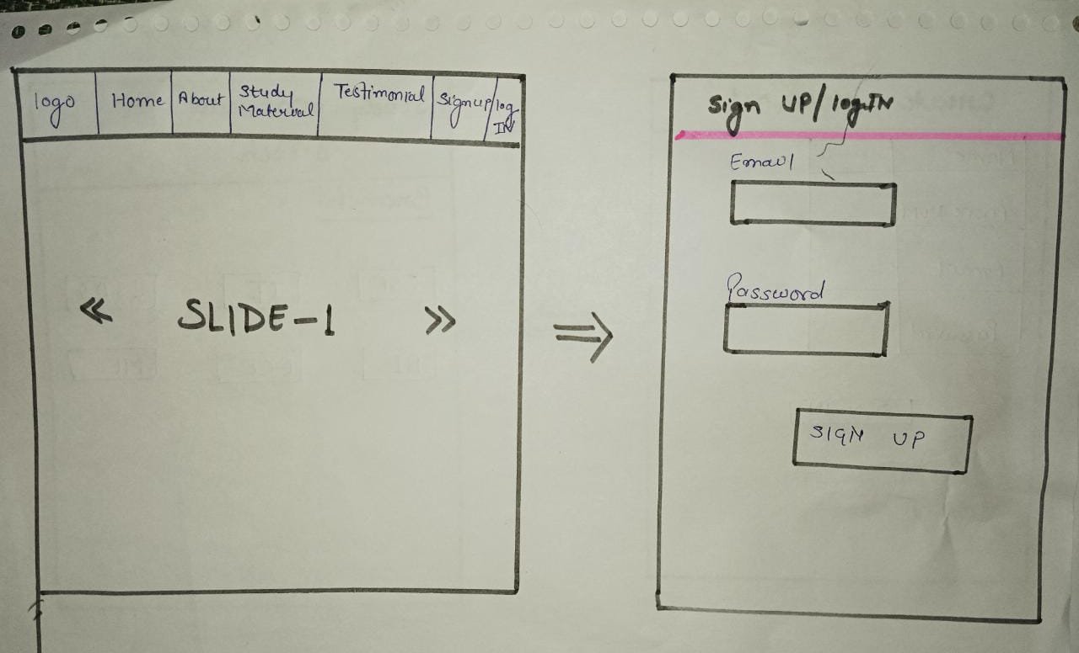
Layout

Slide 6
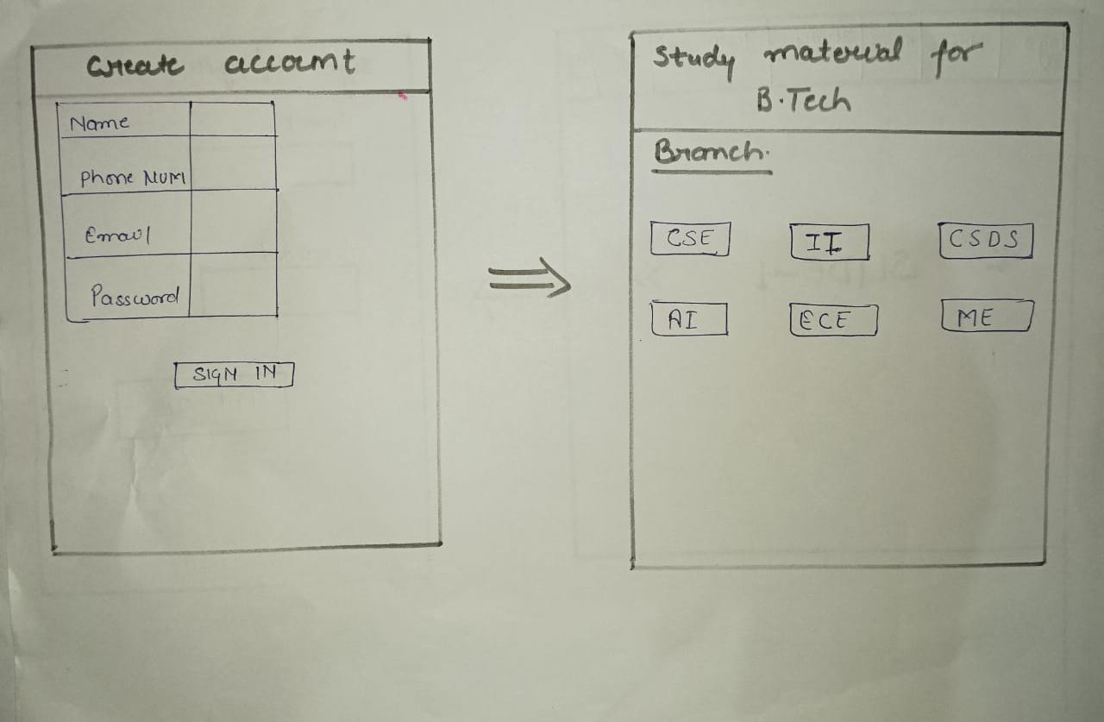
Layout

Slide 7
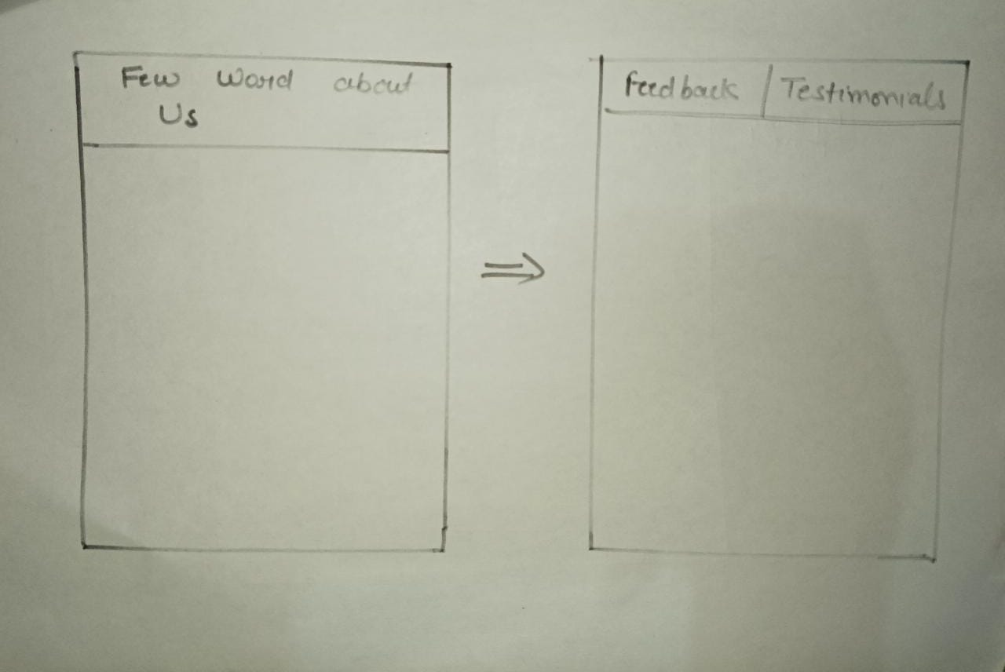
Layout

Slide 8
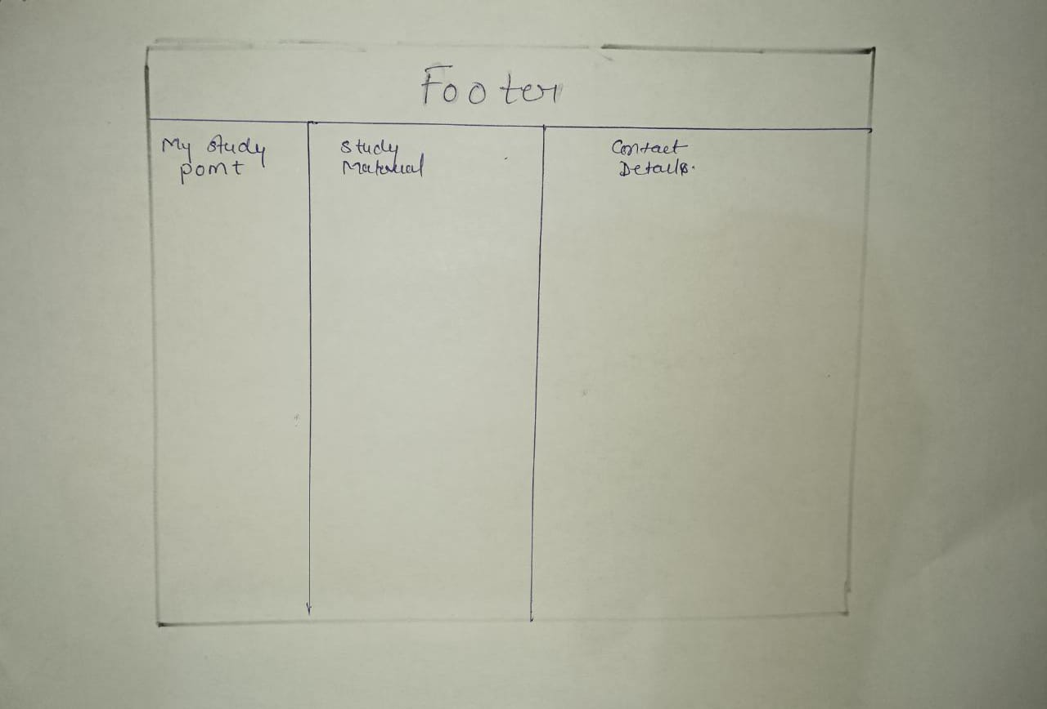
Layout

Slide 9
Sign up
Name:
Phone Num:
Mail Id:
Password
Submit

Slide 10
Card
Branch
CSE
IT
CSDS
AI

Slide 11
Footer
About My Study Point Study Material Contact Details
Welcome to our Study CSE 7800470577
Point Website! IT piyush@gmail.com
Here, we strive to
Provide a comprehensive
And engaging resource for
Students.

Slide 12
Details about components
Nav bar:-
A navigation bar is a section of a graphical user interface intended to aid visitors in accessing information.
Navigation bars are implemented in operating systems, file browsers, web browsers, apps, web sites and other similar user interfaces.

Slide 13
Details about component
Carousel:-
The carousel is a slideshow for cycling through a series of content, built with CSS 3D transforms and a bit of JavaScript.
It works with a series of images, text, or custom markup. It also includes support for previous/next controls and indicators.

Slide 14
Details about component
Grids:-
uses a series of containers, rows, and columns to layout and align content.
Cards:-
A card is a flexible and extensible content container. It includes options for headers and footers, a wide variety of content, contextual background colors, and powerful display options.
Footer:-
A footer is an additional navigation method for websites. It can hold links, buttons, company info, copyrights, forms and many other elements.

Slide 15


