Slide 1

Wealth Management
Report for Analytical insights
TEAM 15
Alexandra George Piyush Kumar Ruoyan Chen Takashi Konishi

Slide 2

Agenda
1 Our clients
2 Rate of Return and Risk
3 Correlation
4 Financial Advice
5 Rebalancing

Slide 3
Our Clients
Edson Antonio da Silva Filho
Kengo Sugaya
3 accounts
Six years experience
2 accounts
Two years experience
Heba Faddah
Lucas Ezequiel de Ortuzar
3 accounts
Seven years experience
2 accounts
One year experience

Slide 4

Rate of return and Risk
Name | return_12m | return_18M | return_24M | sigma_12m | risk_adjusted_return_12m
Edson Antonio da Silva Filho | 0.0087 | 0.0106 | 0.0123 | 0.323 | 0.024
Kengo Sugaya | 0.0039 | 0.0048 | 0.0055 | 0.344 | 0.016
Heba Faddah | 0.0088 | 0.0108 | 0.0125 | 0.307 | 0.022
Lucas Ezequiel de Ortuzar | 0.0051 | 0.0062 | 0.0071 | 0.237 | 0.019

Slide 5
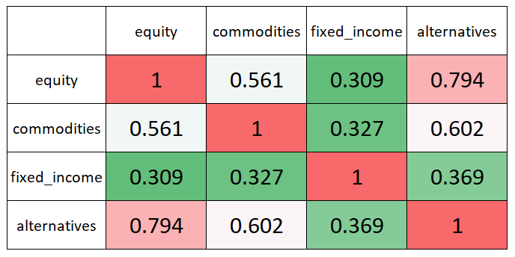
Correlations
Kengo Sugaya's case
Positive?
Negative?
Non-correlated?

Slide 6
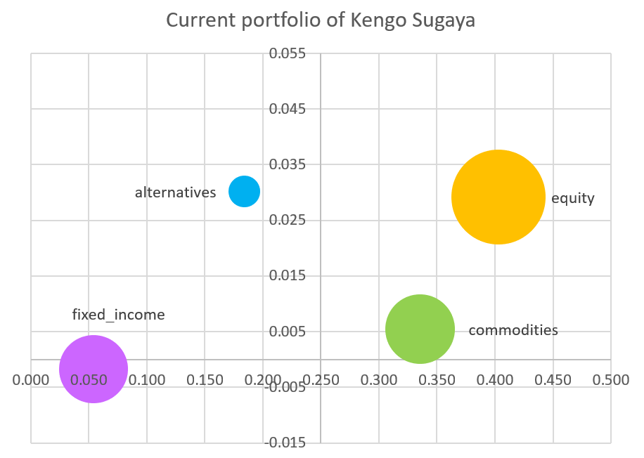
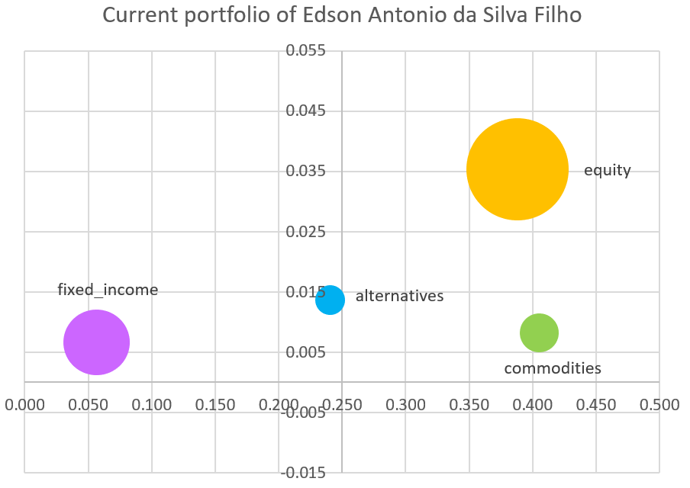
Current Porfolio
Kengo's Portfolio
Edoson's Portfolio

Slide 7
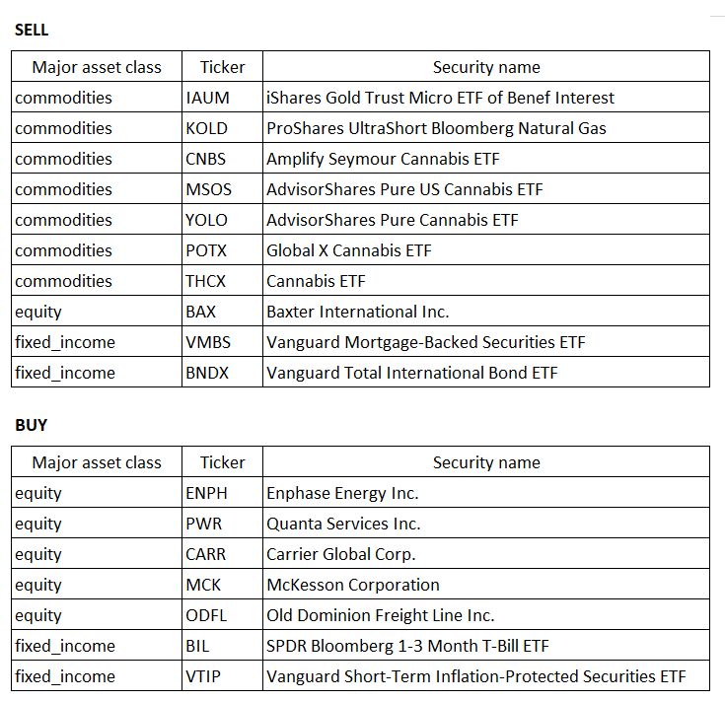
Recommendation

Slide 8
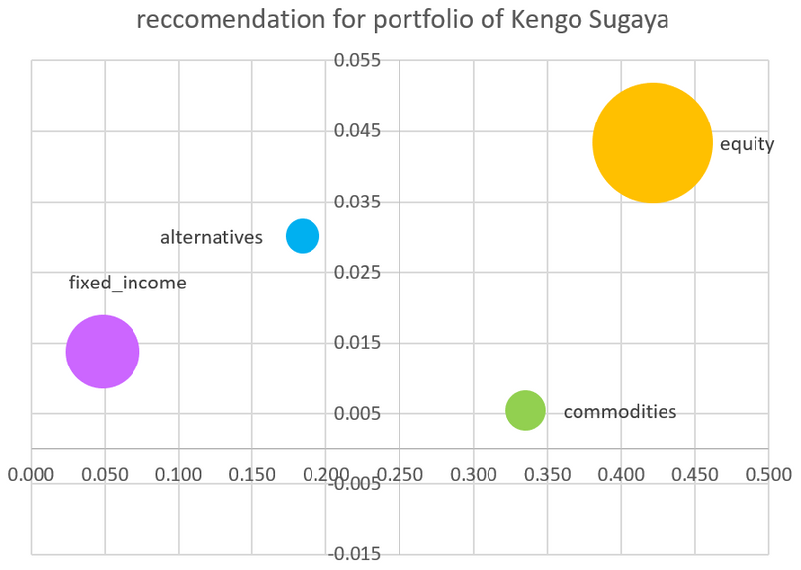
Rebalancing
Risk Adjusted Return Before
1.6%
Risk Adjusted Return After
2.3%

Slide 9

Thank You

