Slide 1

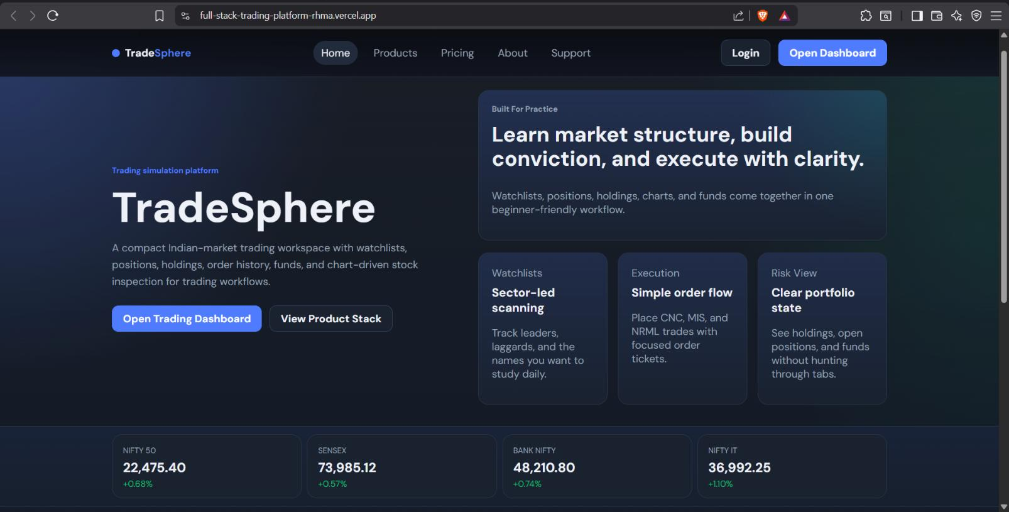
TradeSphere
MCA-II · SEM-IV · PROJECT REPORT · 2025–2026
Trading Sphere
A Full Stack Trading Platform
A three-tier-application, risk-free Indian equity trading simulation built with React, Node.js, Express & MongoDB, deployed on the cloud.
NIFTY 50
SENSEX
BANK NIFTY
NIFTY IT
22,475 ▲
73,985 ▲
48,210 ▲
36,992 ▲
PRESENTED BY
Piyush Kiran Oswal
Live deployment · full-stack-trading-platform-rhma.vercel.app
Roll No. 26424
Seat No. 53236

Slide 2




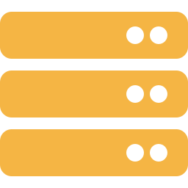
01 · INTRODUCTION
TradeSphere
What is Trading Sphere?
Trading Sphere replicates the complete lifecycle of a real Indian retail trading session from registration and stock discovery to order placement, portfolio review and fund management in a fully simulated, risk-free environment.
THE THREE-TIER APPLICATION ARCHITECTURE
Public Website
Home · Products · Pricing · About · Support
Three-tier application
↓
Presentation, logic and data tiers, deployed as independent applications.
Trading Dashboard
Live-like market data
Watchlist · Holdings · Positions · Orders · Funds · Admin
Enriched via the Upstox API with an automatic seeded fallback.
↓
Secure & role-based
Backend API
JWT authentication with protected routes and an admin control panel.
Node.js + Express · REST · Auth · Market data service
Trading Sphere · A Full Stack Trading Platform
01

Slide 3








02 · MOTIVATION
TradeSphere
The Problem & The Need
THE PROBLEM
THE NEED
Learning to trade safely is hard
A realistic, risk-free trading platform
Real-money risk
True-to-life workflows
Beginners must open live brokerage accounts and risk real capital just to learn.
Stock search, buy/sell, holdings, positions, funds & order tracking end to end.
Shallow simulators
One complete full-stack project
Existing paper-trading tools don't reflect real order, portfolio and fund workflows.
Frontend, backend, database, auth, API integration & cloud deployment together.
Isolated academic work
Secure by design
Most projects show only frontend or backend never an integrated full-stack system.
JWT authentication and role-based access protect user and admin operations.
Single point of failure
Always available
Platforms that depend entirely on a live market API break when that API is down.
A seeded local dataset keeps every feature working even without the live API.
Trading Sphere · A Full Stack Trading Platform
02

Slide 4


03 · GOALS
TradeSphere
Project Objectives
01
02
03
Public-facing website
Secure authentication
Core trading engine
Communicate features, pricing and purpose to prospective users.
JWT-based login giving users a personalised trading dashboard.
Search stocks, place buy/sell orders, manage holdings, positions & funds.
04
05
06
Scalable backend API
Market Data Integration
Admin & deployment
Modular routes for auth, orders, portfolio and admin operations.
Integrate the Upstox API for live stock quotes, search and market overview.
Admin panel for oversight; three apps deployed as cloud services.
Trading Sphere · A Full Stack Trading Platform
03

Slide 5
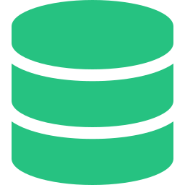

04 · DESIGN
TradeSphere
Three-Tier System Architecture
Public Website
Trading Dashboard
PRESENTATION
React + Vite
React + Vite
Frontend Layer
Home · Products · Pricing · About · Support
Watchlist · Holdings · Positions · Orders · Funds · Admin
Backend API · Node.js + Express.js
LOGIC
Backend Layer
REST Endpoints
JWT Auth
Role-Based Access
Order Processing
Market Data Service
Validation & Errors
DATA
MongoDB Atlas
Upstox API
Data Layer
Cloud database
External market service
Users · Orders · Holdings · Positions · Funds · Watchlists
Live quotes · company info → seeded fallback when unavailable
HTTPS / REST between every tier · stateless serverless backend
Trading Sphere · A Full Stack Trading Platform
04

Slide 6

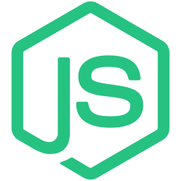





05 · TOOLING
TradeSphere
Technology Stack
FRONTEND
BACKEND
DATABASE
INTEGRATE & DEPLOY
React
Node.js
MongoDB
Upstox API
UI library
Runtime
NoSQL store
Market data
Vite
Express
Mongoose
Vercel
Build tool
API framework
ODM / schemas
Serverless host
Axios
JWT + bcrypt
Atlas
Git + GitHub
HTTP client
Auth & hashing
Cloud cluster
Version control
Trading Sphere · A Full Stack Trading Platform
05

Slide 7






06 · DATA MODEL
TradeSphere
Database Design
Seven Mongoose-modelled collections in MongoDB Atlas, centred on the User entity. Schemas enforce validation, defaults and relationships across the platform.
User
Order
Holding
name · email · password · role · pan · availableFunds
symbol · qty · price · mode · type · exchange · status
symbol · qty · avgPrice · currentPrice · dailyReturn
Position
Fund Transaction
Watchlist
symbol · qty · buyPrice · currentPrice · productType
type · amount · status · remark · createdAt
userId · symbol · companyName · addedAt
Market Stock
Hosted on MongoDB Atlas
symbol · company · exchange · sector · price
M0 free-tier cluster · live & queryable
Trading Sphere · A Full Stack Trading Platform
06

Slide 8





07 · MODULES
TradeSphere
Core Platform Features
Watchlist
Holdings
Positions
Orders
Search & track instruments by symbol or company name.
Delivery-based portfolio with avg price, LTP & P&L.
Active intraday / product-specific open exposures.
Full buy & sell order history with status & timestamps.
Funds
Summary
Profile
Admin Panel
Add / withdraw funds with full transaction history.
KPI cards, allocation donut & 30-day performance chart.
Editable name, phone, PAN & avatar management.
Platform-wide view of users, orders, holdings & positions.
Trading Sphere · A Full Stack Trading Platform
07

Slide 9

08 · SECURITY
TradeSphere
Authentication Flow (JWT)
1
2
3
4
5
6
7
Login request
Server validation
JWT generated
Token stored
Auth request
Token verified
Access granted
User submits email & password
Credentials checked against DB
Signed token issued to client
Held in client local storage
Token sent in Authorization header
Signature, expiry & role checked
Protected response returned
bcrypt password hashing
Signed JWT secret
Role-based access (RBAC)
Passwords are never stored in plaintext.
Token secret lives only in backend env vars.
Admin routes require an admin role else 403.
Trading Sphere · A Full Stack Trading Platform
09

Slide 10
9 · INTEGRATION
TradeSphere
Upstox API Integration
The backend integrates with the Upstox API to retrieve real-time stock information powering search, quotes, market overview and detailed price data throughout the trading dashboard.
Dashboard request
Backend API
Upstox API
Live market data
User searches a stock or loads market data.
Prepares & routes the market-data request.
Fetches live quotes via bearer-token auth.
Real-time data rendered on the dashboard.
WHAT THE UPSTOX API POWERS
Stock search
Market quotes
Market overview
Price details
By symbol or company name
Live prices & day change
Gainers, losers & indices
52-week, day high / low, volume
Robust error handling on every external call keeps the trading experience smooth and uninterrupted.
Trading Sphere · A Full Stack Trading Platform
10

Slide 11



10 · QUALITY
TradeSphere
Testing & Validation
10
20
0
4
Automated tests
Manual test cases
Critical failures
Layers verified
passed
executed
across modules
FE · BE · DB · API
Automated backend
Manual functional
Environment config, JWT & admin middleware, stock helpers and market-data merge logic run via the Node test runner.
Registration, login, protected routes, search, watchlist, funds, buy/sell, holdings, profile & admin access.
API & database
Responsive UI
Endpoints verified in Postman; correct storage & retrieval confirmed in MongoDB Atlas.
Layout, navigation and usability validated across desktop and mobile screen widths.
Trading Sphere · A Full Stack Trading Platform
11

Slide 12




11 · WRAP-UP
TradeSphere
Conclusion & Future Scope
FUTURE ENHANCEMENTS
CONCLUSION
Objectives achieved
Real-time price streaming
WebSocket-based live quotes & candlestick updates.
Trading Sphere was successfully built as a complete, risk-free stock-trading simulation unifying frontend, backend, database, authentication, trading workflows, external API integration and cloud deployment in a single platform.
AI insights
Stock prediction & recommendation engine.
Native mobile apps
Secure JWT auth & role-based admin access
Dedicated Android & iOS clients.
Real-time market data via Upstox API integration
Two-factor auth
Modular, scalable three-app architecture
Stronger account security via 2FA.
Live, publicly deployed on Vercel + Atlas
Microservices + containers
Containerised, independently scalable services.
Trading Sphere · A Full Stack Trading Platform
12

Slide 13
TradeSphere
THANK YOU
Questions & demonstration welcome.
Live Deployment
Source Code
full-stack-trading-platform-rhma.vercel.app
github.com/Piyush98906/full-stack-trading-platform
Piyush Kiran Oswal · MCA-II (Sem-IV) · Roll No. 26424 · Dr. D. Y. Patil School of MCA

