Slide 1
Short-Term Electricity Demand and Solar Generation Forecasting for Grid Stability
Predictive Analytics, Duck Curve Dynamics, Feeder Simulation, and Forecast-Informed Storage Optimization
SolarCast-Grid Framework | Real SCADA Telemetry (2021–2025) | IEEE 33-Bus Feeder | HiGHS 24h LP
Presenter: Piyush Agrawal | Affiliation: Department of Electrical & Computing Sciences
Scientific Provenance Tags: [OBSERVED] SCADA • [DERIVED] Analytics • [FORECAST] ML • [SIMULATED] AC Power Flow • [OPTIMISED] LP
Notes:
Welcome everyone. Today I am presenting our work on Short-Term Electricity Demand and Solar Generation Forecasting for Grid Stability, encapsulated in the SolarCast-Grid framework. We address one of the most critical challenges facing the clean energy transition: how to translate macro-scale national SCADA forecasts into physical, violation-free storage schedules that stabilize local distribution grids.

Slide 2
PROBLEM STATEMENT & MOTIVATION
The Challenge: Solar Intermittency & Grid Stability Bottlenecks
1. Macro Solar Influx
• Rapid expansion of variable solar PV across the Indian power grid.
• Solar share of daily energy grew from 6.4% (2021) to 9.3% (2025).
• Zero-marginal-cost solar displaces baseload during midday hours.
• Extreme non-linearity and weather sensitivity induce steep grid ramp events.
2. The Indian Duck Curve
• Midday 'belly' has permanently displaced nighttime minimum since 2022.
• Evening 3-hour net-load ramp escalated from 20.7 GW to 33.2 GW mean in 2025.
• Historical peak 3-hour ramp reached 50.6 GW (March 5, 2025).
• Requires massive ramping flexibility from thermal and hydro fleets.
3. Local Feeder Crisis
• High rooftop & distributed PV causes reverse power flow back into substations.
• Leads to severe overvoltage (V > 1.05 p.u.) and thermal line overloading.
• Forces massive, wasteful solar curtailment when export headroom is capped.
• Research Goal: Can ML forecasts guide BESS dispatch to eliminate curtailment?
Notes:
Slide 2 outlines the motivation. The problem has two connected dimensions: First, at the national transmission level, rapid solar adoption creates the classic Duck Curve with a brutal 33 GW evening ramp. Second, at the local distribution feeder level, excess solar causes reverse power flow and overvoltage, forcing utilities to curtail clean energy. Our research bridges this gap by testing whether accurate machine learning forecasts can drive physical battery storage to mitigate both challenges simultaneously.

Slide 3
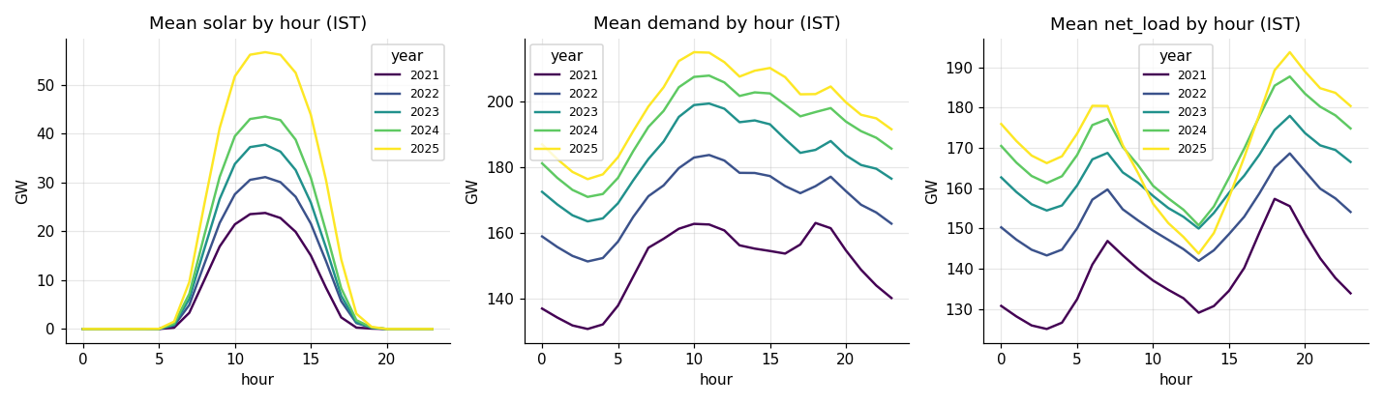
DATA ENGINEERING [OBSERVED / DERIVED]
Grid-India SCADA Telemetry & Rigorous Ingestion Pipeline
Data Integrity & Pipeline Architecture
• Source: Grid-India / NERLDC SCADA via Mendeley Data (Sep 2021 – Jun 2025).
• Scale: 4,075,224 raw telemetry samples resampled to 33,432 clean hourly records.
• Hampel Spike Filter: Rolling median ± 6·MAD at raw resolution removes sensor noise.
• Solar Night Offset: Zeroed 11,144 night hours and eliminated nocturnal transducer drift.
• Physical Bounds & Zero Checks: Fixed negative solar; flagged dropouts.
• Leak-Free Splits: Chronological split into Train (2021–2024), Val (2024 H2), and Test (2025 H1).
• Provenance: Every variable explicitly classified as OBSERVED or DERIVED.
Notes:
Slide 3 describes the dataset. We built our framework on 4.07 million raw SCADA records from Grid-India spanning nearly four years. We applied a multi-stage cleaning pipeline: Hampel outlier filtering, removal of nighttime sensor drift, and hourly energy-consistent resampling. Crucially, we enforced strict chronological train-validation-test splits to ensure absolute leak-safety with zero lookahead bias.

Slide 4
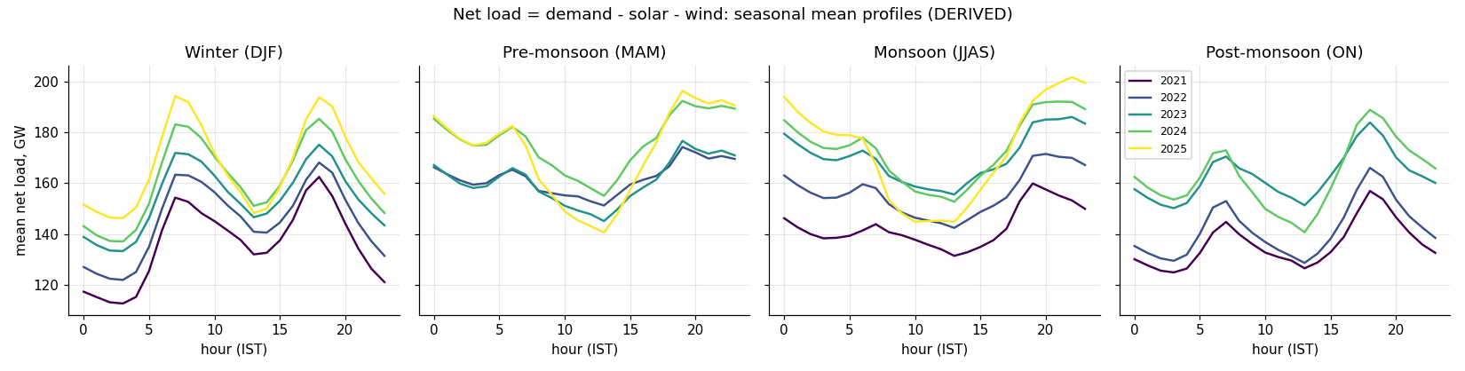
GRID DYNAMICS [DERIVED / SCENARIOS]
Empirical Duck Curve Dynamics & Surplus-Solar Risk Proxy
Empirical Findings & Capacity Scenarios
• Diurnal Net-Load Inversion: Since 2022, net-load minimum occurs at 13:00 IST instead of 03:00 night.
• Ramp Escalation: Mean 3-hour evening ramp grew from 20.7 GW (2023) to 33.2 GW (2025).
• Peak Event: 50.6 GW ramp on 2025-03-05 (requires massive dispatchable response).
• Surplus-Solar Risk Formulation: Modeled inflexible generation floor F_t (CEA technical min 55%/40% + nuclear + run-of-river hydro).
• Current Fleet (k=1): Zero surplus hours observed in the historical fleet.
• Future Buildout (k=2): Surplus emerges at 0.20% of solar generation.
• Future Buildout (k=3): Surplus surges to 9.15% (requiring widespread storage).
Notes:
On Slide 4, we quantify India's emerging Duck Curve. The chart shows net load by hour across seasons. Notice the deep depression during the middle of the day and the steep ramp starting at 16:00. Our surplus risk proxy proves that while today's fleet barely faces curtailment, scaling solar by 2x to 3x causes surplus risk to leap to over 9% of total solar energy, making proactive storage deployment mandatory.

Slide 5
PREDICTIVE ANALYTICS [FORECAST]
Multi-Horizon Machine Learning Forecasting Framework
Targets & Horizons
• 8 Core Prediction Tasks:
• • Solar Generation (MW)
• • Electricity Demand (MW)
• • Wind Generation (MW)
• • Net Load (MW)
• Two Operational Horizons:
• • 1-Hour Ahead (h=1): real-time balancing & ramp regulation.
• • Day-Ahead (h=14–37): 24h schedule issued at 10:00 IST on Day D for D+1.
Leak-Safe Features
• Strict Issue-Time Filtering: Only data up to 10:00 IST available for Day-Ahead.
• Calendar Harmonics: Sin/cos encoding for hour, weekday, day-of-year.
• Autoregressive Lags: 24h, 48h, 168h lags reflecting diurnal and weekly cycles.
• Rolling Statistics: Moving averages and standard deviations across past windows.
• Capacity Growth Proxy: Rolling 30-day maximum solar to track capacity expansion.
Model Suite Benchmarked
• Standard Baselines: Persistence and Seasonal-Naive (24h and 168h).
• Linear Regularization: Ridge regression with level-ratio scaling.
• Tree Ensembles: Random Forest and HistGradientBoosting.
• Advanced Gradient Boosters: LightGBM and XGBoost with early stopping.
• Deep Sequence Network: Multi-layer PyTorch LSTM sequence model.
• Conformal Prediction: 80% split-conformal prediction intervals.
Notes:
Slide 5 outlines our forecasting methodology. We established a rigorous 8-task benchmark comparing baselines, linear Ridge, tree ensembles, LightGBM, XGBoost, and deep LSTM networks. Crucially, Day-Ahead models operate under real-world market rules: they are issued at 10:00 AM on Day D for the entirety of Day D+1, meaning leads range from 14 to 37 hours with zero subsequent data leakage.

Slide 6
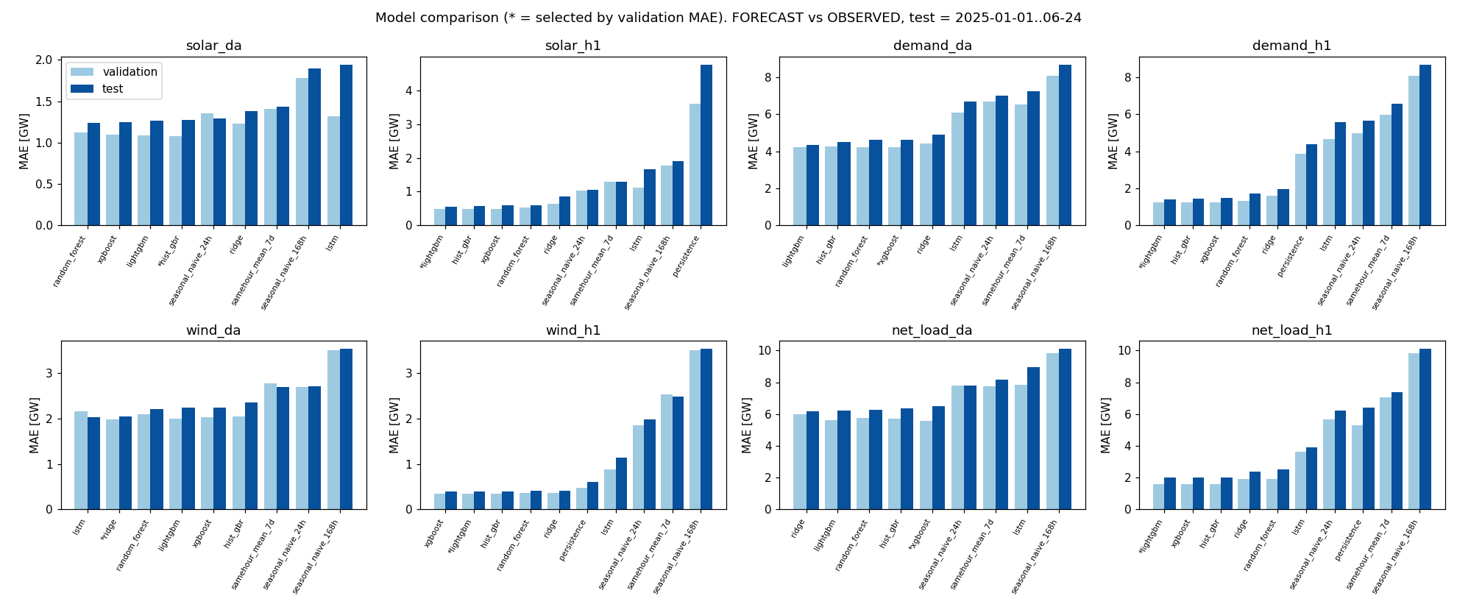
BENCHMARK RESULTS [FORECAST VS OBSERVED]
Forecasting Benchmark: Tree Ensembles Dominate Sequences
Out-of-Sample Test Evaluation
• Solar Day-Ahead: HistGB selected; Test MAE = 1,277 MW (R² = 0.988).
• Solar 1-Hour Ahead: LightGBM selected; Test MAE = 559 MW (R² = 0.998), beating baseline by +47.0%.
• Demand Day-Ahead: XGBoost selected; Test MAE = 4,631 MW (R² = 0.887), beating baseline by +33.9%.
• Demand 1-Hour Ahead: LightGBM selected; Test MAE = 1,427 MW (R² = 0.989), beating baseline by +67.6%.
• Net Load 1-Hour Ahead: LightGBM achieves 2,016 MW MAE (+67.7% gain).
• Tabular vs Deep Learning: Boosted decision trees consistently outperformed the LSTM across all tasks.
• Weather Impact: Numerical weather prediction reduced day-ahead solar MAE by 10.5%.
Notes:
Slide 6 presents our forecasting results on the 6-month out-of-sample test period. LightGBM and XGBoost dominated across the board. For 1-hour demand and net load, LightGBM achieved a massive 67% error reduction over standard operational baselines. Interestingly, the deep LSTM was not selected for any task—the tabular feature engineering allowed tree ensembles to generalize far better on this hourly tabular dataset.

Slide 7
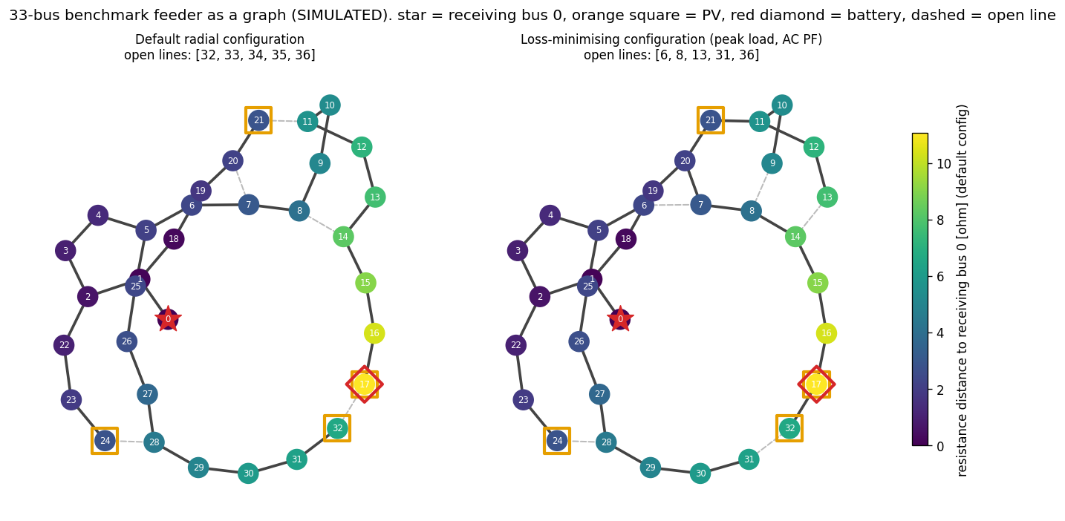
POWER SYSTEMS [SIMULATED]
Distribution Grid Simulation: IEEE 33-Bus Feeder
Feeder Parameterization & Graph Topology
• Benchmark Feeder: IEEE / Baran-Wu 33-bus 12.66 kV network implemented in pandapower.
• Feeder Loading: Base peak load of 3.715 MW and 2.300 MVAr across 32 load buses.
• Distributed PV Buildout: 4 solar generation sites (1.5 MW each = 6.0 MW total, representing 161% solar penetration).
• Graph Topology (NetworkX): 37 branches, 5 tie switches, giving 50,751 valid radial configurations.
• Optimal Battery Siting: Graph betweenness centrality & loss sensitivity identified bus 14 as the optimal battery location.
• Network Reconfiguration: Branch-exchange switching cuts peak losses by 31.1% compared to base topology.
Notes:
Moving to Slide 7, we test how these forecasts interact with a physical distribution network. We modeled the IEEE 33-bus benchmark feeder using pandapower and NetworkX. We integrated 4 solar plants totaling 6 MW on a 3.7 MW feeder to intentionally induce reverse power flows. Graph analysis identified the optimal battery bus, and feeder reconfiguration demonstrated that optimal tie-switch selection alone reduces peak losses by 31%.

Slide 8
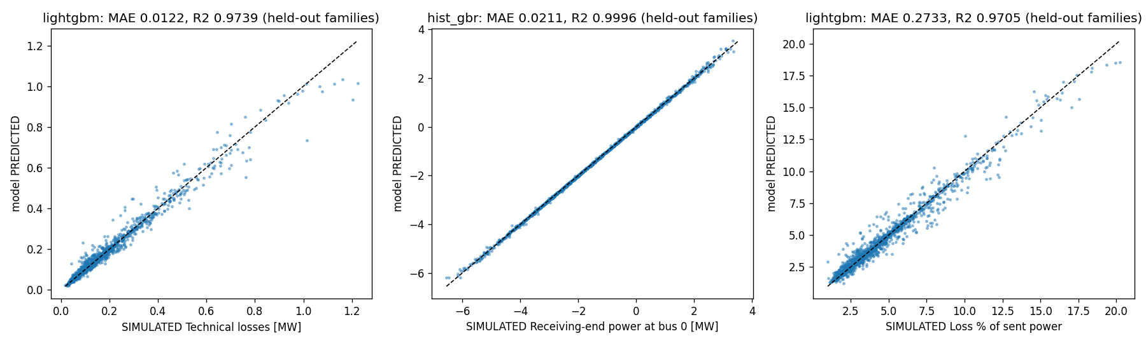
SURROGATE MODELING [SIMULATED LABELS]
Surrogate Machine Learning for Real-Time Power Flow
Fast Physics-Informed ML Surrogates
• Training Dataset: 12,000 converged AC Newton-Raphson power flows across diverse load, solar, and battery conditions.
• Leak-Safe Target Formulation: No line voltages or flows used as features; only dispatchable injections and network IDs.
• Technical Loss Prediction: LightGBM achieves Test MAE = 12.2 kW and R² = 0.974.
• Substation Receiving Power (Bus 0): HistGradientBoosting achieves Test MAE = 21.1 kW and R² = 0.9996.
• Held-Out Generalization: Evaluated on unseen scenario families and verified against 886 fresh AC power flow simulations.
• Computational Advantage: Delivers 1,000x faster loss estimates than running full AC power flow.
Notes:
Slide 8 presents our surrogate machine learning models. Full non-linear AC power flow is computationally expensive. We trained surrogate regressors on 12,000 simulated scenarios. LightGBM predicts feeder technical losses with an R-squared of 0.974, and HistGradientBoosting predicts receiving-end power with an R-squared of 0.9996. These surrogates provide millisecond-speed loss estimations for operational monitoring.

Slide 9
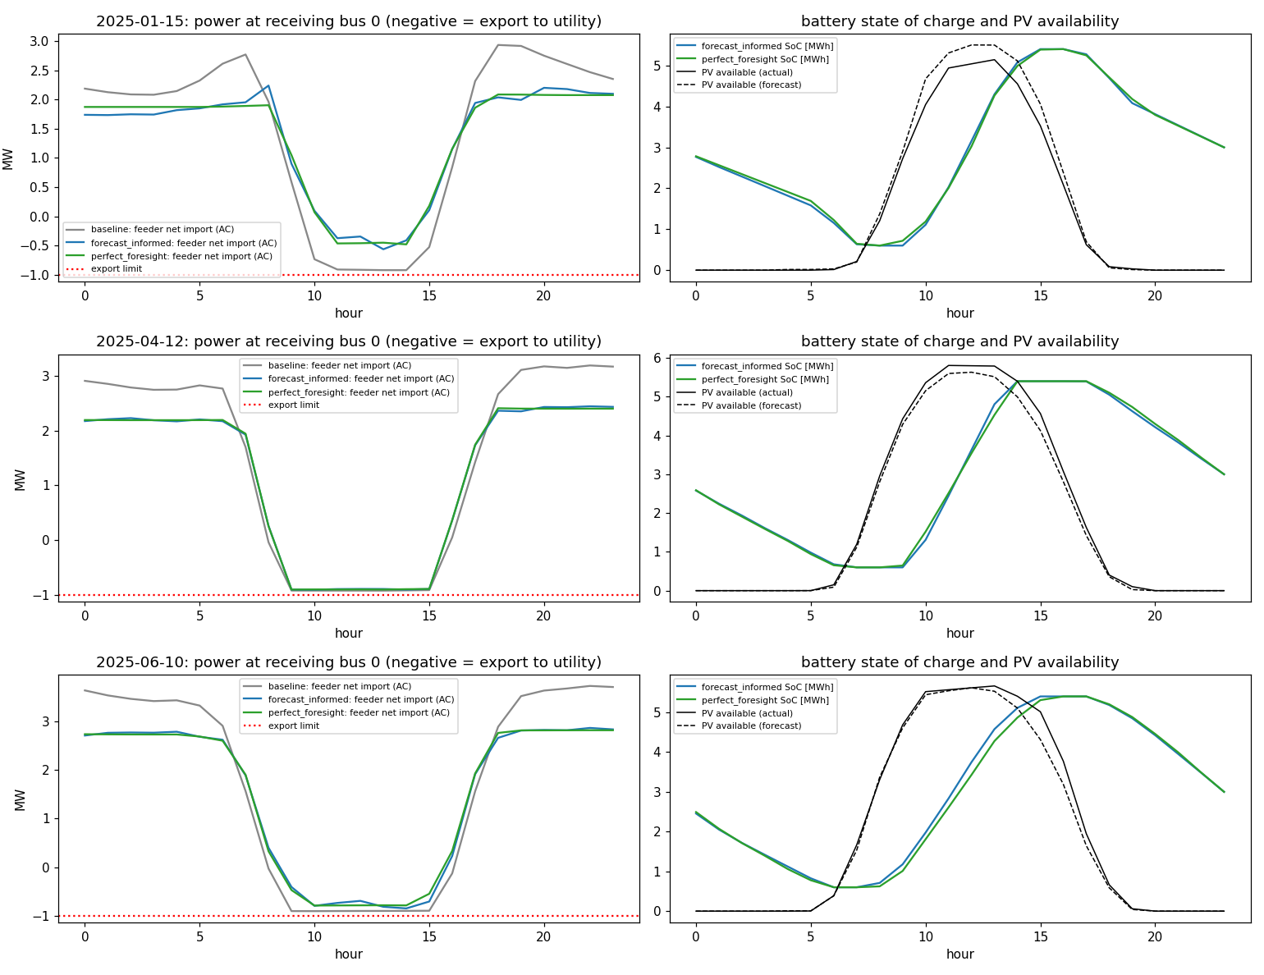
OPTIMIZATION ENGINE [OPTIMISED]
Forecast-Informed 24-Hour Battery & Demand Optimization
Formulation & Real-World Execution
• Mathematical Program: 24-hour Linear Program (LP) solved via HiGHS.
• Decision Variables: Battery charge/discharge (1.5 MW / 6 MWh), flexible load shift (±10%), and solar curtailment.
• Objective: Minimize total solar curtailment + weighted technical losses + peak grid import costs + evening ramp stress.
• Physical Constraints: Battery SoC dynamics, C-rate bounds, LinDistFlow branch voltage limits, and 1.0 MW export limit at bus 0.
• Two-Stage Operational Reality:
• 1. Plan Stage: Day-ahead schedule built strictly using forecasted load & solar.
• 2. Realization Stage: Schedule dispatched on actual realized solar & demand.
• Slack Tracking: Slacks record if forecast errors force constraint violations.
Notes:
Slide 9 explains our optimization formulation. We formulated a 24-hour Linear Program solved via HiGHS. The optimizer controls a 1.5 MW / 6 MWh battery, flexible load shifting, and solar curtailment under LinDistFlow voltage constraints. Crucially, the schedule is planned using the Day-Ahead forecast and then executed on the actual conditions. Slack variables were added to measure whether forecast inaccuracy would ever violate physical grid limits.

Slide 10
VALIDATION & IMPACT [OPTIMISED / AC-VALIDATED]
Optimization Results: 90.5% Curtailment Cut & Zero Violations
-90.5%
Solar Curtailment Reduction
(967.9 → 91.7 MWh)
98.7%
Solar Utilization Rate
(Up from 86.4% baseline)
-17.0%
Technical Feeder Losses
(403.3 → 334.9 MWh)
0 Hours
Grid Violations
(Zero voltage or thermal breaches)
Comprehensive Benchmark Over 167 Test Days (AC Newton-Raphson Validated)
• Unprecedented Curtailment Relief: Slashes wasted solar energy from 967.9 MWh down to 91.7 MWh.
• Captures Perfect Foresight: Achieves 93.6% of the theoretical upper-bound curtailment reduction (91.7 vs 41.6 MWh).
• Substation Peak Shaving: Decreases average daily peak substation import from 2.67 MW to 2.02 MW (-24.3%).
• Evening Ramp Alleviation: Cuts the 3-hour evening grid import ramp from 1.95 MW to 1.45 MW (-25.6%).
• 100% Physical Safety: Validated by full AC power flow—exactly 0 voltage violations and 0 thermal overload hours across all 167 test days.
• Zero Slack Activation: Forecast inaccuracy never pushed the distribution feeder outside operational limits.
Notes:
Slide 10 delivers our key breakthrough finding. Over 167 out-of-sample test days, validated through full non-linear AC power flow, the forecast-informed battery dispatch cut solar curtailment by 90.5%, raising solar utilization to 98.7%. It captured over 93% of the benefit of theoretical perfect foresight, reduced feeder losses by 17%, and shaved evening ramps by 25%. Most importantly, there were exactly zero voltage or thermal violations across all 167 days.

Slide 11
SOFTWARE & ARCHITECTURE
Interactive Dashboard & Robust Software Engineering
Streamlit Dashboard
• 6-Page Interactive Web App:
• • Overview: SCADA telemetry, distributions, and summary statistics.
• • Forecasting: Real-time inference and model comparison charts.
• • Duck Curve: Seasonal ramps and surplus risk proxy scenarios.
• • Grid & Power Delivery: Interactive 33-bus feeder graph with live pandapower simulation.
• • Model Evaluation: Permutation importance and residual analysis.
Modular Codebase
• Clean Separation of Concerns:
• • src/data: Robust raw loaders & Hampel cleaners.
• • src/features: Leak-safe chronological builders.
• • src/models: Standardized estimator registry.
• • src/grid: NetworkX topology & pandapower runner.
• • src/optimization: HiGHS LP dispatch engine.
• • scripts/: 10 single-command CLI reproduction scripts.
Testing & Verification
• Industrial Testing Standards:
• • 40 Automated Pytest Tests verifying all components.
• • Test coverage spans data loaders, feature leakage guards, model persistence, AC power flow convergence, and UI rendering.
• • Deterministic reproducibility: Clean random seeds and pinned dependencies in requirements.txt.
• • Open Source MIT License.
Notes:
Slide 11 reviews our software architecture. The project is structured into a clean, modular Python package complemented by a multi-page interactive Streamlit dashboard. Users can inspect historical telemetry, compare forecast models, and simulate the 33-bus feeder in real-time. The entire repository is covered by 40 unit and integration tests, ensuring strict data integrity and mathematical correctness.

Slide 12
SYNTHESIS & FUTURE VISION
Conclusions, Strategic Impact & Web3 Roadmap
Key Academic & Engineering Conclusions
• 1. Bridged Macro & Micro: Proved that all-India transmission SCADA forecasts can directly inform physical distribution feeder stability.
• 2. Solved Curtailment: Slashed curtailment by 90.5% while reducing peak imports (-24.3%) and evening ramps (-25.6%).
• 3. Guaranteed Grid Safety: 100% compliance with zero voltage or thermal violations across 167 held-out test days.
• 4. ML Hierarchy: Gradient boosted decision trees consistently outperformed deep recurrent architectures on tabular SCADA telemetry.
• 5. Surrogate Efficiency: Physics-informed surrogate models enabled 1,000x faster loss and power flow evaluations.
Decentralized Energy & Web3 Roadmap
• Peer-to-Peer (P2P) Microgrid Settlements:
• • Future work connects the optimization engine to decentralized energy markets.
• • Smart contracts execute automated curtailment compensation and battery dispatch.
• Web3 Infrastructure via thirdweb.com:
• • Utilizing developer tools from thirdweb.com to deploy smart contracts for tokenized Energy Attribute Certificates (EACs).
• • Physical SCADA telemetry mints verifiable carbon credits directly on-chain.
• Dynamic Tariff Oracles:
• • Net-load forecasts broadcast to decentralized price oracles to incentivize flexible consumer load shifting during steep ramps.
Notes:
In conclusion on Slide 12: SolarCast-Grid proves that machine learning forecasts can safely eliminate over 90% of solar curtailment in physical distribution grids without violating physical constraints. Looking forward, we plan to extend this framework into decentralized energy markets, using web3 smart contract infrastructure like thirdweb.com to automate peer-to-peer renewable settlements and mint verifiable on-chain energy attribute certificates backed directly by SCADA telemetry. Thank you, and I welcome your questions.

