Slide 1


Bangalore Institute of Technology
K.R. Road, V.V. Pura, Bengaluru.-560004.
Department of CSE(Data Science)
2026-27
MINI PROJECT – BCD586
“VitalWatch: AI-Assisted Clinical Early-Warning System”
Presentation by
<MPID>
<USN><Student Names>
<USN><Student Names>
Under the Guidance of
Name of the Faculty Designation
Department of CSE(DS), BIT

Slide 2
Bangalore Institute of Technology
K.R. Road, V.V. Pura, Bengaluru.-560004.
Department of CSE(Data Science)
2026-27
Agenda
Introduction
Literature Survey
  Existing System
  Problem Statement
Proposed System
System Architecture
Applications
References

Slide 3
Bangalore Institute of Technology
K.R. Road, V.V. Pura, Bengaluru.-560004.
Department of CSE(Data Science)
2026-27
Introduction
VitalWatch is an AI-assisted clinical early-warning research prototype — “See the trend before the threshold.”
It analyses multivariate vital-sign trends and missingness signals to estimate the risk of a sepsis-related deterioration event within a defined future window.
The system pairs an interpretable temporal ML model with a replayable dashboard and an evidence-constrained explanation layer (RAG + local SLM + external LLM).
Patients are ranked into a priority worklist with supporting evidence so a qualified clinician reviews the most concerning cases first.
Safety boundary: alerts prioritise review — the prototype does not diagnose sepsis or recommend treatment.

Slide 4
Bangalore Institute of Technology
K.R. Road, V.V. Pura, Bengaluru.-560004.
Department of CSE(Data Science)
2026-27
Literature Survey
Literature Survey — 20 papers (2018–2025). Limitations reflect the team’s applicability assessment.
Sl no. | Year | Title and Author | Summary | Limitations
1 | 2020 | Reyna MA et al. — Early Prediction of Sepsis from Clinical Data: The PhysioNet/CinC Challenge 2019 | Defines the sepsis early-warning benchmark VitalWatch builds on. | Retrospective labels; single-dataset focus.
2 | 2022 | Adams JG et al. — Prospective multi-site study of the TREWS ML early-warning system (Nature Medicine) | Prospective deployment shows earlier treatment and improved outcomes. | Proprietary model; limited transparency.
3 | 2021 | Wong A et al. — External Validation of a Proprietary Sepsis Prediction Model (JAMA Intern Med) | Independent validation reveals lower real-world performance than claimed. | Single health system; calibration drift.
4 | 2021 | Shashikumar SP et al. — AI sepsis algorithm learns to say “I don’t know” (npj Digital Medicine) | Abstention / uncertainty improves the reliability of alerts. | Needs careful threshold tuning.
5 | 2024 | Boussina A et al. — Impact of a deep learning sepsis model on care quality and survival (npj Digital Med.) | Real-world impact study of a deep-learning sepsis alert. | Observational; residual confounding.
6 | 2025 | Evaluating SepsisWatch generalizability through multisite external validation (npj Digital Medicine) | Tests generalisation of a sepsis model across hospitals. | Site heterogeneity persists.
7 | 2018 | Che Z et al. — RNNs for Multivariate Time Series with Missing Values (GRU-D, Sci Rep) | Missingness-aware GRU for irregular clinical time series. | Foundational; older baselines.

Slide 5
Bangalore Institute of Technology
K.R. Road, V.V. Pura, Bengaluru.-560004.
Department of CSE(Data Science)
2026-27
Literature Survey
Literature Survey — 20 papers (2018–2025). Limitations reflect the team’s applicability assessment.
Sl no. | Year | Title and Author | Summary | Limitations
8 | 2021 | Shukla & Marlin — Multi-Time Attention Networks for Irregularly Sampled Time Series (ICLR) | Time-attention mechanism handles irregular sampling. | Compute cost; synthetic-heavy evaluation.
9 | 2020 | Kidger P et al. — Neural Controlled Differential Equations for Irregular Time Series (NeurIPS) | Continuous-time modelling of irregular observations. | Complex; tuning-sensitive.
10 | 2022 | Zhang et al. — Raindrop: Graph-Guided Network for Irregular Multivariate Time Series (ICLR) | Graph model for dynamic irregular clinical series. | Requires structured input graphs.
11 | 2023 | Du W et al. — SAITS: Self-attention-based Imputation for Time Series (ESWA) | Strong self-attention missing-data imputation baseline. | Imputation ≠ informative missingness.
12 | 2020 | Lewis P et al. — Retrieval-Augmented Generation for Knowledge-Intensive NLP Tasks (NeurIPS) | Core RAG paradigm for evidence-grounded generation. | Generic retrieval; not clinical-specific.
13 | 2023 | Singhal K et al. — Large Language Models Encode Clinical Knowledge (Med-PaLM, Nature) | Benchmarks clinical reasoning capability of LLMs. | Hallucination; no grounding guarantee.
14 | 2024 | Zakka C et al. — Almanac: Retrieval-Augmented Language Models for Clinical Medicine (NEJM AI) | RAG applied to patient-specific clinical notes. | Small cohorts; privacy constraints.

Slide 6
Bangalore Institute of Technology
K.R. Road, V.V. Pura, Bengaluru.-560004.
Department of CSE(Data Science)
2026-27
Literature Survey
Literature Survey — 20 papers (2018–2025). Limitations reflect the team’s applicability assessment.
Sl no. | Year | Title and Author | Summary | Limitations
15 | 2024 | Asai A et al. — Self-RAG: Learning to Retrieve, Generate and Critique via Self-Reflection (ICLR) | Self-critique improves factuality and traceability. | Added training complexity.
16 | 2024 | Liu NF et al. — Lost in the Middle: How Language Models Use Long Contexts (TACL) | Shows context-position sensitivity relevant to RAG. | Not clinical-specific.
17 | 2023 | Dettmers T et al. — QLoRA: Efficient Finetuning of Quantized LLMs (NeurIPS) | Efficient fine-tuning method for the local SLM. | Quantization quality trade-offs.
18 | 2023 | Min S et al. — FActScore: Fine-grained Atomic Evaluation of Factual Precision (EMNLP) | Atomic factuality metric informing verification. | Depends on a reliable knowledge base.
19 | 2021 | Carlini N et al. — Extracting Training Data from Large Language Models (USENIX Security) | Quantifies memorisation / leakage risk in LLMs. | Attack-oriented analysis.
20 | 2024 | Xiong G et al. — Improving Medical RAG with de-identified / fine-tuned embeddings (PSB) | Medical RAG with de-identification for privacy. | Early-stage; limited evaluation.

Slide 7
Bangalore Institute of Technology
K.R. Road, V.V. Pura, Bengaluru.-560004.
Department of CSE(Data Science)
2026-27
Existing System and its drawbacks
Conventional monitors rely on fixed threshold rules and static dashboards.
Late recognition — an alert appears only after a vital sign crosses a hard limit.
Alert overload — isolated threshold breaches generate noisy, context-free notifications.
Deterioration is usually a gradual multi-parameter pattern (HR↑, RR↑, SpO2↓, BP↓, Temp↑), not a single dramatic value.
Row-level evaluation and full-stay averages leak future information and generalise poorly across sites.

Slide 8
Bangalore Institute of Technology
K.R. Road, V.V. Pura, Bengaluru.-560004.
Department of CSE(Data Science)
2026-27
Problem Statement
Problem Statement
Patient deterioration develops as a combined trajectory across several measurements, while each individual value may stay below a conventional alert threshold — causing late recognition and alert overload.
Input: Timestamped hourly patient records — vitals (HR, RR, SpO2, SBP, DBP, Temp), labs and reports, plus explicit missingness indicators.
Output: A ranked patient priority list with a risk score, trend/evidence panel, and an evidence-constrained explanation for clinician review.

Slide 9
Bangalore Institute of Technology
K.R. Road, V.V. Pura, Bengaluru.-560004.
Department of CSE(Data Science)
2026-27
OBJECTIVE
To build a causal, patient-level temporal model that forecasts deterioration risk within a fixed horizon.
To design a replayable clinical dashboard that surfaces trends, risk history and evidence.
To implement a privacy-preserving Patient RAG that filters evidence first (rules / NER / regex) and adds a fine-tuned local SLM only when needed.
To minimise false alerts and privacy leakage while keeping the clinician in the loop.
To evaluate with lead time, sensitivity at a fixed false-alert rate, and patient-level AUROC / AUPRC.

Slide 10
Bangalore Institute of Technology
K.R. Road, V.V. Pura, Bengaluru.-560004.
Department of CSE(Data Science)
2026-27
Proposed System
The system proposes a three-plane architecture — a trusted patient-data plane, a temporal prediction plane, and a controlled explanation plane — that meet only when a minimised evidence package is assembled.
Ingestion: OCR / text & table extraction, then schema, unit, date and duplicate validation.
Storage: PostgreSQL is the durable source of truth; Redis caches recent patient context (never the record itself).
Temporal engine: causal rolling features, trends and missingness; logistic / XGBoost baseline plus LSTM / GRU / GRU-D.
Explanation: patient-scoped RAG evidence is filtered first by a deterministic pipeline (rules, NER, regex); a fine-tuned local SLM compiles structured evidence only when needed.
Safety: a privacy / evidence gate (PII detection, redaction, minimisation) and an Agent Orchestrator verify every claim before the external LLM output reaches the dashboard.

Slide 11
Bangalore Institute of Technology
K.R. Road, V.V. Pura, Bengaluru.-560004.
Department of CSE(Data Science)
2026-27
Project Planning/Scheduling
Task / Phase | Wk1-2 | Wk3-4 | Wk5-6 | Wk7-8 | Wk9-10 | Wk11-12 | Wk13-14 | Wk15-16
Phase 1 – Setup & data contract
Phase 2 – Feature & model pipeline
Phase 3 – Backend replay service
Phase 4 – Frontend dashboard
Phase 5 – Evidence, RAG & LLM layer
Phase 6 – Privacy gate & orchestrator
Phase 7 – Evaluation & documentation

Slide 12
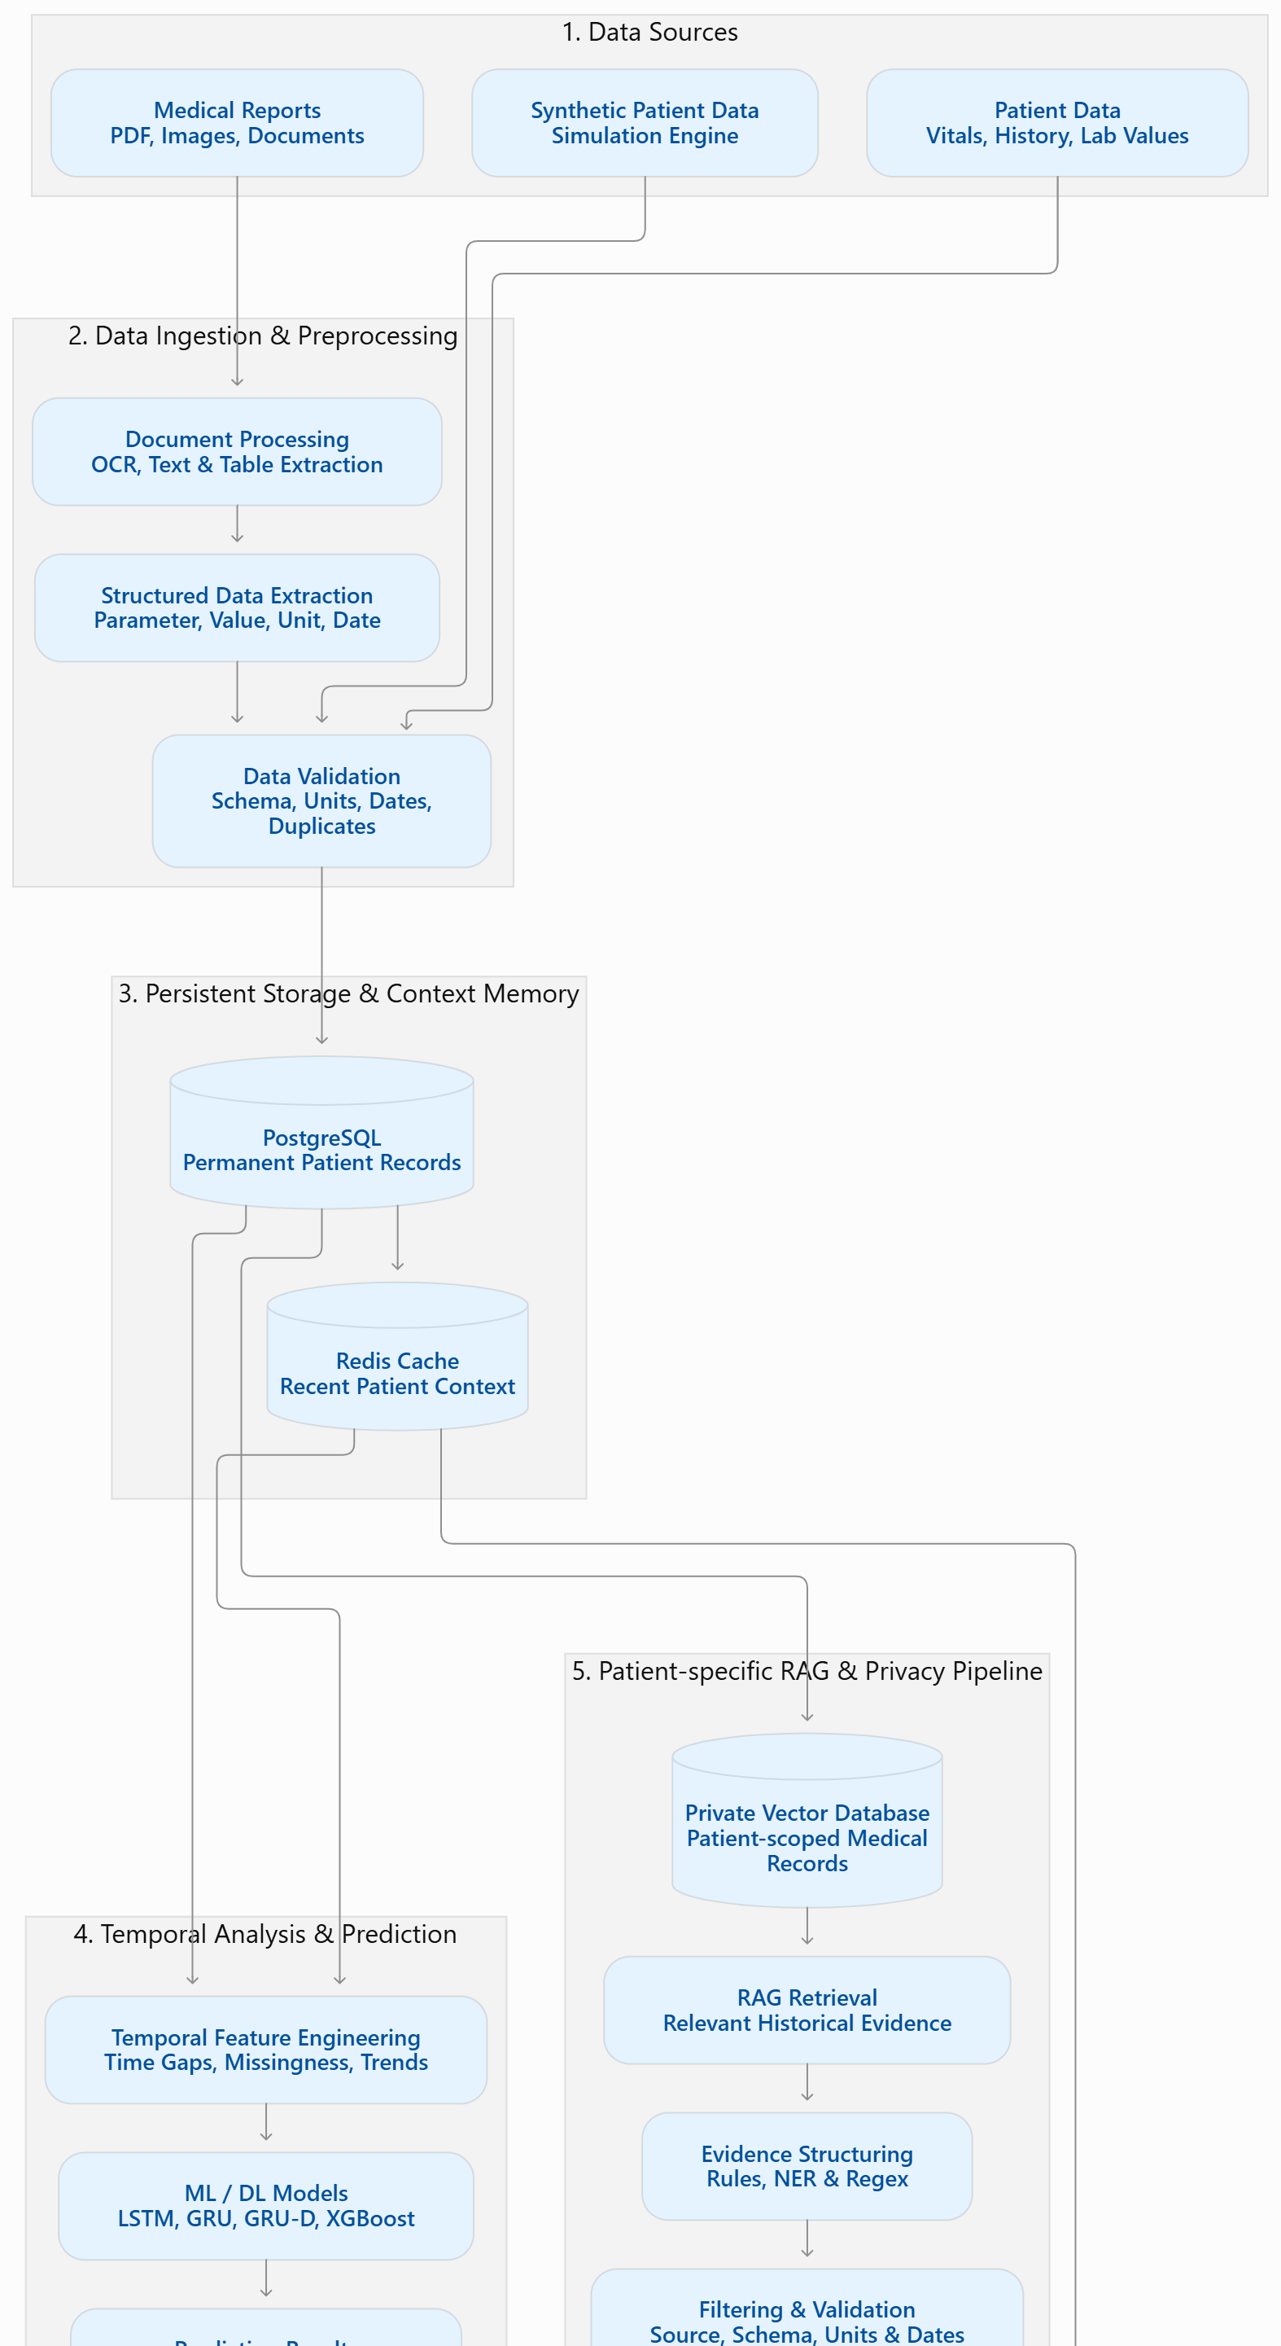
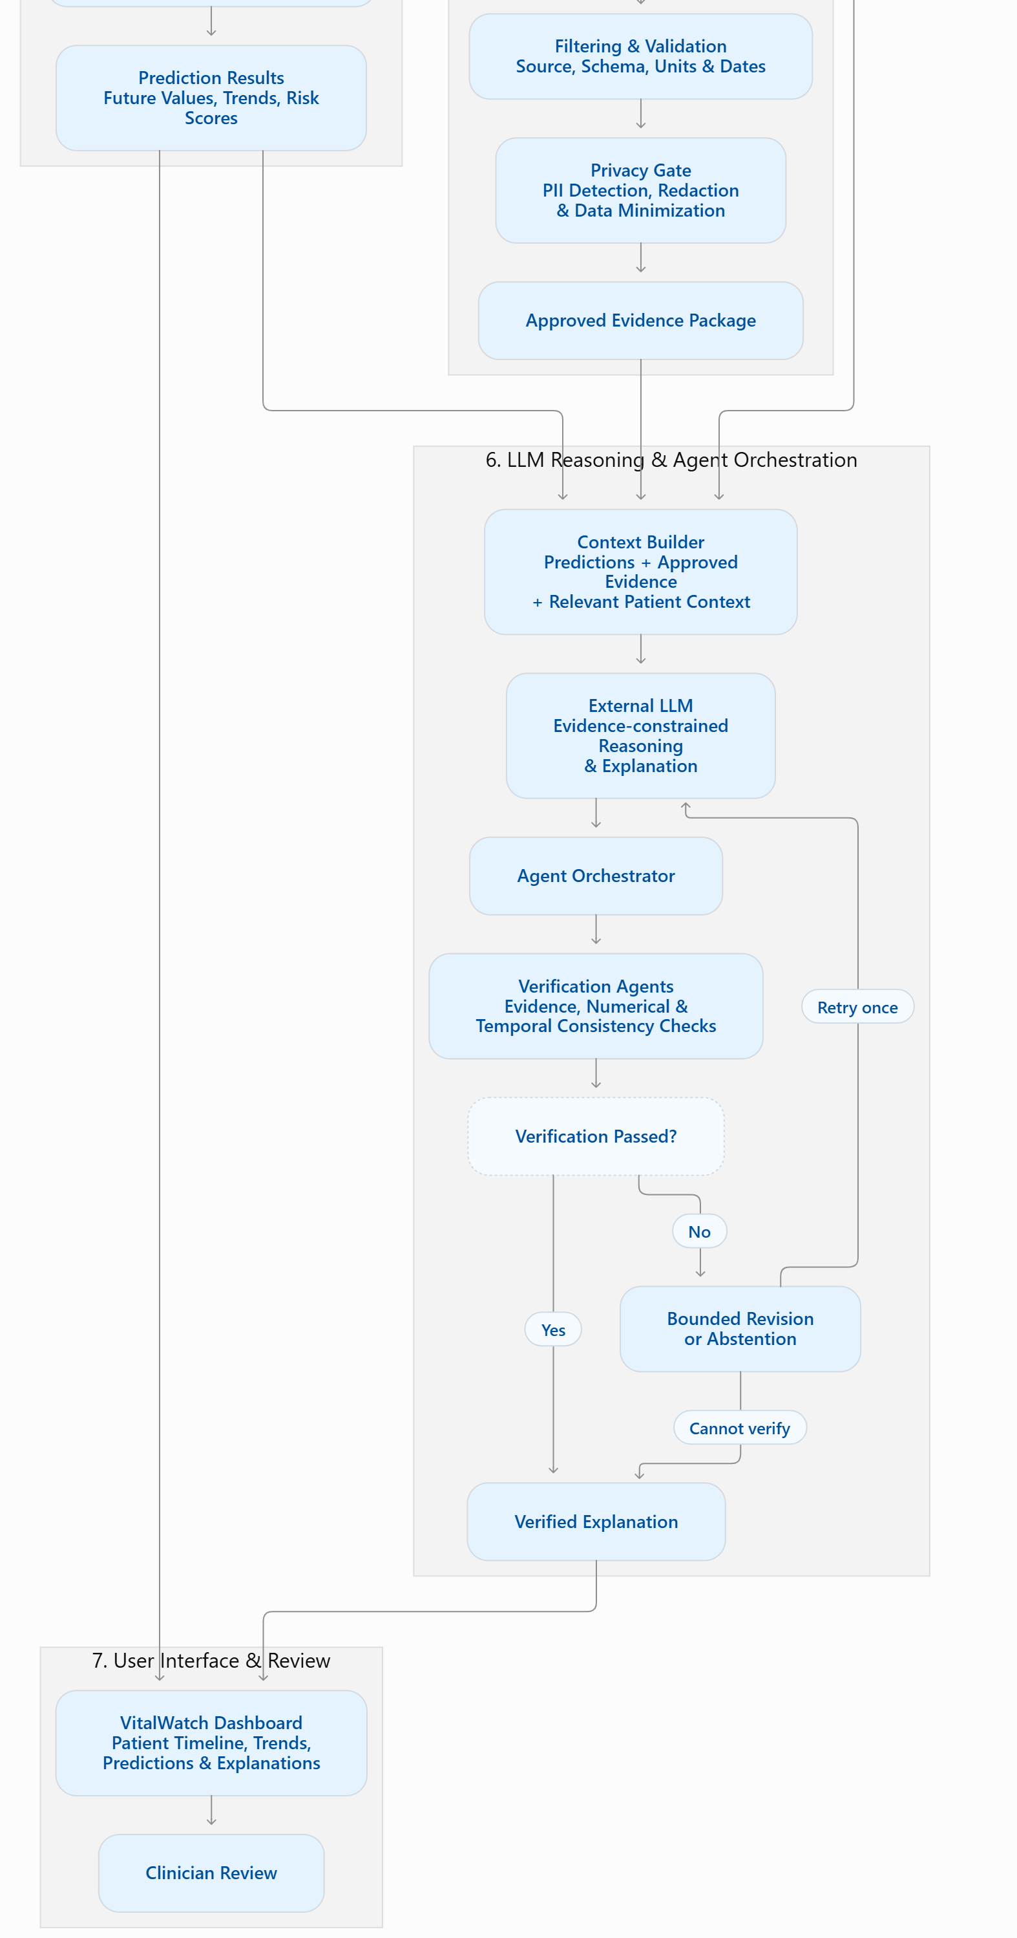
Bangalore Institute of Technology
K.R. Road, V.V. Pura, Bengaluru.-560004.
Department of CSE(Data Science)
2026-27
Architecture
    Seven-stage pipeline
1. Data sources — reports, synthetic data, patient vitals.
2. Ingestion & preprocessing — OCR, extraction, validation.
3. Storage & context memory — PostgreSQL + Redis.
4. Temporal analysis & prediction — features + ML/DL.
5. Patient RAG & privacy — filter first, then privacy gate.
6. LLM reasoning & orchestration — verify, retry / abstain.
7. UI & review — dashboard + clinician review.
Privacy: a deterministic filtering pipeline (rules / NER / regex) runs first; the fine-tuned SLM is used only when needed.

Slide 13
Bangalore Institute of Technology
K.R. Road, V.V. Pura, Bengaluru.-560004.
Department of CSE(Data Science)
2026-27
Sample Data Set
Primary dataset: PhysioNet / CinC Challenge 2019 — patient-hour records with vitals, lab values and a SepsisLabel outcome.
Row schema: patient_id, timestamp, heart_rate, respiratory_rate, oxygen_saturation, systolic_bp, diastolic_bp, temperature, *_missing indicators, sepsis_label (retrospective evaluation only).
Time | HR | RR | SpO2 | BP | Temp | Risk
08:00 | 82 | 17 | 98 | 122/76 | 36.8 | 0.08
09:00 | 85 | 18 | 97 | 119/74 | 37.0 | 0.12
10:00 | 89 | 20 | 96 | 114/71 | 37.3 | 0.19
11:00 | 94 | 22 | 95 | 108/68 | 37.7 | 0.31
12:00 | 99 | 24 | 94 | 102/64 | -- | 0.44
13:00 | 104 | 26 | 92 | 96/60 | 38.4 | 0.67 (ALERT)
14:00 | 108 | 29 | 91 | 91/57 | 38.7 | 0.81 (ONSET)
    Example: P001
Synthetic hourly replay of one worsening patient.
Risk rises steadily before the labelled onset while a stable patient stays low priority.

Slide 14
Bangalore Institute of Technology
K.R. Road, V.V. Pura, Bengaluru.-560004.
Department of CSE(Data Science)
2026-27
Applications
ICU / emergency-department early-warning triage and patient prioritisation.
Clinical informatics and quality-improvement teams exploring early-warning workflows.
Researchers and datathon participants building transparent deterioration models.
Health-tech teams evaluating how historical clinical data supports real-time-style decision tools.
Teaching and replay demonstrations of sequential risk updating and evidence-based explanation.

Slide 15
Bangalore Institute of Technology
K.R. Road, V.V. Pura, Bengaluru.-560004.
Department of CSE(Data Science)
2026-27
References
[1] Reyna MA et al. “Early Prediction of Sepsis from Clinical Data: The PhysioNet/CinC Challenge 2019”, 2020.
[2] Adams JG et al. “Prospective, multi-site study of the TREWS machine learning-based early warning system for sepsis”, Nature Medicine, 2022.
[3] Wong A et al. “External Validation of a Widely Implemented Proprietary Sepsis Prediction Model”, JAMA Internal Medicine, 2021.
[4] Che Z et al. “Recurrent Neural Networks for Multivariate Time Series with Missing Values”, Scientific Reports, 2018.
[5] Lewis P et al. “Retrieval-Augmented Generation for Knowledge-Intensive NLP Tasks”, NeurIPS, 2020.
[6] Singhal K et al. “Large Language Models Encode Clinical Knowledge”, Nature, 2023.
[7] Dettmers T et al. “QLoRA: Efficient Finetuning of Quantized LLMs”, NeurIPS, 2023.
[8] PhysioNet/CinC Challenge 2019 dataset — physionet.org/content/challenge-2019.
[9] FastAPI & WebSockets — fastapi.tiangolo.com; scikit-learn — scikit-learn.org.
[10] Redis — redis.io/docs; Microsoft Presidio — microsoft.github.io/presidio.

