Slide 1

BLOG WEBSITE
USING MERN
By :
Ahmed Sajid - 33105
Aiman Sajid - 33106
Bhavnesh Bhat - 33117
Piyush Bhokre - 33118
Sanika Bhosale - 331

Slide 2

Introduction
In today's digital era, blogs are a vital medium for sharing ideas and experiences. Leveraging the MERN stack – MongoDB, Express.js, React.js, and Node.js – we've developed a dynamic blog website. Featuring user-friendly interfaces, secure authentication, and seamless content management, our platform showcases the power of the MERN stack in creating modern, engaging web applications.

Slide 3
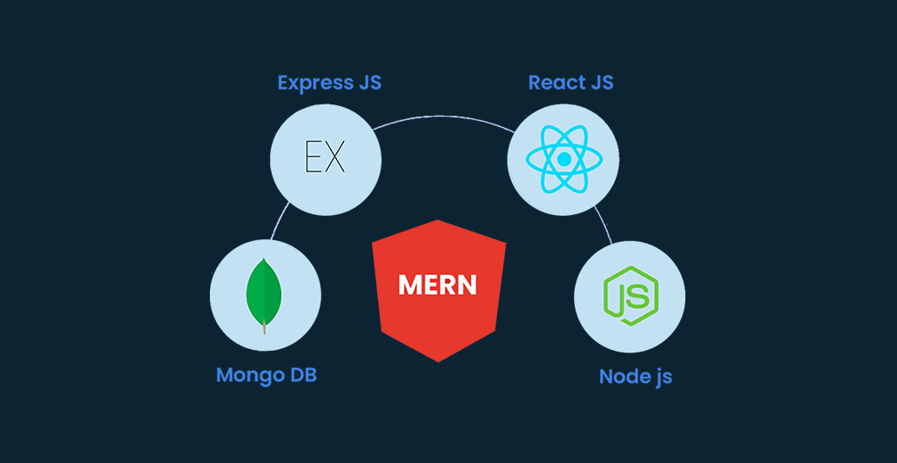
MERN
MERN is acronym for four main components or can say four main technologies that are:
M stands for MongoDB(Database), mainly used for preparing document database and is a NoSQL (Non-Structured Query Language ) Database System
E stands for Express, mainly used for developing Node.js web framework
R stands for React, mainly used for developing a client-side JavaScript framework in other word frontend
N stands for Node, mainly used for developing the premier JavaScript web server

Slide 4
Requirements
SOFTWARE REQUIREMENTS
• Operating system : Windows 8 and above
• Coding Language : HTML,CSS, JAVASCRIPT
• Data Base : MongoDB • Front End : React.js
• Back End : Express.js(Node.js)
• IDE : Visual Studio Code or atom 4.5
HARDWARE REQUIREMENTS
▪ Processor : i3+ ▪ Ram : 512 MB.
▪ Hard Disk : 20 GB+ ▪ Processor Speed : 2 ghz+

Slide 5
Architecture
The architecture section describes the high-level architecture of the blog application, including its components and interactions.

Slide 6
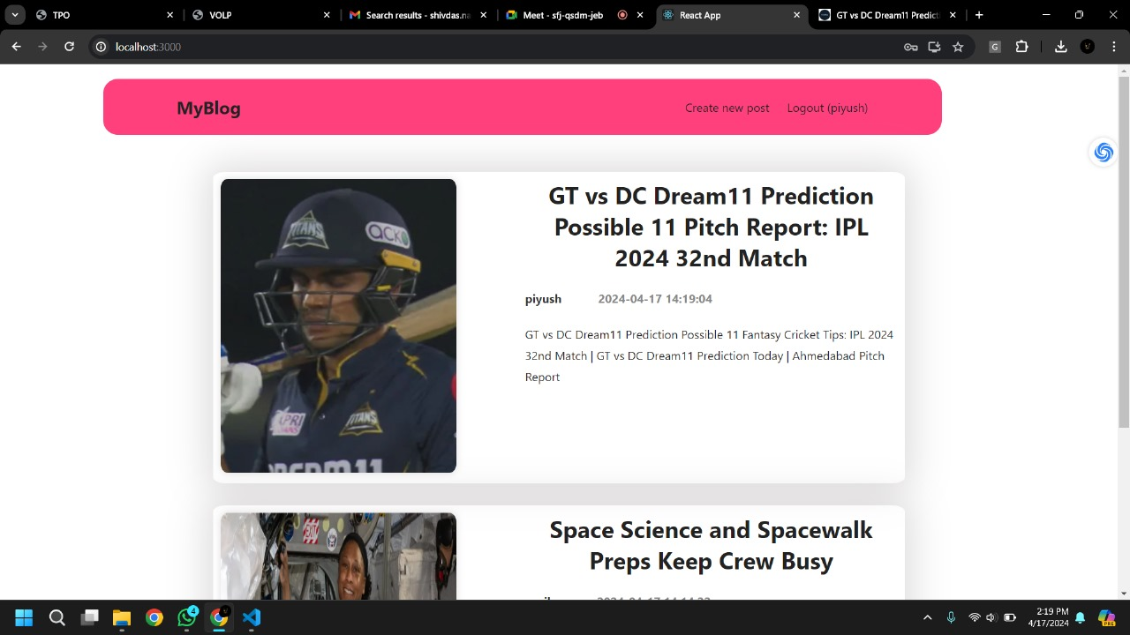
Design
The design section presents the detailed design of the blog application and user interface design.

Slide 7
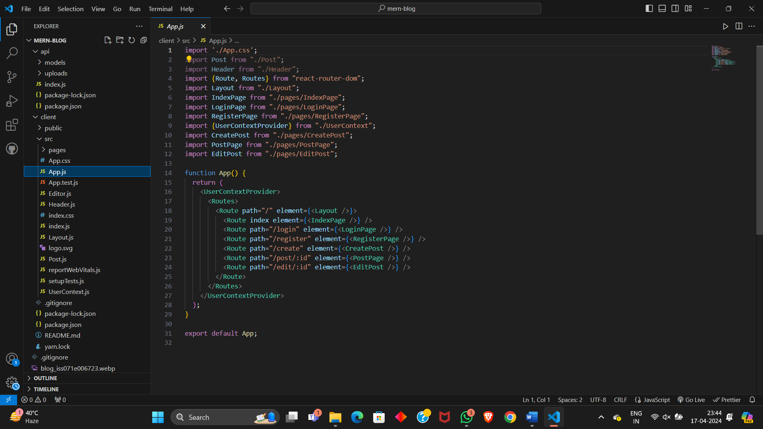
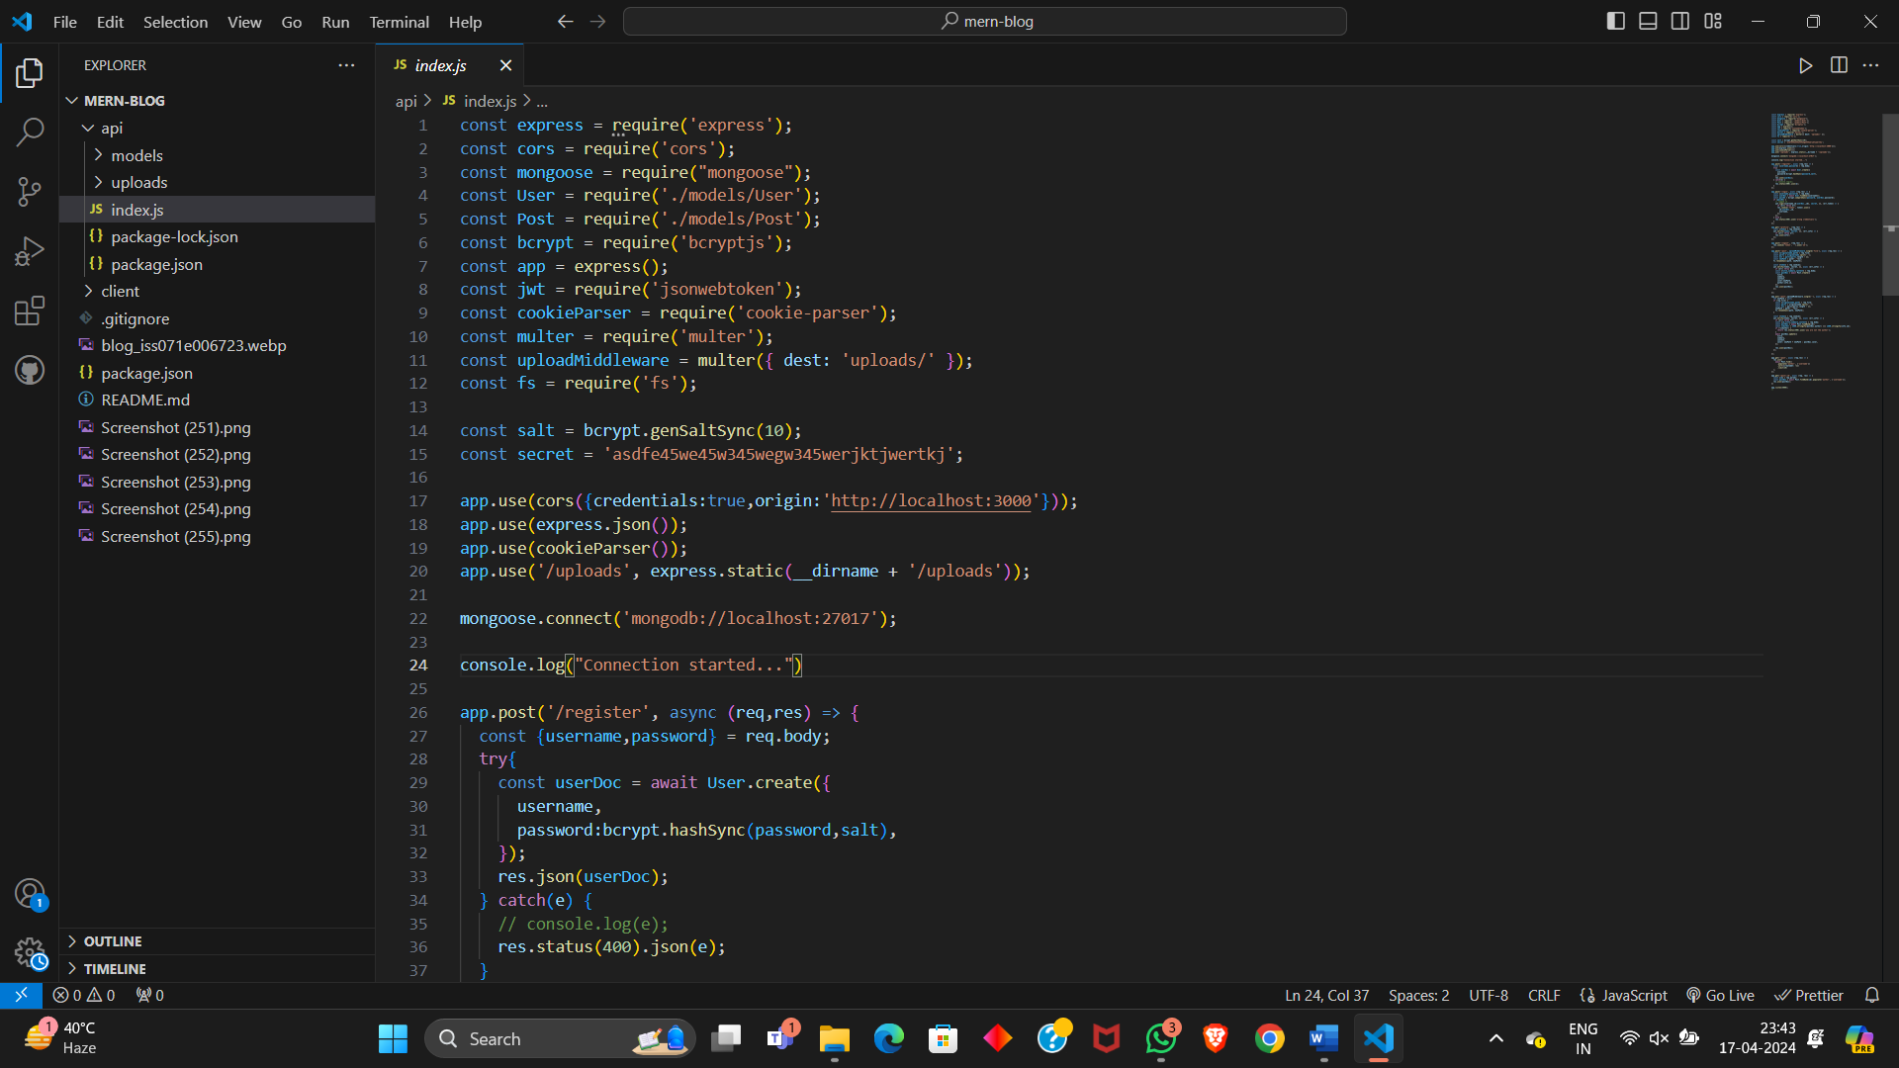
Code Highlights
The code highlights section showcases key snippets of code that demonstrate important features or functionalities of the blog application.

Slide 8
Challenges
Learning Curve: Mastering the MERN stack required overcoming steep learning curves for each technology component, especially for team members unfamiliar with JavaScript frameworks.
Integration Complexity: Integrating frontend and backend components seamlessly posed challenges, particularly in ensuring smooth communication between React.js and Express.js.
Security Concerns: Implementing robust security measures, such as authentication and authorization, presented challenges to safeguard user data and prevent unauthorized access.
Performance Optimization: Optimizing performance across the stack, including database queries and frontend rendering, required careful consideration and implementation to ensure fast and responsive user experiences.
Deployment Complexity: Deploying the application to production environments, configuring servers, and managing dependencies presented logistical challenges that required thorough planning and execution.

Slide 9

Future Improvements
Enhanced User Experience: Implement features such as user preferences, personalized recommendations, and improved UI/UX design to enhance user engagement and satisfaction.
Scalability: Optimize database performance and architecture to handle increased user traffic and data volume as the application grows.
Advanced Security Measures: Strengthen security protocols, implement encryption techniques, and conduct regular security audits to safeguard user data from potential threats.
Mobile Optimization: Develop mobile-responsive design and native mobile applications to provide seamless user experiences across various devices and platforms.
Community Engagement: Introduce features such as user comments, social media integration, and community forums to foster user interaction and collaboration.

Slide 10
CONCLUSION
Our project developed a fully functional blog website with the MERN stack, showcasing the power of modern web technologies. Despite challenges like learning curves and security concerns, we delivered a robust website.
We demonstrated the MERN stack's efficacy and identified areas for improvement, including user experience enhancements and scalability optimizations. This project signifies a milestone in our web development journey, highlighting the MERN stack's effectiveness and setting the foundation for future innovation.

