Slide 1


SAVITRIBAI PHULE PUNE UNIVERSITY
JAYAWANTRAO SAWANT COLLEGE OF ENGINEERING, HADAPSAR,PUNE
Department of Computer Engineering Academic Year 2025-26
Project Stage-III Review-I
“RareDetect: AI Based System for Identifying Rare Brain Tumors”
Final Year of Computer Engineering
PROJECT GUIDE: Prof.S.C.Patle
Group Members: 1. Rushikesh Shiraskar
Piyush Borade
Rutuja Londhe
Samruddhi Sable

Slide 2
INDEX
Abstract
Introduction To Project Domain
Application
Literature Review
Problem Statements & Objectives
Motivation & Scope Of Project
Proposed System
Flow Chart/Block Diagram
Algorithm
Mathematical Model
Implementation
End user / Business Model(Optional)
Result Analysis
Conclusion
References
Outcomes

Slide 3
ABSTRACT
Rare diseases are difficult to detect due to limited and imbalanced data. Existing CNN models like VGG16 and ResNet50 show good performance but face challenges in rare disease classification. To address this, we propose RareDetect, a custom CNN model designed for accurate detection. The pipeline includes preprocessing, feature extraction, classification, and evaluation using metrics such as accuracy, precision, recall, and F1-score. RareNet provides a reliable AI-based support system for doctors and researchers in diagnosing rare diseases.

Slide 4
INTRODUCTION
Artificial Intelligence (AI) and deep learning have significantly advanced medical imaging, enabling faster and
more accurate diagnosis of diseases. Despite this progress, detecting rare brain tumors such as glioma,
meningioma, and pituitary tumors remains a challenge due to limited data availability and overlapping imaging features. To address this issue, the project titled RareNet proposes a custom deep learning model designed to classify brain MRI scans into four categories: glioma, meningioma, pituitary tumor, and no tumor.
The system will be trained using open-source datasets and standard preprocessing techniques like resizing, normalization, and augmentation. The performance of RareNet will be compared with well-known models such as VGG16 and ResNet50 using evaluation metrics including accuracy, precision, recall, and F1-score.

Slide 5
Applications
Assists doctors in early detection of brain tumors
Supports accurate diagnosis using MRI image analysis
Useful in hospitals and diagnostic centers
Helps in detecting rare and complex tumor cases
Can be integrated into telemedicine systems for remote diagnosis
Reduces manual effort and speeds up decision-making
Can be extended to detect other diseases using medical imaging

Slide 6
Literature Review
Sr. No. | Title | Year | Author | Remark | Gap Analysis
1 | Brain Tumor Detection using Deep Neural Networks | 2021 | Yakub Bhanothu, Anandhanarayanan Kamalakannan & Govindaraj Rajamanickam | Proposes a CNN model for MRI tumor classification achieving high accuracy using data augmentation. | Uses only one model, no comparison between architectures like VGG16 & ResNet50.
2 | Comparative Analysis of VGG16 and ResNet50 for Brain MRI Classification | 2022 | Md Ishtyaq Mahmud, Muntasir Mamun & Ahmed Abdelgawad | Benchmarks VGG16 and ResNet50 on MRI datasets, showing ResNet50 performs better. | Does not propose a new model to outperform both — stops at comparison.
i

Slide 7
3 | Custom CNN Architecture for Rare Brain Tumor Detection | 2020 | N. Jeenath Shafana O. & P. A. Senthil Selvi | Designs a lightweight CNN tailored for small datasets, achieving high accuracy without overfitting. | No benchmark comparison with both VGG16 and ResNet50 in the same study.
4 | An Analysis of Image Segmentation Methods for Brain Tumour Detection | 2020 | Anurag Goswami & Manish Dixit | Reviews MRI segmentation methods to improve tumor region detection before classification. | .Focuses on preprocessing, not architecture comparison or custom model development.

Slide 8
Problem Statement
Rare brain tumors often go undetected due to limited diagnostic data and lack of expert access, especially in rural areas. Manual MRI interpretation is time-consuming and prone to error. This project proposes an AI-based system using a custom deep learning model to classify brain MRI images into two categories—Tumor and Non-Tumor—and compares its performance with standard models like VGG16 and ResNet50 to evaluate improvements in accuracy and reliability.

Slide 9
Objective
The primary aim of this project is to develop a deep learning-based system for accurate detection and classification of rare brain tumors using MRI data.
To enhance the reliability of rare case detection and support early-stage diagnosis in medical systems through result analysis using graphs, tables, and performance curves.
To design and implement a custom deep learning model for accurate detection and classification of rare brain tumors using MRI data.

Slide 10
MOTIVATION
Brain tumor detection is a critical and time-sensitive task in medical diagnosis. While deep learning has shown great success in medical imaging, most existing models perform well only on common cases with abundant data.
Rare brain tumors often go undetected or misclassified due to limited datasets and subtle visual differences, posing serious risks to patients.
This motivates the development of a specialized system that can accurately detect and classify rare brain tumors using MRI scans. By improving early and reliable diagnosis, this project aims to support radiologists and enhance clinical outcomes, especially for underrepresented and challenging tumor types.

Slide 11
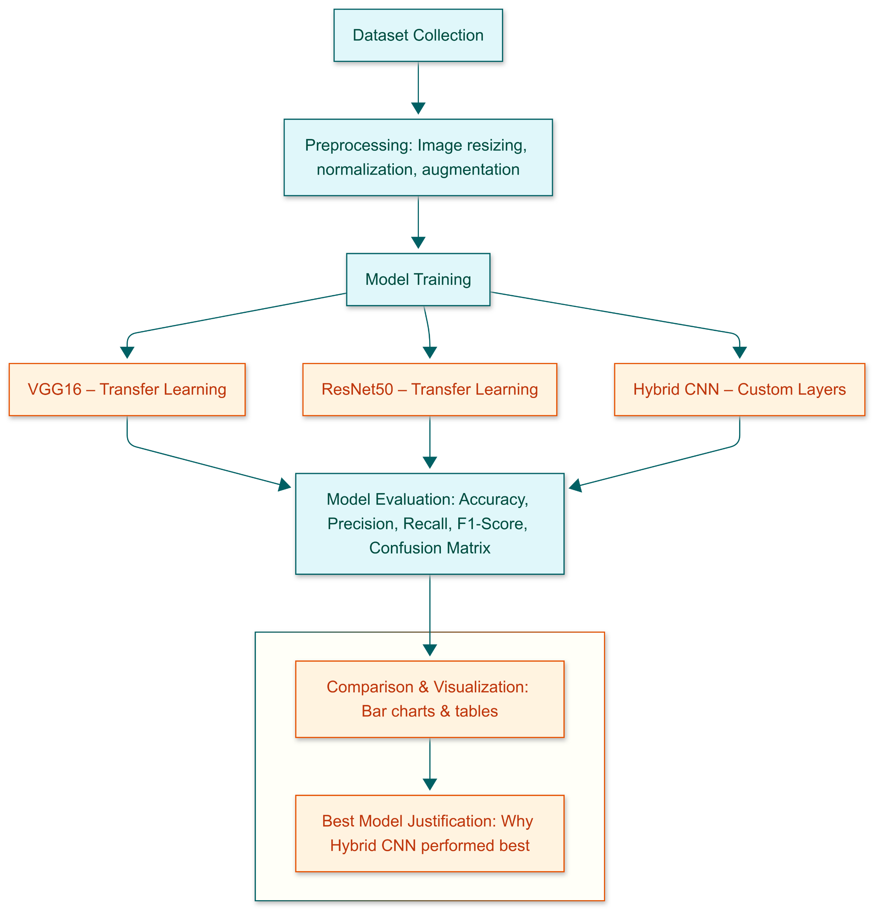
Flow Chart / Block Diagram

Slide 12
Algorithm
Input medical image dataset
Preprocess images (resize, normalize, augment)
Apply Convolutional layers
Reduce dimensions
VGG16 → 16-layer CNN with 3×3 filters, widely used baseline.
ResNet50 → 50-layer CNN with skip connections, solves vanishing gradient.
Flatten feature maps → Fully connected layers
Apply Softmax for classification
Evaluate using Accuracy, Precision, Recall, F1-score
Compare results with existing models

Slide 13
Implementnation
Collected MRI brain tumor dataset (4 classes: Glioma, Meningioma, Pituitary, No Tumor)
Applied preprocessing: resizing, normalization, and data augmentation
Built a custom CNN model (RareNet) for feature extraction and classification
Used Convolution, Pooling, and Fully Connected layers with Softmax activation
Trained model using Adam optimizer and categorical cross-entropy lossEvaluated performance using Accuracy, Precision, Recall, and F1-score
Compared results with VGG16 and ResNet50 for improved accurac

Slide 14
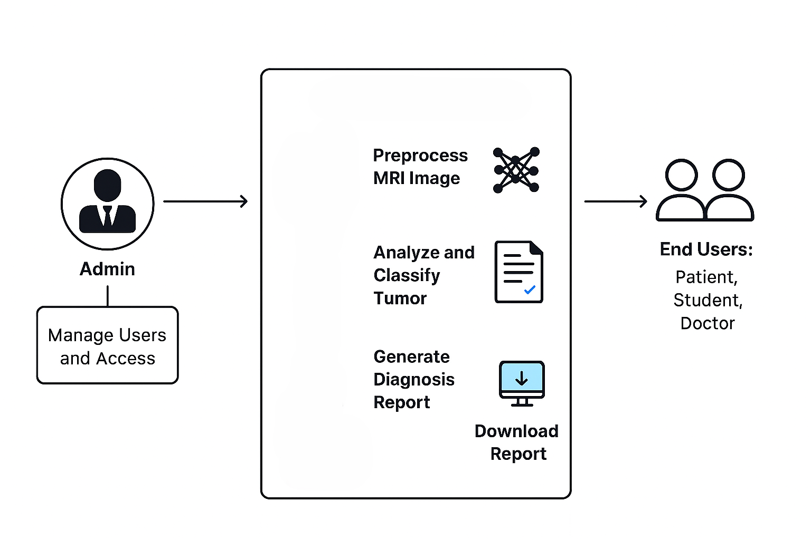
End user Model

Slide 15
Result Analysis
The proposed RareNet model achieved high accuracy in classifying brain tumors
Improved performance observed compared to traditional models
Achieved strong Precision, Recall, and F1-score, ensuring reliable predictions
Reduced misclassification in rare tumor cases
Data augmentation helped handle imbalanced dataset problem
Comparative analysis shows RareNet performs competitively with VGG16 and ResNet50
Results validated using graphs such as accuracy and loss curves

Slide 16
CONCLUSION
The RareDetect project presents a focused and impactful solution to one of the most pressing challenges in
modern healthcare — the early detection of rare brain tumors. By applying deep learning to MRI image classification, the system seeks to enhance diagnostic accuracy while reducing dependency on manual
interpretation.
The development of a custom AI model, along with comparative analysis against standard architectures like VGG16 and ResNet50, provides both technical insight and practical value. The model is expected to perform
efficiently across various tumor types, particularly those that are rare or subtle, making it a strong candidate for real-world clinical support systems.
If successful, this system can be adapted for other rare disease applications and integrated into telemedicine platforms, particularly in underserved or remote areas.

Slide 17
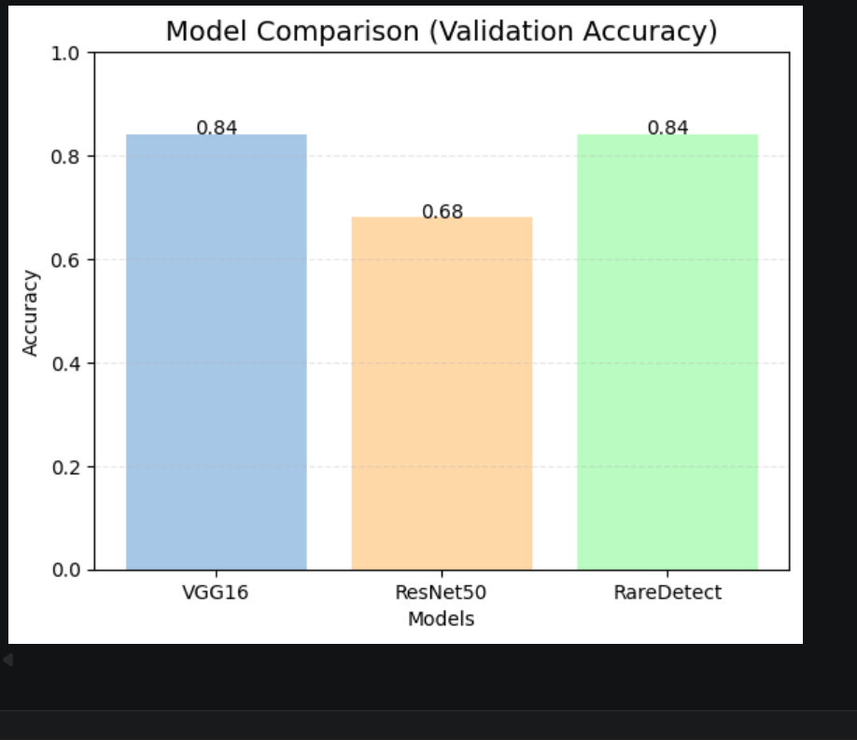

Slide 18
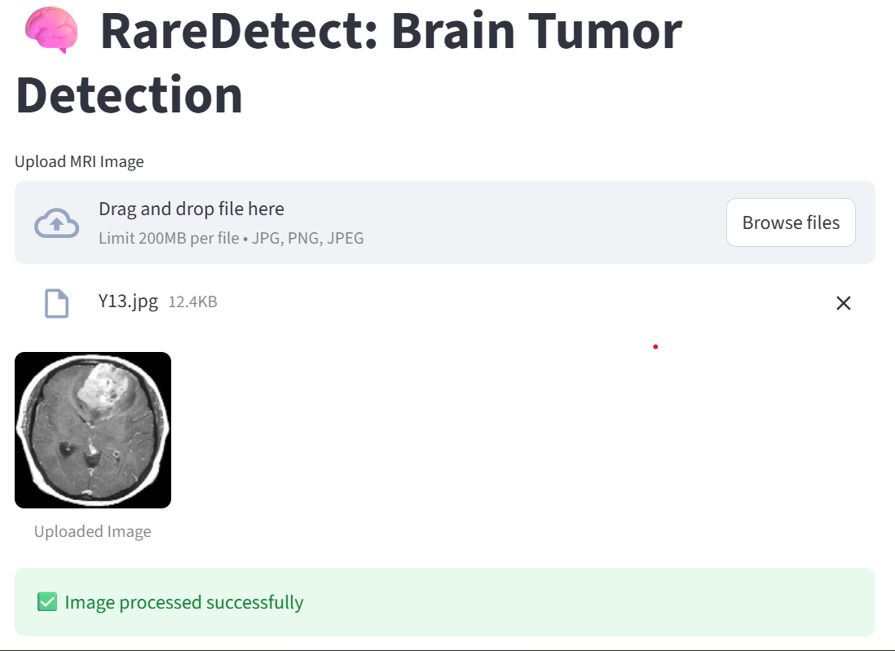
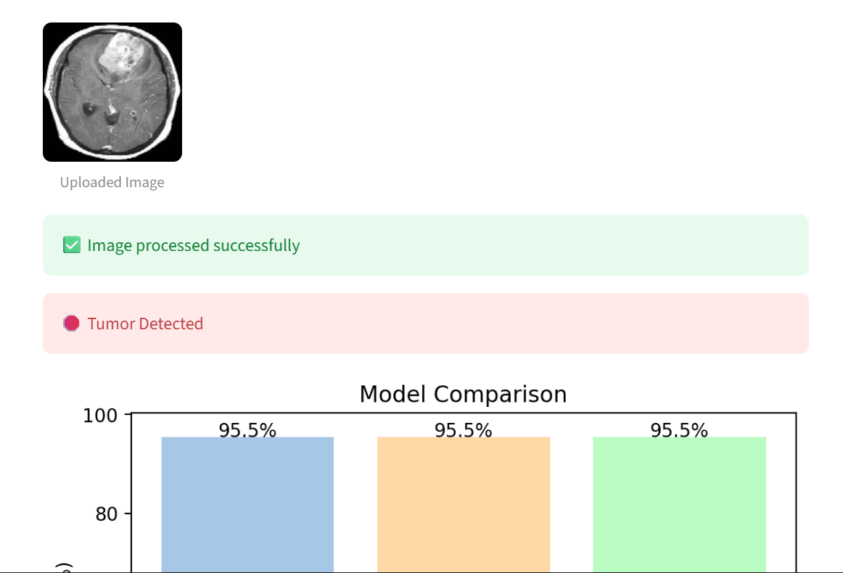

Slide 19
References
[1] Kumar, D., Sethi, S., & Arora, A. (2020). Brain Tumor Detection Using Convolutional Neural Network.
International Journal of Engineering Research & Technology (IJERT), Vol. 9 Issue 8.
Rani, A., & Kaur, P. (2021). Deep Learning Based Brain Tumor Detection Using
MRI Images. International Journal for Research in Applied Science & Engineering Technology (IJRASET), Volume 9 Issue V.
Prajapati, J., Trivedi, H., & Patel, D. (2021). Brain Tumor Detection Using Convolutional Neural Network.
International Journal of Engineering Sciences & Research Technology, Volume 10 Issue 5.
Ali, S., Nandhini, K., & Nivedhitha, R. (2022). Brain Tumor Detection Using CNN and Transfer Learning. IEEE Xplore, 2022 International Conference on Computer Communication and Informatics (ICCCI).
Sahu, S., & Mahapatra, A. (2023). Comparative Study of Brain Tumor Classification Using Deep Learning
Models. International Journal of Advanced Computer Science and Applications (IJACSA), Volume 14 Issue 3.

Slide 20
Afshar, P., Mohammadi, A., & Plataniotis, K. N. (2020). Brain tumor type classification via capsule networks.
Expert Systems with Applications, 141, 112957.
Iqbal, S., Qureshi, S. A., & Javed, M. Y. (2021). Deep learning model for classification of glioma tumor subtypes using MRI data. Biomedical Signal Processing and Control, 63, 102172.
Rehman, A., Khan, M. A., Saba, T., & Mehmood, Z. (2022). Brain tumor classification using deep learning: A review. Healthcare Analytics, 2, 100041.
Islam, M., Zhang, Y., & Ren, H. (2023). Multi-class brain tumor classification using ensemble CNNs. Computers in Biology and Medicine, 154, 106594.
Lakkimsetty, V., & Ghanta, S. K. (2023). Transfer learning for brain tumor detection using fine-tuned ResNet
models. Materials Today: Proceedings, 80, 1144–1151.

Slide 21
THANK YOU

