Slide 1


Amazon Sales Analysis With PowerBI
By Piyush Kadam

Slide 2
Table Of
Content
Overview
Objectives
Drive Through Objectives
Recommendations
Sample Dashboards
Conclusion

Slide 3

Overview
This Amazon sales analysis aims to provide comprehensive insights into the sales performance, category demand, geographical distribution, and order fulfillment efficiency. By analyzing data from various dimensions, including time, product category, and region, this study seeks to identify key trends and offer actionable recommendations to optimize sales strategies and enhance operational efficiency.
Data Source and Analysis Period
Data Source: Amazon sales data
Analysis Period: January 2022 to December 2022
Key Metrics Analyzed
Total Sales: The total revenue generated from sales.
Total Orders: The total number of orders placed.
Total Quantity: The total quantity of items sold.
Average Sales: The average revenue per month.
Average Order Value: The average revenue per order.
Total Canceled Orders: The total number of orders that were canceled.

Slide 4

2. Objectives
3.1
Sales Overview
Understand the overall sales performance, trends, and patterns over time.
3.2
Product Analysis
Analyze the distribution of product categories, sizes, and quantities sold to identify popular
products.
3.3
Fulfillment Analysis
Investigate the fulfillment methods used and their effectiveness in delivering orders.
3.4
Customer Segmentation
Segment customers based on their buying behaviour, location, and other relevant factors.
3.5
Geographical Analysis
Explore the geographical distribuƟon of sales, focusing on states and ciƟes

Slide 5

3. Drive Through Each Objectives

Slide 6
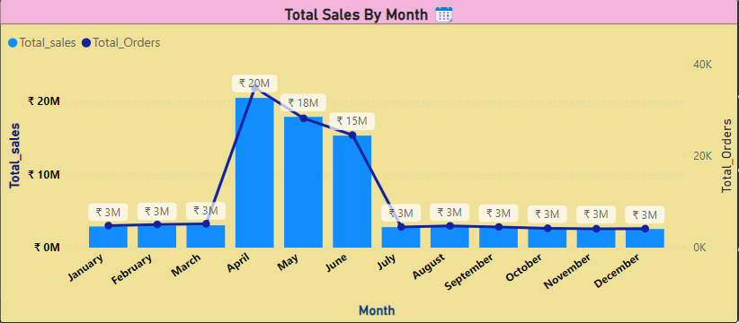
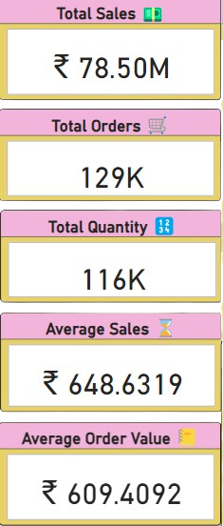
3.1 Sales Overview
April and May show a peak in total sales, with April reaching ₹20M and May close to ₹18M.
Sales decline steadily from June onwards, maintaining a lower but consistent level from July to December.

Slide 7
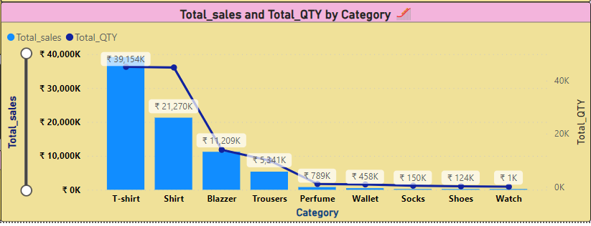
3.2 Product Analysis-1
T-shirts are the top-selling category with the highest total sales (₹39.15K) and quantity.
Shirts and blazers follow, with shirts showing significant sales (₹21.27K).
Categories like trousers, perfumes, wallets, socks, shoes, and watches show lower sales and quantities.

Slide 8
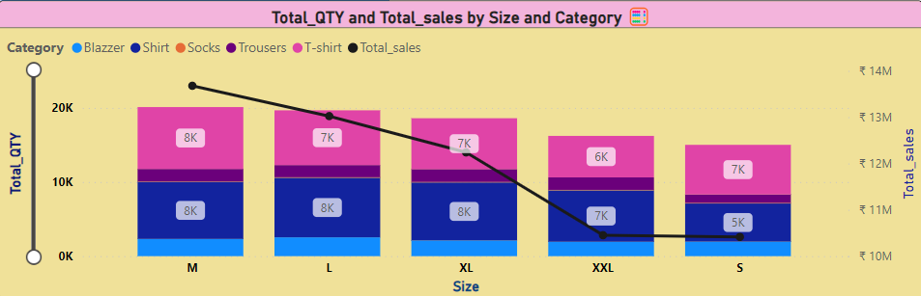
3.2 Product Analysis-2
Sizes M, L, XL, and XXL show consistent order quantities, with a slight preference for sizes M and L.
Categories such as T-shirts and shirts perform well across all sizes, with XXL showing a slight decline.

Slide 9
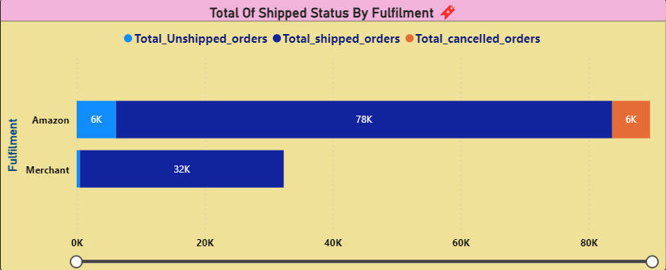
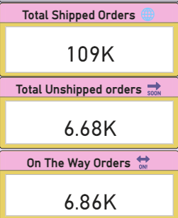
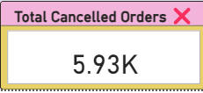
3.3 Fulfillment Anaylsis
Amazon fulfilled 90K orders, while merchants fulfilled 39K orders.
Amazon also has a higher number of unshipped (6K) and shipped (78K) orders compared to merchants.

Slide 10
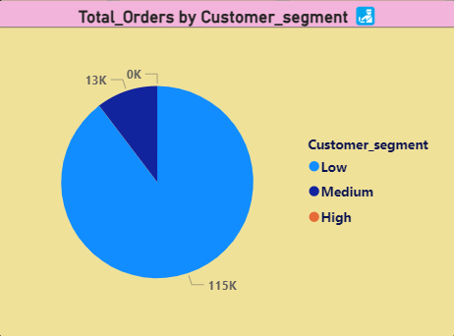
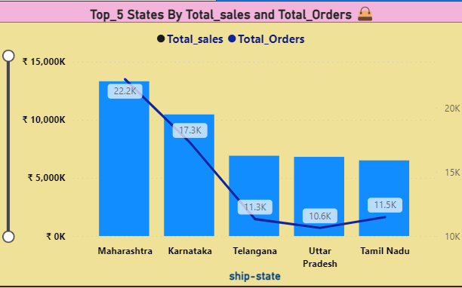
3.4 Customer Segmentation
The majority of orders come from the 'Medium' customer segment, accounting for 115K orders.
The 'High' and 'Low' customer segments contribute significantly less, with 'High' at 13K and 'Low' at 0K.
Maharashtra has the highest total orders (22.2K) and total sales.
Karnataka follows with 17.3K total orders.
Telangana, Uttar Pradesh, and Tamil Nadu have similar order volumes, each ranging between 10K and 12K orders.

Slide 11
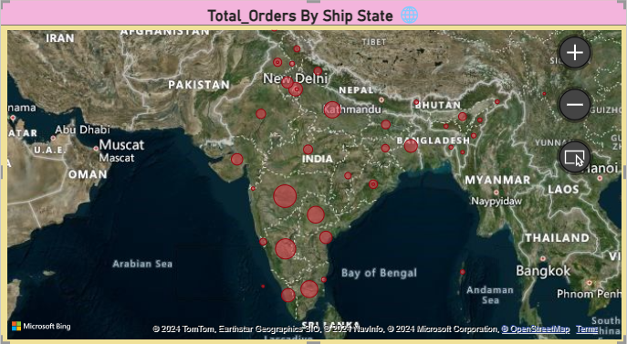
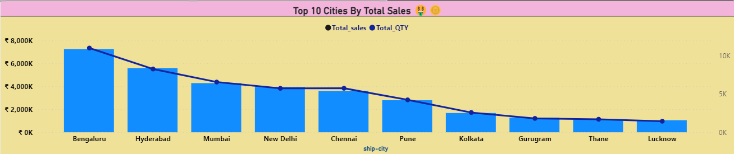
3.5 Geographical Analysis
Bengaluru leads with the highest total sales, followed by Hyderabad and Mumbai.
New Delhi, Chennai, Pune, and Kolkata show significant sales volumes.
Gurugram, Thane, and Lucknow round out the top 10, with relatively lower sales compared to the top cities.

Slide 12
4. Recommendations-1
Trends & Insights
Recommendations
1
April reaching ₹20M There is a significant peak in sales during the months of April and May, likely due to seasonal factors or promotional campaigns.
Investigate the factors contributing to the sales peak in April and May and consider replicating successful strategies in other months.
2
Apparel categories, particularly T-shirts and shirts, dominate the sales, indicating strong consumer demand in this segment.
Focus inventory and marketing efforts on top-selling categories like T-shirts and shirts.
Explore opportunities to boost sales in lower-performing categories through targeted promotions or product enhancements.
3
Sizes M, L, XL, and XXL show consistent order quantities, with a slight preference for sizes M and L.
Size preferences are relatively balanced, with a slight preference for medium and large sizes.
4
Amazon fulfilled 90K orders, while merchants fulfilled 39K orders.
Amazon's fulfillment centers handle a majority of the orders, indicating a preference or efficiency advantage.
5
The majority of orders come from the 'Low’' customer segment, accounting for 115K orders.
The 'Low’' customer segment is the primary driver of orders, suggesting a strong mid-tier customer base.

Slide 13
4. Recommendations-2
Trends & Insights
Recommendations
6
Maharashtra has the highest total orders (22.2K) and total sales.
Karnataka follows with 17.3K total orders.
Telangana, Uttar Pradesh, and Tamil Nadu have similar order volumes, each ranging between 10K and 12K orders.
Focus marketing and promotional efforts in top-performing states and cities to further boost sales.
Consider targeted campaigns in states like Telangana, Uttar Pradesh, and Tamil Nadu to increase order volumes and sales.
7
Bengaluru leads with the highest total sales, followed by Hyderabad and Mumbai.
New Delhi, Chennai, Pune, and Kolkata show significant sales volumes.
Gurugram, Thane, and Lucknow round out the top 10, with relatively lower sales compared to the top cities.
Analyze consumer behavior and preferences in top cities to tailor product offerings and improve customer satisfaction.

Slide 14

5. Sample Dashboards

Slide 15
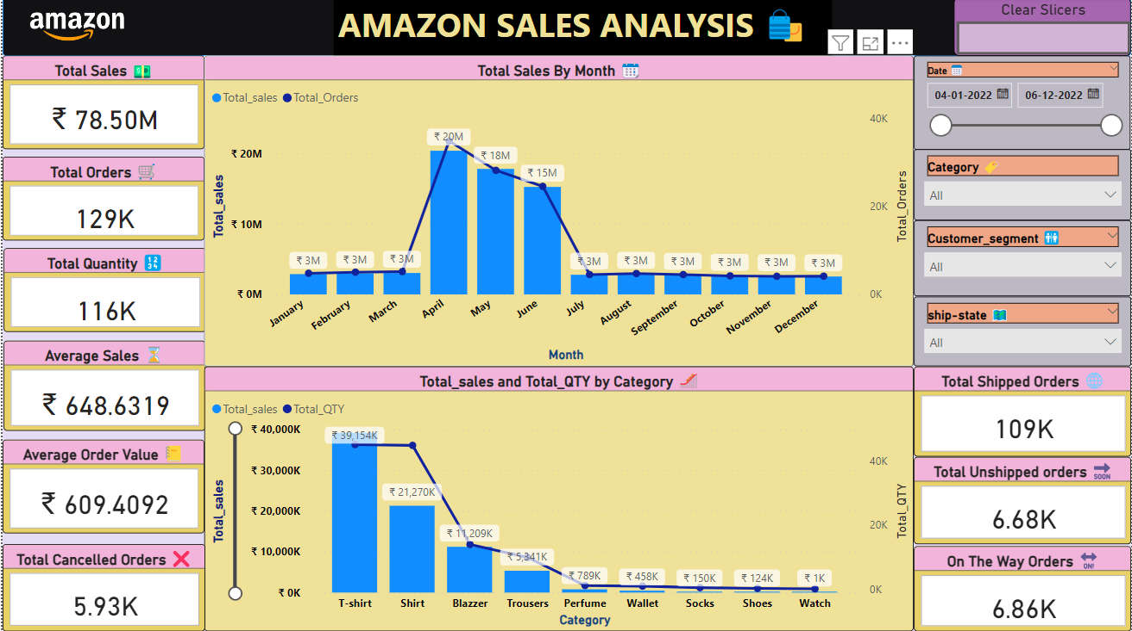
Dashboard-1

Slide 16
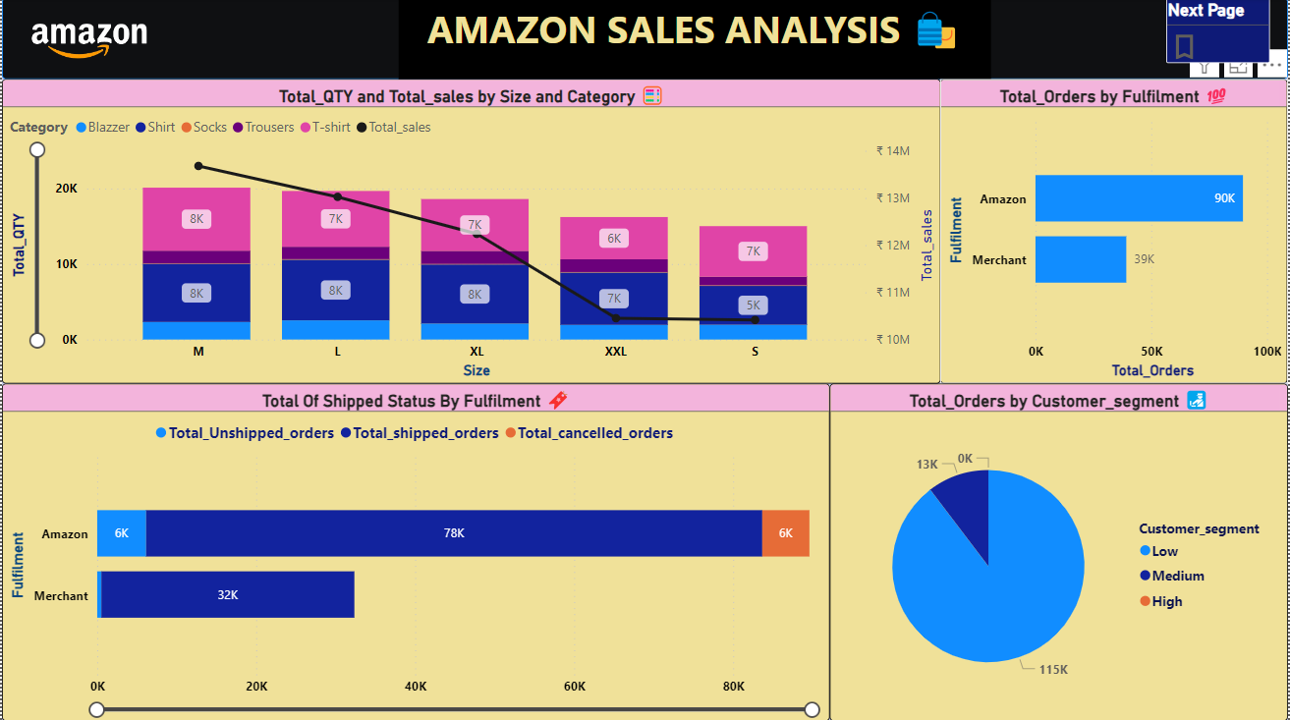
Dashboard-2

Slide 17
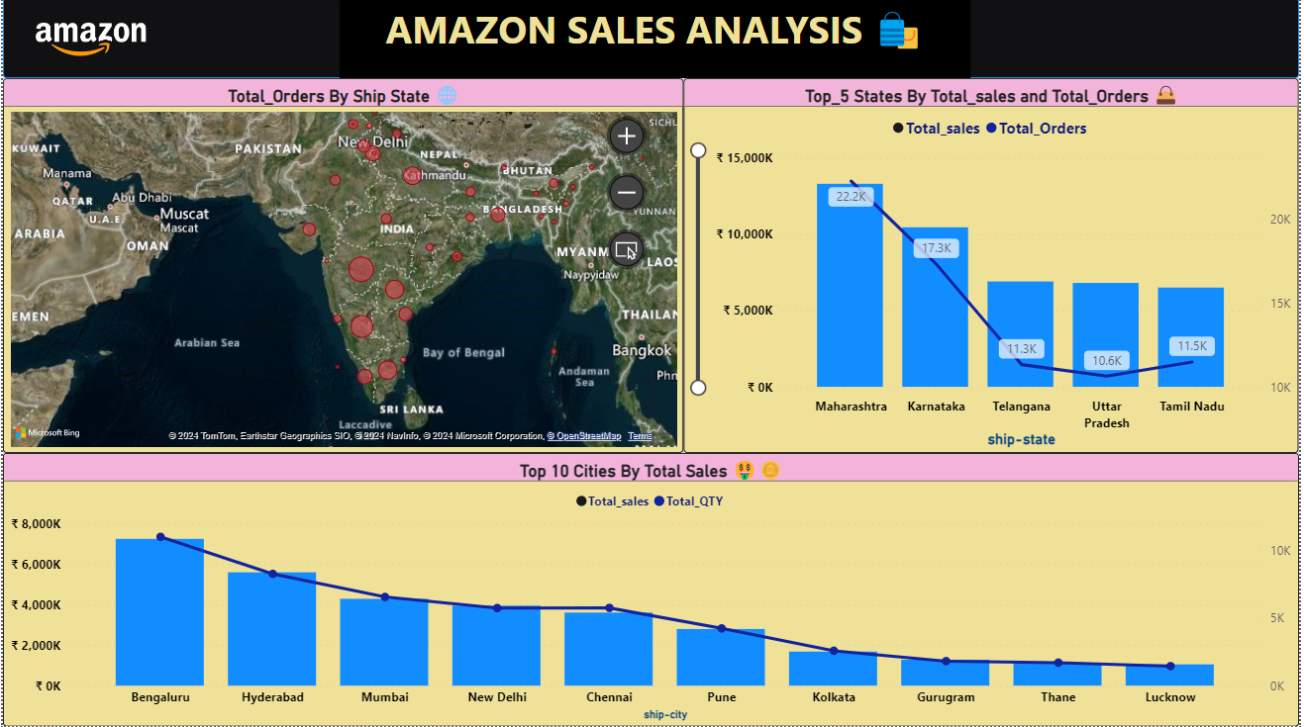
Dashboard-3

Slide 18
6. Conclusion
Trends
Seasonal Sales Peaks: Significant sales peaks in April and May suggest a seasonal trend, possibly driven by promotions, holidays, or seasonal demand.
Category Preferences: T-shirts and shirts dominate sales, indicating high demand for these clothing categories.
Geographical Concentration: Sales are heavily concentrated in urban areas, particularly in Bengaluru, Hyderabad, and Mumbai.
Fulfillment Challenges: Higher unshipped and canceled orders for Amazon indicate potential challenges in inventory management or logistics that need addressing.

Slide 19

Thank YOu !
For queries regarding project contact here - piyushkadam4484@gmail.com
Special Thanks To —->

