Slide 1

Hotel Reservation Analysis With SQL
By Piyush Kadam

Slide 2
TABLE OF CONTENTS
1
INTRODUCTION
2
OVERVIEW
3
SQL QUERIES
4
CONCLUSION
Contents of table
Drive Through The Each Query
Key Findings

Slide 3

1
INTRODUCTION
I am Going To Analyze Hotel Rerservation Data Through SQL queries to Inhance the Client Asks.
In this Project Data About Hotel Reservation Is given for the year 2017 and 2018.

Slide 4
2
OVERVIEW
The dataset includes the following columns:
Booking_ID: A unique identifier for each hotel reservation.
no_of_adults: The number of adults in the reservation.
no_of_children: The number of children in the reservation.
no_of_weekend_nights: The number of nights in the reservation that fall on
weekends.
segment to which the reservation
belongs.
avg_price_per_room: The average price per room in the reservation.
booking_status: The status of the booking.
no_of_week_nights: The number of nights in the reservation that fall on
weekdays.
type_of_meal_plan: The meal plan chosen by the guests.
room_type_reserved: The type of room reserved by the guests.
lead_time: The number of days between booking and arrival.
arrival_date: The date of arrival.
market_segment_type: The market

Slide 5

3
Drive Through SQL Queries

Slide 6

1. What is the total number of reservations in the dataset?
select count(*) from hotel_data;
700

Slide 7


2. Which meal plan is the most popular among guests?
select type_of_meal_plan,count(type_of_meal_plan) as count_of_meal_plan from hotel_data group by type_of_meal_plan order by count(type_of_meal_plan) desc limit 1;

Slide 8

3. What is the average price per room for reservations involving children?
select round(avg(avg_price_per_room),2) as avg_price_per_room from hotel_data where no_of_children>0;
144.57

Slide 9

4. How many reservations were made for the year 2017?
select count(*)from hotel_data where arrival_date like "%2017";
123

Slide 10
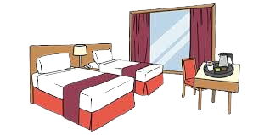

5. What is the most commonly booked room type?
select room_type_reserved as most_common_room_type ,count(room_type_reserved) as count
from hotel_data
group by room_type_reserved
order by count(room_type_reserved) desc limit 1;

Slide 11

6. How many reservations fall on a weekend (no_of_weekend_nights > 0)?
select count(*) as reservations_on_weekend from hotel_data where no_of_weekend_nights>0;
383

Slide 12
7. What is the highest and lowest lead time for reservations?
select max(lead_time) as highest_lead_time from hotel_data;
select min(lead_time) as lowest_lead_time from hotel_data;
highest_lead_time
443
Lowest_lead_time
0

Slide 13


8. What is the most common market segment type for reservations?
select market_segment_type as most_common_segment,count(market_segment_type) as count
from hotel_data group by market_segment_type
order by count(market_segment_type) desc limit 1;

Slide 14
9. How many reservations have a booking status of "Confirmed"?
select count(booking_status) as confirmed_bookings from hotel_data where booking_status="confirmed";
493

Slide 15

10. What is the total number of adults and children across all reservations?
select sum(no_of_adults) as total_adults from hotel_data;
select sum(no_of_children) as total_childrens from hotel_data;
1316
69

Slide 16

11. What is the average number of weekend nights for reservations involving children?
select avg(no_of_weekend_nights) as avg_weekend_nights from hotel_data where no_of_weekend_nights>0 and no_of_children>0 ;
1.60

Slide 17
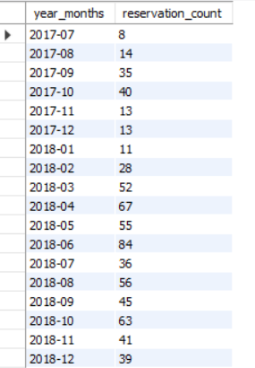
12. How many reservations were made in each month of the year?
select date_format(str_to_date(arrival_date,"%d-%m-%Y"), "%Y-%m")as year_months,
count(*) as reservation_count
from hotel_data
group by Year_months
order by year_months;

Slide 18
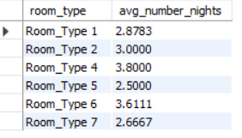
13.What is the average number of nights (both weekend and weekday) spent by guests for each room.
-- type?
select room_type_reserved as room_type,avg(no_of_weekend_nights)+avg(no_of_week_nights) as avg_number_nights
from hotel_data group by room_type_reserved order by room_type;

Slide 19

14. For reservations involving children, what is the most common room type, and what is the average
price for that room type?
-- type?
select room_type_reserved,count(room_type_reserved) as count_room_type,round(avg(avg_price_per_room),2) as avg_room_type
from hotel_data
where no_of_children>0
group by room_type_reserved
order by count(room_type_reserved) desc
limit 1;

Slide 20

15. Find the market segment type that generates the highest average price per room.
select market_segment_type as market_segment,max(avg_price_per_room) as highest_average
from hotel_data group by market_segment_type
order by highest_average desc limit 1;

Slide 21
4
CONCLUSION
Meal Plan 1 Is Most Popular Menu.
144 RS is the Average Price Spend By Guests.
Room Type 1 Most Popular Room Type.
Many Guests Prefer Reservation On Weekend Nights (i.e. 383)
Adults are more in terms of reservation than childrens(i.e.1316 over 69 childs)
On June Of 2018 the reservation was seem Highest (i.e. 84)
Room Type 4 Had Highest No avg nights spend(i.e. 3.8)
Most Of The Guests Prefer To Reserved Room via Online Segment and Hence It Generates Highest Average Price Too.

Slide 22

THANKS!
Does anyone have any questions?
piyushkadam4484@gmail.com
Special Thanks To ->

