Slide 1


Songs Analysis with Power BI
By Piyush Kadam

Slide 2
Objectives
Data Overview
Data Preparation
Exploratory Data Analysis (EDA)
TABLE OF CONTENT :-
Content & Channel Analysis
Temporal Trends
User Engagement Insights
Recommendations for Content Optimization
Example Dashboards
Conclusion

Slide 3
OBJECTIVES:-
Data Cleaning and Preparation : Clean and preprocess the dataset, handling missing values or outliers, and convert relevant columns to appropriate data types.
Exploratory Data Analysis (EDA) : Explore patterns and distributions in view counts, like counts, and comments to identify trends in the popularity and engagement of YouTube song videos.
Content and Channel Analysis : Analyze the distribution of videos across different channels and identify popular tags and their correlation with view counts.
Temporal Trends : Explore how YouTube song video metrics vary over time and identify peak publishing times and their impact on engagement.
User Engagement Insights : Investigate relationships between likes, comments, and views, and identify factors influencing user engagement with YouTube song videos.

Slide 4
DATA OVERVIEW :
video_id: Unique identifier for each YouTube video.
channelTitle: Title of the YouTube channel publishing the song.
title: Title of the YouTube song video.
description: Description provided for the YouTube song video.
tags: Tags associated with the YouTube song video.
publishedAt: Date and time when the YouTube song video was published.
viewCount: Number of views received by the YouTube song video.
8. likeCount: Number of likes received by the YouTube song video.
9. favoriteCount: Number of times the YouTube song video has been marked as a favorite.
10. commentCount: Number of comments posted on the YouTube song video.
11. duration: Duration of the YouTube song video.
12. definition: Video definition or quality (e.g., HD, SD).
13. caption: Availability of captions for the YouTube song video

Slide 5
DATA PREPARATION :-
01
Created Column - Time
Extract Time From Published At Column
02
MEASURE - Total View Counts
total_view_count =sum(Sheet1[viewCount])
03
MEASURE - Total Videos
Total_videos = COUNT(Sheet1[video_id])
04
MEASURE - Total Like Counts
total_like_count =sum(Sheet1[likeCount])
05
MEASURE - Total Comments Counts
Total_comment_count=sum(Sheet1[commentCount])
06
MEASURE - Engagement Ration
Engagement_rate = ('Measure'[total_like_count]+'Measure'[Total_comment_count])/'Measure'[total_view_count]

Slide 6
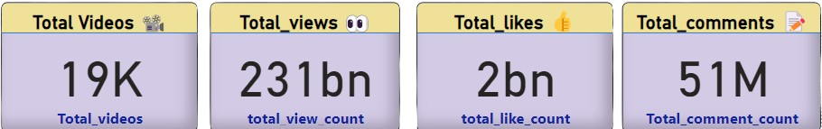
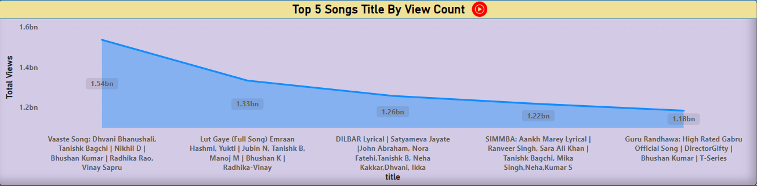
Exploratory Data Analysis (EDA):-

Slide 7

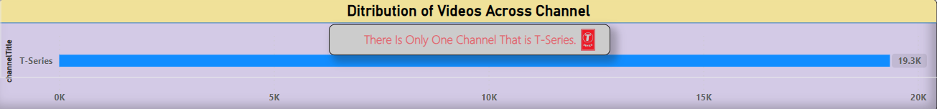
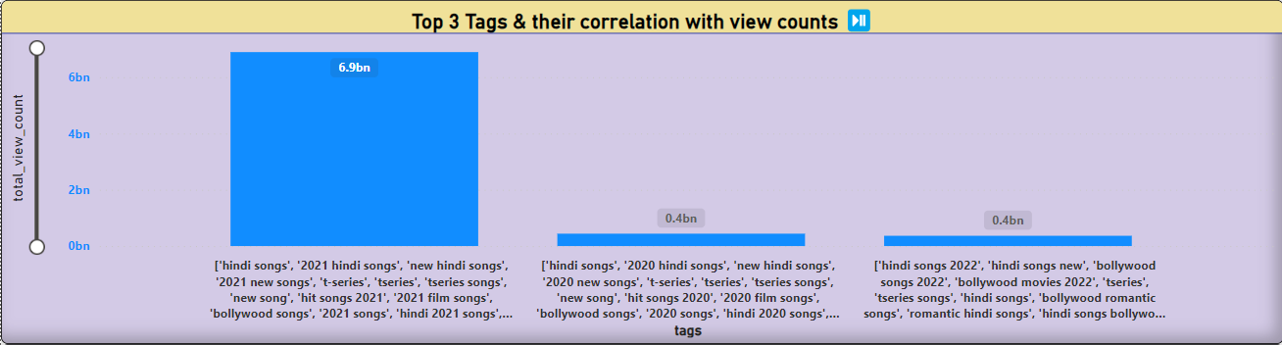
Content and Channel Analysis :-

Slide 8
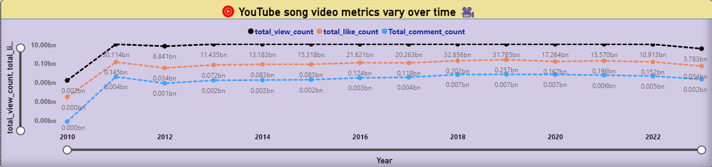
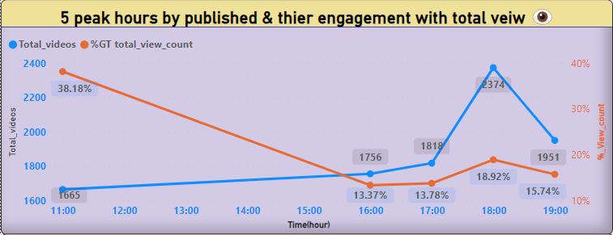
Temporal Trends:

Slide 9
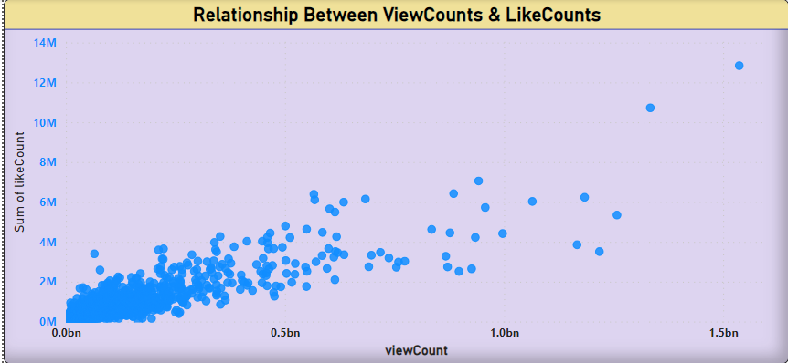
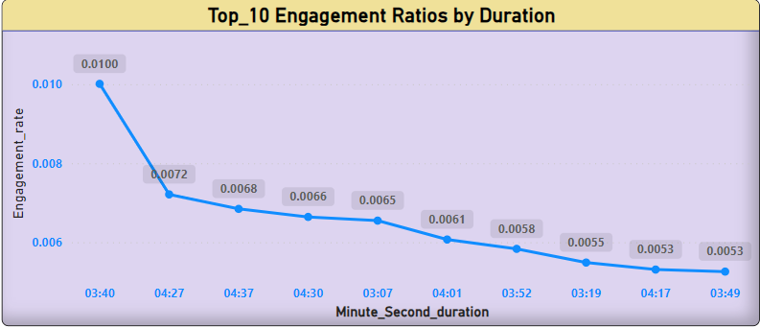
User Engagement Insights:

Slide 10
Recommendations for Content Optimization :-
INSIGHTS
RECOMMENDATIONS
1
Tags like ['hindi songs', '2021 hindi songs', 'new hindi songs', '2021 new songs', 't-series', 'tseries', 'tseries songs', 'new song', 'hit songs 2021', '2021 film songs', 'bollywood songs', '2021 songs', 'hindi 2021 songs', 'film songs', 'hindi movie songs'] have the highest total view count (962) with views 6.,9 bn.
Consistently use these high-performing tags in your video descriptions and titles to boost visibility and attract more viewers.
Tags
2
top published time is 17 pm to 18 pm and count for this is 2374 with view % is 18.92% but ,
The 5 th most published hour i.e. 10 am to 11 pm with 1665 published video having 38.18% of views.
Schedule video uploads during these peak times, particularly around 10 AM to 11 PM and 5 PM to 6 PM, to maximize exposure and engagement.
Schedule
3
Aim to produce videos within these durations to enhance viewer engagement and retention.
The top engagement ratios are seen in videos with durations of 03:40 (0.0109 engagement rate), 04:27 (0.0072), and 04:37 (0.0068).
Duration

Slide 11
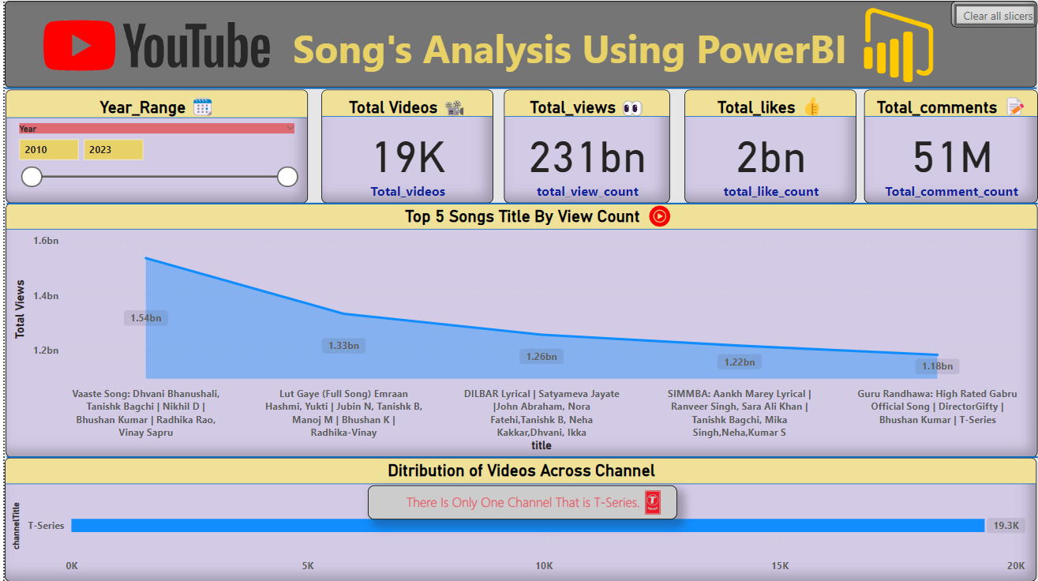
EXAMPLE DASHBOARD :-

Slide 12
CONCLUSION :-
Total_comment_count started trending up on 2015, rising by 9.29% (182732) in 8 years.﻿﻿
﻿﻿
﻿﻿Total_comment_count jumped from 1967811 to 2150543 during its steepest incline between 2015 and 2023.﻿﻿
﻿﻿
﻿﻿At 6893700793, ['hindi songs', '2021 hindi songs', 'new hindi songs', '2021 new songs', 't-series', 'tseries', 'tseries songs', 'new song', 'hit songs 2021', '2021 film songs', 'bollywood songs', '2021 songs', 'hindi 2021 songs', 'film songs', 'hindi movie songs'] had the highest total_view_count and was 1,789.92% higher than ['hindi songs 2022', 'hindi songs new', 'bollywood songs 2022', 'bollywood movies 2022', 'tseries', 'tseries songs', 'hindi songs', 'bollywood romantic songs', 'romantic hindi songs', 'hindi songs bollywood', 'remix hindi songs', 'hindi song status', 'bollywood dance songs'], which had the lowest total_view_count at 364762031.﻿﻿
['hindi songs', '2021 hindi songs', 'new hindi songs', '2021 new songs', 't-series', 'tseries', 'tseries songs', 'new song', 'hit songs 2021', '2021 film songs', 'bollywood songs', '2021 songs', 'hindi 2021 songs', 'film songs', 'hindi movie songs'] had the highest total_view_count at 6893700793.
﻿﻿
﻿﻿['hindi songs', '2021 hindi songs', 'new hindi songs', '2021 new songs', 't-series', 'tseries', 'tseries songs', 'new song', 'hit songs 2021', '2021 film songs', 'bollywood songs', '2021 songs', 'hindi 2021 songs', 'film songs', 'hindi movie songs'] accounted for 89.55% of total_view_count.﻿﻿
﻿﻿
﻿﻿['hindi songs 2022', 'hindi songs new', 'bollywood songs 2022', 'bollywood movies 2022', 'tseries', 'tseries songs', 'hindi songs', 'bollywood romantic songs', 'romantic hindi songs', 'hindi songs bollywood', 'remix hindi songs', 'hindi song status', 'bollywood dance songs'] had 364762031 total_view_count, ['hindi songs', '2021 hindi songs', 'new hindi songs', '2021 new songs', 't-series', 'tseries', 'tseries songs', 'new song', 'hit songs 2021', '2021 film songs', 'bollywood songs', '2021 songs', 'hindi 2021 songs', 'film songs', 'hindi movie songs'] had 6893700793, and ['hindi songs', '2020 hindi songs', 'new hindi songs', '2020 new songs', 't-series', 'tseries', 'tseries songs', 'new song', 'hit songs 2020', '2020 film songs', 'bollywood songs', '2020 songs', 'hindi 2020 songs', 'film songs', 'hindi movie songs'] had 439906608.﻿﻿

Slide 13

THANK YOU !
Special Thanks To

